Slide 1
Summary Report Training - EOY
Recorded August 2024
Notes:
Welcome to the EOY Summary Report Training for the End of Year Submissions.
This training, recorded by the CSI data team, provides information on the importance of the End of Year Summary Report, what’s included in the report, and how to review it.

Slide 2
How is EOY data used?
Used by CDE in determination of a school’s plan type
Used by CSI in determination of a school’s accreditation rating
Considers student demographic information as well as exit data used to calculate completion, graduation, dropout, and mobility rates.
Notes:
As a reminder, the End of Year (EOY) data collection collects generally the same type of student data that is collected during the October count data collection at the beginning of the school year.
Instead of showing enrollment through the Fall, the EOY data collection shows student enrollment through the course of the whole school year.
This data is used by both the Colorado Department of Education and CSI for accountability purposes. Specifically, EOY data helps calculate completion, graduation, dropout, and mobility rates. These rates will be reflected in your EOY Summary Report data, therefore, reviewing the EOY Summary Report data is so important.

Slide 3
EOY Summary Deadlines
Summary Review
Last chance for schools to review and update all data fields
CSI internal checks still in progress and may require limited updates in Fall
Graduate records should be updated before this deadline
Summary Assurance Report Due ~ end of August*
Electronic assurance form to replace signed certification
*For specific deadlines, check one of the following resources:
CSI online calendar
Weekly Update email
Notes:
EOY Summary Review is the last chance for schools to update data in most of the EOY fields. Therefore, it is expected that schools have reviewed in full all the data in the summary report prior to the deadline. These reviews should be in partner with the relevant school staff including data submissions, the school leader and other appropriate staff.
If there are changes that need to be made, schools are expected to notify CSI and update the data within the set timeline. More information will be available later in this training.
Additionally, it should be noted that CSI is still conducting internal data validations during this time and may reach out to you to discuss or adjust any data discrepancies we find, and that may take place after your review.
Schools with graduates should be sure all graduate records have been updated by this deadline.
After the EOY Summary report has been reviewed and all updates (if needed) are made, the Summary Assurance Report is due confirming that you have reviewed your data in full and it appears to be accurate. A signed certification is no longer required.

Slide 4
Sample Report Walk Through

Slide 5
Summary Report Contents
Admin Tabs
Instructions
Summary Assurance Report
CDE Calculations
Membership
Mobility
Attendance & Truancy
For High Schools
Grad Complete
AYG Records
School Data
Warnings
Snapshot - Filter to find data causing issues.
Notes:
The EOY Summary report, like most CSI Summary Reports, has several tabs.
The first and last tabs are administrative tabs --- tabs that help guide you through the Summary Report process. It is extremely important to start your review the instruction tab prior to completing the Summary Assurance Report.
The second set of tabs are related to CDE’s calculations of membership, mobility, and attendance and truancy. These tabs will give you detailed insight into your student population by grade, race/ethnicity/ and gender; FRL and retention counts; and stability and mobility rates.
The third set of tabs are for high schools only and contain information for schools with grades 9th-12th, including grad completion rates for a range of 4-7 years; post-secondary education options data, and detailed Anticipated Year of Graduation records for the given school year.
The final set of tabs include your school’s raw data. As you notice potential inaccuracies in the summary data presented in other tabs (such as in the CDE Calculation Tabs or High School tabs), you can use the Snapshot data tab to filter and search your data to find specific records that may need to be updated.

Slide 6
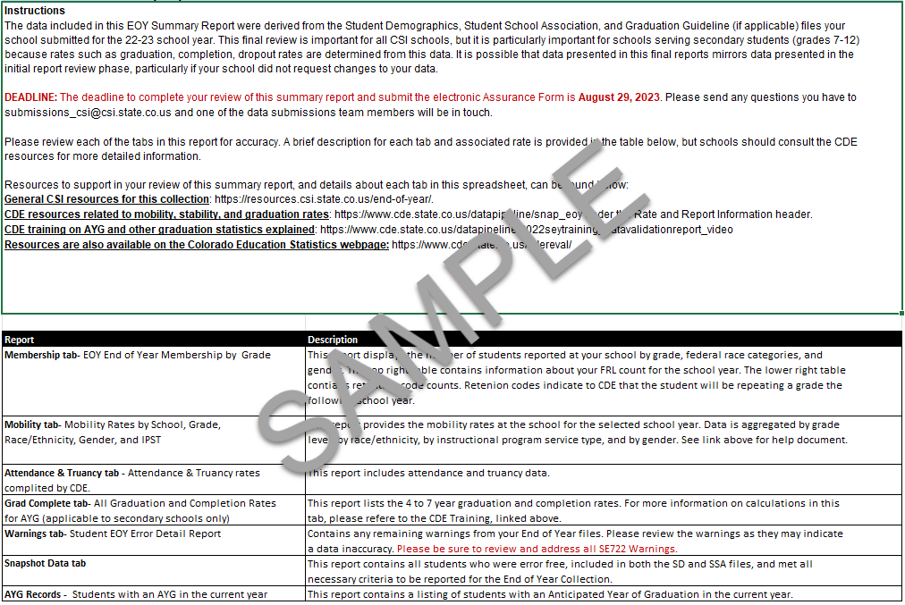
Instructions Tab
This information should be read in its entirety since it provides all the instructions and deadlines schools.
Notes:
The first tab contained in your Initial Summary Report is the Instructions tab. This information should be read in its entirety since it provides all the instructions and deadlines schools should follow when reviewing the data on the later tabs.

Slide 7
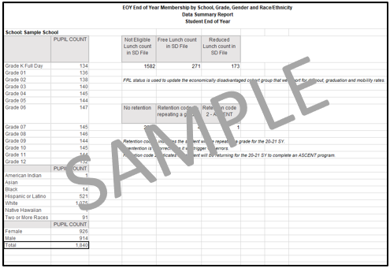
Membership Tab
This data should reflect the number of students who attended your school at any point during the year and not just students who were still active on the last day of school.
Notes:
The Membership tab is a report of your school’s student population broken down by grade, race/ethnicity, and gender. This data should reflect the number of students who attended your school at any point during the year and not just students who were still active on the last day of school.
This tab also includes Free and Reduced Lunch counts as well as retention counts.
For the retention numbers, be sure to pay attention to the number of students marked with a 1 retention code. This indicates to CDE the number of students who will be repeating a grade in the upcoming school year. If this information is not correct in the EOY report, errors will be triggered in the upcoming year’s October Count data collection. If the count seems too high, navigate to the SSA tab and filter the retention code column to identify the students who should not be retained to repeat the grade they finished in the current school year.

Slide 8
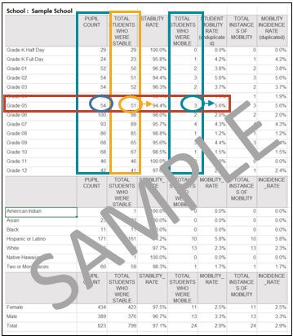
Mobility Tab
Pupil Count – total number of students enrolled at any time during the school year.
Stability – the number of students who remained at your school for the full 21-22 school year, beginning on Count Day.
Mobility – the number of students who moved in or out of your school at any point during the school year after Count Day. At least 10 days.
Fore more support: access the Mobility Rate Validation Instructions on the EOY page: resources.csi.state.co.us/end-of-year/
Notes:
The Mobility tab includes the stability and mobility rates for your school broken down in a variety of ways.
Included on this slide are several definitions to help you better understand the data being shared.
Pupil Count refers to the total number of students in membership at any time during the academic year.
Stability is the number of students who remained at your school for the full school year, beginning on Count Day.
Mobility, on the other hand, is the number of students who moved into or out of your school at any point after the October Count date. Essentially anyone who wasn’t with you on Count Day or didn’t end with you on the last day of school. There must be an attendance gap of at least 10 consecutive days for the student to be considered mobile.
When reviewing this tab you want to compare the ‘Pupil Count’ column with the ‘Total Students Who Were Mobile’ column and the ‘Total Students who were Stable’ column.
For example, take a look at the 5th grade line. Out of the 54 total students, 51 were stable, enrolled in the school for the entirety of the year, beginning with October Count, giving the school a 94.4% stability rate for 5th graders. 3 these 5th grade students were mobile, either entering after October Count or exiting prior to the last day of school, giving the school a 5.6% mobility for 5th graders.
The best approach to reviewing this Mobility Tab is one grade level at a time. If you notice anything that looks off, navigate to the SSA tab and filter by the grade you are reviewing. Then you can further filter by Entry and Exit dates until you find the data that needs to be updated. Any student with a start date after Count Day and/or an end date that is not zero filled will contribute to your overall mobility rate. This is why any student who finished the school year with you, even if they are moving out of state over the summer, or attending a new school in the fall, must be coded with a zero-filled exit date and type in order to show that they completed the school year with you and do not negatively impact your mobility rate.
If you’re worried you might not remember all of this, don’t worry, we’ve made a specific resource just for this Mobility tab and to guide you through reviewing the data on this tab. The resource is the Mobility Rate Validation Instructions and is found under the validations section of the CSI EOY web page. Or you can click the link here.

Slide 9
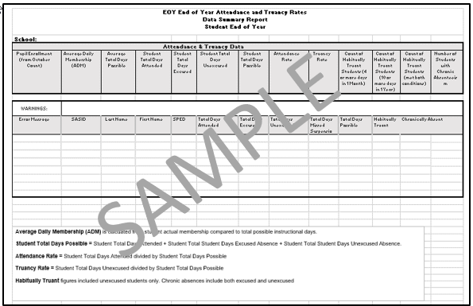
Attendance & Truancy
Overall calculations for school wide Attendance and Truancy.
Fore more support: access the EOY Training: Attendance Fields resource on the EOY page: resources.csi.state.co.us/end-of-year/
Notes:
The Attendance & Truancy tab provides you with your overall calculations for school wide Attendance and Truancy. To see how CDE calculates this data, please review the short Attendance field training provided by CSI on the End of Year website.
This tab also contains any Attendance Warnings you may have. Please review each of these warnings to confirm if the student is actually truant or if their attendance data needs to be updated.

Slide 10
Grad Complete Tab
Only for schools with 9th-12th grades.
Provides the 4-, 5-, 6-, and 7-year graduation and completion rates for students.
Graduate: a student receiving high school diploma.
Graduated exit code = 90
Graduated and received GED in same year exit code = 95
Completer: a student receiving high school diploma, GED, or certificate of completion.
Exit code = 92, 93, 94
Notes:
The Grad Complete tab only applies to schools that have grades 9-12 and will be blank for all other schools. Essentially, this tab provides the 4, 5, 6, and 7 year graduation and completion rates for those students.
The graduate column is defined by CDE as any student who receives a high school diploma (that is, has an exit code of 90) or for any student who graduated and received a GED in the same year (which is a exit code of 95)
CDE defines completers as those students as students from the Graduate Count tab and students who received a certificate of completion, which includes exit codes 92, 93, and 94.
All graduation and completion rates are based on the student’s anticipated year of graduation or AYG. This is calculated based off of when a student first enters 9th grade, with the Anticipated Year of Graduation (or AYG) being 4 years later. If a student is retained once at any point in High School, the student will fall into the 5 year AYG rather the the 4 year. If you have any questions regarding AYG, please reach out to us.

Slide 11
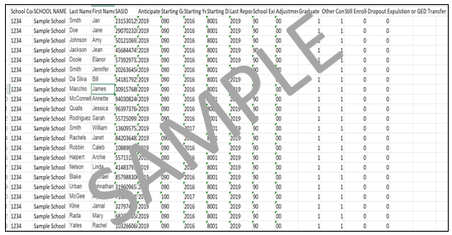
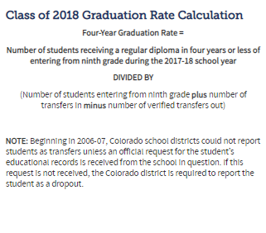
AYG Records Tab
Only for schools with 9th-12th grades.
Checks graduation exits, retention exits, and dropout numbers.
Notes:
Like the Grad Completion tab the AYG Records tab only applies to schools that have grades 9-12 and will be blank for all other schools. This tab is a more extensive record of the 4 year Anticipated Year of Graduation information seen on the Grad Completion tab earlier.
Be sure to review this and check graduation exits, retention exits, and dropout numbers.

Slide 12
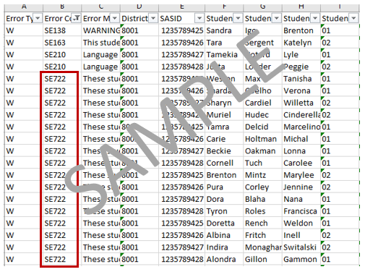
Warnings Tab & SE722
Warnings should always be reviewed to determine the accuracy of your data, if the data is accurate, then no further action needs to be taken.
SE722 will turn into Errors!
Collect Adequate Documentation from receiving school to address these future errors.
Fore more support: access the Cleaning SE700 Warnings resource on the EOY page: resources.csi.state.co.us/end-of-year/
Notes:
The Warnings tab of the initial summary report includes all Level 2 Snapshot Warnings that your school is still receiving for the most recent EOY file submission. Warnings should always be reviewed to determine the accuracy of your data, if the data is accurate, then no further action needs to be taken. Warnings can indicate inaccuracies within your files, so reviewing and making any necessary changes is important.
While warnings typically do not need to be corrected, the exception to this statement are the warnings listed here, particularly SE722 Warnings which will turn into Errors once CDE begins their validation process.
SE722 warnings indicate that a student has exited your school with an Exit Type 13 – exited to another Colorado school district, but no record of that student has shown up in another district, making your school the last school that was accountable for that student. Again, these warnings will become errors at a later phase in the collection, so addressing them sooner rather than later is imperative.
To address, these future errors, review any Confirmation of Enrollments or other Adequate Documentation you may have on the student from the receiving school. If you do not yet have confirmation of enrollment and other supporting documentation, you need to start reaching out to the receiving school or possibly even the students guardians, to establish where the student has gone and the proper Exit code. A link to what qualifies as Adequate Documentation is on this slide. If you do have a confirmation of enrollment, make sure that it shows not only enrollment, but also attendance the receiving school.
Other SE700 warnings, you will have to address are SE720, 721, and 724 Warnings. These are much easier to fix and CDE has provided the Exit Type code you need use, as seen here. CSI has also provided a help resource for guidance on clearing these Warnings, located on the EOY website under the Validations section. Or you can click the link on this slide.

Slide 13
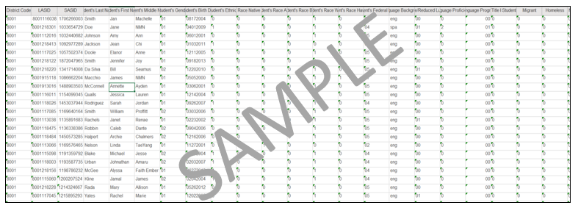
Snapshot Tab
The Snapshot tab includes all of the Error Free data from your school that CDE recognizes as being valid and on record at the close of the collection. This information includes demographic identifiers, codes indicating Entry/Exit and any services they’ve received at your school.
Notes:
The Snapshot tab includes all of the Error Free data from your school that CDE recognizes as being valid and on record at the close of the collection.
The Snapshot is a combination of all error free records for students included on all other files submitted. This information includes demographic identifiers, codes indicating Entry/Exit and any services they’ve received at your school.
Snapshot data is used to derive graduation, completion, dropout, mobility and stability rates you see on the preceding tabs of the Summary Report. It’s important to review this data to ensure that all students who attended your school during collection’s school year are not only being reported but being reported accurately according to CDE.
This tab could also be used to filter by grade level, gender or any other information you would like to look at more specifically and ensure the counts are correct and which students specifically makes up those counts. Accuracy is key for End of Year and utilizing this snapshot tab can be a great resource in ensuring the data is not only error free, but accurate.

Slide 14
Summary Assurance Report
In lieu of a signed summary report, the Summary Assurance Report indicating that the reports have been reviewed, corrected as needed, and approved for final submission to CDE.
Notes:
The Summary Assurance Report is the final tab on the EOY Summary Report. This report is in lieu of a signed summary report indicating that the reports have been reviewed, corrected as needed, and approve your school’s data. Again, it is important that all relevant school staff review the EOY Summary Report information before completing the Summary Assurance Report. It is also important to remember that CSI internal checks are still in progress and there may be additional changes needed based on findings later in the Fall.
To submit your Report, a school representative may click the link provided on the Summary Assurance Report tab. Complete the form and send.

Slide 15
Resources
General CSI End of Year resources
CDE End of Year resources
CDE Colorado Education Statistics
Refer to links on left of this webpage—graduation, completion, and mobility/stability statistics
Notes:
As you are going through your reports, there are many good resources that you may find beneficial. This includes the CSI End of Year Resources located on the EOY page of the CSI website and the CDE website. Also you have the Colorado Education Statistics from the CDE website included here, which will provide details on graduation, completion, mobility and stability.

Slide 16
Next Steps
Retrieve your Summary Report from G-Drive.
Review and validate data
If data needs to be updated, do one of the following by the Initial Summary Review deadline:
Send an email to submissions_csi@csi.state.co.us with a description of the edits needed; OR
Update a copy of your most recent file submission (highlighting edited cells), upload to G-Drive & email CSI; OR
Request to walk through changes needed with a CSI staff member
Once data has been deemed accurate, complete the Summary Assurance Report Form by using the link.
Notes:
If you haven’t already, retrieve your EOY Summary Report from the Summary Report folder, located in your EOY G-Drive folder. You will then review the data and verify its accuracy. It is important that relevant school staff review portions of the data including school leaders. Relevant staff may include EL, SPED, GT, Nutrition, McKinney Vento coordinators, registrars, and councilors. Because of the extensive amount of data for this important school accountability collection, it is recommended to break up the review into smaller increments to insure accuracy.
If data issues and errors are discovered, you have one of three options to update your data.
You can send an email to the submissions inbox with a description of the edits needed;
You can update a copy of your most recent SD, SSA, or GG submission. Be sure to highlight in yellow the updated cells, upload to G-drive & notify CSI of new files; OR
You can request to walk through changes needed with a CSI staff member.
When requesting EOY data updates, it is important to update your SIS data to match. Remember, August is the last chance schools have to update EOY data, so be very diligent in making sure it is correct.

Slide 17
Thank you
Send questions to: submissions_csi@csi.state.co.us
Notes:
Thank you for watching our training of the EOY Summary Report review process. For questions, please reach out to the CSI Data Submissions Team!

