Slide 1
Generate Recipient Drawdown (RFF) Report In GrantVantage
This document describes the process within GrantVantage to generate consolidated request for funds (RFF) reporting. This report aids schools in identifying milestone status and RFFs that need attention.

Slide 2
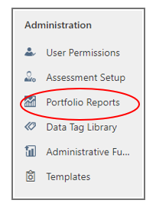
Step 1
Single click Portfolio Reports under Administration from the left side of the GrantVantage home screen.
Note - Your screen may have fewer options than the example below*
Notes:
Welcome! Its busy day and thanks for being here to help with the move, learn about finance and some of our work. Today you'll hear from, Ilene Agustin our School Nutrition Manager, and Marcie Robidart our Grants Fiscal and Acct'ing Manager and myself. Review Agenda

Slide 3
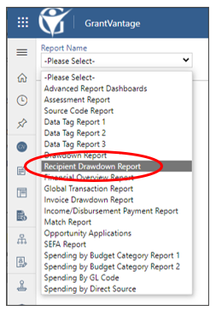
Step 2
Single-click Recipient Drawdown Report from the Report Name dropdown.
Note - Your screen may have fewer options than the example below*
Notes:
Welcome! Its busy day and thanks for being here to help with the move, learn about finance and some of our work. Today you'll hear from, Ilene Agustin our School Nutrition Manager, and Marcie Robidart our Grants Fiscal and Acct'ing Manager and myself. Review Agenda

Slide 4
Step 3
Set Project Status to Active Projects , Drawdown Status to All, and View By to Project.
Refresh report screen. Download report to see individual RFF detail.
Notes:
Welcome! Its busy day and thanks for being here to help with the move, learn about finance and some of our work. Today you'll hear from, Ilene Agustin our School Nutrition Manager, and Marcie Robidart our Grants Fiscal and Acct'ing Manager and myself. Review Agenda

Slide 5
Step 4
Review status to identify RFF status or any problems.
Planned = RFF has been submitted and has not yet been reviewed by CSI
Take Action if RFF is in planned status for over one week
Make sure that a communication was sent alerting CSI to review
Reach out to RFF@csi.state.co.us if communication was sent
Approved = RFF is approved and no further action required
Paid = RFF is approved and paid
Denied/Requested = RFF pending additional back-up or clarification
Take Action
Review communications within subproject to identify next steps for approval

