Slide 1
EDID Request and Update Process
Notes:
Hello All,
Thanks so much in advance for reviewing this training. This recorded training will cover the EDID request and update process along with the resources available to you on the CSI EDIDs page. If you have questions while reviewing this training, don’t hesitate to reach out to the submission's inbox!

Slide 2
Agenda
EDID Access and Roles
EDID Request and Update Process
EDID Results Review
Notes:
Here is a quick overview of the topics that we will be discussing today.
First, we’ll give an overview of the access request process and the roles and expectations of you, as you request EDIDs for your school, and also discuss our role in supporting you.
We’ll then cover both the EDID request and EDID update process that should be completed as new staff are hired or you notice discrepancies in existing EDIDS. We’ll also touch on the differences between the two as we move forward
Finally, we’ll end with details on how to review the results.
So, let’s jump in….

Slide 3
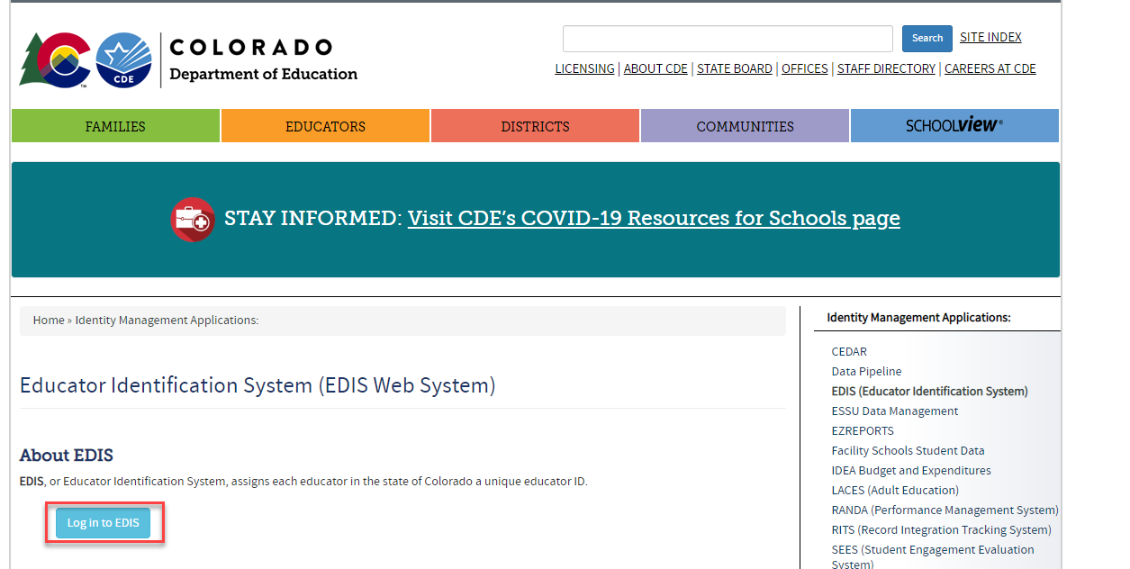
EDIS Access
The first step will be to ensure that you have access to EDIS and G-Drive. The setup process for this differs from other collections as the school leader must send an email approving the setup due to the sensitive nature of the data. Ensure the school leader emails the submissions inbox at: submissions_csi@csi.state.co.us
Link to EDIS login page: https://resources.csi.state.co.us/edis-access/
Notes:
The first step to consider when working with EDIDs is access to both Google Drive and EDIS. Google Drive or G-Drive is the new secure file transfer system that you be placing your requests in and EDIS is the state page that allows you to search for staff EDIDS prior to requesting them. All staff working with EDIDs will need this access, so if you currently do not have this, feel free to have your school leader email the submissions inbox at the listed address to let us know you will need this. This process somewhat differs from requesting access for SASIDs. Due to the sensitivity of the HR data involved, CSI does require school leader approval prior to setup.

Slide 4
EDIS Process Roles
Role of Schools
Review EDIS and search for new staff at your school
If an EDID has not been created, utilize the template provided on the CSI website
Submit the template to G-Drive and email the submissions inbox (submissions_csi@csi.state.co.us to notify CSI that a new request has been made
Wait for a return response saying file has been processed and use!
Role of CSI
Navigate to G-Drive obtain the updated template file that needs to be processed
Review the file to check for any formatting issues
Process in the data pipeline and email school to notify that either a Results report is in G-Drive or the EDIDs are available in EDIS
CSI EDID Resource page: https://resources.csi.state.co.us/data-submissions/edids/
Notes:
This slide covers the overall roles of the schools versus the role of CSI staff as it pertains to EDID requests. In terms of your role at the school you should always start by reviewing the EDIS page and searching for staff to ensure they don’t already have an EDID assigned. IF that is the case, then you want to complete the request template provided on the CSI EDIDs page and submit in G-Drive. Once submitted, ensure you reach out to the CSI submissions inbox. CSI will then review your request to ensure correct formatting and process in CDE’s data pipeline. Once complete we will either email you to let you know a results report is available in G-Drive or let you know that they have been processed for you to look up in EDIS. This is all dependent on what is going on and if we have the time. Now that we know the process as a whole, lets dive deeper into each step.

Slide 5
Process to Request and Update EDIDs
Notes:
We’ll first be taking a look at the request process and then dive into how to update existing EDIDS!

Slide 6
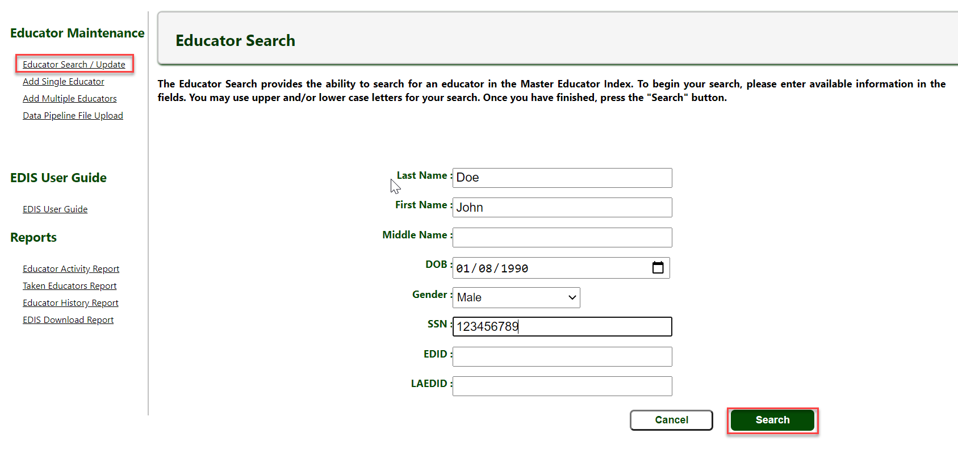
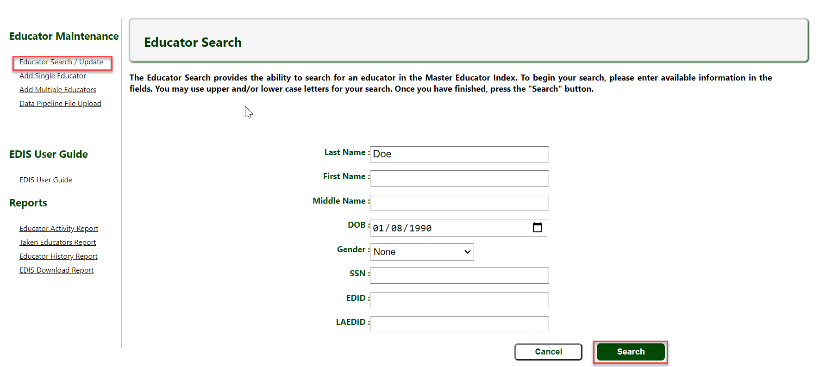
Searching EDIS Prior to Request
It is very important to search EDIS in various ways due to potential discrepancies or inaccurate date. Try searching various combinations of the Staff persons Name, Date of Birth, SSN etc. to ensure they do not have an EDID. This could look like:
Search Full Name, DOB, SSN
Then search by SSN
Try searching by Last Name and DOB
If all searches do not result in a match, then an EDID request is necessary. If an EDID is found, but some information is inaccurate, an EDID update request is necessary
For full instructions on the EDID process, see the EDID Request Update Guide
Notes:
One of the most important steps a school can do for the EDID request process is to search for the staff member in EDIS prior to requesting. In many cases, staff have already had an EDID assigned to them previously, so you want to be sure to do a thorough search. This involves searching by a combination of name, date of birth, and SSN etc. In some cases, a staff member may have an EDID, but some of the details of their record may be incorrect and would just require an EDID update. If you request an EDID for someone who already has one, if could lead to the request going into CDE’s case review or potentially a duplicate, so being thorough in this step is important.

Slide 7
EDIS Template
Complete the EDIS Request Template when requesting new EDIDs or making updates to existing ones. These should be submitted separately
Link to CSI EDIS Template: https://resources.csi.state.co.us/wp-content/uploads/2024/06/EDID-Request-Template_rev06282024.xlsx
Notes:
Once you have done a detailed search and have confirmed the staff member does not have an EDID, the next step in the process would be to request one using CSI’s request template. This is located on the CSI website at the provided link. Keep in mind when you are completing this that the formatting of the data is very important. Ensure you are keeping leading zeros and not using slashes or dashes. Within the template headers you will see notes were added. Hovering over each field of the header will provide you additional details on what is necessary to help with the formatting. For example, as you can see here with gender that female is 01, male is 02, and nonbinary is 03. The only fields that may be left blank are the EDID field, the LAEDID and the notes section. The LAEDID is an identifier schools use internally, which can be added or not and the notes can be used to provide additional details if there is a similar staff member already in EDIS. Ensuring this is filled out correctly will save time and allow you to get your EDID results back much more quickly.

Slide 8
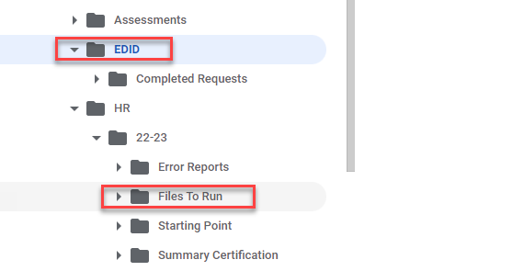
EDID Request File Transfer
EDID request templates should be named similar to how files are to ensure the most recent request is being processed. See below for an example:
5453_MMS_EDISRequest_09012024
3326_CILA_EDISUpdate_09012024
All files should be submitted in either the EDID folder or HR folder, depending on setup and access levels. Please email the submissions inbox when available at submissions_csi@csi.state.co.us
Notes:
After you have completed the necessary fields in the template, it is time to save it. You want to be sure you are saving using the example structure in this slide. Generally it is the school code followed by the school abbreviation, the words EDISRequest and ending with the date. This helps CSI staff more quickly identify which request needs to be processed. After it is renamed, it should be placed in the G-Drive in either the EDID submissions folder or in the Files to Run in the HR folder depending on your setup and access levels. Be sure to never email these as they contain PII or personally identifiable information. The last step in the process would be to email the submissions inbox to notify us that there is a new EDID request to process.

Slide 9
Updates to Existing EDIDs
If incorrect information is discovered when searching for EDID or a change has been made since last update, submit an EDID request following these instructions:
EDIS update must be provided in a template with EDID added
EDIS updates must be in a separate file from EDIS requests
Highlight any fields where changes are necessary with the correct information included
Add notes of clarification to ensure CSI knows what to update
Submit in G-Drive and email the submissions inbox. Note that it is an EDIS update, not request
Notes:
You may encounter times when a staff member has an EDID, but some of the details may be incorrect. This may be due to a name change or details added by other school staff that is not accurate. In those cases, they will require an EDID update. The process for an EDID update is very similar to an EDID request and involves the use of the template file we previously discussed. The difference is that you will want to provide the EDID number within the template request along with the highlighted changes necessary similar to the example in this slide. The notes section can also be used to further clarify what fields need to be updated. These files will also be submitted in G-Drive with an email to the submissions inbox to notify us they are available. Keep in mind when doing these types of requests, they should be in their own template and not mixed in with EDID requests. The process in the data pipeline for adding and updating is different, so if submitted together, CSI has to separate prior to processing.

Slide 10
EDID Review
Notes:
Now that you have made your request for a new EDID or an EDID update and CSI has processed, how do you review the results?

Slide 11
Results Review
Once CSI Processes the file, results will come back in one of two ways:
CSI will provide a results report to G-Drive and notify you when available. OR
CSI will let you know they have been processed and to access EDIS and search to obtain the results.
Courtesy of clipartpanda.com
Blank results typically mean the staff person when to CDE’s case review. This means there may be a potential duplicate and may require further details or more time on CDE’s end to review. Please allow 24-48 hours, so keep checking EDIS!
Reach out to CSI if no EDID is assigned after 48 hours and we will contact CDE
Once EDIDs are received, update your system or Starting Point files accordingly
Notes:
In terms of the EDID results review, we will send the results in one of two ways. We will either provide you a results report with the EDIDs included or email you and let you know it has been processed and you can look them up in EDIS. This is very dependent on what is going on and how busy we are, but most often you will receive the report. Keep in mind when reviewing the report that blanks in the EDID field means there may be a similar name or potential match already in EDIS and the record has been flagged for a CDE case review. The review process generally takes 1-2 days and they will review whether this is a unique request or if the staff member already exists. In most cases they will be assigned in that one to two day timeframe, but may reach out to CSI for additional details. Your role in this process is to keep checking back in EDIS to see if it has been assigned and use the EDID when ready. If it has been several days with no result, reach out to the submissions inbox and we will check into it!

Slide 12
Thank you for Reviewing this Training
Contact the Submissions Inbox with Questions:
Submissions_CSI@csi.state.co.us
Notes:
Thank you so much for reviewing this training on the EDID request and update process. If you have questions, don’t hesitate to reach out to CSI and we are more than happy to assist you!

