Slide 1
SASID Request & RITS Update – NEW Process 2024
Data Submissions
Recorded May 2024
submissions_csi@csi.state.co.us
Notes:
This CSI Data Submission training will discuss the NEW process for SASID requests and the NEW process for requesting RITS updates. After viewing this training in its entirety, you will have the ability to complete a survey which will be used to request access to your new RITS rights for SASID requests.
Upon this request, CSI will also update your SASID folder in the G-Drive to accommodate the new process. This training is intended only for school contacts that ALREADY have RITS view only rights. For school contacts that need first time access to RITS, please email the CSI submission team.

Slide 2
Updated – SASID Request & RITS Process
NEW - Requesting SASIDS through RITS
Existing – Requesting mass batch requests thought CSI using SIS extract
NEW – Requesting RITS Update though CSI
Notes:
There are three sections included in this training:
The first is the NEW process for schools to request new SASIDS within RITS. We will be emphasizing the importance of searching for all student carefully, prior to requesting a new SASID.
The second is the EXISTING process for school to request mass, batches of SASIDS through CSI, for schools that choose to upload lists of students needing SASIDS from their SIS.
The Last is the NEW process for requesting RITS updates through CSI.

Slide 3
Requesting SASIDS through RITS (NEW)

Slide 4
SASID Requests
NEW Process-
Schools will receive rights in RITS.
Schools will have the ability to request new SASIDS after searching for the student directly in RITS.
This new process should allow quicker, more direct SASID results.
After completing this training, request updated RITS rights by completing the survey.
Notes:
For the New SASID request process, schools will receive new rights within RITS. These new rights will allow you to request a SASID directly through RITS if a student is not found during the student search process. Previously schools would conduct a search and if the student was not found in RITS, schools would complete a template, upload template to the G-Drive, and email CSI to inform us of the request. CSI would then submit the SASID request through RITS and respond to the school when the process was complete. We hope that this new process will expedite SASID results for schools and eliminate extra steps through this more direct method.
Once you have completed this training, please complete the survey located in the initial email & on the CSI SASID Webpage to let CSI know that you have watched the trainings and are ready to receive your new RITS access rights.
After the rights are set up, the view on the RITS page will include new two options including: add a single student AND add multiple students. Before we talk about those in detail it is important to emphasize that schools need to do a thorough search for ALL students prior to a SASID request in RITS. We will briefly touch on CSI's search expectations.

Slide 5
1. Search for ALL Students in RITS
Search for ALL students in RITS PRIOR to requesting new SASIDS, including:
Pre-Kinder,
Kindergarteners,
Students moving from out-of-state,
Students moving from out-of-country,
Student with enrollment paperwork stating that they have not attended another CO school.
Notes:
It is critical that schools search for ALL students in RITS prior to requesting a new SASIDs to minimize the risk of adding duplicate students in RITS, causing potentially time-consuming impacts during the critical collection times. CSI has expectations for schools to search for students using the following three steps to avoid potential mistakes.
The first step is: ALL students should be searched in RITS including:
Pre-K, Kindergarteners, students moving from out of state, AND students moving from out of country.
Even if a parent or guardian indicates on enrollment paperwork that a student has not attended a Colorado school, a search must still be conducted. Some students have a history in the Colorado RITS system that may not be apparent to a guardian. For example, RITS identifies infants in preschool programs that guardians may not be aware. In addition, some students that come from out of state or country may have lived in Colorado at one point for a short period of time during their educational history, but the guardian does not disclose it on paperwork.
In every case, a search MUST be conducted to double check the RITS system.

Slide 6
2. Confirm Names and DOB
Whenever possible, use legal documents to confirm:
Spelling of Student’s Full Name, (including suffix, hyphens, and apostrophes)
Student’s Date of Birth.
If RITS has incorrect information:
Following steps for a RITS Update Request discussed later in this training.
Notes:
The next step, whenever possible, is to use legal documentation, not enrollment paperwork, for student legal names and birth dates. It's can be surprisingly common for parents/guardians to complete enrollment paperwork with incorrect student names and birth dates. Also, enrollment paperwork will sometimes include the student’s preferred or nicknames names instead of legal names. SIS and RITS require legal names for data collections. Duplicates will occur if a student is already in RITS under their legal name and a SASID is requested for the same student by their preferred or nickname.
Other benefits to viewing legal documents prior to searching RITS is that you may find that RITS has the incorrect spelling and/or birth date for a student. When this happens, schools will submit a RITS update to CSI. We will discuss the new process for requesting RITS updates a little later in this training.

Slide 7
3. Conduct a Broad Search
Use first 3 letters of last name & the first 3 letters of the first name.
Refine the search if needed.
If student has hyphenated name or more then one last name, consider using the first 3 letters of first name and date of birth.
If schools are unsure of a potential match in RITS, email the submissions inbox.
Notes:
The last and very important step for avoiding duplicate student SASIDS, is to use a broad search method. This is the number one way that schools can successfully find a student within RITS and even potentially catch if the student's name is misspelled or has other inaccurate information.
In RITS, the search page offers many search fields but, if numerous fields are completed such as full first name, full last name, the student’s birth date, this will limit search results and could increase the risk of entering something incorrectly. The best searches use data in only 2 fields. In many situations, it is recommended to use only the first few letters if searching by name. For example, schools will use the 1st 3 letters of the student’s last name and the 1st 3 letters of the first name to conduct a search. This will then generate a list of students that meet that criteria and schools can look through this list for the student by birthdate and full names. By using this broad search process, you may be able to find your student and notice that the birthdate is incorrect, last name is hyphenated, middle name is missing, etc. There are times when the searches may need to be refined to reduce the number of search results.
For a student that has multiple names or for student with a hyphenated last name, instead of searching using their last name, schools should search by the 1st 3 letters of the first name and the student's date of birth. This will allow you to see search results for all students with this criteria, but it will also show search results if the student was entered in RITS incorrectly or by only one of the student’s last names.
If a student looks to have a close name match and birthdate to another student that is already in RITS, and you are unable to confirm that the student is the same student by viewing the detail of the prior school and district, please reach out to CSI. We will ask for you to drop a document in the G-Drive with YOUR student’s information and the SASID of the student in question within RITS. We will also ask for YOUR student’s parent/guardian names so we can check with CDE to confirm the potential student match. If you are ever in question of a match, please reach out to CSI and we will help confirm.

Slide 8
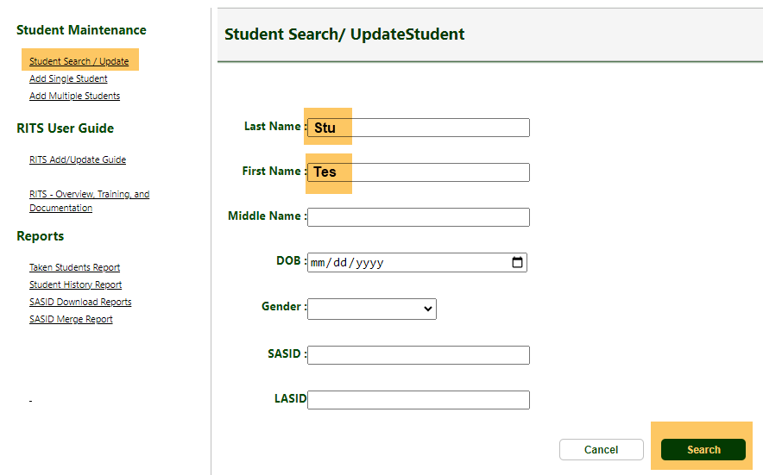
Conduct a Broad Search
Name: Test NMN Student - DOB: 1/1/2006
Notes:
In the example above, Schools will click the “Student Search/Update” under Student Maintenance in RITS. Suppose we are searching for a student with the first name: Test, NMN for No Middle Name, and Last name: Student, with date of birth January 1st, 2006. Instead of entering the student’s full first, and full last name and date of birth, we will search using only the first 3 letters of the last name and the first 3 letters of the first name. Then click the “Search” button.
The search results will be broad. You can then see that rows 2, 3 and 4 have close name matches, but since the birthday of the student matches the student in row 2, you will copy and paste this SASID number into your SIS and the process is complete.

Slide 9
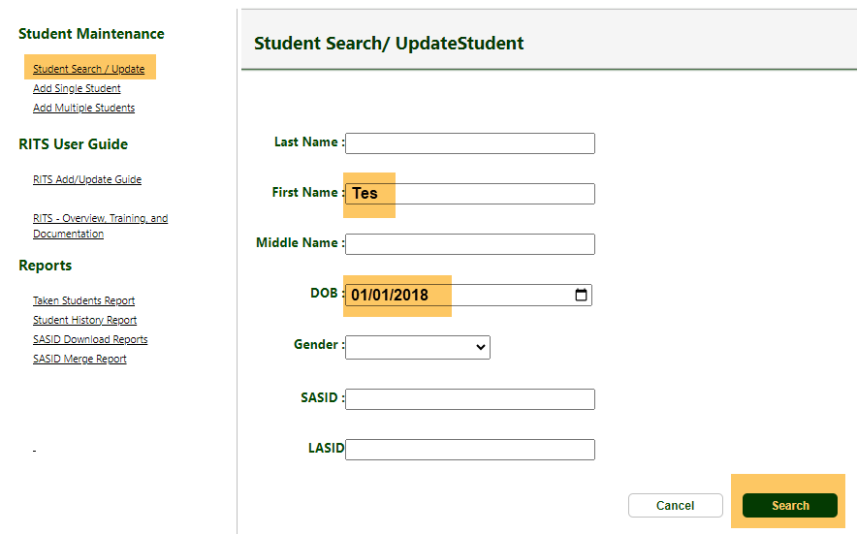
Conduct a Broad Search
Name: Test NMN Student-Test - DOB: 1/1/2018
Notes:
In this second example: Suppose we are searching for a student with the first name Test, NMN for No Middle Name, and last name: Student-Test, with date of birth January 1st, 2018. Since the most common RITS errors are for student with multiple names or hyphen names, to broaden the search, we will search using only the first 3 letters of the first name and date of birth. Then click the “Search” button.
The search results will be broad. In this case, the student matches the information in row 4. You can copy and paste this SASID number into your SIS.
During these broad searches, you may notice multiple student that meet your criteria or come close. Please reach out to CSI if you suspect duplicate students in RITS OR if you are unsure if RITS may have your student but with inaccurate information. To get more information about the student, click on the last name in the search results to see the last date RITS was modified, the last school, and district name.

Slide 10
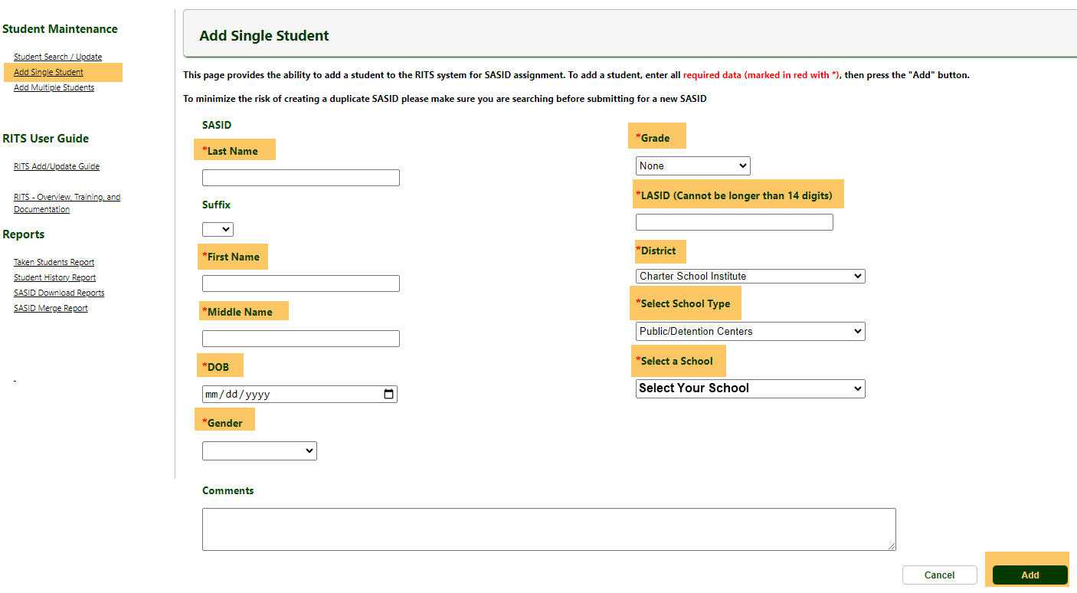
Add Single Student in RITS
Complete required fields including LASID
Use comment box to indicate students that have the same last name and birthdate. Ex. “twin”
Notes:
If after a thorough search has been conducted and a student is not found in RITS, you will take these steps to request a new SASID in RITS.
To add students one at a time, you will click “add single student” under Student Maintainance, and enter information in the mandatory fields. Please note: LASID (the local student number created by your school) is a mandatory field and this number is often generated from a school’s SIS or manually assigned during the enrollment data entry process. To see the last LASID that CSI used to request SASIDS for your school, please find the last SASID request file that your school submitted to CSI located in the in the G-Drive. For schools that currently use the student’s SASID as the LASID, you will need to manually create a LASID during the RITS request process before the SASID can be genereated.
Other items to note: if a student does not have a legal middle name, since middle names are required in both school’s SIS and RITS, use NMN for No Middle Name.
In addition, please use the “Comments” box for requesting SASIDS for any students that have same last names and birthdates such as for twins, triplets, etc.. Indicate this in the comments box so Case Management can process your request quicker.
Before submitting your request, double check that that spelling, and data is accurate. Click ADD.
Once submitted, a pop up will display either a SASID, which can be copied and pasted into your SIS, or a message stating that the request is in review with case management. Requests in review with Case Management simply means that the request has two or more fields that match another Colorado student in RITS. This does not necessarily mean that the request is a duplicate. Please check RITS by conducting a search in 1 – 2 business days to find the updated SASID result. If it has been over a week and a result is not in RITS, please reach out to CSI through the CSI submissions e-mail and we will contact CDC to check on the request. These unanswered requests can mean that a duplicate was found.

Slide 11
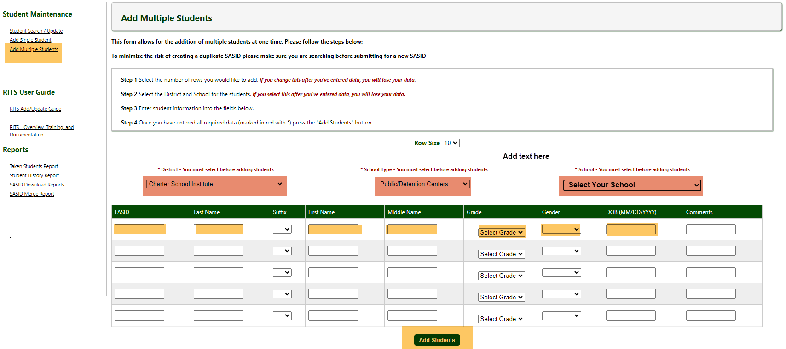
Add Multi Students in RITS
Complete required fields including LASID
Use comment box to indicate students that have the same last name and birthdate. Ex. “twin”
Notes:
In addition to single student entry, a multi student entry is available in RITS,HOWEVER, please be advised that from CSI’s experience, data entry in the multi student section, works sporadically. If you choose to use this feature, it is important to make sure that your district, school type and school is selected in the dropdown (highlighted on the screenshot in red) PRIOR to entering student information. Also, consider entering smaller batches of students (maybe 5 students at a time) instead of entering many at once. Lastly, consider the time for entering fields. It is possible that the system can log you out while you are completing fields. RITS can be logged out while remaining on the same page. This makes the system look like it is active, however, your entries may not be saved.

Slide 12
Requesting mass batch requests thought CSI using SIS extract (EXISTING PROCESS)

Slide 13
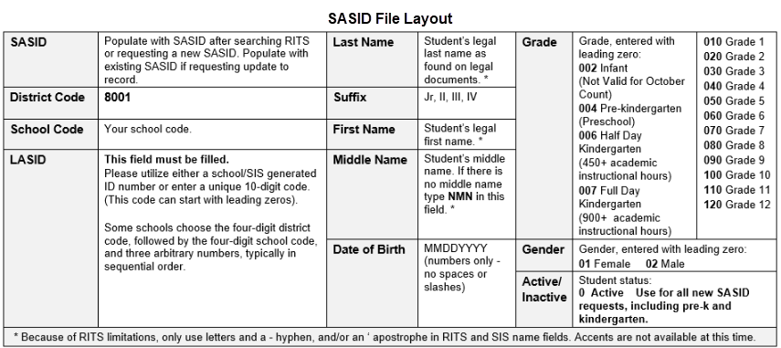
Batch SASID Request
SASID Resource Webpage: https://resources.csi.state.co.us/sasid-edid-requests/
Notes:
This next section may not apply to all school. This process is for schools that use their SIS to upload lists of students with missing SASIDS. For these schools, the process has not changed, a mass, batch can be sent to CSI using the same practice as previous batch requests. Schools will continue to use the SASID Request Template format and upload the file to the G-Drive.

Slide 14
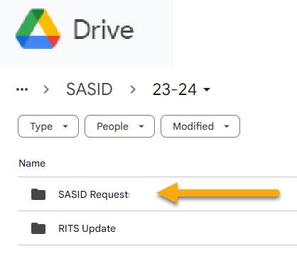
G-Drive – SASID Batch Request
Notes:
The only update is for batch requests is there will be a new folder in the G-Drive>SASID folder named folder named “SASID REQUEST”. Be sure that the file maintains leading zeros. The SASID template and SASID format information can still be found on the CSI SASID Resource Webpage. As always, after a file is uploaded to the G-Drive, schools will reach out to the Submissions inbox to notify the CSI data team that a new file is waiting to be processed. Please allow 1 – 2 business days to process your request.

Slide 15
Requesting RITS Update though CSI (NEW)

Slide 16
RITS Update Requests
The RITS Update Request is used when:
School’s find that RITS contains inaccurate information.
There has been an update to student information.
NEW Process-
School’s SASID folder in the G-Drive will contain a new folder named “RITS Update” which will house a running spreadsheet.
The running spreadsheet, “RITS UPDATE REQUEST” will be used for all RITS update requests for the year.
Notes:
The last topic is the new process for RITS update requests which will be used when a mistake is found in RITS or a student's information has changed and a RITS update is needed.
CSI requires that all schools send RITS update requests to CSI as the timing of updates can often affect other schools and districts throughout critical collection times. The new RITS Update Request process will include a new folder within the SASID folder in the G-Drive named “RITS Update”. Within this folder, you will find a running spreadsheet named “RITS Update Request”. Your school will continue to add to this one spreadsheet throughout each school year.
The previous process required schools to upload the request template, enter the data for the student, highlight the fields that need to be updated, then upload the file to the G-Drive. The running spreadsheet will eliminate the need to create and collect multiple files for each request. Instead, schools will open the RITS Update Request spreadsheet in the G-Drive, complete a row for all required fields, and highlight the field/s that need to be updated in RITS. As always, please email the CSI Data Submissions inbox to let us know that a new request in added to the spreadsheet. You will not need to do anything further.

Slide 17
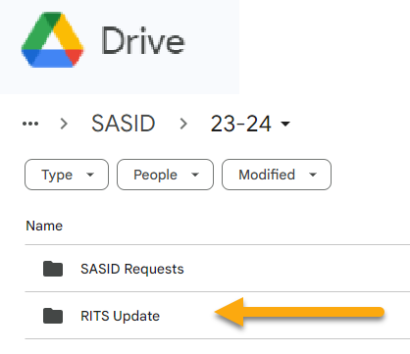
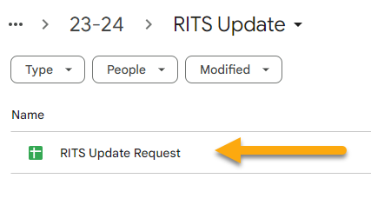
G-Drive – RITS Update
Notes:
The new running spreadsheet named “RITS Update Request” will be found in the G-Drive within the SASID>”RITS Update’ folders.

Slide 18
RITS Update Requests
Complete all fields (Suffix is not required)
Highlight in yellow the cells that will need the update in RITS
Email the submission inbox that a request has been added to the spreadsheet
Continue to use this spreadsheet using a new row each time your school has a RITS Update Request.
Reminder: Email the submissions inbox every time an update is added to the spreadsheet for processing.
Notes:
An example of the new “RITS Update Request” running spreadsheet is displayed here. All fields on this form are required including SASID, unless otherwise indicated, to help CSI locate the correct student in RITS. In addition, schools are asked to highlight the cell or cells that contains the information needing the updated. Notice that each row contains a request submitted on different days (date shown in blue). Schools will complete a new line per request leaving former requests on the spreadsheet. This allows schools and CSI to continue to use this running spreadsheet throughout the year eliminating the need to submit new files for each request.
Each time a school adds information to this spreadsheet, the submissions team must be notified by email so we can process the request. CSI is NOT automatically informed of updates to this spreadsheet. CSI will then complete the update, add a completion date onto to the spreadsheet, and email the school to confirm that the update is complete.

Slide 19
SASID Resources & Support
For SASID Resources and Information:
https://resources.csi.state.co.us/sasid-edid-requests/
After watching this training, please use the link located in the initial email or on the CSI SASID Webpage to request your new RITS access.
https://forms.gle/YxAYAJAr3Q587En49
submissions_csi@csi.state.co.us
Notes:
Thank you for reviewing this training.
As a reminder, once you have completed this training, use the Google Forms link in the initial email to request your new RITS access and G-Drive updates.
And for for access to this training and other SASID resources throughout the year, please visit the CSI SASID Resource Webpage.
Thank you!

