Slide 1
CSI School Leaders Call
May 10, 2024

Slide 2
Agenda
CSI Updates
Reminders, Upcoming Events & Deadlines
Legislative Updates
Notes:
Note for familiar faces, new leaders should add name, school in the chat.

Slide 3
CSI Updates

Slide 4
School Leader Survey Results
Strengths
Satisfaction with CSI
Level of support and autonomy
Satisfaction in school leader events this year
Areas for Growth
Clarity and communication around data analysis and compliance requirements
Increase SPED, data analysis, mental health, legal trainings
Website and event access

Slide 5
Next Steps
Leadership development
Legal trends and topics in K-12
Special education oversight
Using data to inform decision-making
Increase opportunities/formats of leadership trainings
Organization-wide efforts
Clarify between requirements and best practices
Reduce the burden on schools

Slide 6
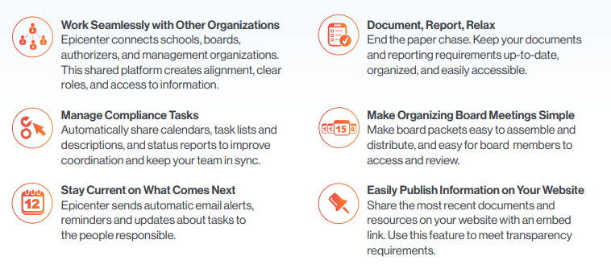
System Updates
Thanks for continuing feedback on systems to help streamline requirements/submissions!
G-Drive is the primary system CSI is using with schools for securely sharing data
Epicenter will be the primary system CSI is using with schools for contact management and organizational/financial submissions

Slide 7
Beginning of the Year School Leader Event
Tuesday, July 23
Monday, July 29
Wednesday, July 31
**POLL**

Slide 8
School Safety Coordinator
Grant Funded 2-year position
Comprehensive Needs Assessment
Document review
School visits
Interviews
Improved systems, structures, and relationships with local agencies

Slide 9
Legislative Updates

Slide 10
CSI Mill Levy Equalization

Slide 11
CSI-Specific Wins
HB24-1394: Mill Levy Equalization
HB24-1154: Institute Charter Schools & Bond Indebtedness
SB24-034: Increase Access to School-Based Health Care (now includes charter schools)
HB24-1146: PD for Science Teachers (now includes CSI schools in rural districts for rural priority)
HB24-1320: Educator Safety Task Force (now includes CSI representation)

Slide 12
Additional Wins
Defeat of HB24-1363 Charter Schools Accountability
SB24-188: School Finance Act
7.3% increase to PPR
HB24-1448: New School Finance Formula
$65.5M in charter school facilities funding

Slide 13
Accessibility
HB24-1454: Grace Period Noncompliance Digital Accessibility
Delays the implementation of HB21-1110 which required public entities, including charter schools, to comply with digital accessibility standards
Provides a one-year extension to July 1, 2025, of immunity from liability for failure to comply with the digital accessibility standards for an agency (district, or charter school) that demonstrates good faith efforts toward compliance or toward resolution of any complaint of noncompliance.

Slide 14
School Leader Events

Slide 15
Brown Bag Board Training
Friday, May 24, 9:00am-9:45am
(last of the year) Register here
Legislative updates from Dan Schaller at the League
Financial Policies & Procedures updates
At least one board member from every CSI school is required to attend (school leaders are welcome as well)

Slide 16
Departmental Reminders & Upcoming Deadlines

Slide 17
Organizational Submissions & Audits (2023-24)
S
Please submit your revised Physical Intervention, Restraints and Seclusion Policy via the Google Classroom no later than July 1.
Notes:
As a reminder, state legislation and corresponding regulations changed requirements around physical intervention, restraint and seclusion in public schools, and schools must revise their policies to align. The deadline to submit the revised policies to CSI is July 1. Schools should submit using the Google Classroom or send directly to Stephanie.
If any asks about EOPs: I am still finalizing feedback on EOPs and will send feedback forms before schools adjourn for Summer break (in an ideal world, next week). Feedback should be addressed in the 24-25 EOP updates. [Jess may want to provide update on School Safety Coordinator work related to EOP reviews/comprehensive needs assessment.]

Slide 18
Organizational Submissions & Audits (2024-25)
The 2024-25 submission schedule will be released in June.
Schools will submit via Epicenter instead of Google Classroom.
Additional information, instructions for submitting and support for schools will be provided throughout the Summer months.

Slide 19
Title IX Regulations
The new Title IX Regulations were published in April. The rules are effective on August 1.
Schools should continue to comply with the current regulations until the new effective date.
More information and role-specific training for schools to follow…

Slide 20
Changes to Restraints and Seclusion Under HB 22-1376
Provides that under no circumstances can a student be physically held for more than one minute (formerly five minutes) unless certain restraint provisions are followed.
Changes requirements for seclusion, including specific requirements for seclusion rooms to ensure continued monitoring and student safety.
Provides that SROs and law enforcement cannot use handcuffs on a student unless there is a danger to themselves or others.
Requires parents/guardians be notified verbally and in writing of certain incidents resulting in restraint or seclusion.
Requires training for employees who may need to restrain or seclude students.
CSI Guidance and Sample Policy
Notes:
HB 22-1376 and the associated regulations approved in 2023 changed requirements for restraint and seclusion in public schools. The law [BULLETS].
CSI has provided an overview of the new requirements and has developed a sample policy for use by schools.

Slide 21
Annual Restraint Review
Schools must also complete an Annual Restraint Review. As part of this Review, schools should:
Analyze incident reports, including procedures used during the restraint, preventative or alternative techniques tried, documentation, and follow up;
Consider the training needs of staff;
Review the staff to student ratios; and
Review environmental conditions, including physical space, student seating arrangements and noise levels.

Slide 22
Annual Restraint Review Report
HB22-1376 requires an Annual Restraint Review Report be submitted by each CSI school.
CSI plans to fulfill the requirements on behalf of schools, including:
Submitting one document listing all CSI schools with 0 reportable restraints
Submitting a customized report for schools with reportable restraints (data to come from Discipline collection and related follow ups)
PPRA Requirements for the Annual Review - Guidance - April 2024 (state.co.us)

Slide 23
School Finance Rule Updates
Continue to fund traditional seat time (direct instruction) in K-12
Expanded to include time when students and teachers are in the same virtual classroom receiving synchronous instruction
Expand alternative instruction to grades 6-12
Learning may take place asynchronously and off-site
Students exclusively enrolled in online courses must be enrolled in an online school or program
ACTION ITEM: If your school plans to offer Alternative Instruction courses in 24-25, email SheilaSellers@csi.state.co.us with notification of your plan.

Slide 24
Board-Approved 24-25 Calendar and Bell Schedules
Submit as many calendars/bell schedules as your school will follow for 24-25 (elementary, secondary, homeschool)
Recommendations:
Build in a few buffer days for unexpected closures
If using Alternative Instruction, do not use passing periods for instructional time in bell schedule
ACTION ITEM: Submit calendar(s), bell schedule(s), calendar Bell Summary Sheet by May 15 to Submissions_CSI@csi.state.co.us
Notes:
https://go.boarddocs.com/co/cde/Board.nsf/goto?open&id=D2QQYP6B9E57

Slide 25
HR / Employers Council Membership
All CSI Schools have access to our Employers Council membership.
Free services include:
Expert guidance on day-to-day employment issues.
Assistance with the development and implementation of employee appraisal systems and performance management plans.
Access to comprehensive salary survey data.
Support and consultation regarding FMLA (Family and Medical Leave Act) and ADA (Americans with Disabilities Act) leave provisions.
Assistance with navigating workers' compensation concerns.
Project-specific specialized for-fee services (bill at competitive rates) include:
Employment Law Compliance Posters
Executive and Management Coaching
Professional mediation services.
Comprehensive employment testing and assessments.
CSI schools can identify 2-3 people to access Employers Council.
This typically includes the School Leader, HR Manager or Board Chair
Please reach out to Allegra Wenger at AllegraWenger@csi.state.co.us if you need to make updates to your membership or have questions.
Comprehensive list of free and specialized for-fee services

Slide 26
Finance & Ops
School Budgets:
Resources can be found: CSI's Finance Resource website
SpEd Reserve
SPED Reserve = 1% of Prior Year Oct Count Actual FPC x $10K
not to exceed $90K. Equal to $100 per pupil.
Pay for student supports if the school has an unexpected need.
Other funding:
IDEA and ECEA funds, ensure these are being utilized.
CSI Mini Grant – schools can apply after IDEA, ECEA and Reserve is spent.
Audit Prep:
Connect with your finance team early.

Slide 27
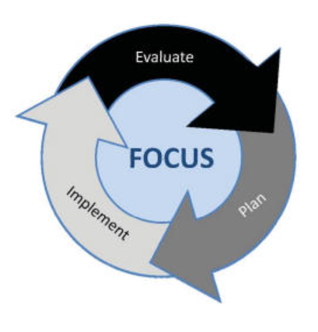
School Programs
First draft of UIP due August 15
Resources for both UIP formats on CSI Resource site
Email jessicawelch@csi.state.co.us for access to the “streamlined” UIP template
Notes:
Oct 18 Accommodation Training Registration link: Virtual
Registration

Slide 28
School Contact Information
As in prior years, spreadsheets will be sent out in early June with a deadline of mid-July
Please ensure contacts for the 2024-25 school year are accurate
School Leader cell phone numbers

Slide 29
See you at graduations! CSI staff and board members will be attending just about every high school graduation ceremony!

