Slide 1
SEL For Every Educational Philosophy
Betsy Jane Basch, Psy.D.
Charter School Institute
betsybasch@csi.state.co.us

Slide 2
What is SEL?
Self-awareness
Self-Management
Social Awareness
Responsible Decision Making
Relationship Skills
Can we focus on the Learning?
Notes:
www.casel.org

Slide 3
Impact of Social Emotional Learning on Academics
Decades of research students demonstrate the following benefits of SEL:
Improvements in students’ social & emotional skills, attitudes, relationships, academic performance, and perceptions of classroom and school climate
Decline in students’ anxiety, behavior problems, and substance use
Long-term improvements in students’ skills, attitudes, prosocial behavior, and academic performance
Wise financial investment according to cost-benefit research
Notes:
Zero to Three, 2017
https://www.zerotothree.org/
Benefits of SEL
•We know from a large body of research on SEL that high-quality SEL programming leads to improved academic performance, decreases in anxiety and behavior issues, among other benefits.
•We also know from research beyond the traditional SEL field that there are additional insights to be gained that are relevant to SEL.
Meta-analysis source (first 3) Durlak, J.A., Weissberg, R.P., Dymnicki, A.B., Taylor, R.D., & Schellinger, K. (2011). The impact of enhancing students’ social and emotional learning: A meta-analysis of school-based universal interventions. Child Development: 82 (1), 405-432.
Financial investment (bottom): Belfield, C., Bowden, B., Klapp, A., Levin, H., Shand, R., & Zander, S. (2015). The Economic Value of Social and Emotional Learning. New York: Center for Benefit-Cost Studies in Education.

Slide 4
Long Term Implications
Early social emotional delays are associated with an increase in later challenges (Campbell et al., 2006)
Positive experiences can have positive long-term implications (Jones et al., 2015)
Social Emotional Skills need to be explicitly taught & modeled
“Good Enough” relationships
Notes:
https://www.zerotothree.org/

Slide 5
Let’s Talk About Discipline
When we overreact to children’s behaviors, the results are lifechanging
If we punish kids for small things, they tend to act out later
The better we are at addressing racial bias & social stigma the better our responses are for children
Notes:
found that about 50,000 children in preschool and child care were suspended each year and 17,000 were expelled, meaning about 250 children per day are asked to leave temporarily or permanently,
https://www.k12dive.com/news/Trauma-from-preschool-expulsions-suspensions/640034/

Slide 6
Why the Emphasis on Skills?
If a child doesn’t know how to read, we teach;
If a child doesn’t know how to swim, we teach;
If a child doesn’t know how to multiply, we teach;
If a child doesn’t know how to drive, we teach;
If a child doesn’t know how to behave, we……..teach?......punish???
Why can’t we finish that sentence as automatically as the others?
-Tom Herner, NASDE President, 1988
Notes:
Because we’re a school, we teach!
Kids are here to get an education

Slide 7
Options for SEL Terms
Professional Development Skills
Executive Management Skills
Social Skills
Peer Engagement Skills
Career Readiness Skills
Civic Responsibility Skills
Behavioral Competencies
Can we focus on the skills?
Notes:
www.casel.org
SEL4MT-”Advocacy with Grassroots Efforts”

Slide 8
Messaging Options

Slide 9
Contextual Messaging Options

Slide 10
“We are not here to replace parents”
Contextual Messaging I
Our objective is to work collaboratively with families to ensure that our students receive the best possible support, encompassing both academic and behavioral needs.
Practically, educating students is a team effort.

Slide 11
“We are committed to the well-being of all students”
Contextual Messaging II
Our commitment to the comprehensive well-being of our students is unwavering. We believe it is our duty to not only provide an academically rigorous environment but also to address the proven correlation between mental health and academic success, social development, and long-term achievement.
Practically, we bring our entire hierarchy of needs with us to school.

Slide 12
Skill-Building Messaging Options

Slide 13
“Professional Development Skills”
Skill Messaging I
Our educational intent is for students to succeed in their chosen profession. During our professional development block, students learn critical skills to be a competent professional in communication, effective collaboration, problem-solving analyses, and emotional intelligence.
Practically, employees have to be able to engage in a diverse workforce.

Slide 14
“College & Career Readiness Skills”
Skill Messaging II
The number one skill identified by Forbes (2015) that was desirable by employers was the ability for employees to work in a team structure. Interpersonal skills (sometimes called soft skills) matter in today's workforce.
Practically, we cannot have temper tantrums at work & have to act appropriately.

Slide 15
“Peer Engagement/Social Skills”
Skill Messaging III
Our collaborative educational philosophy uniquely prepares students to be particularly skilled in peer engagement. Students have opportunities to hone their skills in cooperation, conversational assertiveness, interpreting social situations, and adapting situational communication skills.
Practically, to function well in society, we have to learn how to get along.

Slide 16
“Executive Management Skills”
Skill Messaging IV
Our scholars graduate prepared to be leaders in their field. We provide focused executive management training to accompany our rigorous academics where students learn critical skills in conflict resolution, effective decision-making, problem-solving analyses, and complex leadership dynamics.
Practically, excellent leaders have to manage themselves to manage people.

Slide 17
“Civic Education”
Skill Messaging V
Twenty-first century civic education requires the development of knowledge and competencies that lead to compassion, communication, and action. It is not enough for students to recite the Articles of Confederation or the Bill of Rights; rather they need to know how to skillfully wield these tools for equality and justice in a rapidly changing world.
Practically, we have to behave well with others to be a good citizen.

Slide 18
Social Emotional Learning is excellent for children regardless of the name and sometimes the name matters
Notes:
Judith Ramaley from the NSF had the good sense to veto SMET & turn it into the powerhouse acronym we all know as STEM

Slide 19
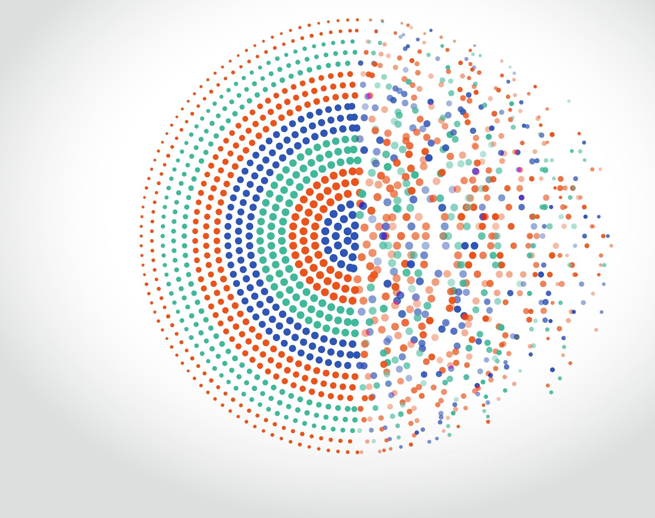
Systemic Supports

Slide 20
Do You Like Me?
Growth mindset isn’t enough for lower SES backgrounds
Growth mindset AND skills
Am I welcome here? Am I valued here? Am I celebrated here?
When kids don’t like school, they tend to not do well in school
Notes:
https://www.apa.org/monitor/2022/01/lab-youth-school

Slide 21
Welcome
What do I see
Marketing Materials, Pictures on the Walls…
What is the very first thing families & students see when they approach your school and walking in….
How do I know I am welcome
If I do or if I do not see myself reflected……
How do I know I am welcome?
How do I know I am valued
Is who I am valued?
How do you show I have value?

Slide 22
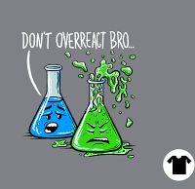
Overreact
Give detentions for everything
Suspend Suicidal Students
ignore their circumstances

Slide 23
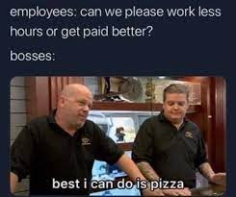
Throttle Communication
Do not listen
Interrupt feedback loops
Celebrate deficits
Abolish strength-based conversation

Slide 24
Exclude as many people as possible
Advertise who is not welcome in your school
Establish clear hierarchies
Make your mission only accessible to select groups of people

Slide 25
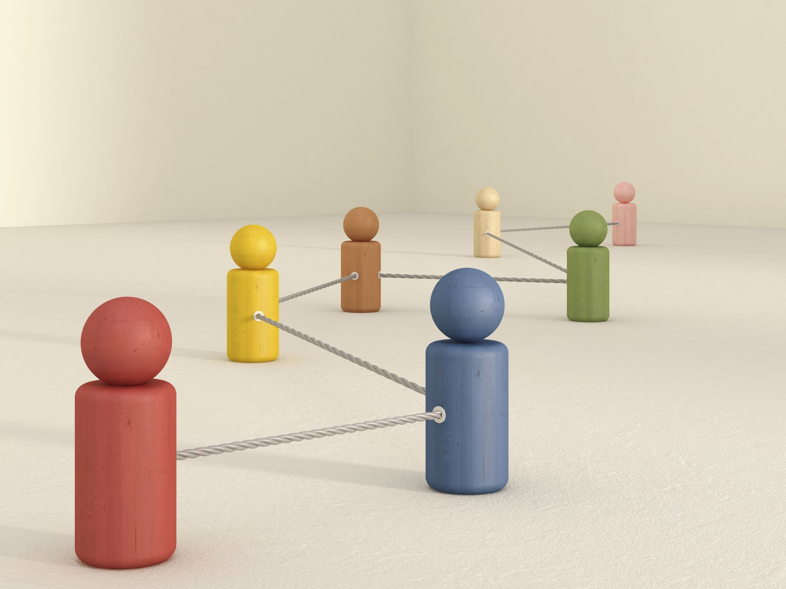
Individualized Supports

Slide 26
Reduce Stressors
GO Quiet: approach silently, use nonverbals, limit auditory processing demands
Ask Open-ended questions: skip directions & corrections, pause between questions, aim to understand perspective
Give Visual Support: Write, Draw or Display Directions
Offer Breaks: Go for a Walk, Take a Breath, Sit Together, Get Some Water
Get Creative: Play Calm music, move, dance, draw, create
Notes:
Inclusive Schooling

Slide 27
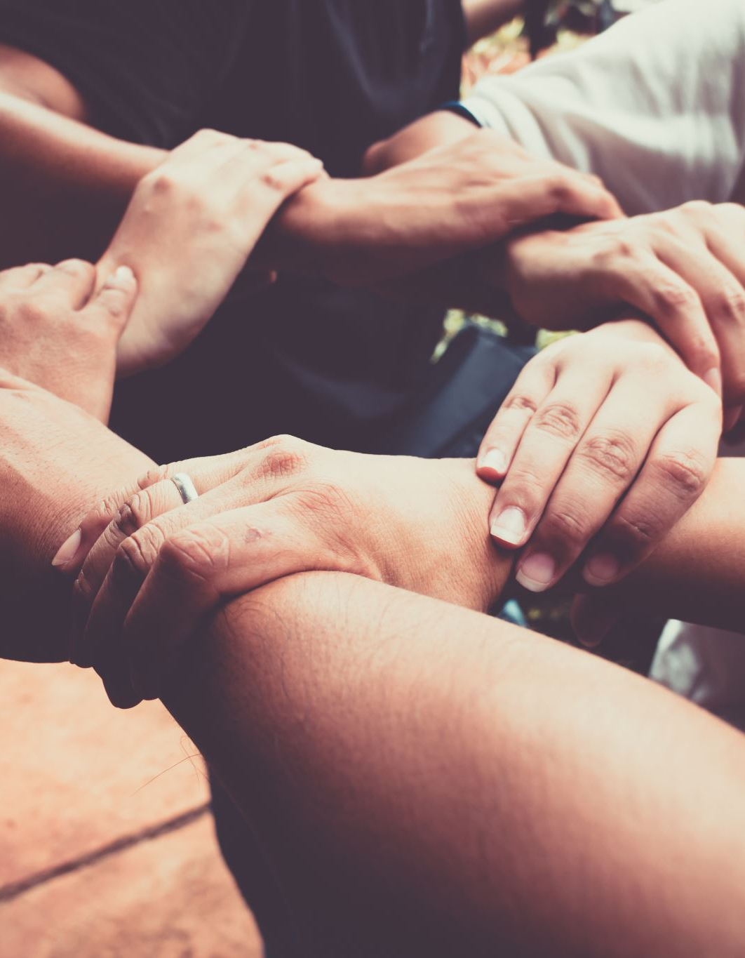
Reduce Stressors II
Show Compassion: Offer a smile, hug or a hand
Reduce the Size of the Group: Peer partners, stations, co-teaching, small groups
Reduce Inputs: Reduce clutter, increase space between students, use outdoor or other environments
Reduce Demands: reduce number of tasks/directions, provide choice for working together/peer, additional timeline, provide choices
Slow Down & Give Time: Count to 3, take 2 deep breaths, use a visual, peer turn and talk
Notes:
Inclusive Schooling

Slide 28
Let’s Translate These Skills

Slide 29
Frustration Tolerance
This is a skill that is difficult for all students
This is a skill that is difficult for adults
This is a skill that we do not see in public or social media
We have whole genres of film and television telling us how awesome it is to take out our frustration on others, and that others deserve what’s coming to them

Slide 30
Frustration Tolerance Expectations by Philosophy
Traditional | Classical | Montessori | Personalized Learning Plan | Early College
Explain that everyone experiences frustration, but it's how we respond that matters. | Clearly define behavioral expectations and the importance of maintaining composure in the face of challenges. | Begin by observing the child's interactions and understanding their individual needs, strengths, and challenges. | Collaborate with each student to set personalized goals related to frustration tolerance. Goals should be specific, achievable, and aligned with the student's interests. | Provide an orientation to college expectations, emphasizing the challenges students may encounter and the importance of developing resilience and frustration tolerance.

Slide 31
Frustration Tolerance Lesson Example by Philosophy
Traditional | Classical | Montessori | Personalized Learning Plan | Early College
Help the student identify specific situations or tasks that tend to trigger frustration. | Encourage students to take a moment of silent reflection to regain focus and composure. | Incorporate "Grace and Courtesy" lessons into the daily routine, teaching children how to express frustration respectfully and seek assistance when needed. | Integrate self-paced activities and assignments, allowing students to progress at their own speed and revisit challenging concepts as needed. | Align frustration tolerance goals with both academic and college readiness objectives. Emphasize the connection between effective frustration management and success in a college environment.

Slide 32
Frustration Tolerance Reflection by Philosophy
Traditional | Classical | Montessori | Personalized Learning Plan | Early College
Encourage the student to reflect on their experiences, noting when the coping strategies were effective and when adjustments may be needed. | Facilitate reflective discussions about the value of maintaining a disciplined and composed demeanor, connecting it to academic and personal success. | Incorporate self-reflection activities, such as journaling or drawing, to help children express and process their emotions. | Utilize digital tools for reflection, such as online journals or self-assessment platforms, where students can document their emotions, challenges, and successes. | Integrate reflection sessions into the intervention, allowing students to reflect on their experiences, revise goals, and identify areas for improvement.

Slide 33
Frustration Tolerance Curriculum Integration by Philosophy
Traditional | Classical | Montessori | Personalized Learning Plan | Early College
Collaboratively create a "Coping Toolbox" with the student. Include various strategies that they can use when feeling frustrated. | Integrate discussions on frustration tolerance and discipline into the curriculum, emphasizing character development alongside academic learning. | Introduce conflict resolution skills through collaborative discussions and role-playing. Emphasize the importance of effective communication and understanding others' perspectives. | Develop personalized learning plans for each student, incorporating strategies for building frustration tolerance within the context of their academic goals. | Create simulated college challenges or projects that mirror the demands of college coursework. This provides students with opportunities to practice frustration tolerance in a controlled environment.

Slide 34
Frustration Tolerance Measuring Progress by Philosophy
Traditional | Classical | Montessori | Personalized Learning Plan | Early College
Integrate the use of coping strategies into the student's daily routine, both in and out of the classroom. | Recognize and celebrate instances where students demonstrate improved frustration tolerance and disciplined responses. | Celebrate and acknowledge children's progress in frustration tolerance, reinforcing the idea that challenges are opportunities for growth. | Use data and ongoing assessments to inform adjustments to the personalized resilience plan, ensuring that interventions are responsive to the student's evolving needs. | Prepare students for constructive feedback and guide them in utilizing feedback as a tool for growth. Emphasize the importance of learning from setbacks.

Slide 35
Key Questions
If wellness isn’t a priority, am I saying that unwellness is?
When I say, “This kid just isn’t a good fit here," what does this actually mean?
How am I communicating values through my words, actions, policies and finances?
Is your system planning for trauma & SEL or are you responding to Crisis?

