Slide 1
Culturally & Linguistically Diverse Learners & Mental Health
Betsy Basch and Rachel Franks

Slide 2
Definitions

Slide 3
Definitions II
Who are Newcomer Students? (OELA, 2023)
K-12 students born outside of the United States
Arrived in the last 3 years
Still learning English

Slide 4
Logical Sequence

Slide 5
Legal Rights
As you know, the Supreme Court of the United States held more than 40 years ago in the case of Plyler v. Doe, 457 U.S. 202 (1982) that all children in the United States have an equal right to enroll and participate in public elementary and secondary schools without regard to their or their parents’ or guardians’ immigration status. Public school districts may not deny access to an education to any child based on immigration status. It is a violation of federal law for districts to prohibit or discourage children from enrolling in public schools because the children or their parents or guardians are not U.S. citizens or do not have immigration documentation. Therefore, a local educational agency (LEA) must provide such a student with equal access to a public elementary and secondary education, regardless of their or their parent’s actual or perceived national origin, citizenship, or immigration status, and determine whether the student is eligible, on the same basis as any other student, to participate in programs supported with local, State, and federal funds. Dear Colleague Letter (September 2023)

Slide 6
Scenario #1
Eduardo is a 6th grade student who recently arrived from Venezuela and is attending a K-8 school. He is living with his parents and younger sister at his uncle's house. Eduardo's teacher is concerned because he is absent 2-3 days per week. The school does not have a bus and staff thinks that he is likely absent due to lack of transportation.

Slide 7
Consider First…
Systems of Support
Individualized Support

Slide 8
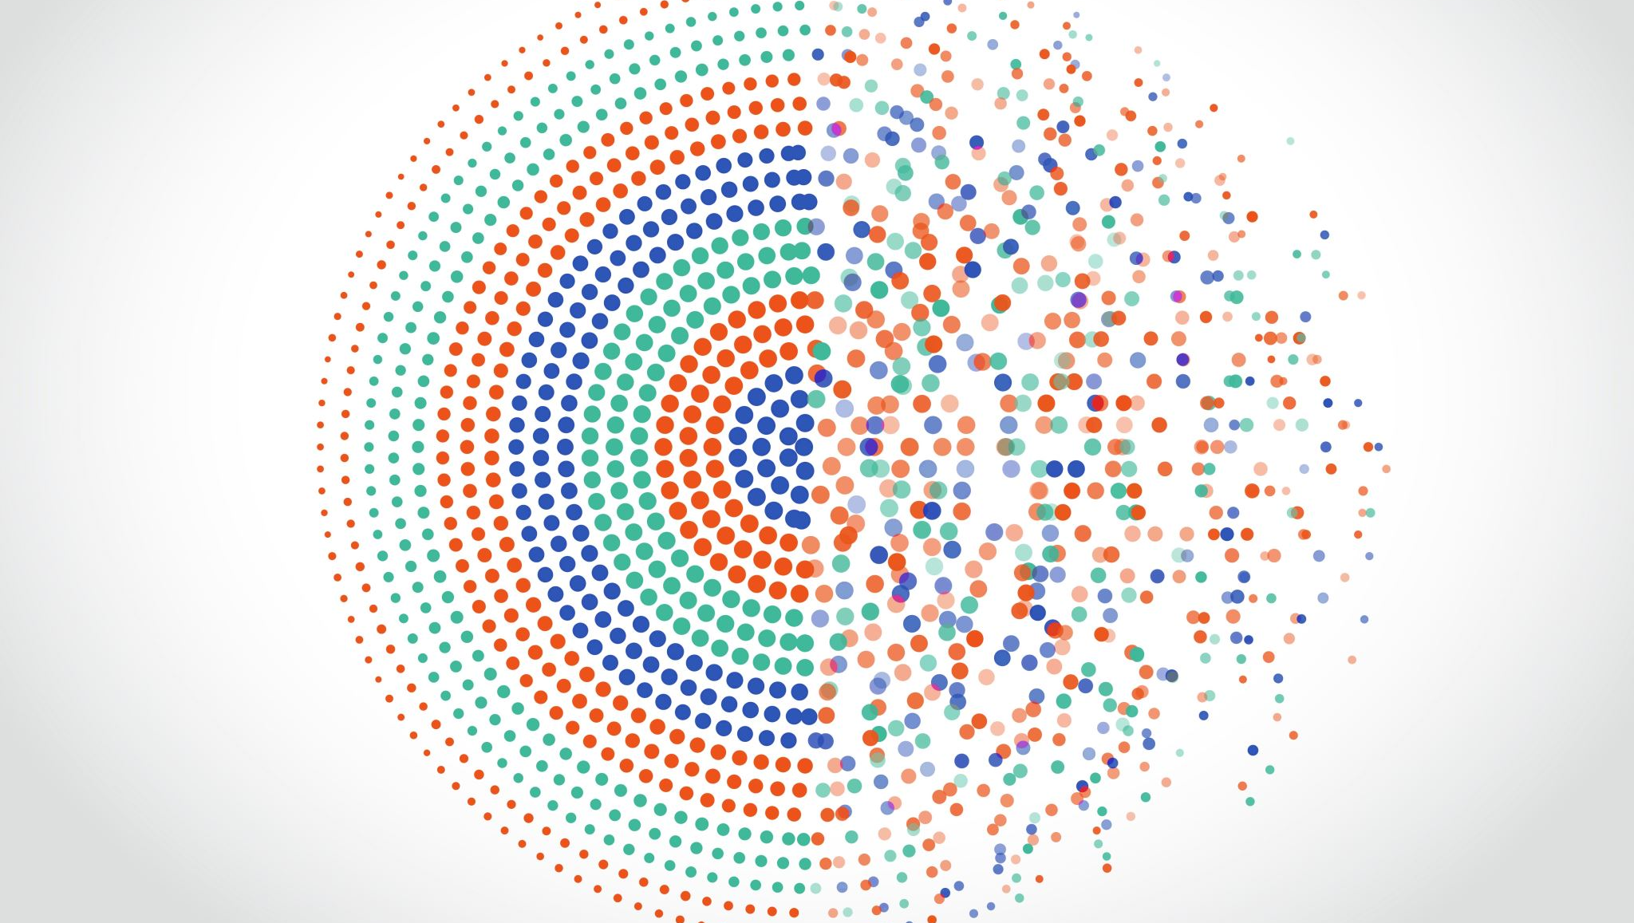
Systemic Supports

Slide 9
Welcome
What do I see
Marketing Materials, Pictures on the Walls…
What is the very first thing families & students see when they approach your school and walking in….
How do I know I am welcome
If I do or if I do not see myself reflected
How do I know I am welcome?
How do I know I am valued
Is who I am valued?
How do you show I have value?

Slide 10
Before you dismiss the importance of welcoming……
SEL benefits
Improvement in students' social and emotional skills, attitudes, relationships, academic performance, and perceptions of classroom and school climate
Decline in students' anxiety, behavior problems, and substance use
Long-term improvements in students' skills, attitudes, prosocial behavior, and academic performance
Wise financial investment according to cost-benefit research
Values
Every CSI school states all students are welcome
Notes:
We hear from schools that are hesitant about providing services to students
An overview slide for those who want only one slide, with research highlights. It combines findings from several studies on one slide. Note that the citations are not on the actual slide, but they are here in case you are asked:
Benefits of SEL
•We know from a large body of research on SEL that high-quality SEL programming leads to improved academic performance, decreases in anxiety and behavior issues, among other benefits.
•We also know from research beyond the traditional SEL field that there are additional insights to be gained that are relevant to SEL.
Meta-analysis source (first 3) Durlak, J.A., Weissberg, R.P., Dymnicki, A.B., Taylor, R.D., & Schellinger, K. (2011). The impact of enhancing students’ social and emotional learning: A meta-analysis of school-based universal interventions. Child Development: 82 (1), 405-432.
Financial investment (bottom): Belfield, C., Bowden, B., Klapp, A., Levin, H., Shand, R., & Zander, S. (2015). The Economic Value of Social and Emotional Learning. New York: Center for Benefit-Cost Studies in Education.

Slide 11
Strengths Focus

Slide 12
Scenario #2
Several of the adults in your community (including your own staff & colleagues) believe the border should be closed and a busload of newcomers are dropped off in your parking lot

Slide 13
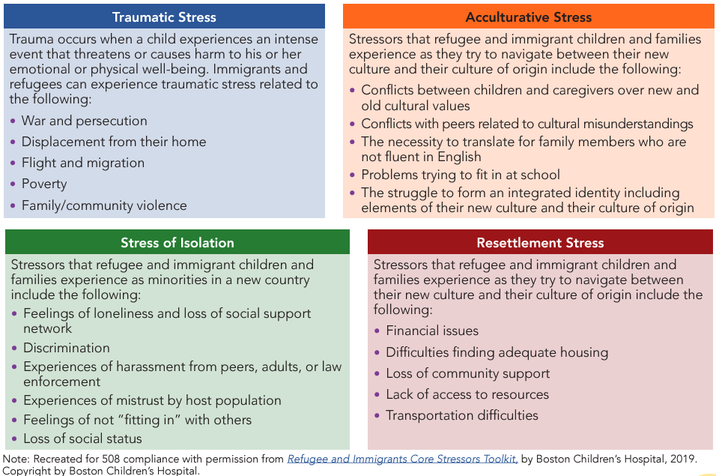
Stressors for Newcomers

Slide 14
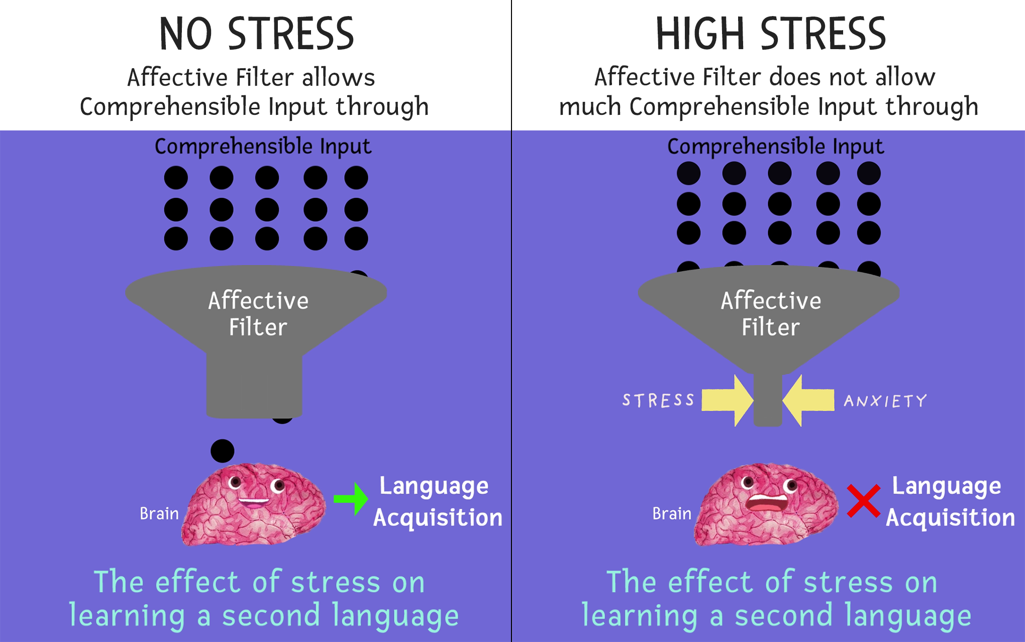
Stephen Krashen's Affective Filter
The affective filter is a metaphor that describes a learner's attitudes that affect the relative success of second language acquisition. Negative feelings such as lack of motivation, lack of self-confidence and learning anxiety act as filters that hinder and obstruct language learning.

Slide 15
Structure & Onboarding
What do I need to do
How do I know I need to do it
How am I making connections
Lunch Bunches?
Tier II Groups?
Affinity and/or Interest Groups?
How are we continuing to support the structure
How are we helping students and families navigate the required pieces of communication in schooling

Slide 16
Contributions
How are we contributing to the wellbeing of everyone
Intersectionality
Responding to needs we have & we could anticipate
How are we incorporating and asking for cultural wisdom
How are we involving all families
What kinds of local community agencies can we partner with?
Notes:
Are we considering our students as assets or burdens? Kids know when we don’t like them or think they are a burden

Slide 17
Financial
Are we spending money on the students we want or the students we have?
Are we planning for finances for the students we want or the students we have?

Slide 18
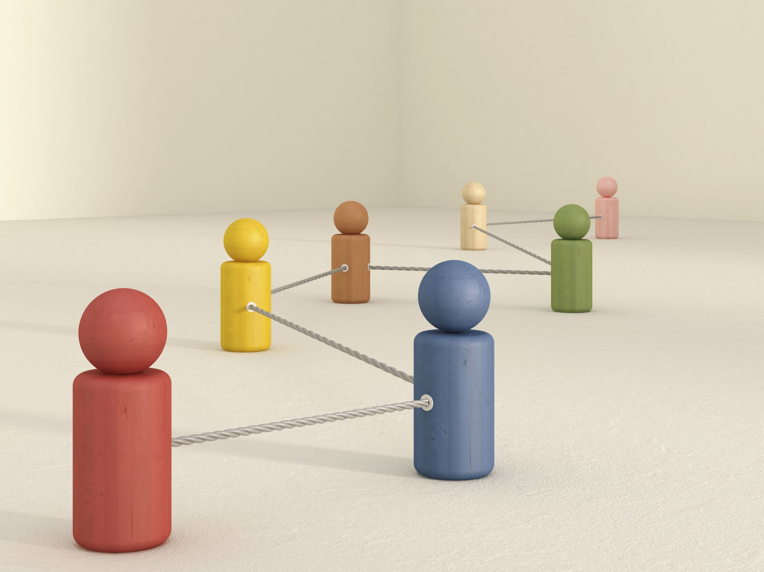
Individualized Supports

Slide 19
Pronunciation
Learn students' names
How they sound
What their name means to them
Demonstrate vulnerability
ASAP
Notes:
Resources
"Cultural Identity & Names in the Classroom"
"Pronouncing Students' Names Should be a Big Deal"
"The Name Jar" by Yangsook Choi

Slide 20
Finding Joy
Find something that brings them joy!
Connect & Share
Notes:
Resources
"Know Your Students"
"A 4-Part System to get to Know Your Students"

Slide 21
Scenario #3
Fatima is a 9th grade student at a 9-12 school who recently arrived in Colorado from Afghanistan. Fatima speaks Dari and has not had any instruction in English before coming to the United States. Multilingual learners at the school primarily speak Spanish as their native language. No one else at the school speaks Dari and although Google translate has Farsi, translation resources are limited. Fatima generally has a positive attitude about school; however, school staff is concerned that Fatima is feeling isolated, confused, not growing.

Slide 22
Making the Connection
Be Interested
Be Interesting
Connect
Implicit Bias
Notes:
Resources
"Implicit Bias"
"I, Too, am Harvard"

Slide 23
Using Social Theory
Demonstrate Developmental Appropriateness
Modeling
Think Out loud
Notes:
Resources
"Social Learning Theory"

Slide 24
Resource Connections
Strategically Connect Communications
Staff Relationships
Translations
Interpreters
Notes:
Resources
"How to Reach out to Parents of ELLs"
"Partnering with Latino Parents"

Slide 25
Resources
CDE’s Equity Toolkit
Project Based Learning for ELLs
Enhancing Family-School Collaboration with Diverse Families
Creating Welcoming School Environments
Newcomer Toolkit
Notes:
Newcomer Toolkit
https://www2.ed.gov/about/offices/list/oela/newcomers-toolkit/index.html

