Slide 1
Discipline Quick Entry
PowerSchool
Notes:
Hello All,
Thanks so much for reviewing this training on how to enter disciplines in PowerSchool. This training covers all the necessary steps that need to be taken within your SIS to accurately record state reportable behaviors and resulting actions. If you have questions while reviewing this training, feel free to reach out to the CSI submissions inbox.

Slide 2
Purpose of the School Discipline Collection
The School Discipline collection contains student level information for:
Students disciplined, including the type of behavior and resulting disciplinary action taken for each disciplinary incident.
the demographics of the student(s) disciplined, and
the counts of students that brought or possessed a firearm for each school.
The School Discipline collection data is used to populate the Civil Rights Data Collection (CRDC – every other year)
For more information on State Statues (HB22-1376) related to Collection: https://www.cde.state.co.us/dropoutprevention/disciplinepolicy
courtesy of depositphotos.com
Notes:
Let’s jump into the purpose of the School Discipline collection, schools are required by State and Federal law to collect information on certain discipline events that have occurred at your school during the current school year. The School Discipline collection is currently the way this information gets collected and submitted to CDE to meet these requirements. Feel free to take a look at the full description and purpose listed in this slide. The big take home point is that the Collection has been modified recently to report by student rather than in aggregate.
Also, you will notice the State Statutes related to this collection at the bottom of this screen. If you would like more information on these and the regulation tied to this collection feel free to review the information in this link on the CDE website

Slide 3
Reporting of Disciplines
Historically, CSI has seen Discipline data being under-reported at schools resulting in an inaccurate picture of disciplines.
Ensuring that all disciplines that occur are entered accurately and are State reportable is necessary to reflect situation at schools and avoid under-counting.
Strategies for Addressing Accuracy | Questions to Keep in Mind
Determining behavior and consequence | Who are the main staff members responsible for discipline at your school?
Entering behavior and consequence
Reviewing behavior and consequence | Who enters the discipline information into your student information system?
Comparing across systems for overall accuracy
Comparing across collections for special education accuracy | How is your school classifying behavior that is being tracked? (Example: What is disruptive behavior?)
Notes:
In terms of the reporting of disciplines, CSI has noticed that in general, schools have been historically under reporting this information which leads to an inaccurate depiction of the incidents and actions going on at schools. This training will hopefully provide the instructions necessary to accurately report state reportable disciplines within PowerSchool. To help with this, the slide outlines some strategies for addressing the accuracy of your reported data including (READ). Keeping the steps of determining, entering, reviewing, and comparing this information will assist with your school submitting accurate data. Also, some good questions to keep in mind as you start a new year include: Who are the staff at responsible for disciplines at your school? Who will be entering that information into your SIS? If these people are different, then a good system should be in place so that all are recorded. Also, how is your school classifying behavior that is being tracked? This may differ from school to school on what is considered a state reportable incident. It is often important for your school to develop standardized guidelines that should be followed throughout the year, particularly if multiple people are recording incidents in your SIS and that these details are being entered in a timely manner.

Slide 4
Data Entry Process
Notes:
Now that we have seen the big picture and importance of reporting incidents, let’s dive into the data entry process and each of the steps required to accurately report in PowerSchool!

Slide 5
Steps of the Discipline Process
Once a behavior occurs at your school, navigate to PowerSchool and complete these steps:
Navigate to Incident Management
Add an Offender and Create a Behavior
Add a Resulting Action
Log in to PowerSchool
Click on Special Functions
Click on Incident Management
Create an Offender
Create the Incident
Drag Incident onto the Offender
Create Resulting Action
Drag onto the Incident
Ensure both the Incident and Action are State Reportable or not (must match)
Notes:
Here is a high-level overview of the steps necessary in PowerSchool to accurately report incidents and resulting actions in your SIS. It can be broken down into 3 main steps: Navigating to the Incident Management section, Adding an offender and creating an incident, and adding the resulting action. As you can see here each of these areas have a listing of sub-steps that need to be completed and that is primarily what we will be covering today! Let’s jump into the first step, navigating to incident management.

Slide 6
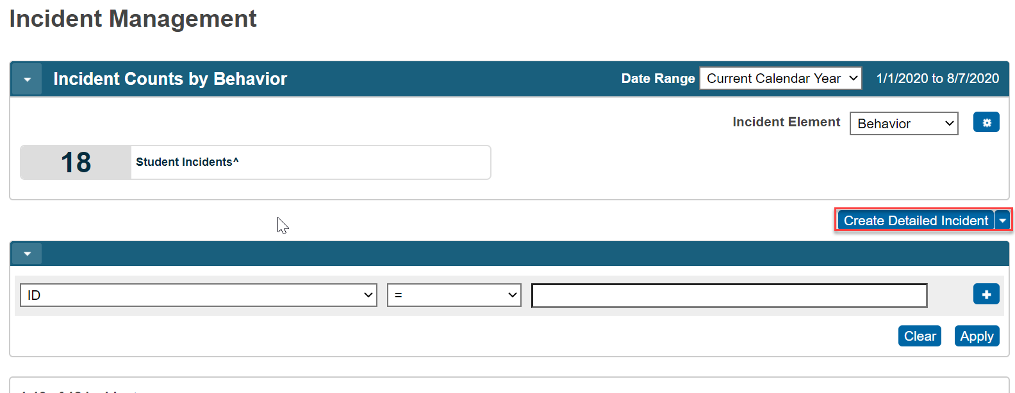
Access Incident Management
Notes:
So, once you are logged into PowerSchool, you want to find the functions header on the left side of the screen and click on the Subheading Special Programs (NEXT). Clicking on this will bring up a listing of all the Special Functions available in PowerSchool and for discipline entry, you want to click on (NEXT) Incident Management. (NEXT) This will take you to a new popup for the incident management section in PowerSchool. Clicking on Create Detailed Incident or dropdown arrow will allow you to begin creating the incident and resulting action.

Slide 7
Quick Incident vs. Detailed Incident
Notes:
When talking about adding incidents in PowerSchool, you have two options in the dropdown arrow menu that I mentioned. You can create a quick incident or a detailed incident, which we will be discussing here. Each will give you the result of reporting an incident, but the detailed version will allow for more of a thorough entry of all the details.

Slide 8
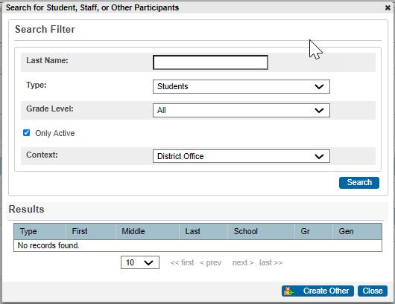
Add Incident Details and Assign Offender/Victim
Complete all details of the incident at the top of the screen
Ensure that you mark as State Reportable or not, but must match resulting action
Once details are added, click on the + button to assign offender and victims (if applicable)
Search for students and add as offender. Add victims if necessary
Notes:
Once you have clicked on Create Detailed Incident, you will be taken to a new popup where all details should be entered. The second question down pertains to Incident type. This is where you are able to mark the incident as either State Reportable or GFSA Incident. GFSA refers to an incident involving a weapon of firearm and is not used very often but may be necessary if you encounter this situation. As you can see both types have a carat symbol at the end. This is what PowerSchool uses to show the information detailed is state reportable. If nothing is selected here, then the incident will not be pulled into your files and is only recommended if you need to record an incident internally but is not severe enough to be state reportable. Always be sure that if you select as State Reportable here in the incident, the resulting action MUST be state reportable as well and vice versa, otherwise you will get errors in the School or SPED Discipline collections. Once the Incident details section at the top is completed, click on the plus sign under the Participants in the incident builder section (NEXT). The resulting popup will allow you to search and add the offender, victim, witnesses or reporters. Incidents should always have an Offender and you may add other types of participants as deemed necessary. To add the offender, just search for the students name and add. The offender should now show up within that section of the Participants.

Slide 9
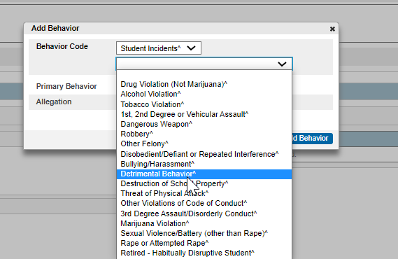
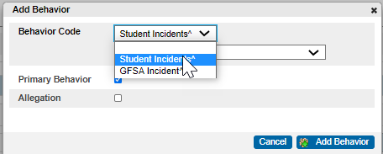
Create Behavior
Click the “+” sign and Add Behavior
Select the most applicable Behavior Code. The ^ symbol indicates State Reportable. Click Add Behavior
Select either Student Incident^ or GFSA Incident^. GFSA is for incidents involving weapons
Notes:
The next step in the process would involve adding the Behavior related to the incident that occurred. To start this, click on the plus sign to the right of the incident Elements section and click Add Behavior (NEXT). This will take you to a section where the behavior code can be added. You’ll notice that you have the Student Incidents and GFSA Incident options that you had before with the carat to ensure it is state reportable. Selecting the appropriate option and will provide you a picklist of options that can be selected (NEXT). The picklist options will vary among schools if more were added to better suit the schools needs, but the state reportable ones will again have that carat. Select the behavior most applicable, in our example we are selecting detrimental behavior.

Slide 10
Drag Behavior onto Offender
Notes:
Once the behavior is added and saved, it should show up within the Incident Elements section on the right. The next step would be to drag that behavior directly onto the Offender (NEXT). Which will result in it now showing up directly below the offenders name (NEXT). As you will see later in this training, dragging the behavior and actions over correctly in the right order is vital to ensure that it reports out on the extract files.

Slide 11
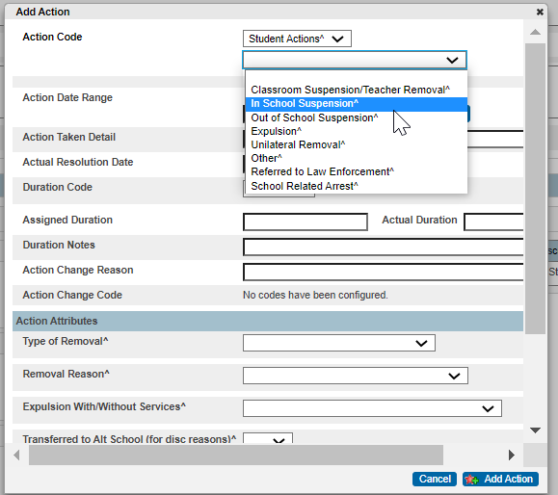
Create Resulting Action
Click the “+” sign and the Add Action
A new popup will appear where you select Student Actions^ or GFSA Actions^
Select the resulting disciplinary action (i.e. In-School/Out of School Suspension, Expulsion, Other, etc.
Complete the rest of the Action Details
Notes:
Now that the behavior has been created and dragged onto the offender, it is time to create the resulting action. This can be done by again clicking on the plus sign in the incident elements section, but this time select Add Action. This will take you to a popup where you need to complete all the details of the resulting action. In our example, we will be selecting an in-school suspension for the student's detrimental behavior.

Slide 12
Additional Action Details
Notes:
This slide is a detailed overview of all the questions located in the “Add Action” section with notes to keep in mind. Again, we want to ensure we are correctly matching the Student Action or GFSA Action that was selected before within the behavior and incident sections. Select the appropriate action and the correct date range for the suspension or expulsion. You also notice a duration code, assigned and actual duration fields next. These fields are extremely important to add for the SPED Discipline collection and if not added, the incident will not be reported. It is best practice to add this to all actions regardless of if Student is in Special Education or not. Some schools may notice that the duration code picklist has not been set up. This must be done within the District Setup section of PowerSchool in order to proceed. Below the duration fields, you will see an action attributes section. This section should only be used if a student was expelled, unilaterally removed, or transferred to an Alternative School. The latter two are extremely rare, but need to be input if the situation warrants this. Once all details are complete, click Add Action.

Slide 13
Drag Action onto Behavior
Notes:
The Action should now show up in the incident elements section on the right side of the screen. Again, you will need drag the student action into the Offender section of the Incident Builder (NEXT), this time onto the behavior itself. Be sure not to drag it onto the offender as it will not extract in your files.

Slide 14
Final Result and Submit!
If correctly entered, it should look like this.
The incident and resulting action are both State Reportable
The Action is indented from the Incident
If resulting action is dragged prior to the incident, it is incorrect and will not report
If action is dragged onto the offender, it will not report correctly
The action must be indented.
Don’t Forget to Submit!
Notes:
This slide provides details on how the incident should look when complete with two examples of inaccurate ones. You see in the first one that is correct, that the incident is directly below the offender and the action is directly below the incident and indented. This is exactly how your final result should look for any discipline entry. You’ll notice on the second one, the action was first dragged onto the offender and then the incident. The last one shows the resulting action was dragged onto the offender and not the incident resulting in the action not being indented. I have seen all these combinations and more when working the School Discipline collection with the bottom two examples not extracting into the files correctly resulting in errors. Keep in mind with that collection, the disciplines are reported in aggregate, so it can be difficult to diagnose which incident is causing issues. That is why each incident added should be done following the steps outlined in this slide to ensure you are not having to dig into all your disciplines next spring to figure out where the issues may be coming from. The last step would be to (NEXT) submit the incident.

Slide 15
Thank you for Reviewing this Training
Contact the Submissions Inbox with Questions:
Submissions_CSI@csi.state.co.us
Notes:
Thank you so much for reviewing this training for the Discipline Entry in PowerSchool. If you have questions, don’t hesitate to reach out to CSI and we are more than happy to assist you!

