Slide 1
Discipline Quick Entry
Infinite Campus
Notes:
Hello All,
Thanks so much for reviewing this training on how to enter disciplines in Infinite Campus. This training covers all the necessary steps that need to be taken within your SIS to accurately record state reportable behaviors and resulting actions. If you have questions while reviewing this training, feel free to reach out to the CSI submissions inbox.

Slide 2
Purpose of the School Discipline Collection
The School Discipline collection contains student level information for:
Students disciplined, including the type of behavior and resulting disciplinary action taken for each disciplinary incident.
the demographics of the student(s) disciplined, and
the counts of students that brought or possessed a firearm for each school.
The School Discipline collection data is used to populate the Civil Rights Data Collection (CRDC – every other year)
For more information on State Statues (HB22-1376) related to Collection: https://www.cde.state.co.us/dropoutprevention/disciplinepolicy
courtesy of depositphotos.com
Notes:
Let’s jump into the purpose of the School Discipline collection, schools are required by State and Federal law to collect information on certain discipline events that have occurred at your school during the current school year. The School Discipline collection is currently the way this information gets collected and submitted to CDE to meet these requirements. Feel free to take a look at the full description and purpose listed in this slide. The big take home point is that the Collection has been modified to report by student rather than in aggregate.
Also, you will notice the State Statutes related to this collection at the bottom of this screen. If you would like more information on these and the regulation tied to this collection feel free to review the information in this link on the CDE website

Slide 3
Reporting of Disciplines
Historically, CSI has seen Discipline data being under-reported at schools resulting in an inaccurate picture of disciplines.
Ensuring that all disciplines that occur are entered accurately and are State reportable is necessary to reflect situation at schools and avoid under-counting.
Strategies for Addressing Accuracy | Questions to Keep in Mind
Determining behavior and consequence | Who are the main staff members responsible for discipline at your school?
Entering behavior and consequence
Reviewing behavior and consequence | Who enters the discipline information into your student information system?
Comparing across systems for overall accuracy
Comparing across collections for special education accuracy | How is your school classifying behavior that is being tracked? (Example: What is disruptive behavior?)
Notes:
In terms of the reporting of disciplines, CSI has noticed that in general, schools have been historically under reporting this information which leads to an inaccurate depiction of the incidents and actions going on at schools. This training will hopefully provide the instructions necessary to accurately report state reportable disciplines within Infinite Campus. To help with this, the slide outlines some strategies for addressing the accuracy of your reported data including (READ). Keeping the steps of determining, entering, reviewing, and comparing this information will assist with your school submitting accurate data. Also, some good questions to keep in mind as you start a new year include: Who are the staff at responsible for disciplines at your school? Who will be entering that information into your SIS? If these people are different, then a good system should be in place so that all are recorded. Also, how is your school classifying behavior that is being tracked? This may differ from school to school on what is considered a state reportable incident. It is often important for your school to develop standardized guidelines that should be followed throughout the year, particularly if multiple people are recording incidents in your SIS and that these details are being entered in a timely manner.

Slide 4
Data Entry Process
Notes:
Now that we have seen the big picture and importance of reporting incidents, let’s dive into the data entry process and each of the steps required to accurately report in Infinite Campus!

Slide 5
Steps of the Discipline Process
Once a behavior occurs at your school, navigate to Infinite Campus and complete these steps:
Navigate to Behavior Management
Create a behavior Incident and add Participant
Add a Resolution
Log in to Infinite Campus
Click on Click on Behavior
Click on Behavior Management
Click New
Add Behavior Event Details
Add Participants – Offender and Victim (if applicable)
Create a Resolution
Add applicable resolution type
Complete details on expulsions and unilateral removals (if applicable)
Notes:
Here is a high-level overview of the steps necessary in Infinite Campus to accurately report when behaviors and resulting actions in your SIS. It can be broken down into 3 main steps: Navigating to the Behavior Management section, Adding a behavior and offender, and adding the resolution. As you can see here each of these areas have listing of sub-steps that need to be completed and that is primarily what we will be covering today! Let’s jump into the first step, navigating to behavior management.

Slide 6
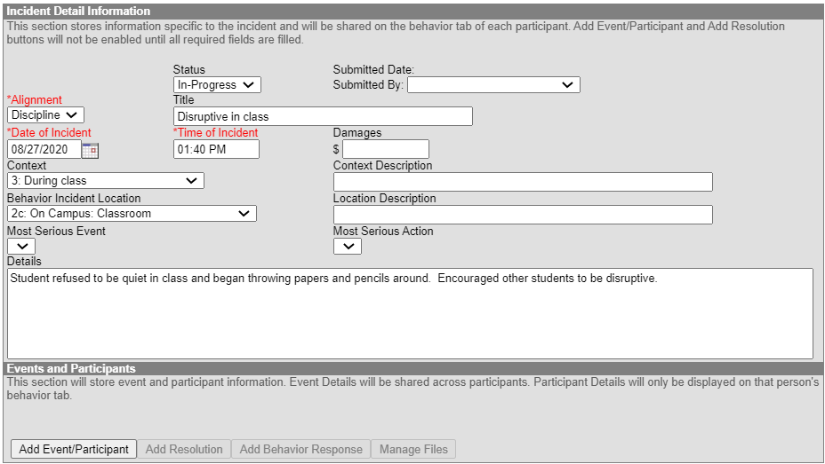
Access Behavior Management
Notes:
To access Behavior Management in IC, you first want to navigate to the behavior section of the index and expand. The first option listed is Behavior Management and you want to click on that (NEXT). To add an incident, click New (NEXT) at the top of the resulting screen, which will take you to the Incident Detail Information. Complete all the information listed in this pop-up, including a title, the status, Alignment, and the date of the incident among several others. Once completed, click on the Add Event slash Participant (NEXT).

Slide 7
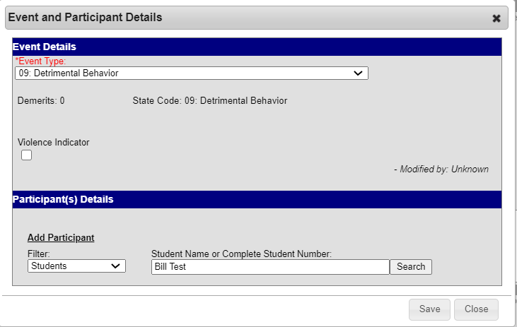
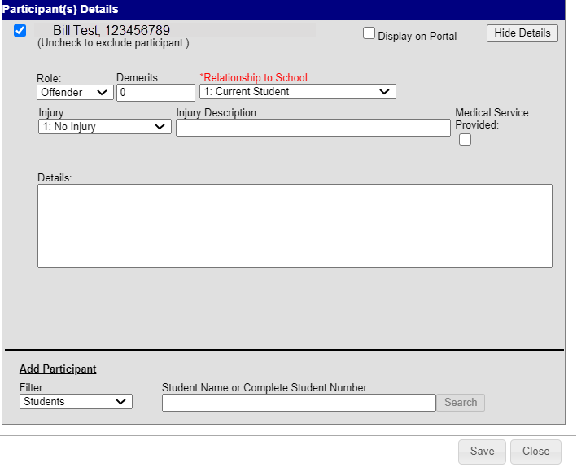
Add Event Details and Assign Offender/Victim
Complete all details of the incident at the top of the screen
Numbered Event Types are State Reportable
If state reportable option selected, the resulting action must also be state reportable
Search for students and add as offender. Add victims if necessary
Notes:
Once details have been completed and you have added, you will be taken to a new screen where you can add the event type. The event type field contains a listing of options that can be selected based on the incident that occurred. Keep in mind the numbered event types are the ones that are state reportable, but others may have been added on a school specific basis. Those should be utilized if the event is not state reportable. Keep in mind that if the event you select is state reportable, then the resulting action should be state reportable as well, otherwise they will not be pulled into the collection files leading to errors. Once the correct behavior event is added (NEXT), it is time to add the search and add the students involved. This may be the participant, victim, witnesses, or others, but all must at least have an offender. To complete this, search (NEXT) for the student located in the Add Participant section at the bottom and hit Save (NEXT). This will bring up a new screen allowing you to add more participant details, like that actual role, relationship to school and if an injury occurred. In our example, we have added Bill Test as our offender. After all details are added, click Save (NEXT).

Slide 8
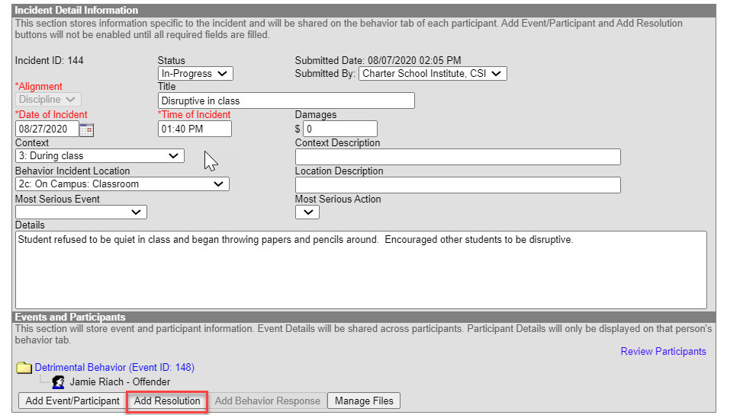
Create Resolution
Click Add Resolution button
Select the resulting disciplinary action (i.e. In-School/Out of School Suspension, Expulsion, Other, etc.
Numbered resolutions are state reportable and must match Behavior
Complete the rest of the Action Details, including Expulsion or Transfer to Alternative school (if applicable)
Notes:
Now that the behavior event has been added along with all the participants involved, it is time to create a resolution. To do this, click the add resolution button at the bottom of the screen and complete all the necessary details. Keep in mind that the resolutions include things like in-school suspensions, out of school suspensions, expulsions, or any other applicable option. This resolution must also contain a state reportable code similar to the behavior. You want to complete all the details of the resolution thoroughly prior to proceeding.

Slide 9
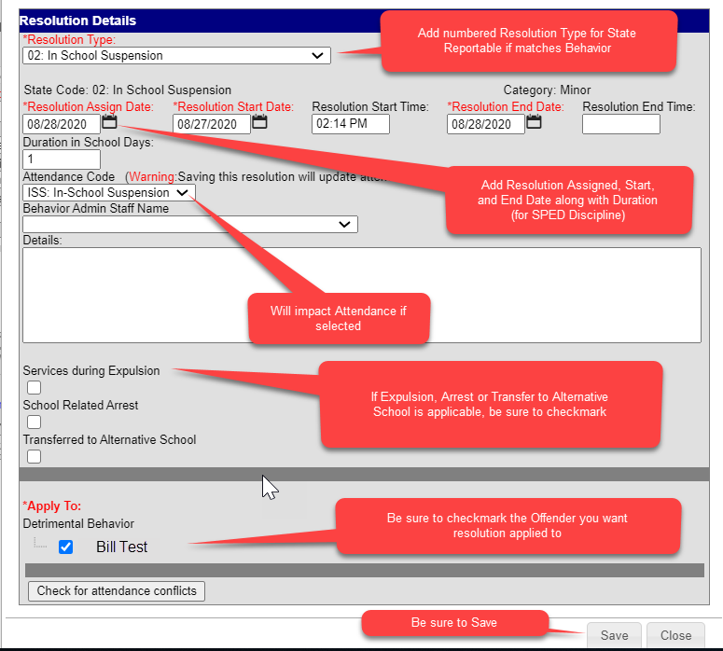
Additional Resolution Details
11
Notes:
Here is a screenshot of the all the resolution questions that must be completed along with some notes to help with the process. The resolution type at the top is where you input the aforementioned suspension, expulsion or other option. In our example, we used 02 in-school suspension for Bill. You’ll notice that both the behavior and resolution have that state reportable code. Complete the rest of the details ensuring you add the resolution assigned, start and end dates. These are necessary for the SPED Discipline collection. Adding a proper attendance code is necessary as it will impact the attendance of the student selected. In terms of the 3 check boxes near the bottom, those should be used for instances of expulsion, arrest, and transferred to alternative school which are all uncommon but need to be checked if it applies to your incident. Once you have check marked the offender, you can save the resolution.

Slide 10
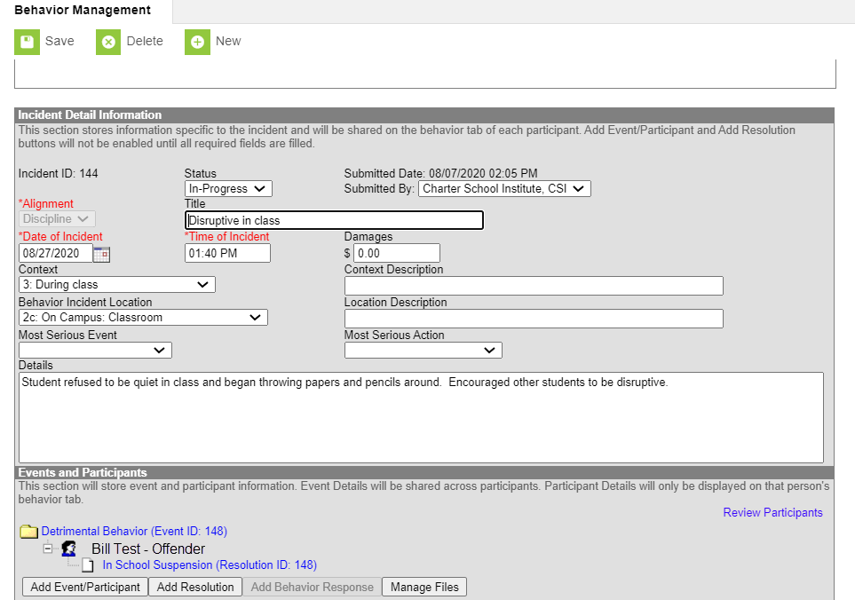
Final Result and Save!
Click Save to complete the incident entry
Check to ensure added correctly, it should look like this with state reportable behavior and resolution
Notes:
This will bring you back to the main behavior management screen showing the event and resolution listed with the offender at the bottom. Double check everything was added correctly and if so, it should look like the one listed here. The last step is to change the status from in-progress to complete and click Save (NEXT) at the top to complete the Incident entry.

Slide 11
Thank you for Reviewing this Training
Contact the Submissions Inbox with Questions:
Submissions_CSI@csi.state.co.us
Notes:
Thank you so much for reviewing this training for the Discipline Entry in Infinite Campus. If you have questions, don’t hesitate to reach out to CSI and we are more than happy to assist you!

