Slide 1
Gifted and Talented Mental Health

Slide 2
Affective Development is the Law
ECEA Rules state AUs shall develop programming options to support the affective needs of students, provide affective and guidance support systems, develop an Advanced Learning Plan (ALP) goal for affective development, and monitor and measure affective growth.

Slide 3
We were wrong about GT kids historically
Intellectual development is not an automatic advancement to social emotional development
Cognitive prodigy does not mean that a student will be automatically socially isolated
Being smart is a good enough reward
Excellence doesn’t mean there won’t be struggles
Being around kids just like you will solve any problem

Slide 4
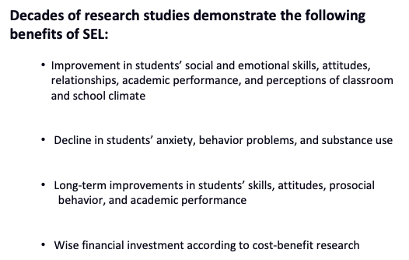
Impact of Social Emotional Learning on Academics
Notes:
Zero to Three, 2017
https://www.zerotothree.org/
Benefits of SEL
•We know from a large body of research on SEL that high-quality SEL programming leads to improved academic performance, decreases in anxiety and behavior issues, among other benefits.
•We also know from research beyond the traditional SEL field that there are additional insights to be gained that are relevant to SEL.
Meta-analysis source (first 3) Durlak, J.A., Weissberg, R.P., Dymnicki, A.B., Taylor, R.D., & Schellinger, K. (2011). The impact of enhancing students’ social and emotional learning: A meta-analysis of school-based universal interventions. Child Development: 82 (1), 405-432.
Financial investment (bottom): Belfield, C., Bowden, B., Klapp, A., Levin, H., Shand, R., & Zander, S. (2015). The Economic Value of Social and Emotional Learning. New York: Center for Benefit-Cost Studies in Education.

Slide 5
The Most Important Skills

Slide 6
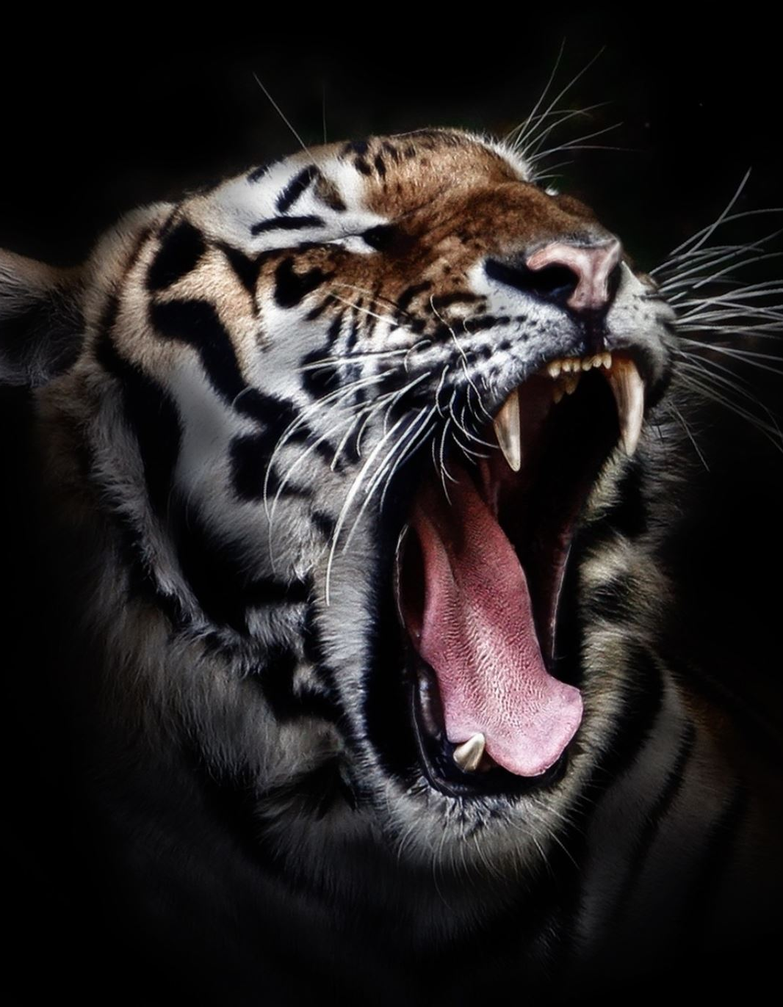
Frustration Tolerance
This is a skill that is difficult in neurotypical students
This is a skill that is difficult for adults
This is a skill that we do not see in public or social media
We have whole genres of film and television telling us how awesome it is to take out our frustration on others, and that others deserve what’s coming to them

Slide 7
Resilience
Embracing failure
Resisting perfection
Praising the effort rather than the product
(this can be hard when the product takes us by surprise)
Stress management

Slide 8
Perseverance is not Perseverance
“persistence in doing something despite difficulty or delay in achieving success”
vs
“doing the same thing over and over again even if it doesn’t make sense or work”

Slide 9
Navigating Discomfort
I am different
I am more different than I want to be
I can’t help being different
I don’t want to be this way
Do I want to do this or are others around me pushing me to do this?
What happens when you’re the smartest person in the room?
I didn’t have a choice

Slide 10
Intersectionality
How our social identities, or how race, class, gender, and other individual characteristics “intersect” with one another and overlap
A gifted student is never “just” a GT student
GT is its own lens, and when we layer on top of it race, gender, access to resources & even double exceptionality, we have very different ways of seeing the world……and very different ways of how the world sees us….
Notes:
Kimberle Crenshaw

Slide 11
Substance Use
GT students are more likely to experiment with substances AND
They’re more likely to experience addiction and addictive behaviors than neurotypical students
………………………………
They’re also better at hiding it/passing

Slide 12
Queerness
GT students are more likely to be queer than neurotypical students
GT students may explore their identity in your GT safe space whether or not you think they will
In gender
In sexuality
In gender and sexuality
(Wexelbaum & Hoover, 2014)

Slide 13
Adult Behaviors

Slide 14
Working with a Team
Work with your Mental Health Clinician and/or
Social Emotional Support/Teacher
GT teachers may need Professional Development in social-emotional development; AND
Mental Health/Social Emotional Professionals may need Professional Development in Gifted and Talented areas

Slide 15
Avoiding Educational Trauma
Wounds of Creativity
Wounds of Compliance
Wounds of Rebelliousness
Wounds That Numb
Wounds of Underestimation
Wounds of Perfectionism
Wounds of the Average
(Kristen Olsen, 2009)
Notes:
Let’s not pit kids against each other
Let’s not use shaming techniques for learning

Slide 16
Embracing Your Own Ego
How comfortable are you with not being the smartest person in the room?
How comfortable are you when a child is smarter/knows more than you?
What kinds of actions or questions might activate your ego defense?
What situations might you feel more vulnerable to be competitive with a child?
What happens when a student does not choose the path you chose or you want them to choose or you think is best for them?

Slide 17
Resources
CSI Gifted Education
CDE Gifted & Talented Affective Development
American Psychological Association: Social Emotional Learning for Gifted & Talented Students
Supporting Emotional Needs of Gifted Students (Substance Use Resources)
Gifted & LGBTQ1: A Comprehensive Research Review
Wounded by School: Recapturing the Joy in Learning and Standing up to Old School

