Slide 1
Spring 2024 READ Act Data Collection Training
K-3 Assessment Collection
April 10, 2024

Slide 2
Goals for Today
Introductions in the Chat
Name, role, school, new/returning
Grounding in the WHY
Purpose of the READ data collection
Data privacy and security
READ collection timeline
2024 data elements
Live walk-through
Common problems, solutions & sharing
Q & A
One on one support

Slide 3
Purpose of READ collection
Required by statute
Fund distribution
Reporting, legislative updates, grants, etc.
ALL K-3 students included

Slide 4
Data privacy and security

Slide 5
Continued Data privacy and security
The Google Drive in the professional Google workspace for education is the main file exchange system and has been named “G-Drive”.
The CSI approach with using G-Drive with the schools is to exchange files with schools.
A READ folder has been shared with the designated person at your school. Within that folder are the
READ Data Collection SY24
Teacher Training SY24
Cohort SY24 folders
If you need the name of the person at your school who has been shared on the folder, email willynwebb@csi.state.co.us

Slide 6
READ Budget
Finance contacts at schools will be sent a READ Budget template May 27.
Narrative description Budget line amount
Allowable uses document (CSI resource site)
READ Budget due to RFF@csi.state.co.us on June 10.
Funds released in November (delayed due to teacher training reporting)

Slide 7
READ Act Report Requirements
READ BUDGETS
Schools submit a district budget including a narrative explanation of how they plan to
use READ funds in the upcoming school year to ensure that the district’s proposed use of money follows allowable uses of READ funds.
K-3 LITERACY PROGRAM & ASSESSMENT DATA (in progress on google form)
Schools report school and grade level K-3 literacy assessments, core, supplemental,
and intervention programs, as well as intervention services and supports and professional development plan if applicable.
K-3 END OF YEAR READ ACT ASSESSMENT DATA (No Change)
Schools report student level spring assessment data for ALL K-3 students that is used to determine the number of students identified as having SRDs and their progress.
READ TEACHER TRAINING REQUIREMENT (New)
Schools are required to ensure all K-3 teachers and K-12 reading interventionists (not
paraprofessionals acting in this role) complete evidence-based training in teaching
reading to be eligible for READ Act funds for 2023-2024 school year (more training to come)

Slide 8
READ Assessment collection timeline
Now through May 19
Assess all K-3 students
April 30
Deadline for Cohort file in G-Drive
May 19 – June 1
Correct READ Data File Errors
Have a summer contact to Willyn
READ funds distributed in the Fall, has varied due to Teacher Training (Nov)
Complete READ Data file by May 19th
Upload in G-Drive-email Willyn
April 10
Cohort files in the G-Drive
unless more time is needed for a student to potentially exit the READ plan. Email Willyn
August 1
Teacher Training Verification
Deadline for file in G-Drive

Slide 9
2023-2024 READ Data File
elements
No changes from prior years
Use most current excel template. Submitted files must be in excel or .csv format.
Template in your G-Drive Read Data SY24 folder

Slide 10
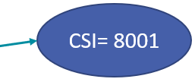
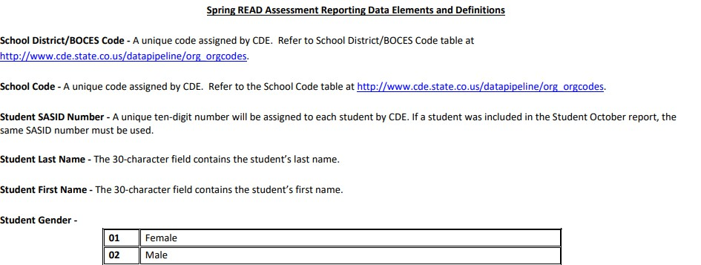
Spring 2023-2024 READ K-3
Data File
A
B
C
D
E
F

Slide 11
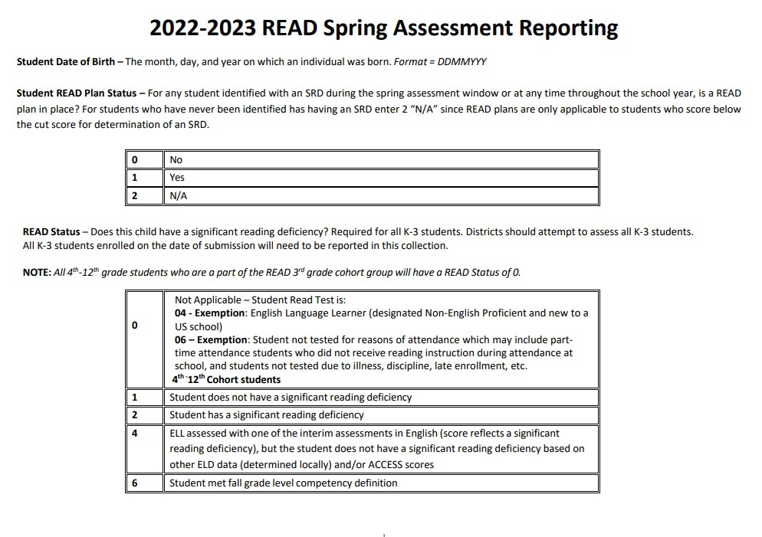
READ Spring Assessment Reporting
Column H- If a student scored below this cut score this has to be Yes
Column I- the SRD column!

Slide 12
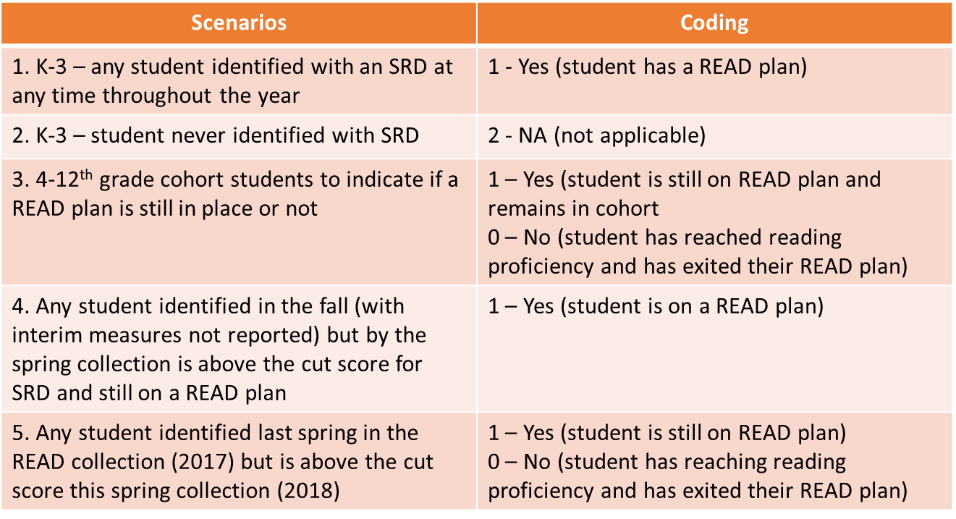
How to use the READ Plan field Column H

Slide 13
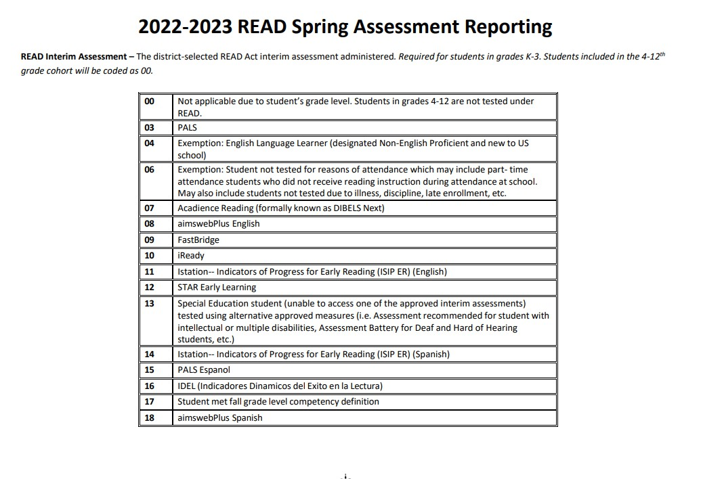
Column J-What test did the student take?

Slide 14
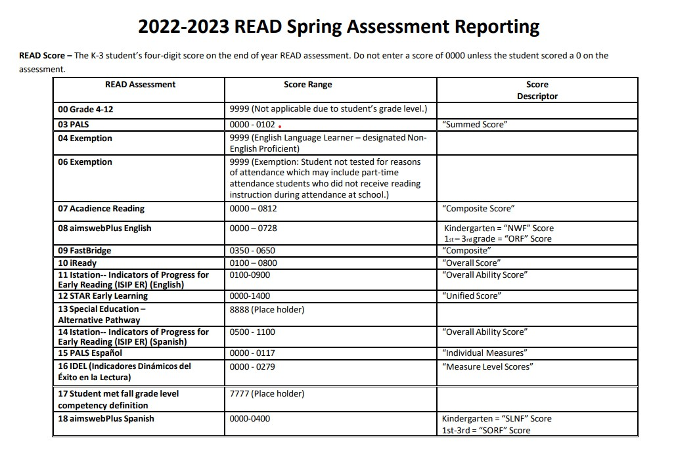
Column K- What is the student’s score?
Column K

Slide 15
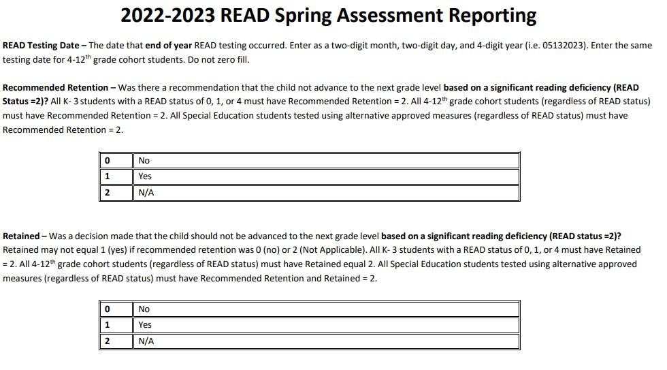
Cont. Assessment Reporting
Ok to use the same date
Column L
Column M
ONLY if Column I is a 2 and Column M is a 1
Column N

Slide 16
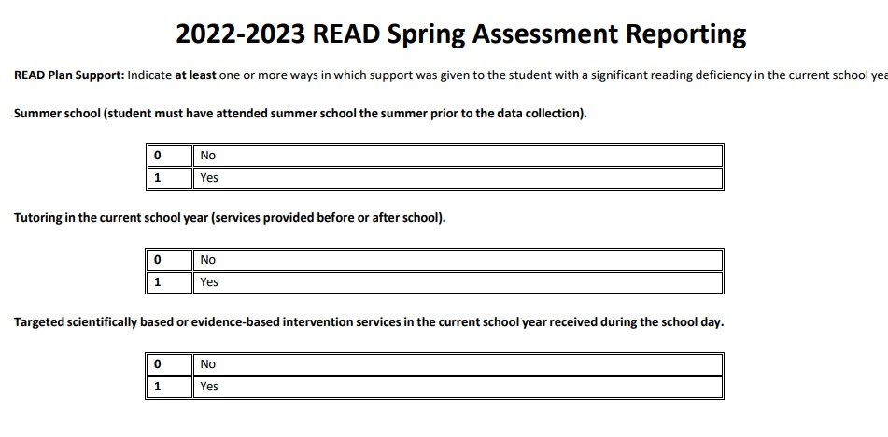
What did the READ plan provide?
Column O
and only for summer 2022
Column P and only before or after school
Column O
and only for summer 2022
Column P and
only for
before or after school
Column Q during the day interventions

Slide 17
Template Link, Cut Scores and Naming Conventions
2023-2024 READ Spring Assessment File Layout Template (Excel)
Cut Scores Documents for Interim Assessments
Please name your submission with NO spaces: SchoolCode_SchoolAcronym_READK3_Date
0657_AAK_READK3_05152023

Slide 18
Common Problems & Questions
Losing Leading Zeros
Opening a file in excel and format is not already set to ‘text’
Files will not upload properly and will create errors
Fix:
1.Select the cells on your worksheet where you’ll be
adding the data.
1.Right-click anywhere in the highlighted cells, and
then on the shortcut menu, click Number
Format >Text >OK.

Slide 19
Common Issues
An English Language Learner in our school was tested because she is not NEP and she is beyond her first year in a US school. She received a score low enough on PALS to qualify as having a significant reading deficiency. We don’t believe the score accurately reflects SRD because we have a body of evidence that says she can read fluently in her first language.
READ Plan = 2 (NA because student was not identified with a SRD)
READ Status = 4
READ Test = 07
READ Score = 0170
READ Testing Date = 05202020
Recommended Retention = 2
Retained = 2
READ Plan Support = 0 for each

Slide 20
Common Issues Continued
A student in my school was unable to be tested due to excessive absences, but the child was enrolled during the period for testing and has a READ Plan in place
READ Plan = 1
READ Status = 0
READ Test = 06
READ Score = 9999
READ Testing Date = 05202020
Recommended Retention = 2
Retained = 2
READ Plan Support = Indicate the supports the student received

Slide 21
Other Common Issues
A 1st grade student in our school was placed on a READ plan earlier this year. The Spring Acadience (DIBELS) score is above the cut score so she is no longer identified as having a significant reading deficiency. However, the body of evidence doesn’t demonstrate she is at grade level yet. We will keep her on a READ plan.
READ Plan = 1
READ Status = 1
READ Test = 07
READ Score = 0812
READ Testing Date = 05202020
Recommended Retention = 2
Retained = 2
READ Plan Support = 0 for each

Slide 22
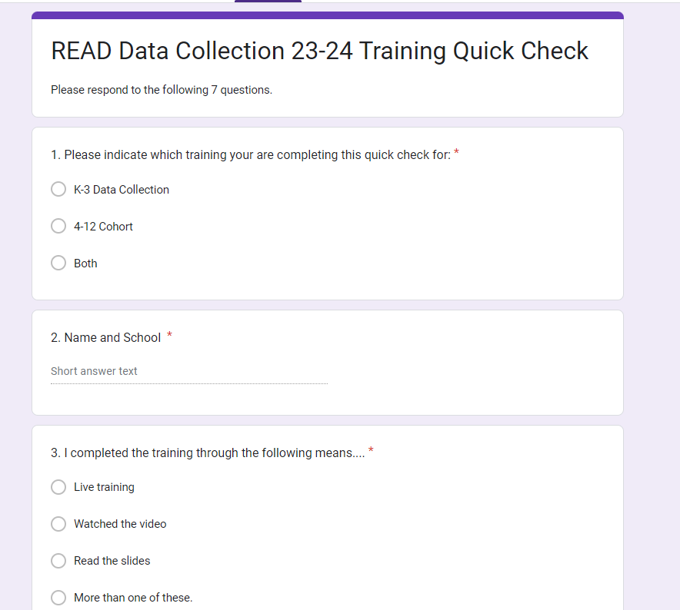
/
Tips and Tricks
Quick Check -required
PLC survey for next year

Slide 23
READ Act Resources
https://resources.csi.state.co.us/read-act-home/
http://www.cde.state.co.us/coloradoliteracy/read datapipeline
https://co.chalkbeat.org/2022/5/11/23067136/jeff co-bright-minds-colorado-dyslexia-middle-high- school-students

Slide 24
Don’t forget!
DUE DATE: MAY 18
G-DRIVE UPLOAD

Slide 25
willynwebb@csi.state.co.us 303-532-6262
One on One support by appointment
Newsletter: Ready, Set, READ! Newsletter and podcast Email to get on the listserv.
CSI Resource Site READ Data Collections

