Slide 1
READ Act Required Administrator Training
School Leader Gathering
Feb. 26, 2024

Slide 2
Session Objectives
SB 22-004
Definitions of Administrator and Principal
Principal Administrator Training

Slide 3
Why?
Senate Bill 22-004

Slide 4
Just so you have it…
1 CCR 301-92
13.01(D): For 2024-25 school year and continuing for each school year thereafter, each local education provider that receives per-pupil intervention money or a grant through the early literacy grant program in any budget year starting with the 2023-24 budget year shall ensure that each principal in a school that serves kindergarten or any of grades one through three and each administrator with responsibility that pertains to programs in kindergarten or any of grades one through three successfully completes or has successfully completed evidence-based training designed for school administrators in the science of reading.
13.01(D)(1) Any evidence-based training designed for school administrators in the science of reading must address the following standards: (full List of Principal Literacy Standards can be found here)
Standard I: Foundational Knowledge of the Science of Reading
Standard II: Curriculum, Instruction, Assessment, and Evaluation
Standard III: Literacy Leadership and Professional Learning
Standard lV: Diversity, Equity, and Inclusion

Slide 5
Great job so far!
K-3 Teachers (including Sped)
K-12 Interventionists
K-3 Principals
& Administrators
45 Hours
45 hours
20 hours
CDE Free Training Administrator specific
If the individual has already completed Teacher Training, only 5 hours.
Notes:
Just for review….Praise getting all of the teachers and interventionists trained!

Slide 6
Definitions of Principal and Administrator
Principal: Any person who is employed as the chief executive officer of any school in the state that serves kindergarten or any of grades one through three.
Administrator: Any employee in a school serving kindergarten or grades one through three who is responsible for
designing, implementing and/or providing professional development on the elementary literacy instructional program
conducting observations of and/or providing coaching to a teacher providing literacy instruction
This would include an assistant or vice principal of an elementary school, curriculum or instructional coach, and/or supervisor of any K-3 Teacher.

Slide 7
Two Training Options
Notes:
K-3 principals/administrators that have completed the READ Act teacher training requirement must complete 5 hours of training that addresses the Colorado Principal Literacy Standards.
Proof of completion of the teacher training requirement must be submitted to access the 5 hour online K-3 Prinicipal/Administrator Training.
The form linked in the button above includes the step to submit proof of completion documentation.
Review of proof of completion documentation may take up to two weeks, please plan accordingly.

Slide 8
Questions?

Slide 9
Based on the definitions, the roles at your school and these two course options…
Who will it be?
<if
Notes:
Start thinking about who this should be and which course. You will complete a form during this session.

Slide 10
Registration, Tips, & FAQs
Select your appropriate option to successfully access and use the CDE courses
20 hour course: Building a Strong Foundation for Lifelong Literacy for Principals/Administrators-20 hours (PPT)
5 hour course: Building a Strong Foundation for Lifelong Literacy for Principals/Administrators-5 hours (PPT)

Slide 11
Getting Started in Pepper
Visit: https://www.cde.state.co.us/coloradoliteracy/onlinecdeadministratortraining
Click:
Fill Out:
Check email, including spam/junk folders, for a notification from Pepper giving details on how to access the course.

Slide 12
A Tour….
My Courses - WillynWebb (pepperpd.com)
My Courses- Rachel Franks (pepperpd.com)

Slide 13
Further Questions?

Slide 14
Upon Completion: Licensed Leaders
Submit Certificate of Completion to CDE:
Connect Pepper to CDE COOL
OR
Upload your Certificate to COOL

Slide 15
Upon Completion: Unlicensed Leaders
Submit Certificate of Completion to CSI:
Upload to the Secure G-Drive File READ>Teacher and Administrator Training
OR
Email to willynwebb@csi.state.co.us

Slide 16
Complete and submit evidence by
August 1, 2024

Slide 17
More Questions?

Slide 18
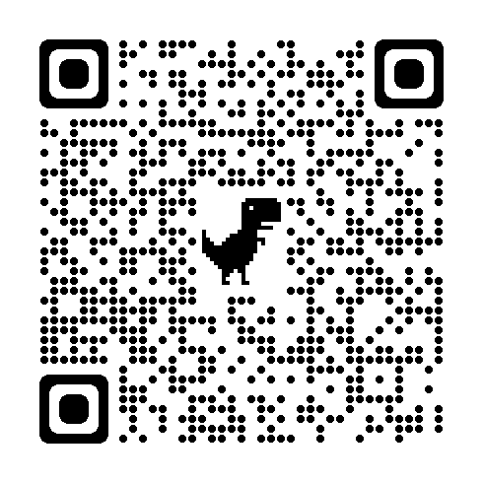
READ Data Collection Designees
Due March 8th
Form Link

Slide 19
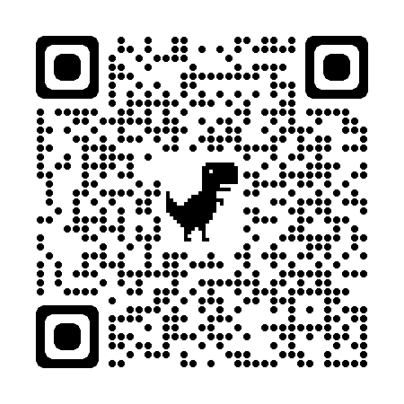
Link to CDE for READ Administrator Training Information
CDE READ Administrator Training page
https://www.cde.state.co.us/coloradoliteracy/schooladministrators-training

Slide 20
Do yourelate?

