Slide 1
Spring 2024 READ Act Data Collection Training
4th through 12th Cohort
Notes:
Introductions

Slide 2
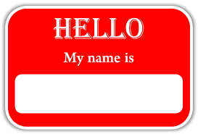
Goals for Today
Introductions in the Chat
Name, role, school, new/returning
Grounding in the WHY
Purpose of the READ data collection
Data privacy and security
READ collection timeline
Live walk-through
Q & A
Office Hours for Support
Notes:
Introduce Kim and Jessica, invite them to jump in.

Slide 3
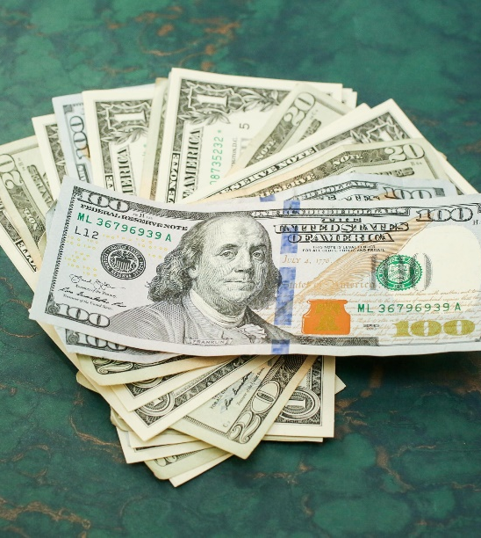
Why 4-12? Purpose of READ collection
Required by statute
Reporting, legislative updates, grants, etc.
READ Plans beyond 3rd grade in the elementary setting
READ Plans in the secondary setting
Frequently Asked Questions about READ Plans for Grades 4-12
Notes:
Best for kids. In order to support students with significant reading deficiencies (SRDs) the READ Act provides per pupil intervention funds to assist districts with providing intervention support. Prevalence SRD in K-3 determines per pupil funding (from previous budget year)

Slide 4
READ Act Report Requirements for 4-12
READ 4th – 12th COHORT
Schools update one column of a pre-populated file to indicate whether or not students in grades 4-12 remain on READ plans.
READ Act TRAINING REQUIREMENT (New)
All reading interventionists K-12 must complete evidenced-based training in teaching reading. Definition of reading interventionist in READ Act Rule.
Reading Interventionist: An individual employed to teach students and whose primary job duties include providing reading intervention to students on READ Act Plans during regular school hours to supplement core academic instruction and who is employed in any of grades K-12.
All principals and administrators must complete evidenced-based training designed for school administrators in the science of reading that addresses the content of the principal literacy standards. School administrators are expected to complete the training without delays so as to not impact the distribution of READ Act per-pupil dollars to the local education agency.
Notes:
From CDE In subsequent years, districts will need to ensure that teachers new to teaching K – 3rd grade also meet this requirement.

Slide 5
Data privacy and security
Notes:
PII personally identifiable information http://www.cde.state.co.us/dataprivacyandsecurity

Slide 6
Data privacy and security
The Google Drive in the professional Google workspace for education replaced FileZilla (mid-year in 21-22) as the main file exchange system and has been named “G-Drive”.
A READ folder has been shared with the designated person at your school. Within that folder is
Cohort SY24 with our template and the highlighted column for your input
Raise your hand if you have it and open right now
If you need the name of the person at your school who has been shared on the folder, email willynwebb@csi.state.co.us
Notes:
May need to create the 2021 directory

Slide 7
Update this field with a 0 or 1 ONLY
0=No READ Plan, meaning the student met grade level proficiency on your locally determined criteria and is being removed: no longer on a READ plan.
1=Yes READ Plan, meaning the student is not reading at grade level proficiency and will remain on a READ plan and in the cohort.

Slide 8
READ 4th-12th Cohort
When does a student exit the cohort?
Once a student has reached reading competency (determined locally) they are removed from their READ plan and will be coded as
READ plan = 0 (No) which will remove them from the cohort group
Do not add students into the cohort.
ONLY the READ plan field is updated-Column H and it will be highlighted for you.
Notes:
Stop and restart recording

Slide 9
READ 4-12th Cohort
Separate file- students who left 3rd grade with a READ plan and have not been indicated as exiting their plan in prior year(s).
Pre-populated file with only ONE field to update
Do not copy paste into main READ Collection file
Due completed in the G-Drive by April 30th
Notes:
5th grade will be missing due to the testing gap from the pandemic. You are not expected to add them. Just update the one column for the students who are listed in the file.

Slide 10
READ Assessment collection timeline
Now through May 19
Assess all K-3 students
April 30
Deadline for Cohort file in G-Drive
May 19 – June 1
Correct READ Data File Errors
READ funds distributed in the Fall, has varied due to Teacher Training (Nov)
Complete READ Data file by May 19th
April 10
Cohort files in the G-Drive
unless more time is needed for a student to potentially exit the READ plan. Email Willyn
August 1
Teacher Training Verification
Deadline for file in G-Drive
Notes:
Try to get into system early, get files error free as early as possible
Do not report inaccurate data just to avoid errors

Slide 11
Don’t forget!
DUE DATE:
Cohort April 30th
G-Drive folder Upload
Email Willyn when you upload

Slide 12
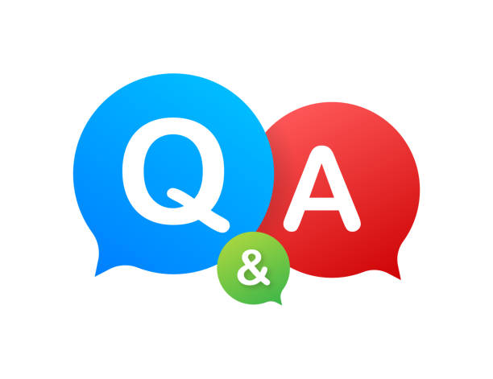
willynwebb@csi.state.co.us 303-532-6262 Office Hours: Wednesday, 12:00-1:00 or scheduled 1:1 Newsletter: Ready, Set, READ Newsletter and Podcast the first of each month, email Willyn to get on the listserv Cohort Instructions CSI Resource Site READ Data Collections
Notes:
Ongoing supports and updates, leave for summer with teacher training solid, but we will be available for support throughout the summer so august goes well.

Slide 13
Take the Surveys
Quick Check for this training (required)
https://forms.gle/NjD7sLGwALJq4p4d6
Support PLC for next year ideas
https://docs.google.com/forms/d/e/1FAIpQLSfSItrPyHXL5oNAoHlluNZA9ND5mxi9Zl14ExvsLA04Lowdsg/viewform?usp=sf_link

