Slide 1
CSI School Board
Brown Bag Lunch
4-18-24
Welcome, School Board Members!

Slide 2
Agenda
Introductions and Icebreaker
Data Dashboard Examples and Process
CSI Strategic Planning Resource
CSI School Leader Evaluation Resource
Discussion, Q & A and Closing

Slide 3
Icebreaker Question:
What’s your favorite summertime dessert?
Put it in the chat along with your name and your school

Slide 4
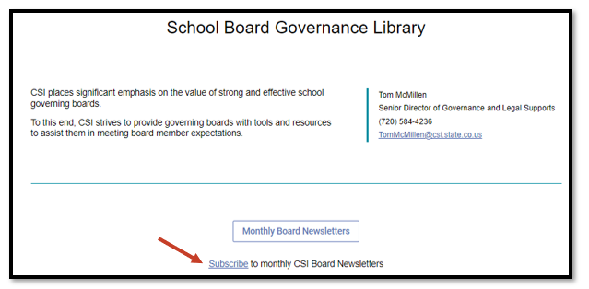
Legislative Update Email
Check your email for a Legislative Update
In the event you didn’t receive the Legislative Update this morning, here’s the link to be added to the listserv:
https://resources.csi.state.co.us/school-board-governance-library/

Slide 5
Joshua Perdue
Accountability and Assessment Coordinator
Durango School District 9-R

Slide 6
Introduction
Professional Background
Data Analyst, Aurora Public Schools
Data Analyst, Accountability Unit, Colorado Department of Education
Data Scientist, Abre
Consultant, K-12 Custom Analytics, LLC
Accountability and Assessment Coordinator, Durango School District 9-R
Key Responsibilities
Data Management
Data Analysis
Public Reporting

Slide 7
Public Dashboards: Guiding Questions
What information do you want to share?
What questions are you trying to answer?
What are the relevant data elements and metrics?
Who is the intended audience?
What is the appropriate level of detail?
What guidance materials might be necessary to facilitate understanding?
How will the dashboards be accessed?
What is the desired mode of delivery?
What are the technology requirements?

Slide 8
Public Dashboards: Key Project Components
Data Integration
Identify data sources
Consolidate data into a single repository
Data Modeling
Establish standards for organizing data
Build structures and processes that allow for consistency and maintenance over time
Visualization Design
Input from content area experts
Input from audience members
Data Governance
Define roles and responsibilities
Establish decision-making protocols to facilitate effective project management

Slide 9
Public Dashboards: Sample Approach
What information is being shared?
Enrollment
Attendance
Behavior
Course Grades
Assessment Results

Slide 10
Public Dashboards: Sample Approach
Who is the intended audience?
Local School Boards
Parents
Community Members

Slide 11
Public Dashboards: Sample Approach
Dashboard Design and Publication
Dashboards were built using Tableau Desktop
  Dashboards are organized around five key content areas
  For each content area, there is a series of three dashboards
    Single-Year Snapshot
    Multi-Year Report
    Explore
Dashboards were published to Tableau Public and embedded in a publicly accessible website:
  https://www.k12customanalytics.com/data-dashboards/community-dashboards

Slide 12
CSI Strategic Planning and Evaluation Resources
School Board Governance Library
Board Governance » Colorado Charter School Institute (state.co.us)

Slide 13
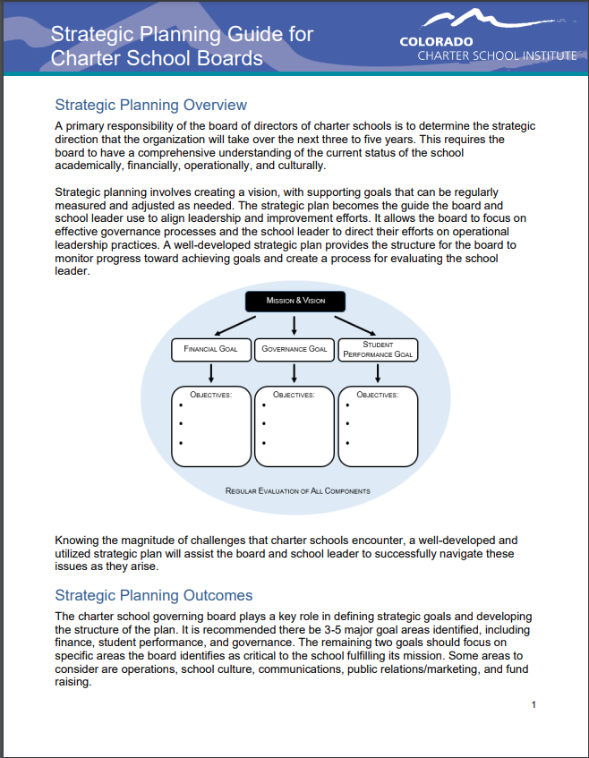
CSI Strategic Planning Guide
https://resources.csi.state.co.us/school-board-governance-library/ → Strategic Planning

Slide 14
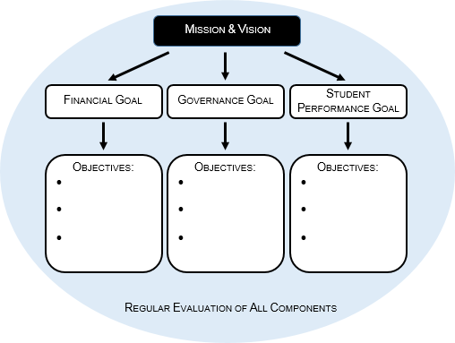
Strategic planning involves creating a vision, with supporting goals that can be regularly measured and adjusted as needed. The strategic plan becomes the guide the board and school leader use to align leadership and improvement efforts. It allows the board to focus on effective governance processes and the school leader to direct their efforts on operational leadership practices. A well-developed strategic plan provides the structure for the board to monitor progress toward achieving goals and create a process for evaluating the school leader.

Slide 15
Strategic Planning Outcomes
The charter school governing board plays a key role in defining strategic goals and developing the structure of the plan. It is recommended there be 3-5 major goal areas identified, including finance, student performance, and governance. The remaining two goals should focus on specific areas the board identifies as critical to the school fulfilling its mission. Some areas to consider are operations, school culture, communications, public relations/marketing, and fund raising.

Slide 16
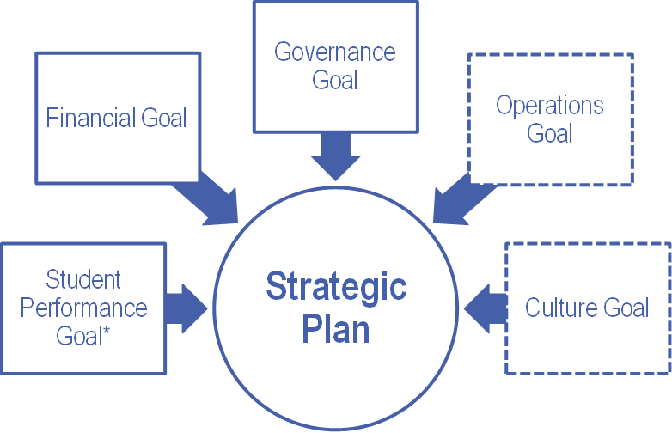
Strategic Plan

Slide 17
The Strategic Planning Cycle

Slide 18

School Leader Evaluation Toolkit
https://resources.csi.state.co.us/school-board-governance-library/ → Sample Materials

Slide 19
Overview and Requirements
The annual review of school leaders and teachers is required by Colorado state law and outlined in regulation (C.R.S. 22-9-106 and 1 CCR 301-87). School leader evaluation systems must be “fair, transparent, timely, rigorous and comprised of valid methods.” Key components include a summary of the (1) Principal Quality Standards, (2) required evaluation system components, (3) final evaluation report, and (4) evaluation objectives.

Slide 20
Principal Quality Standards
School leader evaluation systems should address all of the performance standards established by 1 CCR 301-87 and outlined below:
Quality Standard I: Principals demonstrate organizational leadership by strategically developing a vision and mission, leading change, enhancing the capacity of personnel, distributing resources, and aligning systems of communication for continuous school improvement.
Quality Standard II: Principals demonstrate inclusive leadership practices that foster a positive school culture and promote safety and equity for all students, staff, and community.
Quality Standard III: Principals demonstrate instructional leadership by: aligning curriculum, instruction and assessment; supporting professional learning; conducting observations; providing actionable feedback; and holding staff accountable for student outcomes.
Quality Standard IV: Principals demonstrate professionalism through ethical conduct, reflection, and external leadership.

Slide 21
Evaluation Objectives
Schools with an approved evaluation waiver must operate in compliance with the replacement plan submitted by the school and approved by the State Board of Education. Check your approved waivers for your process.
With or without a waiver, charter school leader evaluations should: serve as the basis for improvement of instruction; enhance the implementation of programs of curriculum; serve as a measurement of the professional growth and development of licensed personnel; evaluate the level of performance based on the effectiveness of licensed personnel; and provide a basis for making decisions in the areas of hiring, compensation, promotion, assignment, professional development, dismissal, and nonrenewal of contract.

Slide 22

Possible Performance Evaluation Timeline
Goal Setting Regular Monitoring Board Review
(Aug-Sept) and Feedback Discussion
(Sept.-May) (June)
School Leader Data Gathering Performance
Self Evaluation and Review Evaluation
(Aug-Sept) (May-June) Delivery
(June)

Slide 23
Strategic Planning
&
School Leader Evaluation
April 18, 2024

Slide 24

Strategic Planning

Slide 25
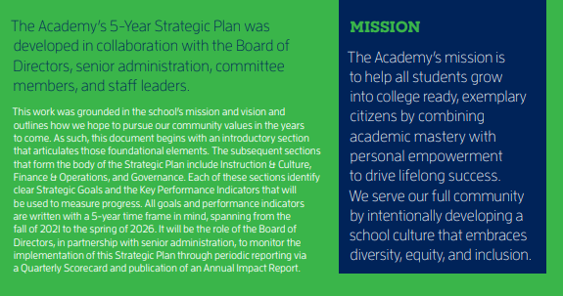
Mission

Slide 26

Vision

Slide 27


Navigational Stars

Slide 28

Instruction

Slide 29
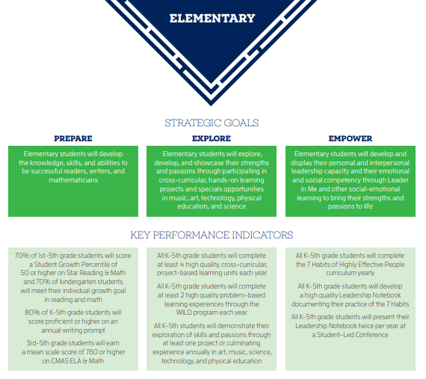
Strategic Goals & KPIs

Slide 30
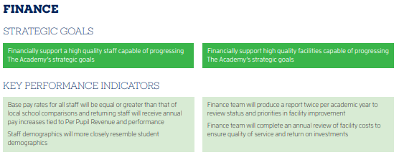
Finance

Slide 31
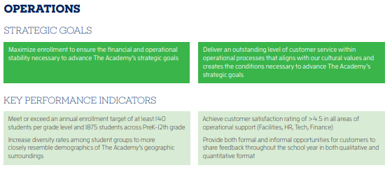
Operations

Slide 32
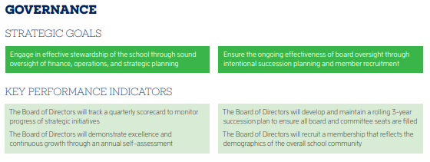
Governance

Slide 33
School Leader
Evaluation

Slide 34
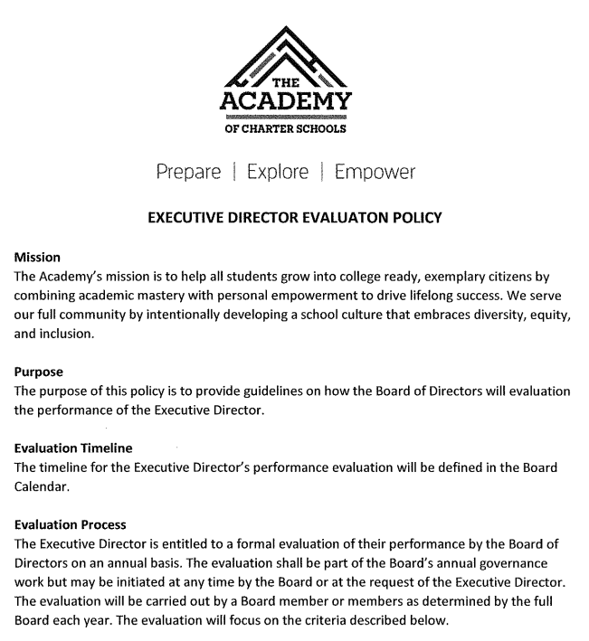
Evaluation Policy

Slide 35

Evaluation Criteria

Slide 36
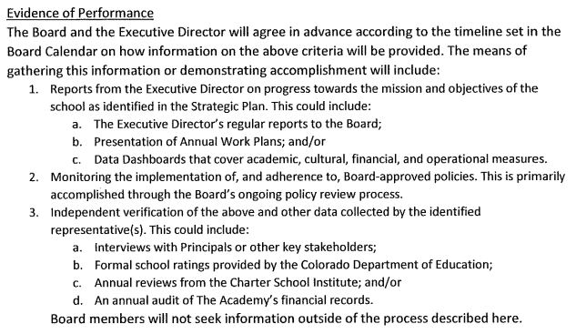
Evaluation Evidence

Slide 37
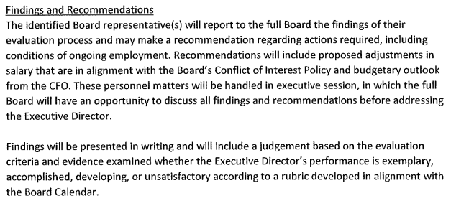
Evaluation Findings & Recommendations

Slide 38
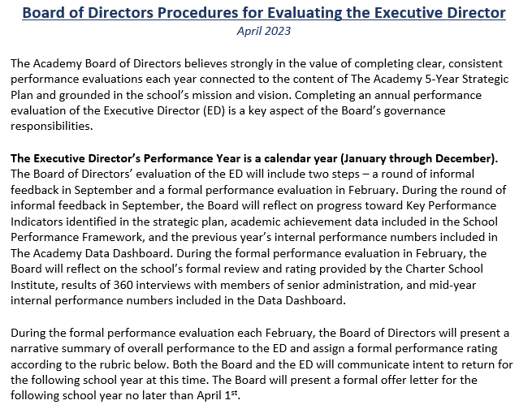
Evaluation Process Overview

Slide 39
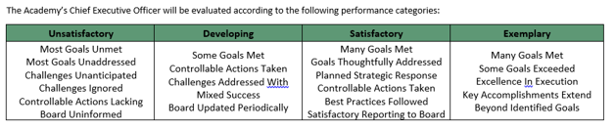
Evaluation Rubric

Slide 40
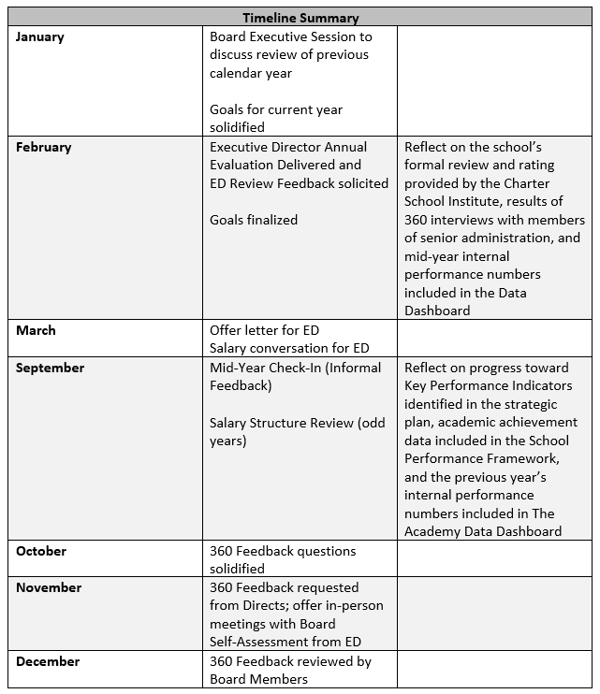
Evaluation Timeline

Slide 41
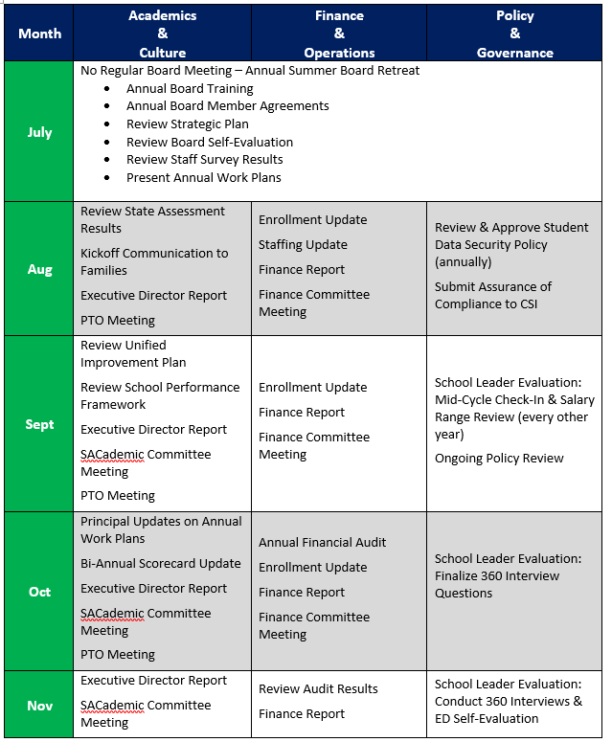
Board Calendar

Slide 42
Questions and Discussion?

