Slide 1
2023-24 Discipline Collections Training
What’s New and Validation Procedures
Recorded April 2024
Notes:
Hello All,
Welcome to the New This Year and Validations training module for the upcoming 23-24 discipline collections. This training will cover all the changes that have occurred with the collection since last year. Given the collection was combined with SPED Discipline and now collected by student, there are a lot of changes to cover.

Slide 2
School Discipline Updates
Notes:
Alright, let’s jump right into this year’s changes for the School Discipline Interchange and Snapshot!

Slide 3
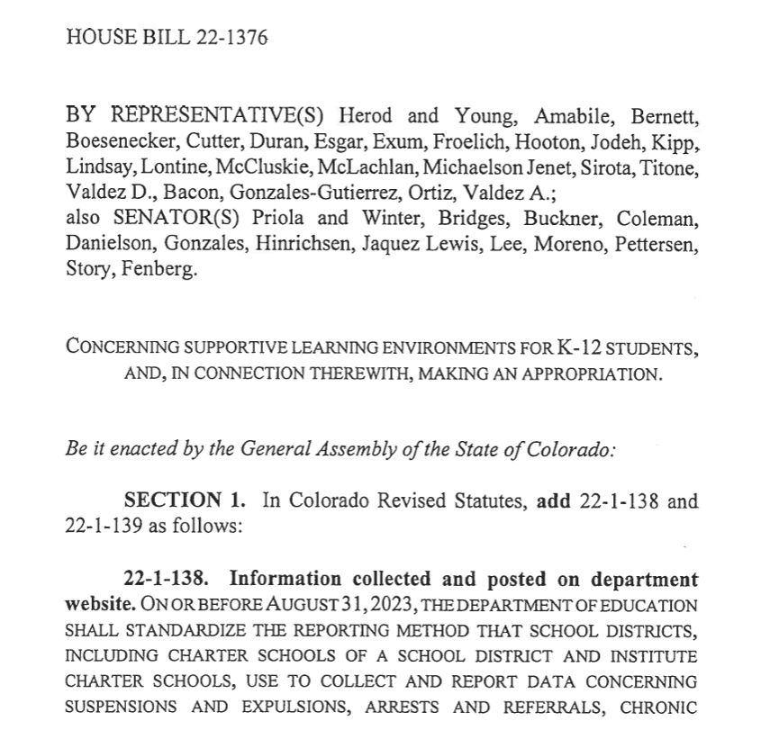
23-24 Summary of Discipline Changes
The Colorado Legislature passed HB22-1376 in 2023 which caused significant changes to how student discipline data is collected. Most importantly:
The School and SPED Discipline collections have been merged into one collection.
All Data is collected at a student level rather than in aggregate.
Only one file is now required for the Discipline Interchange (Discipline Action File)
The collection now includes the addition of a level 2 snapshot for School Discipline and continuing Level 2 SPED Discipline, although it is no longer an interchange.
Notes:
Alright, there definitely had been some big changes with the discipline collections since last year. This was spurred by the Colorado legislature passing HB22-2376 in the past year. We’ll discuss each of these further but the high level overview changes are:
The School and SPED Discipline collections have been merged into one collection at an interchange level.
All Data is collected at a student level rather than in aggregate.
Only one file is now required for the Discipline Interchange (Discipline Action File)
The collection now includes the addition of a level 2 snapshot for School Discipline and continuing Level 2 SPED Discipline, although it is no longer an interchange.
This means Discipline will only have one error report for level 1 errors but two for level 2.

Slide 4
Collections Merging
School Discipline Collection
SPED Discipline Collection
Discipline Interchange
Notes:
Diving into this further, CDE has removed the SPED Interchange altogether and is continuing with the School Discipline interchange, which has always included both General and Special Education. The big difference is that the data is now collected by student rather than in aggregate as it historically has been. As you can see here, the two periodic collections essentially have merged into one interchange collection.

Slide 5
Required Discipline File Differences
Historically, the School Discipline Collection required a potential of three files: Discipline by Action, Discipline by Student Demographics, and the Firearm (GFSA) Discipline Files. These records were combined by 7 distinct demographic categories.
The SPED Discipline collection traditionally has been collected by student on one SPED Discipline Action File.
Both Collections have merged with all data being collected by student (General/SPED) on one Discipline Action file.
Discipline by Action
Firearm (GFSA) Discipline
Discipline Action File
Discipline by Student Demographics
SPED Discipline Action
22-23
23-24
Notes:
With the update of the interchange collection, several files have been removed. Historically, the School Discipline required a potential of 3 files be submitted, the Discipline by Action, the Discipline by Student Demographics, and the Firearm Discipline files. Combine that with the SPED Discipline Action file and there was a potential of 4 files needed to be submitted. This certainly could cause state reporting and cross collection discrepancies that needed to be worked through. As you can see here, now there is only one file that is required to be collected and has changed significantly. This is the Discipline Action file based on student level data and includes various pieces from both historic collections.

Slide 6
Discipline Collection Change
22-23 – Discipline data collected in aggerate by demographic categories
23-24 - Both SPED and Student Disciplines now collected by student name/SASID
Notes:
As I have mentioned, the biggest change would be that the data is now being collected by student rather than in aggregate as it was in 22-23. This means each incident and resulting action will now be tracked by student name and SASID rather than specific demographic categories. This change will cause huge differences in how the data is being collected and reported.

Slide 7
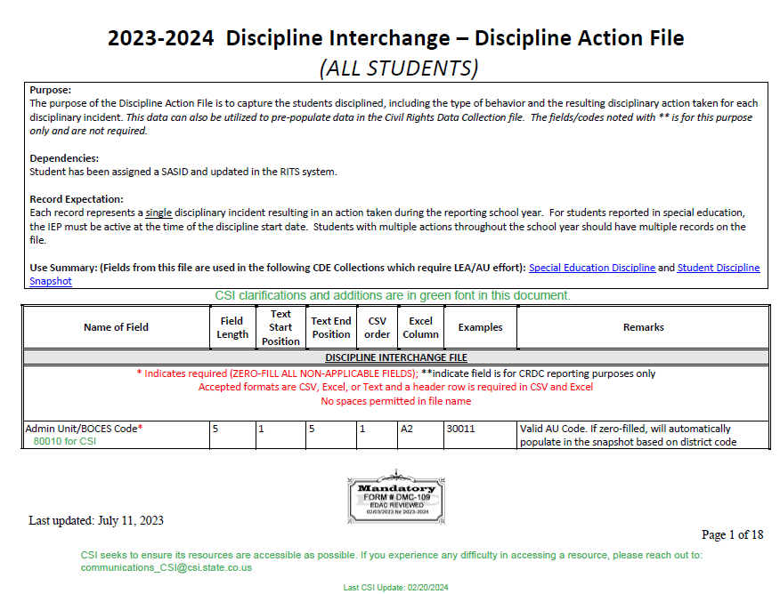
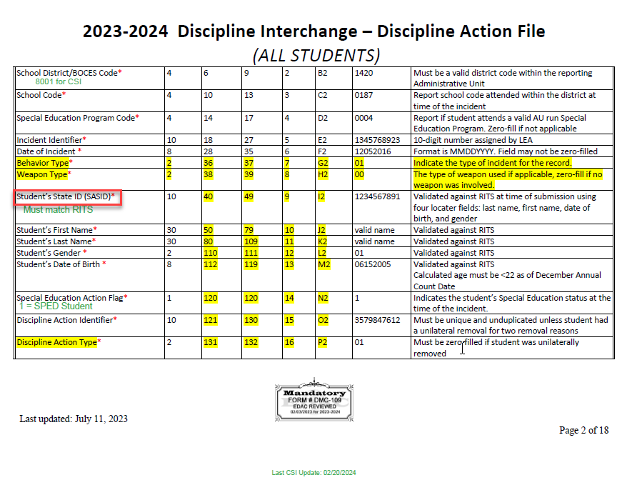
Discipline Interchange File Layout
The purpose of the Discipline Action file is to capture the students disciplined, including the type of behavior and the resulting disciplinary action taken on each incident. It also includes data that can be populated for the CRDC Collection.
https://resources.csi.state.co.us/wp-content/uploads/2024/03/2023-2024-Discipline_Action_Layout_CSIAdditions.pdf
Notes:
As I had mentioned, the file required is the Discipline Action file and given that it is by student, there are several changes to it. The File Layout has been posted to the CSI website at the listed link. This covers every field now required for the collection with the changes highlighted in yellow. CSI also add notes in green that are more specific to CSI schools. As you scroll down the document, you will see each field and the possible coding options. I highly recommend either bookmarking this or printing it out and reviewing it thoroughly to ensure that all fields are being entered into your SIS.

Slide 8
Discipline Snapshot – Collections Impacted
Data from both the Student Interchange (EOY) and the Discipline Interchange go into the Student Discipline Snapshot.
Correcting Snapshot errors may require updates to either collection.
Student Demographics File
Student School Association File
Discipline Action Interchange File
Student Discipline Snapshot
Notes:
Next, lets jump into the Discipline Snapshot. This snapshot incorporates not only the Discipline Action file but also the Student Demographics and Student School Association from the End of Year collection. This means each student with a discipline must be included on the schools EOY file and level 1 error free. Doing this collection will require some collaboration with the staff at your school responsible for the EOY collection as an error may appear in discipline that must be corrected in the SD or SSA files.

Slide 9
Discipline Snapshot – School and SPED Students
Although the School and SPED Collections have been merged into the Discipline Interchange, the Snapshot should remain separate. All SPED and General Education students should be reported on the Discipline Interchange and will receive errors on the same report, you should expect to see a School and SPED Level 2 Report.
Level 1
Level 2
School Discipline Snapshot
SPED Discipline Snapshot
Discipline Interchange
Notes:
Continuing with the Snapshot for Discipline. Although the School and SPED Collections have merged for the 23-24 school year, the level 2 error reports for SPED and General Education students remain separate. This means school should expect a Level 2 School Discipline and a Level 2 SPED Discipline error report with all corrections being made on the Discipline Action file.

Slide 10
New Resources
As this update collection progresses, CSI is working on creating new resources to provide to schools. Not all information has been released by CDE and your SIS, so all resources may not be posted by 4/18. Continue to review the School Discipline page for updates, some of which include:
New Troubleshooting errors
Discipline Record Checker Tool
PowerSchool and IC Crosswalks
PowerSchool and IC File Extraction Guidance
Others as details become available!
Notes:
Given all the changes with the collection, CSI has a plan to create a whole new set of resources to navigate this updated collection for the first time. The new resources include (READ LIST). This may not be a comprehensive list and more resources may be added if a need exists. I should mention that the availability of files and information has been slow to come from CDE and your SIS, in particular IC. This may delay the release of some of these resources but just keep checking back in the CSI School Discipline page for updates!

Slide 11
Data Validation Procedures
Notes:
Now that we have discussed the updates for each collection, lets talk about some important validation procedures that schools should be doing to ensure their data is accurate and that Special Education students are being reported as such.

Slide 12
Unilateral Removal Clarification
Unilateral Removal
Instances where school personnel (not IEP team) or as determined by a hearing officer order the removal of children with disabilities from their current educational placement to an appropriate interim alternative educational setting for not more than 45 school days. The IEP team is responsible the interim alternative setting. Unilateral removals do not include decisions by the IEP team to change a student's placement
School Clarification
Unilateral removals are very uncommon for CSI schools, maybe 1-2 per year across the portfolio. Students must meet the above criteria to be considered a unilateral removal
The Discipline filed should be zero-filled in these cases.
A non-zero filled Removal Type and Removal Reason must be added when this situation occurs
Notes:
The fields related to Unilateral Removals has been an area of confusion over the last couple collection cycles for SPED Discipline , so I thought I would clarify by providing the definition and what schools should be doing in terms of coding these fields as they now are in School Discipline. A Unilateral Removal is an instance where school personnel, not the IEP team, or as determined by a hearing officer – order the removal of children with disabilities from their current educational placement to an appropriate alternative educational setting for not more than 45 days. This does not include decisions by an IEP team to change a student's placement. These are very uncommon to see as we maybe see 1-2 across the entire CSI portfolio on a yearly basis, so you must be very confident in order to code a student as a unilateral removal. In these cases, the discipline field should be zero filled with the removal type and reason being non-zero-filled. Please reach out to CSI if you have questions on this or are unsure if a student is considered a unilateral removal.

Slide 13
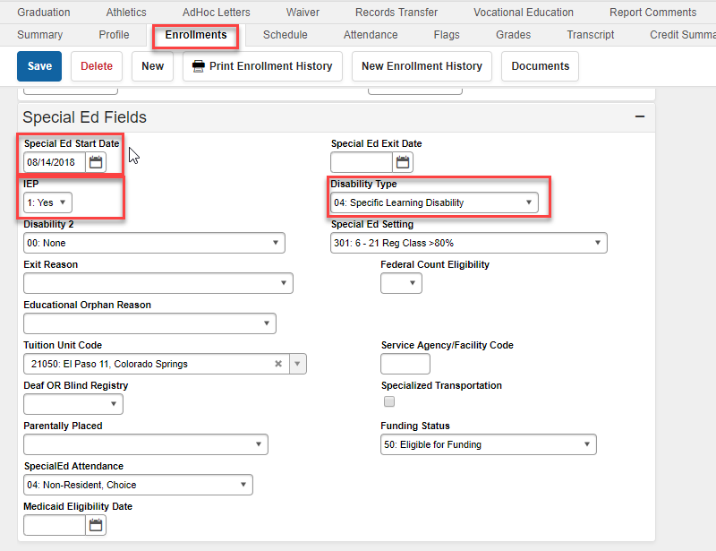
Disability Data in SIS
Verify all students receiving special education services are coded as such in your SIS regardless of if using another plan management system. PowerSchool
Infinite Campus
Notes:
As mentioned previously, a big aspect to ensure that your special education students being disciplined are being reported as such is to make sure you are completing the disability data and other SPED fields in both PowerSchool and Infinite Campus regardless of if you are using another plan management system or not. For PowerSchool, you want to ensure that you are going to the State Provence CO section and navigating to the Special Ed tab. You’ll want to make sure you are selecting the applicable disability, check marking IEP and including an entry date from this year. As for Infinite Campus, you’ll want to go to the current years enrollment and complete all the same fields in the Special Ed Fields section at the bottom of the enrollment in addition to a completed IEP.

Slide 14
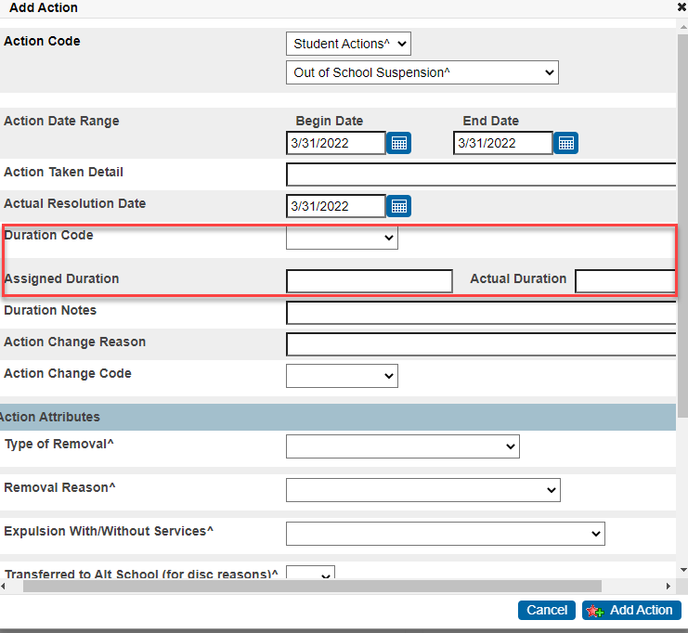
PowerSchool – Resulting Action Duration Coding
All incidents involving an Out of School Suspension require the data entry of the Duration Coding, this includes:
Duration Code (days recommended)
Actual Duration
Assigned Duration
Not completing will result in a record on the School Discipline collection, but no entry on SPED Discipline causing discrepancies
Notes:
Another issue we have been seeing become more prevalent in previous collection years is the data entry of the duration fields in PowerSchool. We have seen the Duration Code, Assigned, and Actual Duration codes not all completed in many cases. All three of these field must be completed properly in order for data to be reported accurately on the School Discipline collection. Completing these will not only provide an accurate number of days suspended for each student but also can impact Attendance for End of Year.

Slide 15
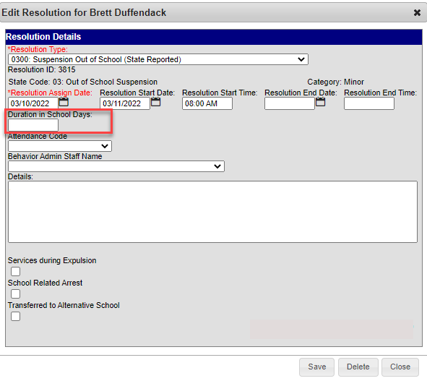
Infinite Campus – Resolution Duration Coding
All incidents involving an Out of School Suspension require the entry of the Duration Coding, in particular:
Duration in School Days
Not completing will result in the record to not report accurately in terms of OSS Days for the Discipline Collection and the CRDC Collection
Notes:
In terms of duration coding for Infinite Campus, this must be completed as well in the SIS. I often see this field not being completed as it is not shown as being required. It is very important to add the number of days within the resolution you are creating anytime an out of school suspension occurs. This may not have implications for the Discipline collection necessarily, but we found several instances of an inaccurate number of Out of School Suspension days during this years CRDC collection. These had to be manually corrected by the school, so being careful and accurately entering this information will save you time in the long run.

Slide 16
Timelines and Deadlines
Notes:
Last, we want to look at the timelines and due dates for this collection.

Slide 17
Discipline Timelines and Deadlines
Deadline | Task
05/02/2024 | Initial File Submittal
06/12/2024 | Schools must have all Level 1 errors cleared
06/24/2024 | Schools must have all Level 2 errors cleared
Last Day of School | Review last file submitted and resubmit files if changes
Early-July* | CSI will provide Data Summary Reports to schools
07/16/2024** | Submit Signed Certification Agreements to CSI
*Dependent upon all schools clearing errors by specified deadlines
**Any requests for changes must be received by CSI on or before 07/12/2024
Be sure to review the 23-24 Data Submissions Calendar for all collection deadlines and the Weekly Update email to keep up to date on the school status of collections.
Notes:
In terms of the Discipline Collection, the initial file must be submitted by May 2nd with the level 1 error clearance due on June 12th. As far as level 2’s are concerned those are due on June 24th, 2024. The next row is primarily for schools that have cleared all errors prior to the last day of school. As that day arrives, make sure that all incidents that occurred at the school have been reported. Error clearance does not always equate with accuracy, so feel free to submit your file again if you have any late in the year incidents. CSI will provide summary reports in early July once a school has cleared all errors with the signed certification due on July 16th, 2024.
.

Slide 18
Discipline Timeline Reminder
Date of Error Clearance Last Day of School
Schools who clear errors prior to the last day should review all disciplines at that point to ensure all are included. Differences in error clearance deadlines can result in discrepancies.
Discipline Steps to Complete on Last Day:
Review the last submitted file and count number of students disciplined, number of In/Out of School Suspensions, and Expulsions.
Extract a new Discipline Action file from your SIS and compare the numbers with your last submitted file.
Submit a new file on the last day of school if changes have occurred since the previous submittal. Email CSI to confirm data has been reviewed and no changes have occurred.
Notes:
So, as I mentioned on the last slide, this pertains to schools who have cleared errors prior to the last day of school. If this is the case then, please keep in mind that the date schools clear out all errors does not always equal the last day of school in many cases, schools are able to clear out errors early, but incidents still can occur after this date. If this is the case please follow this 3 step process, which is: (READ STEPS). This will ensure every incident reported is captured in the files for the collection.

Slide 19
No Reportable Incidents
courtesy of kindpng.com
If you have no reportable discipline information for one or both collections, send an email to submissions_CSI@csi.state.co.us
Notes:
That concludes the timelines for the Discipline collection. I will leave you with one final detail that is not too common but important to let us know. If you have no Incidents to report for this year at your school, you need to send an email to our submission's inbox stating this. CSI will keep this email in our records for future reference if needed.

Slide 20
Thank you for Reviewing this Training
Contact the Submissions Inbox with Questions:
Submissions_CSI@csi.state.co.us
Notes:
Thanks so much for reviewing the New This Year training for the Discipline Collection! If you need further details, feel free to reach out or review the General Overview module posted on the CSI website. Have a great day!

