Slide 1
23-24 Discipline Collections Training
General Overview – School Discipline and SPED Discipline
Recorded April 2024
Notes:
Hello All,
Welcome to the General Overview training module for the upcoming 23-24 discipline collections. This training is designed to take a general look at the recently updated School Discipline collection and the best approach for schools to work through it. Given all the changes that have occurred in the collection, it is important to review this General Overview along with the New This Year Training posted on the CSI website. If you have questions while reviewing this training, feel free to reach out to the submissions inbox and we would be more than happy to help!

Slide 2
Agenda
Purposes of School and SPED Discipline
Purpose, Required File and Collection Changes
Discipline Collections Process
Step 1: Collection Prep | Step 4: Resolve Errors and Resubmit
Step 2: Collect Data | Step 5: Certify
Step 3: Submit to CSI
Timelines and Deadlines
2
Notes:
Here is a quick overview of the topics that we will be discussing today. First, we will look at the collection as a whole and in particular the purpose of the it, required files, and some big changes this year for the collection. We’ll then jump into a look at the 5 steps of the collection process and some resources that can be used. And Lastly, well take look at the timelines and deadlines for this collection!

Slide 3
Purpose of the School Discipline Collection
The School Discipline collection contains student level information for:
Students disciplined, including the type of behavior and resulting disciplinary action taken for each disciplinary incident.
the demographics of the student(s) disciplined, and
the counts of students that brought or possessed a firearm for each school.
The School Discipline collection data is used to populate the Civil Rights Data Collection (CRDC – every other year)
For more information on State Statues (HB22-1376) related to Collection: https://www.cde.state.co.us/dropoutprevention/disciplinepolicy
courtesy of depositphotos.com
Notes:
Let’s jump into the purpose of the School Discipline collection, schools are required by State and Federal law to collect information on certain discipline events that have occurred at your school during the current school year. The School Discipline collection is currently the way this information gets collected and submitted to CDE to meet these requirements. Feel free to take a look at the full description and purpose listed in this slide. The big take home point is that the Collection has been modified this year to report by student rather than in aggregate.
Also, you will notice the State Statutes related to this collection at the bottom of this screen. If you would like more information on these and the regulation tied to this collection feel free to review the information in this link on the CDE website

Slide 4
Collection Changes
22-23 (HB22-1376 Passed)
23-24
School
Discipline
Discipline
Interchange
SPED
Discipline
4
Notes:
This slide is a comparison of the collections in 22-23 versus this year. As you can see last year, the School and SPED Discipline were two separate periodic collections. Since last year Colorado passed HB22-1376 which completely overhauled how Discipline is reported in the state. Given that, CDE modified the two collections into one Discipline Interchange that is reported by student.

Slide 5
School Discipline and HB22-1376 Passing
The Discipline Interchange updates the Special Education Discipline Interchange file with data fields required per HB22-1376 which includes data previously collected in the periodic files for the School Discipline files (Discipline by Action, Discipline by Demographics and Firearm Data). The updated Discipline Interchange file process will start in the 2023-2024 school year and will contain one file: the Discipline Action File. In the file, all students who were disciplined during the reporting school year will be reported. This information is used in the Student Discipline Snapshot for all students and Special Education Discipline snapshot for students with an active IEP.
5
Notes:
Here is a little more details on the Discipline Collection since the passing of House Bill 22-1376. Previously, there were a potential of 3 files to Collect for School Discipline and one for SPED Discipline. The School Discipline was previously aggregated data based on demographic details. Since this passed, schools are only required to submit one file, which is the Discipline Action file. This will report on any incidents that occurred at the school along with the resulting action. All this information will be used to populate errors in both the Student and Special Education Discipline Snapshot.

Slide 6
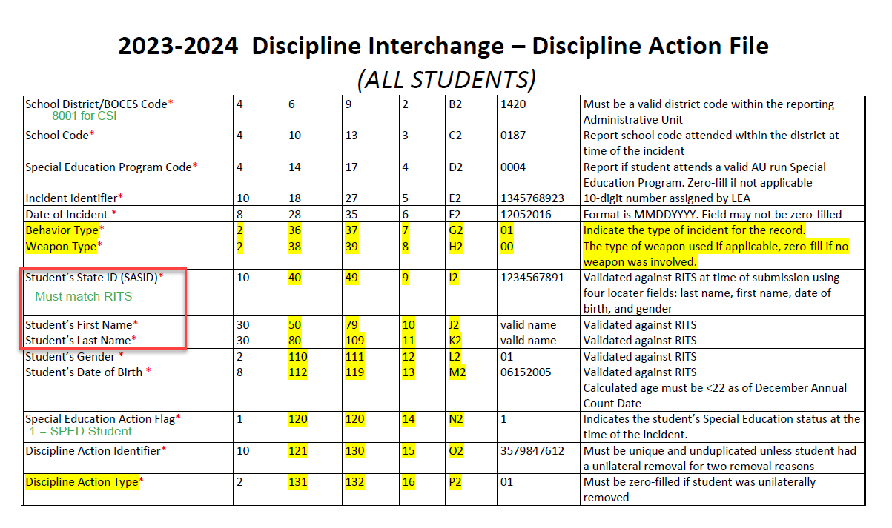
23-24 Discipline Updates
School Discipline Collection
The School and SPED Discipline Interchanges were merged into one collection for 23-24.
The four previous files collected for both collections have been merged into just one file.
The details of Discipline incidents are now being reported by student rather than in aggregate as it historically has been done.
All incidents involving both General and Special Education students will now be reported on this one file.
Now includes a Snapshot with level 2 errors.
For full details on these updates and some validation information, see the New This Year Training on the CSI website.
Notes:
So prior to jumping into the collection process and steps necessary, I thought I’d give a brief overview of the changes to the Discipline files for the 23-24 school year. As mentioned, this collection definitely has seen a lot of changes over the past year, including : (READ Bullets). Given all these changes, it may take some time to ensure that all resources are available to schools and that the file extractions from your SIS are coded properly. This may take extra time and effort to ensure that all disciplines are being reported accurately.

Slide 7
Discipline Snapshot – School and SPED Students
Although the School and SPED Collections have been merged into the Discipline Interchange, the Snapshot should remain separate. All SPED and General Education students should be reported on the Discipline Interchange and will receive errors on the same report, you should expect to see a School and SPED Level 2 Report.
Level 1
Level 2
School Discipline Snapshot
SPED Discipline Snapshot
Discipline Interchange
Notes:
I mentioned this on the previous slide but wanted to be super clear. Although the SPED and School Discipline Interchanges have merged into one collection, the snapshots will remain separate. This means that you will have one error report for level 1 but a potential of 2 for the level 2 snapshot, which include the School and SPED Discipline Errors separately. This can be a bit confusing, just know that any Special Education students with level 2 errors will be on a separate error report.

Slide 8
Discipline Collections Process
Notes:
Now that we have a better understanding of the purpose, files being collected, and major updates for the year- lets take a look at the overall collection process as a whole and some resources available to assist with each step.

Slide 9
Data Collection in 5 Steps
Repeat steps 2-4 until data is complete and accurate!
Notes:
(NEXT) For those of you who have reviewed the data submissions handbook or any other of our trainings, you may be familiar with this slide. This is the 5 steps of any data collection and includes:
Step 1 – Collection prep
Step 2 - collect and enter data
Step 3 – Extract and submit files
Step 4 – Update data to resolve errors
And Step 5 – final review
We will cover each of these steps in more detail in subsequent slides of this training. One thing to keep in mind is that this really is more of an iterative process that involves the repetition of steps 2 through 4 until your school is error free. Once that happens CSI will send you a summary report to complete a final review on. Lets jump into a little more about each of these steps.

Slide 10
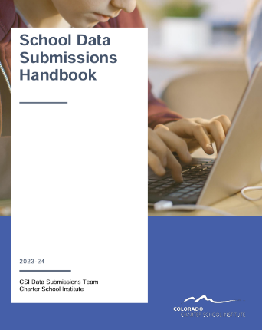
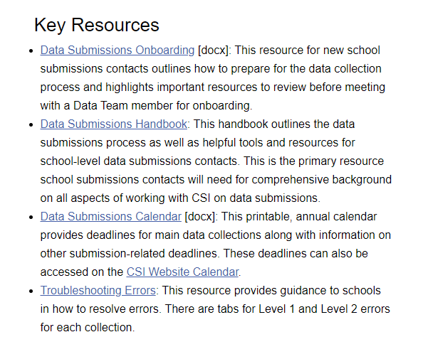
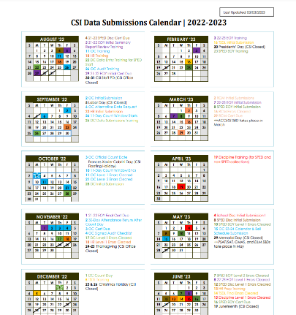
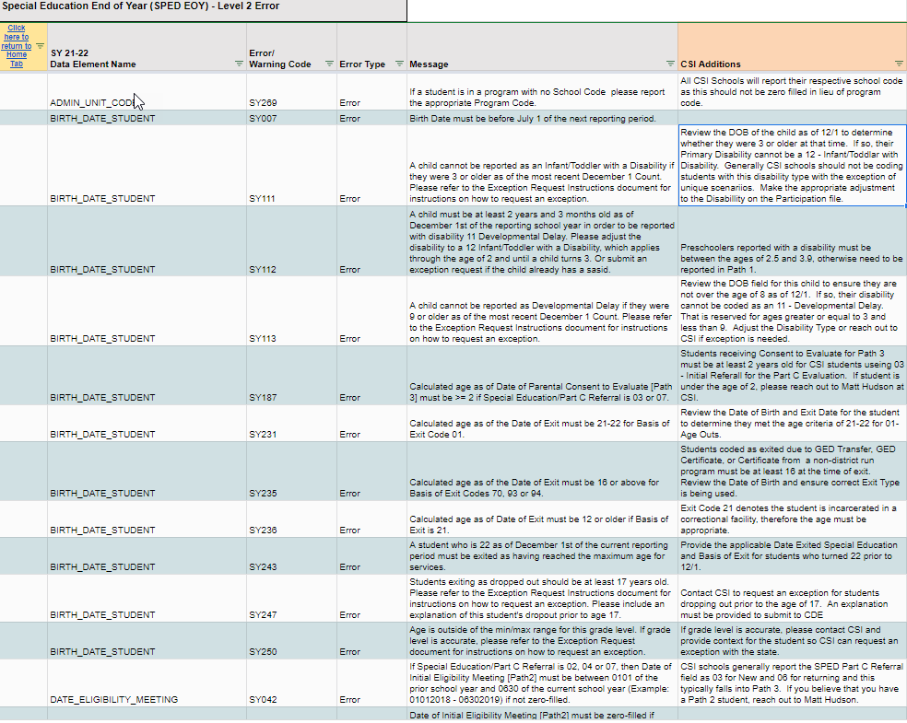
Step 1: Collection Prep Resources
https://resources.csi.state.co.us/general-submissions/
1. Collection Prep
3. Submit to CSI
4. Resolve Errors
5. Certify
2. Data Entry and Review
Notes:
So step 1 really is all about the steps a school should take prior to an upcoming collection to ensure they have the general knowledge necessary to be successful. This involves the 3 main general resources listed in the General Submission page of the CSI website and includes the data submissions handbook, the Data submissions calendar, and the troubleshooting errors spreadsheet. In terms of the first resource listed, It is highly recommended that all new and returning staff review the latest version of the data submissions handbook (NEXT), which comes out every year. It contains helpful information on each step of the process, your role vs. CSI, various resources available to you, to do lists among many others. The next area to focus on would be the data submissions calendar (NEXT), which includes all important due dates for a collection, including initial submittal, level 1 error clearance, level 2 error clearance, and signed summary dates. Printing this and reviewing it often will ensure your school is staying in compliance by meeting all necessary deadlines. The last resource that will be talking about more later is the troubleshooting errors resource (NEXT). This spreadsheet contains tab for each file in a collection along with a tab for level 2 errors. The tabs are a working document and provide updated listings of each error associated with a file or level 2 and includes details regarding the error message, field impacted, and most importantly – a CSI additional notes column that provides CSI-specific details on how to correct an error. Sometimes the error messages CDE provides can be confusing, so having this will go a long way when you get to step 4 error clearance.

Slide 11
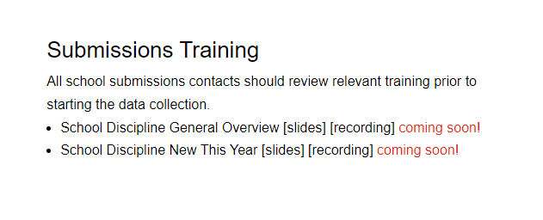
Step 1: Collection Prep Trainings
https://resources.csi.state.co.us/school-discipline/
1. Collection Prep
3. Submit to CSI
4. Resolve Errors
5. Certify
2. Data Entry and Review
Notes:
In addition to the general submission's resources, each page also contains recorded trainings for the collection that are designed to provide you all the details necessary to complete that specific collection. As mentioned at the outset, we have posted updated trainings for the Discipline collection. The details of our trainings may be obvious at this point as you are reviewing one of them, but it is important to note that each collection has a training like the one you are watching, which contains a general overview of the collection and steps necessary. Also, there is a training for “New this year” and includes some validation reminders, which is designed to be provide more established submissions staff an opportunity to see what has changed along with reminders. Given all the changes this year, it is highly recommended that all staff review both trainings.

Slide 12
Step 2: Data Collection/Entry
What Data to Collect
All students who were disciplined during the current school year
This includes General and Special Education students
Resources Utilized
File Layout and Definition Documents
Where the data should be entered
PowerSchool
Infinite Campus OR
Another SIS
Resources Utilized
IC and PowerSchool Discipline Crosswalks
Discipline Record Checker
https://resources.csi.state.co.us/school-discipline/
1. Collection Prep
3. Submit to CSI
4. Resolve Errors
5. Certify
2. Data Entry and Review
Notes:
So, step 2 is all about collecting and Entering data. You may be wondering what exactly is being collected internally at your school for the Discipline Collection? As mentioned, you are collecting information on all students who were disciplined during the 23-24 school year. This includes both SPED and General Education students with a state reportable incident at your school.. To assist with this process, we have some resources listed here that will help in the data collection process and include the File Layout and Definitions Documents for the collection. In terms of where to enter data, you have PowerSchool, Infinite Campus, or any other SIS used and we will be discussing that and all the available resources further on subsequent slides of this training.

Slide 13
Student Discipline Behavior Codes*
01 Drug Violation Use
02 Alcohol Violation Use
03 Tobacco Violation Use
04 1st, 2nd Degree or Vehicular Assault
05 Dangerous Weapons Carrying
06 Robbery
07 Other Felony
08 Disobedience/ Defiant or Repeated Interference
09 Detrimental Behavior
10 Destruction of School Property
11 Bullying
12 Other Violation of Code of Conduct
13 3rd Degree Assault/Disorderly Conduct
14 Marijuana Violation
15 Sexual Violence/ Battery (other than Rape)
16 Rape or Attempted Rape
* - Codes used for CRDC purposes are not listed here. Please see the Discipline Action File Layout to view.
1. Collection Prep
3. Submit to CSI
4. Resolve Errors
5. Certify
2. Data Entry and Review
Notes:
In terms of State Reportable incidents or Behaviors, this slide lists the primary incidents that should be reported, which there are 16 of them. Also, there are incident allegations, which are not listed but should be tracked for CRDC purposes.

Slide 14
Student Discipline Resulting Action/Resolution Codes
00 N/A (used when reporting CRDC allegations)
10 Classroom Removal
11 In-School Suspension
12 Out-of-School Suspension
13 Expulsion
14 Any other form of discipline
1. Collection Prep
3. Submit to CSI
4. Resolve Errors
5. Certify
2. Data Entry and Review
Notes:
Each incident on the previous slide must have a state reportable resolution with it only being zero-filled if those CRDC allegations are used. Other than that, each incident should report a resolution of Classroom Removal, In-School Suspension, Out-of-School Suspension, Expulsion, or any other form of Discipline. It is very important that both the behavior and resulting action match in terms of if they are state-reportable or not.

Slide 15
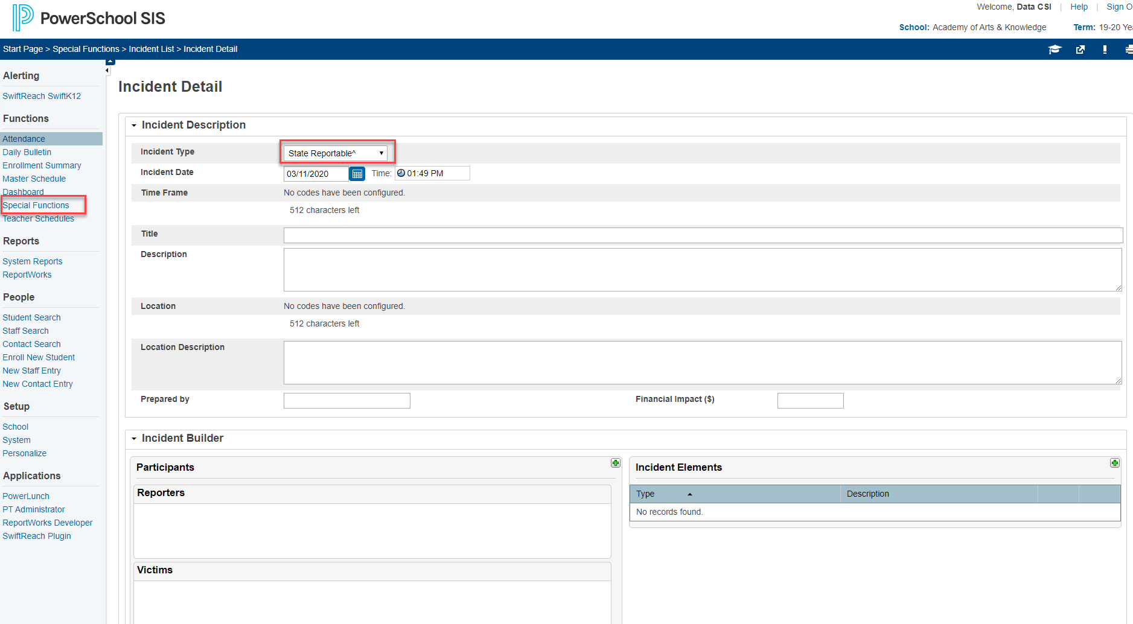
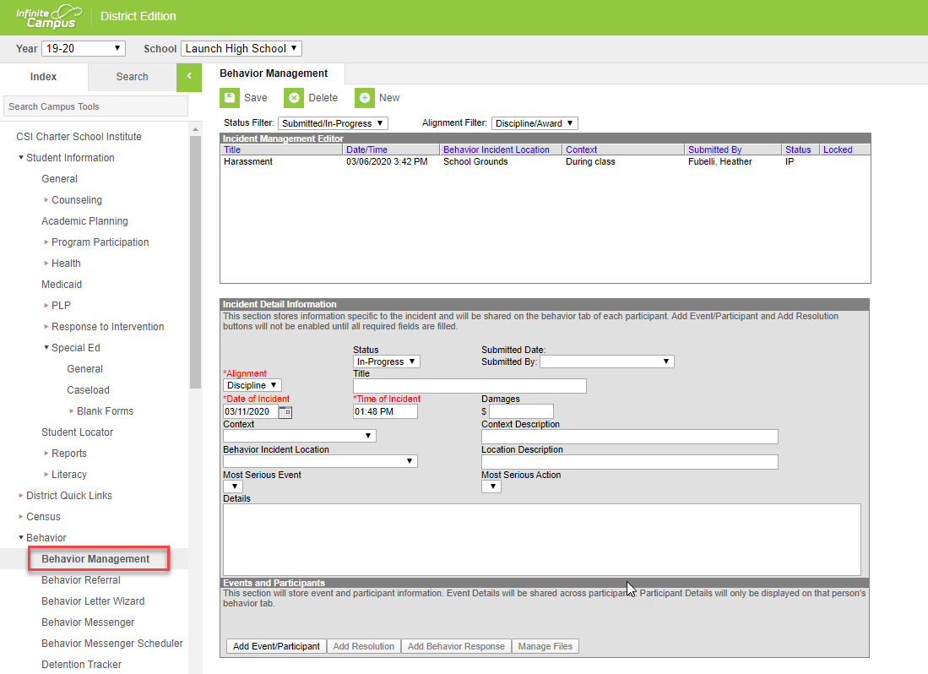
Incident/Discipline Entry in SIS
PowerSchool
Infinite Campus
Start Page > Special Functions > Incident Management
Start Page > Behavior> Behavior Management
https://ps-compliance.powerschool-docs.com/pssis-co/latest/incident-management-quick-entry
https://kb.infinitecampus.com/help/behavior-data-management-and-reporting
1. Collection Prep
3. Submit to CSI
4. Resolve Errors
5. Certify
2. Data Entry and Review
Notes:
So here is a screenshot of where incidents or behaviors and their resulting actions should be reported in both PowerSchool and Infinite Campus. As I mentioned previously, when creating Incidents, if they are coded as State Reportable, then the resulting Action must also be State Reportable. If not, then both should not be state reportable. This is an issue I have seen that causes errors over the past few years, so keep this in mind when entering disciplines. In Infinite Campus, the state reportable generally have a number prior to the behavior and action while in PowerSchool, you typically will see a Carat included on those. I have again included those links to entering behaviors and incidents directly in your SIS as doing this correctly will ensure less errors upon submittal.

Slide 16
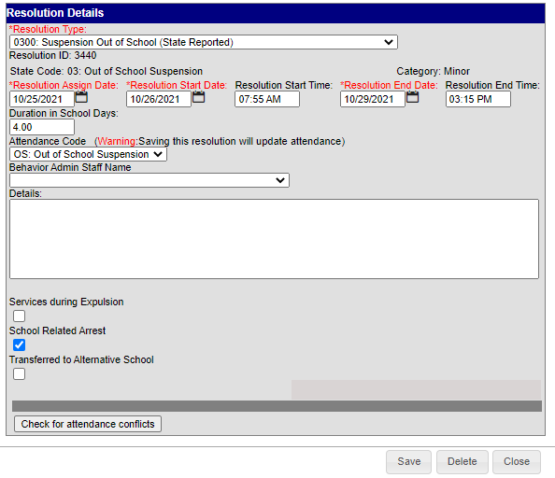
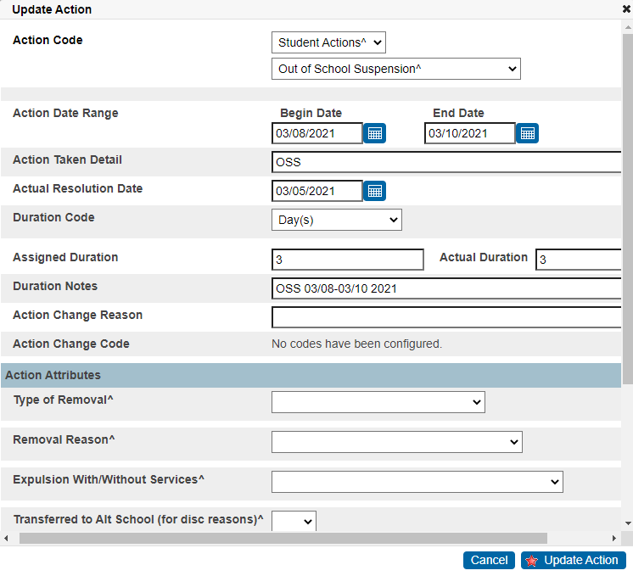
Duration Coding in PowerSchool and IC
Data entry of Duration details is required in both PowerSchool and Infinite Campus. They impact the reporting for both Discipline Collections along with outside Collections:
The Duration in School Days field must be added to accurately report the Number of Days Missed Due to OSS in the CRDC Collection
The Duration Code and Assigned/Actual Duration fields in PowerSchool must be entered on incidents to ensure accurate number of days is being reported for this and other collections.
Notes:
When entering disciplines in either PowerSchool or IC, it is important to note that the duration coding must be completed for each resulting action or resolution. These fields impact not only the discipline collections, but other collections that schools must complete. For PowerSchool, you must enter the duration code, assigned duration, and actual duration fields with accurate data. Not entering correctly can impact several collections including Discipline, Attendance, and CRDC. In terms of infinite campus, the duration in school days field must be completed in order for the Number of Days Missed due to Out of School Suspension field to also populate in CRDC. We ran into many schools where the OSS days differed when it came to CRDC and this appears to be the culprit. Keep this information in mind as you are completing data entry on your disciplines.

Slide 17
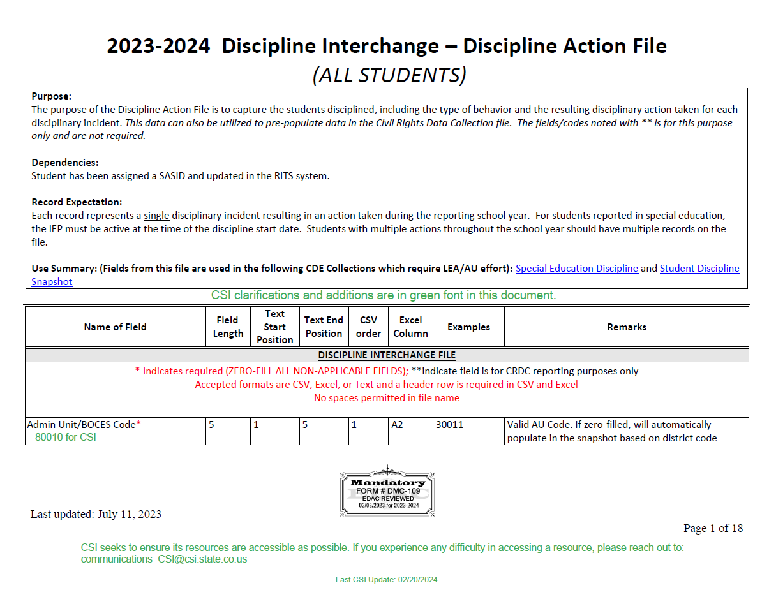
File Layout and Definition Documents – CSI Additions
https://resources.csi.state.co.us/wp-content/uploads/2024/04/2023-2024-Discipline-Interchange-Discipline-Action-File_CSIAdditions.pdf/
1. Collection Prep
3. Submit to CSI
4. Resolve Errors
5. Certify
2. Data Entry and Review
Notes:
So the file layout and definitions document with CSI additions are a great resource as you go through the data entry process. These are included for every state required collection, including Discipline. They contain a listing of all fields that are collected on the file and include a table at the top that shows things like field lengths, position in an excel file, an example, as well as any additional remarks. The rest of the document goes through each field in specific detail, including a description and the allowable coding options. CSI has also added any CSI-specific details in green to further help with details and coding pertaining to our schools. I highly recommend using these during data entry, error clearance, or at any point during a collection!

Slide 18
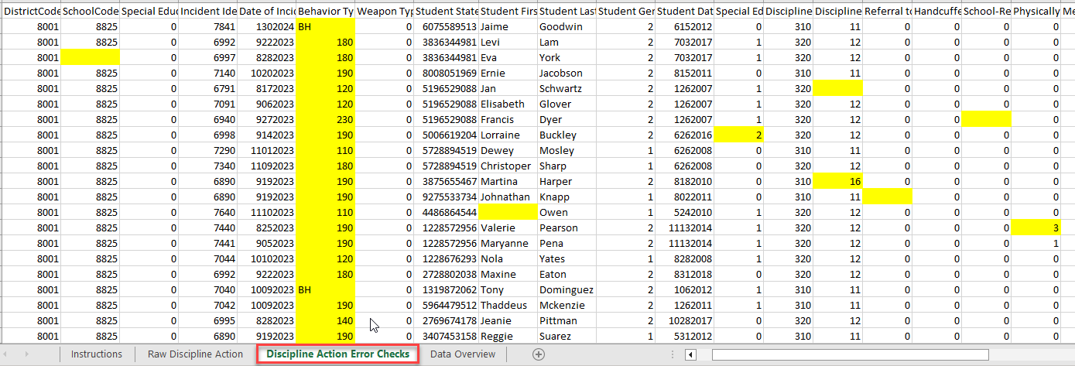
Discipline Record Checker
The Discipline Record Checker is very similar to other collection as it is used to flag errors prior to initial submittal. To use this tool:
Download the Record Checker tool from the CSI Discipline Page.
Extract your Discipline Action file and paste the data into the Raw Data tab (no leading zeros).
Navigate to the Error Checks tab and see what is highlighted.
Make necessary updates in your SIS based on errors.
Extract files and submit.
The goal is to have less errors upon initial submittal, leading to less submittals to error clearance. This can be a huge time saver!
1. Collection Prep
3. Submit to CSI
4. Resolve Errors
5. Certify
2. Data Entry and Review
Notes:
Given that the Discipline Collection is now based on student rather than aggregate, we were able to create a Record Checker for this collection, similar to others. To use this resource you want to (READ Steps). The goal with this tool is to have less errors upon initial submittal which hopefully leads to less submittals to error clearance. This should save time for both CSI and the schools we serve!

Slide 19
Step 3: Submission to CSI
SIS Resource Links
School Discipline Interchange Collection
PowerSchool PowerSchool Discipline File Extraction Guidance – Coming Soon Infinite Campus Infinite Campus Discipline File Extraction Guidance – Coming Soon
1. Collection Prep
3. Submit to CSI
4. Resolve Errors
5. Certify
2. Data Entry and Review
Notes:
Now that we have covered what information should be collected and where to enter it along with applicable resources, I thought we would take a look at the file extraction process in your SIS and submitting those files to CSI. In talking about this extraction process, we have provided some instructions on how to do this in both SIS’s to ensure it is being done correctly. For both PowerSchool and Infinite Campus, we have created a new resource that walks you through the steps necessary to extract your file from your SIS. If followed, you should successfully be able to extract a file in the correct format, rename it, and submit to CSI for processing! It should be noted that both SIS’s and CDE have been slow to provide extracts, resources and details on the updated collection, so CSI resources have been delayed. As more information gets released, expect more CSI specific resource guidance.

Slide 20
Step 3: Submission to CSI (Cont.)
School Discipline →23-24 → Files to Run Naming convention examples: School Code, School name/abbreviation, interchange typeddate School Discipline by Action File for Steamboat Montessori 5423SMDisciplineAction05102024 School Discipline by Student Demographics File for High Point Academy 0655_HPA_DisciplineAction_05152024 Firearm Discipline File for Early College of Arvada Email submissions_CSI@csi.state.co.us that files are ready to be processed
} In Google Drive
1. Collection Prep
3. Submit to CSI
4. Resolve Errors
5. Certify
2. Data Entry and Review
Notes:
Now that the files have been extracted for use, it is important to discuss the naming convention of each file prior to submittal as it really helps us keep track of the last files submitted by your school. To help with this, we’ve provided a color-coded example of how to name files, starting with school code then school followed by file type and ending with the date. If you make corrections and are ready to upload another file, make sure you change that date or if it occurs on the same day, you can always end it with a V2. Keep in mind, there should be no spaces in your file as it prevents us from uploading this information to CDE and is just an extra step on our end to get resolved. Issues with file name structure is definitely something I deal with all too often for both new and returning submissions staff, so please make sure you are following these examples.

Slide 21
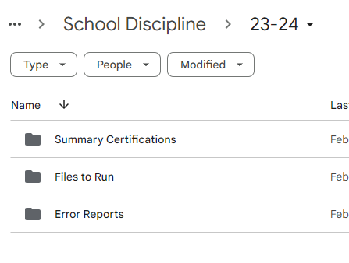
Step 4: Error Resolution
Error Reports loaded to:
School Discipline → 23-24 → Error Reports
CSI Troubleshooting Errors Resource
School Discipline Tabs
Discipline Action Interchange School Discipline Snapshot SPED Discipline Snapshot
Coming Soon
1. Collection Prep
3. Submit to CSI
4. Resolve Errors
5. Certify
2. Data Entry and Review
Notes:
Once you have submitted your files to Google Drive and emailed CSI, we can begin processing your file, which essentially means we will be uploading your Discipline Action file to the CDE system and generate an error report. We will then place those reports in the Error Reports folder an notify you that they are available for review. As you get your first error report, it certainly can seem a bit overwhelming, so we are happy to walk through it with you, just let us know. The other tool which many find helpful with error resolution is the CSI Troubleshooting Errors Resource. If you click on that link, it will take you to a google doc that contains a tab for the Discipline Action file, as well as tabs for the level 2 snapshot errors. So, essentially you will review a total of 3 tabs – 1 for Level 1 errors and the School and SPED Discipline tabs for level 2. Keep in mind that these are still a work in progess as CDE has not released the business rules for the year at the time of this recording.

Slide 22
Level 1 and Level 2 Error Definitions
Level 1 Errors
Also called Interchange Errors
Errors specific to each file submitted. One report per file submitted
Corrections need to be made on the file related to that error report
School Discipline will have a potential of one level 1 error report
Level 2 Errors
Also called Snapshot errors
Schools will only receive these once they are level 1 error free
Incorporates the Student and Discipline Interchange files
More difficult to determine which file and field must be corrected
School Discipline now has a level 2 snapshot starting in 23-24
Includes a separate SPED Discipline level 2 error report
Notes:
Alright, diving into this further regarding level 1 vs level 2 errors. Level 1 errors (READ BULLETS) as far as Level 2 (READ BULLETS). So as you can see the rules and what is being looked at for each level are very different, so keep this in mind as you are going through the error clearance process!

Slide 23
Step 4: Error Resolution (Cont.)
Coming Soon
School Discipline Interchange tab
School Discipline Snapshot tab
SPED Discipline Snapshot tab
Troubleshooting Errors Link
1. Collection Prep
3. Submit to CSI
4. Resolve Errors
5. Certify
2. Data Entry and Review
Notes:
This slide is where you would typically see screenshots of the applicable tabs on the troubleshooting errors resource. At the time of this recording and a week until the collection opens, CDE has not released the Business Rules or listing of errors for the collection. Those will be added to the CSI Troubleshooting errors spreadsheet with additional CSI notes when they become available, so keep checking at the included link.

Slide 24
Step 5: Data Review
courtesy of ya-webdesign.com
Summary/certification report will be provided once error free
Steps to Complete:
Review each tab thoroughly to determine accuracy of data
If accurate, ensure all parties have signed and return version of the signed Certification tab to CSI
School Leader, Data Submissions Coordinator, SPED Coordinator (SPED Discipline) and Primary Discipline Contact (School Discipline)
If errors are found, modify most recent error free files or reach out to CSI for assistance
Changes will be uploaded to the Data Pipeline and a new summary report provided
Once data is accurate, sign and return prior to the due date.
Summary reports for School Discipline: School Discipline→23-24→ Summary Report Certifications
1. Collection Prep
3. Submit to CSI
4. Resolve Errors
5. Certify
2. Data Entry and Review
Notes:
So jumping into Step 5, this is all about reviewing data. Once you have gone through step 2 through 4 a few times on each collection, as this is an iterative process, and have been able to clear all your errors, CSI will provide you collection specific summary reports in G-Drive. It truly takes all the information you provided to us regarding the School Discipline collection file and summarizes it for you to review. These reports should be reviewed by you, your school leader and any other necessary staff for accuracy. The time window for the School Discipline collection is very short, but have been modified this year given this now contains level 2 errors. If you notice any discrepancies in the data you can actually get back to us and resubmit new files to correct. Once your school is comfortable with the information contained in each report, it must be signed and returned no later than July 16th to complete the collection.

Slide 25
Timelines and Deadlines
Notes:
Last, we want to look at the timelines and due dates for these collections.

Slide 26
School Discipline Timelines and Deadlines
Deadline | Task
05/02/2024 | Initial File Submittal
06/12/2024 | Schools must have all Level 1 errors cleared
06/24/2024 | Schools must have all Level 2 errors cleared
Last Day of School | Review last file submitted and resubmit files if changes
Early-July* | CSI will provide Data Summary Reports to schools
07/16/2024** | Submit Signed Certification Agreements to CSI
*Dependent upon all schools clearing errors by specified deadlines
**Any requests for changes must be received by CSI on or before 7/12/2024
Be sure to review the 23-24 Data Submissions Calendar for all collection deadlines and the Weekly Update email to keep up to date on the school status of collections.
Notes:
In terms of the Discipline Collection, the initial file must be submitted by May 2nd with the level 1 error clearance due on June 12th. As far as level 2’s are concerned those are due on June 24th, 2024. The next row is primarily for schools that have cleared all errors prior to the last day of school. As that day arrives, make sure that all incidents that occurred at the school have been reported. Error clearance does not always equate with accuracy, so feel free to submit your file again if you have any late in the year incidents. CSI will provide summary reports in early July once a school has cleared all errors with the signed certification due on July 16th, 2024.

Slide 27
No Reportable Incidents
courtesy of kindpng.com
If you have no reportable discipline information for one or both collections, send an email to submissions_CSI@csi.state.co.us
Notes:
That concludes the timeline for the collection. So I will leave you with one detail, this was mentioned earlier, but I wanted to emphasize the point that if you have no Incidents to report for this year, you need to send an email to our submissions inbox stating this. We will keep those emails in our records for a future date if needed.

Slide 28
Thank you for Reviewing this Training
Next Steps: Review the “New this Year” training on the CSI website for details on changes for 23-24 and important validation procedures
Contact the Submissions Inbox with Questions:
Submissions_CSI@csi.state.co.us
Notes:
Thanks again for reviewing this training on the Discipline collection. In terms of next steps, it would be very beneficial for you to review the New This Year module, which contains more detailed information on the changes for 23-24, other updates and different validations you should be aware of to ensure the data submitted is accurate. If you have questions or concerns, don’t hesitate to contact the submissions inbox and a member of the submission team will be more than happy to assist! Have a great day!

