Slide 1
Compliance Monitoring
Training for CSI School Governing Boards
Notes:
Hello! My name is Stephanie Aragon. I am the Director of School Policy and Compliance at the Colorado Charter School Institute.
This compliance monitoring training is intended for CSI charter school board members.
Please know that while this is meant to be a high-level overview, I am happy to connect with you individually to provide a deeper dive and answer any questions you might have specific to your school.

Slide 2
Objective
After completing this training, governing board members will:
Have a general understanding of the compliance monitoring activities that take place throughout the year.
Understand what steps CSI takes in instances of noncompliance.
Notes:
Over the next few minutes, I will provide an overview of CSI’ compliance monitoring process.
That is: how we ensure you continue to meet the requirements established in law and in your charter contract and what we do when you may be out of compliance.
By the end of this training, you should have a general understanding of the compliance monitoring activities that take place throughout the year and have clear understanding of what steps CSI takes in instances of noncompliance.

Slide 3
Statutory Obligation
C.R.S. 22-30.5-503
“The Institute shall […] revoke, renew, or refuse to renew institute charter school contracts; and monitor the operations of institute charter schools and the academic achievement of students attending institute charter schools, including compliance with applicable state and federal accountability requirements.”
Notes:
To get started, I want to talk about why compliance monitoring is important for CSI as a charter authorizer.
As is written in statue, CSI has the authority to approve and deny applications as well as to revoke, renew, or nonrenew charter school contracts.
CSI is also required by statute to monitor the operations of Institute schools to ensure compliance with state and federal regulations.

Slide 4
Statutory Obligation
C.R.S. 22-30.5-507
“The Institute shall exist to model best practices in authorizing charter schools […].”
Notes:
In addition, CSI is responsible for modeling best practices in authorizing charter schools.
CSI’s compliance monitoring process allows us to ensure ongoing compliance with laws and contractual requirements, identify issues of noncompliance, and work with schools to address those issues early on, ideally long before conversations of nonrenewal or closure are on the table.
Good authorizing requires a blend of school autonomy and authorizer accountability and the compliance procedures allow for both.

Slide 5
Assigning Responsibilities: CSI and School
CSI | School (Board and School Leader)
Broad oversight responsibilities – ensure compliance with applicable laws, regulations, CSI policies and charter contract | Compliance with applicable laws, regulations, CSI policies and charter contract
Communicate with schools when issues of non-compliance arise | Communicate with CSI when issues of non-compliance arise
When available, provide support in remedying areas of noncompliance | Remedy areas of noncompliance
Notes:
As a school board member, it is your responsibility to ensure you are compliant with state laws, regulations, CSI policies and your charter contract. It CSI’s responsibility and duty to monitor the operations of your school to ensure compliance.
You must communicate with CSI when issues of noncompliance arise. We, in turn will communicate with you when we become aware of these issues.
It is your responsibility to remedy an identified issue, and it is our responsibility to ensure you have the supports you need to remedy it.

Slide 6
Ongoing Monitoring: Organizational Submissions
To see the current year’s submissions schedule, see:
https://resources.csi.state.co.us/organizational-submissions/
Notes:
To monitor ongoing compliance, CSI conducts an annual organizational submissions and audits process.
We collect and review key documents from schools through this process. Some of the annual submissions include: the Special Education Memorandum of Understanding, insurance documentation, Parent/Student Handbooks Employee Handbooks and Emergency Operations Plans.
To support schools with policy development, we also collect a few new policies each year. For example, recent collections included board-approved assessment and parent refusal policies, family engagement policies, CORA policies, and restraint and seclusion policies. If we are collecting policies from schools, we provide guidance and sample policies in advance to ensure boards have what they need to pass a compliant policy.
CSI reviews many of the org submissions documents closely and provides feedback to schools where potential issues are flagged.

Slide 7
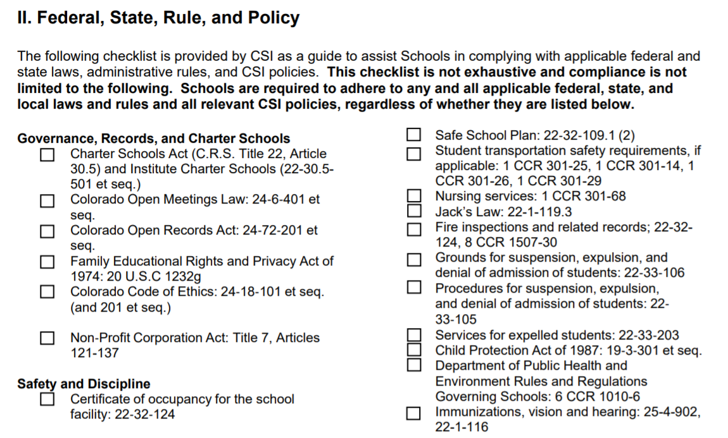
Ongoing Monitoring: Assurance of Compliance
Notes:
In addition, as part of the annual organizational submissions process, your board chair and school leader review and sign of CSI’s assurance of compliance document demonstrating your awareness of—and compliance with—the laws and policies applicable to charter schools.

Slide 8
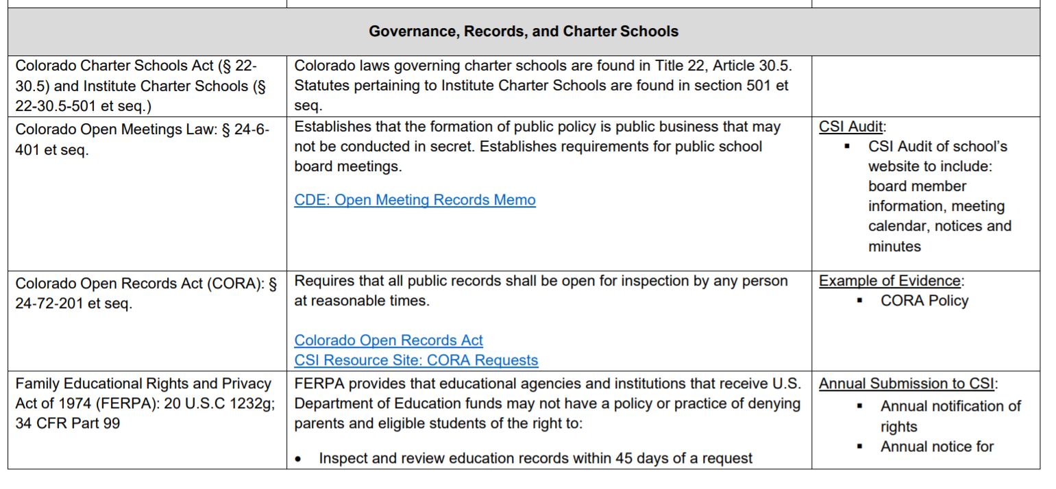
Ongoing Monitoring: Assurance of Compliance
Notes:
The document includes helpful summary information and resources on key policies impacting schools.
We update the document regularly to include newly enacted policies and related summary information.
Although the document only requires a signature from the board chair and school leader, it may be helpful for the entire board to review the document on an annual basis to ensure ongoing compliance.

Slide 9
Ongoing Monitoring: Audits
Enrollment audit
School board materials
Notes:
In addition, we complete two planned audits each year.
In early winter, we audit school websites to ensure proper posting of school board materials (including calendars, agendas and minutes).
In later winter, we audit school application pages/forms to ensure schools are conducting admissions in a nondiscriminatory manner.
We also conduct other unplanned audits, as needed, and provide feedback to schools. Audits are not meant to be a “gotcha”. Instead, we look at them as a way to reduce the submission burden on schools. If we can find the information on your website, we prefer not to ask for it. And, if we have feedback, we can provide that to you via email.

Slide 10
Ongoing Monitoring: Other Department Submissions
Data Submissions
Finance
School Programs
Notes:
There are also other submission requirements and monitoring processes beyond those established by the Policy & Governance Team. For example, the Data Submissions team monitors the timeliness and quality of data submissions through its own tracking system. The team reviews and validates submitted data, which can sometimes identify potential situations of noncompliance. (The same is true for finance and school programs submissions.)

Slide 11
CSI School Compliance Policy
Adopted by the CSI Board in 2011
Guide for addressing and remedying situations of noncompliance before getting to non-renewal or revocation of a charter contract
http://go.boarddocs.com/co/csi/Board.nsf/goto?open&id=APE6QN161099
Notes:
As mentioned, there are times when CSI identifies an issue of noncompliance. When this occurs, staff refer to and employ the CSI School Compliance Policy.
The School Compliance Policy outlines how CSI will address situations of noncompliance, based on the severity of the issue.
The policy is applied across all CSI Departments, so it is important that the school board, leader and others have an understanding of this policy, its procedures, and impacts.

Slide 12
Non-Compliance Notice Escalation Process
Formal Reminder
Notice of Concern
Notice of Breach
Immaterial violations
Used as a preliminary indicator of a potential larger issue at a school if other departments are experiencing similar violations.
A tool for CSI to implement additional supports to ensure schools get back on track.
Violation of law, rule, policy or contract
Meets 1 of 6 established criteria questions
May affect CARS/renewal
When school doesn’t satisfy NOC
3+ NOCs in 1 year
Serious violation
Other grounds for non-renewal/revocation
May affect CARs/renewal
Notes:
In accordance with the compliance policy, when issues arise and cannot be addressed through another informal route, CSI issues one of three notice types: A formal reminder, a notice of concern or a notice of breach.
FRs: Issued to a school in less severe situations of noncompliance (most common)
NOC: Issued when there is a violation […] and one of six required indicators is met. (Although these are issued, they are less common.)
Breach: Rarely issued in the most severe issues of noncompliance.

Slide 13
CSI School Compliance Policy: Formal Reminder
Less severe situation of noncompliance
Generally not material to renewal or other high-stakes decisions but may contribute to larger body of evidence re: performance
May escalate to a Notice of Concern or Notice of Breach
Notes:
Formal reminders are issued for less severe situations of noncompliance (or situations that do not arise to the level of a Notice of Concern).
Formal Reminders are generally not material to renewal or other high-stakes decisions (e.g., expansion, replication, etc.), but may contribute to a larger body of evidence regarding a school’s performance.
Formal Reminders may escalate to a Notice of Concern if not timely or appropriately resolved.

Slide 14
CSI School Compliance Policy: Notice of Concern
More severe situation of noncompliance
hinders, disrupts, or infringes on a student’s ability to access his/her education;
impacts the ability of CSI to fulfill its obligations to various stakeholders (including other schools in the portfolio and CDE);
represents a pattern of noncompliance or indicates larger systemic issues within the school;
seriously jeopardizes the continued operation of the school;
the school fails to remedy identified issues of noncompliance from a previous Formal Reminder; and/or
the issue jeopardizes student and/or staff safety or represents a serious threat to the school or community.
May be considered in renewal or other high-stakes decisions and may impact a school’s accreditation
May escalate to a Notice of Breach
Notes:
Whenever CSI has reason to believe that a school is in material violation of an applicable law, rule, policy, or contract provision, CSI may issue a Notice of Concern.
CSI reserves the right to issue a Notice of Concern in any situation of noncompliance; but, generally, a Notice of Concern is appropriate where the noncompliance [READ 1-3], when [READ 4-5].
Notices of Concern may be considered in renewal and other high-stakes decisions (e.g., expansion, replication, etc.) and may impact a school’s accreditation in accordance with the CSI Annual Review of Schools framework.
Multiple Notices (whether Formal Reminders or Notices of Concern) may result in heightened monitoring of a school. Fewer notices results in increased autonomy.

Slide 15
CSI School Compliance Policy: Notice of Breach
Most severe situation of noncompliance
The school failed to timely and appropriately satisfy a Notice of Concern;
The school has received more than three Notices of Concern in a year;
For any material violation of law, rule, policy, or the charter contract that CSI, in its sole discretion, deems serious enough to warrant immediate escalation to a Notice of Breach; and/or
For any of the situations identified under C.R.S. § 22-­30.05-­511 and 1 C.C.R. 302­1 (Rule 10).
May be considered in renewal or other high-stakes decisions and may impact a school’s accreditation
May result in revocation
Notes:
Whenever CSI has reason to believe that a school is in material violation of an applicable law, rule, policy, or contract provision, CSI may issue a Notice of Breach.
CSI reserves the right to issue a Notice of Breach in any situation of noncompliance; but, generally, a Notice of Breach is appropriate when [READ 1-3].
Notices of Breach may be considered in renewal and other high-stakes decisions (e.g., expansion, replication, etc.),may impact a school’s accreditation in accordance with the CSI Annual Review of Schools framework and ultimately could result in revocation of a charter contract.

Slide 16
When a School May Be Out of Compliance
CSI is committed to:
Providing appropriate notification of, and a clear process for, remedying the issue
Supporting schools to come into compliance
Escalating action under the School Compliance Policy as necessary
Notes:
In all cases, when a school is identified to be out of compliance, CSI is committed to:
Providing appropriate notification to the school and clearly outlining what the school needs to do to remedy the issue
Helping the school come back into compliance and providing consultation supports where needed
Escalating action under the school compliance policy as necessary

Slide 17
CSI School Compliance Policy: Remedies
CSI may revoke or deny renewal of the Contract for any of the grounds set forth in C.R.S. § 22-30.5-511 and 1 C.C.R. 302-1, Rule 10.00. Prior to revocation, CSI may, at its discretion, implement other remedies such as:
1. Withholding of funds
2. Seeking or requiring technical assistance
3. Requesting the Commissioner issue a temporary or preliminary order
4. Taking immediate control of school or a portion thereof
5. Submission of remedial plan
6. Intensive monitoring
7. Charter review
8. Any other remedies allowed by law
Notes:
There are certain conditions for which CSI can revoke or not renew a school’s contract. Prior to revocation, CSI can implement other remedies, which include: withholding funds, requiring technical assistance, intensive monitoring and more.

Slide 18
Effective Communications: CSI Responsibilities
Formal Reminders are typically sent to the school leader and/or assigned staff member (where appropriate)
Notices of Concern and Notices of Breach are sent to the School Leader and School Board Chair
All Notices will clearly identify:
the area of noncompliance; and
the required action and timeline for remedying the noncompliance.
Notes:
Formal Reminders are typically sent to the school leader and/or assigned staff member (where appropriate)
Notices of Concern and Notices of Breach are sent to the School Leader and School Board Chair
All Notices will clearly identify:
the area of noncompliance; and
the required action and timeline for remedying the noncompliance.

Slide 19
Effective Communications: School Responsibilities
Immediate Notice:
Conditions that cause a school to vary from the terms of the Contract, policy, or law;
Circumstances that require an unplanned extended closure of school (natural disaster, emergency);
Circumstances requiring lockdown or other health/safety threats;
Arrest, dismissal, or resignation of any Board member or employee for a federal crime or other crime related to misappropriation of funds or theft;
Misappropriation of funds;
Default on any obligations, including debts that are past due 60 days or more; and
Change in corporate status.
Notes:
CSI’s school compliance policy outlines when a school should provide immediate notice to CSI. This includes: 1) conditions that cause a school to vary from the terms of the contract; 2) circumstances that require an unplanned extended closure; 3) circumstances that require a lockdown or other health/safety threat; 4) the arrest, dismissal or resingation of a board member of employee for a crime; 5) findings of misappropriated funds; 6) the circumstances of a default on any obligations, including past due debts; and 7) and a change in corporate status.

Slide 20
Effective Communications: School Responsibilities
Timely Notice:
The discipline of an employee at the School arising from misconduct or behavior that may have resulted in harm to students or others, or that constituted violations of law;
Any complaints filed against the School or its employees, administration, or Board members by any governmental agency; and
Any changes in Board membership.
Notes:
In addition, timely notice should be provided to CSI when: 1) a school employee is disciplined for misconduct or behavior that may have resulted in harm to students or that constitute legal violations; 2) complaints filed against the school by any governmental agency; or 3) changes in board membership.

Slide 21
Questions for Boards
Has our school received Notices of any type from CSI in the past few years?
Has our track record (number or type of notices) worsened or improved over time?
Do the areas of noncompliance suggest a need for additional training or supports on a particular area?
Notes:
In addition to reviewing CSI’s school compliance policy, you might consider asking the following questions as a board. First… Second…Third… If you recognize a pattern of noncompliance, consider reaching out to CSI for supports in addressing an ongoing issue. CSI can work with you to identify gaps and propose solutions. Ultimately, we want to partner with you so that issues are addressed long before the CSI Compliance Policy comes into play. And, even after a Notice is issued, CSI is committed to working alongside you to remedy the noncompliance.

Slide 22
Resources
CSI School Compliance Policy
http://go.boarddocs.com/co/csi/Board.nsf/goto?open&id=APE6QN161099
Legal and Policy Resource Page
https://resources.csi.state.co.us/legal-and-policy-library/
CSI Calendar
https://www.csi.state.co.us/calendar/
Notes:
As I mentioned before, CSI’s compliance policy can be found on our BoardDocs page. The direct link is provided in this slide. The Legal & Policy Resource page may also be helpful to you. This page includes a link to the organizational submissions and audits process overview document and training webinar, the assurance of compliance document, sample policies, guidance documents and more. You might also consider viewing CSI’s calendar and subscribing to department-specific entries to plan for important events and prepare for upcoming deadlines. Feel free to reach out to Amanda Oberg if you need help subscribing to a calendar

Slide 23
Thanks!
Any questions?
Contact me at:
StephanieAragon@csi.state.co.us
Notes:
Thanks for taking the time to listen. I know this was a quick run through of the CSI Compliance Policy. Please know I am happy to connect with you individually to provide a deeper dive on this topic and answer any questions you might have specific to your school.

