Slide 1
Welcome to CSI’s McKinney-Vento Town Hall
Notes:
We are doing this updated training because some interpretation of the law has shifted, as well as there are new personnel involved both in CSI and in the schools. We want to improve the dissemination of information, as well as the quality of our consultation.

Slide 2
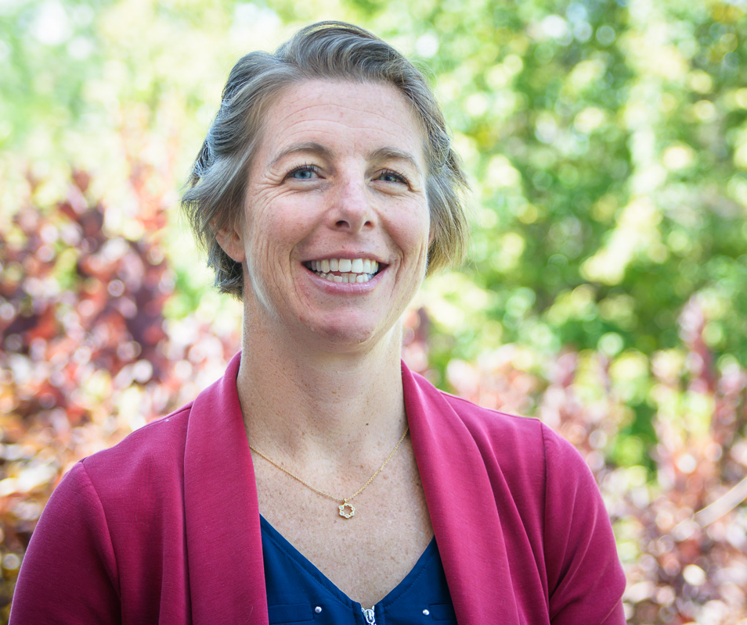
Agenda I
2:00pm-2:15pm
McKinney-Vento Eligibility & Transportation Resources
Betsy Basch, McKinney-Vento Coordinator, CSI

Slide 3
Agenda II
2:15pm-2:45pm
CDE Perspectives on McKinney-Vento and Common Pitfalls
Paula Gumina, State Coordinator for the Education of Homeless Children & Youth, CDE

Slide 4
Agenda III
2:45pm-3:00pm
Resources: How to Find Them, How to Use Them
Jen Smith, McKinney-Vento Liaison, CILA

Slide 5
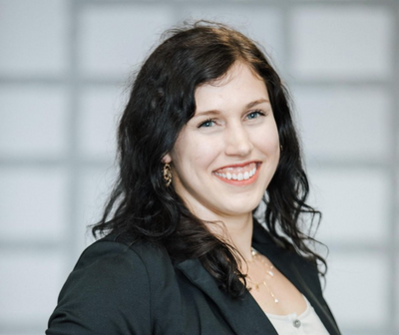
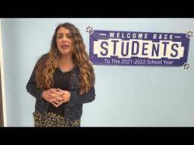
Agenda IV
3:00pm-3:30pm
Food Resources, Understanding FRL Status & Why RFL is Important in a Free Lunch World
Maggie Necaise,
School Nutrition Specialist, CSI
Yaritza Landa,
Pinnacle Charter School

Slide 6
McKinney-Vento Eligibility
The McKinney-Vento Homeless Assistance Act is a Federal Law.
We must identify students who are McKinney-Vento eligible.

Slide 7
McKinney-Vento Rights
Students have the right to be
identified
as being MKV eligible
Notes:
This doesn’t mean students and/or families are forced to accept assistance, it means that we as schools have a duty & responsibility to serve our students and families & to inform them of their rights. When we know students who qualify for McKinney-Vento & we say, “they don’t want help right now” we are knowingly depriving them of their federal rights.

Slide 8
Strategies to Increase Identification
Provide awareness activities for school staff
(what does fixed, regular & adequate mean)
Engage in anti-bias training with staff
Notes:
http://www.naehcy.org/educational-resources/
http://center.serve.org/nche/web/online_tr.php

Slide 9
“without delay”
Although the law is silent on the definition of immediate, the standard dictionary definition is without delay.
Therefore, the student must begin attending classes and participating fully in school activities without delay.
Generally, that would mean the same or the following day.
Notes:
https://nche.ed.gov/wp-content/uploads/2019/01/enrollment.pdf

Slide 10
Newcomers
Notes:
https://www.cde.state.co.us/cde_english/newcomerstudents
https://www.colorincolorado.org/glossary/newcomer-program
https://ona.colorado.gov/

Slide 11
Transportation
Reimbursed mileage
Set up Ride Services
Uber rides
Hop Skip Drive
Everdriven
Coordinated with a local district with a bus route nearby
Provided bus tickets
Filled up gas tanks if they do have a car (not a gas card)

Slide 12
Townhall Feedback-Identification
Two Question Topical Survey Here
Notes:
https://forms.office.com/Pages/ResponsePage.aspx?id=yM9Rp5of206DcJ8cbUvqWif5sy1du7JDpT1iP4FmBPZUOE5LR1lIWUZTRFBWWk1UNTI2T1hUNEE4RS4u

Slide 13
Next Up!
2:15pm-2:45pm
CDE Perspectives on McKinney-Vento and Common Pitfalls
Paula Gumina, State Coordinator for the Education of Homeless Children & Youth, CDE

