Slide 1
CSI Grant & Finance Session
February 2024

Slide 2
Agenda
CSI Finance Team Introduction
School Finance: Enrollment Workbooks
School Finance: School Finance Updates
Grants: Title Draft Budget Instructions
Grants: Milestone #2 Data
Grants: CDE Open Competitive Grants
Grants: Upcoming Milestones and Deadlines
Notes:
Welcome! Its busy day and thanks for being here to help with the move, learn about finance and some of our work. Today you'll hear from, Ilene Agustin our School Nutrition Manager, and Marcie Robidart our Grants Fiscal and Acct'ing Manager and myself. Review Agenda

Slide 3
CSI Finance Team - Introductions
Chief Finance & Ops Officer
Controller
School Nutrition Program Manager
Staff Accountant
Senior Grant & Procurement Analyst
Grants & Accounting Tech
Grants Fiscal & Accounting Manager
School Finance Manager
Nutrition and Data Specialist
Grants & Accounting Tech
Notes:
Quick overview of the team. Our team supports CSI and Schools. Today we're going to provide a deeper look at some of our work because it is evolving – as in SFA - or it relates to the work you might be doing currently or in the year to come. We want to provide clarity on tasks that intersect with the finance team and ensure that you have the right contact to reach out if you have questions.

Slide 4
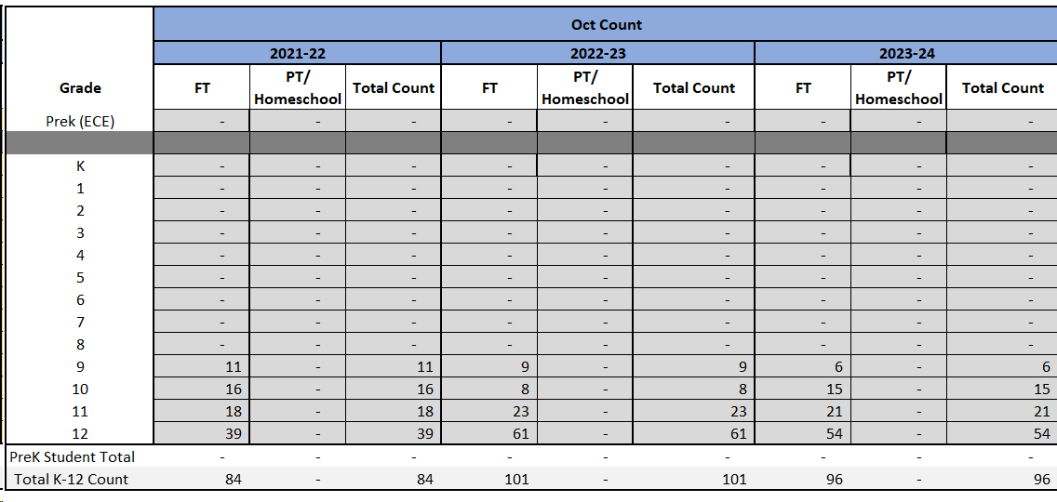
Enrollment Workbooks
FY204-25 workbooks sent
Due May 6th to CSI
Confirm numbers in June
Updates to the workbook

Slide 5
Enrollment Workbooks -
Enrollment Projection Training
Time: Mar 7, 2024 12:00 – 1:15pm
https://us02web.zoom.us/j/85113472319
Passcode: 643756
Topics:
Enrollment Projection Workbook (Andi)
Accessing School Data within Tableau (Collin)
Accessing Community Data from the State Demography Office (Collin)

Slide 6
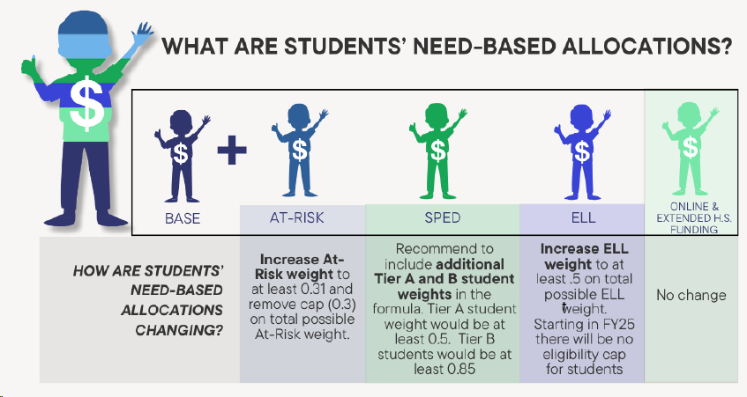
School Finance Updates
School Finance Task Force

Slide 7
FY25 ESSA Budgets
Draft workbooks will be emailed out Monday, February 26th, 2024
10% overall decrease in funding
Sharepoint links to draft budget workbooks
View only
Save a copy online and edit (school level collaboration on budgets)
FY25 Title IA Draft Budget Template
FY25 Title IA-Parent Draft Budget Template
FY25 Title IIA Draft Budget Template
FY25 Title IIIA Draft Budget Template
FY25 Title IIIA-IMI Draft Budget Template
*Program Resources*
Title Program Fact Sheet
ELPA v. Title IIIA Allowable & Required Uses
Title IIIA Immigrant Set-Aside Support
Aligning your UIP and Title Budget *new*
Date | Activity
Monday, February 26th, 2024 | FY25 Unified Improvement Planning Requirements and Timelines Released FY25 Title draft budgets released
March – April 2024 (ongoing) | Updated resources released, including virtual training modules and updated handbook
April – May 2024 | In-person regional work sessions for school leaders/UIP teams
Monday, May 20th, 2024 | Draft budgets due to RFF@csi.state.co.us
Monday, June 17th, 2024 | Assurances agreement deadline via Survey Monkey

Slide 8
FY25 ESSA Draft Budget Title IA
Tips for Complete Submission
Description of Activity should include the who (*omitting names), what, where, when, and intended outcome. Professional development activities need to include the date(s) and number of staff participating.
Staff Name is only required for salary
FTE should represent the amount of time that the budgeted amount is covering versus the FTE of the position objective
EXAMPLE - Staff member has a single objective, salary is $55k, Title IA is covering $15k with remaining from general funds. Proper FTE would be 0.27.
Aligns w/ what UIP Strategy must be complete

Slide 9
FY25 ESSA Draft Budget Title IIA
Tips for Complete Submission​
​
Grade Band Grade band must be selected. Activities spanning multiple grand bands must be split into separate lines with separate allocation amounts.
Description of Activity should include the who (*omitting names), what, where, when, and intended outcome​. Professional development activities need to include the date(s) and number of staff participating. Stipends must include rate information.
​
Staff Name is only required for salary​
​
FTE should represent the amount of time that the budgeted amount is covering versus the FTE of the position objective​
EXAMPLE - Staff member has a single objective, salary is $55k, Title IA is covering $15k with remaining from general funds. Proper FTE would be 0.27.
Aligns w/ what UIP Strategy must be complete

Slide 10
FY25 ESSA Draft Budget Title IIIA
Tips for Complete Submission​
Activity is Funded With Schools are required to identify if any other funding will be used to complete the proposed activity.
How Activity was Funded in FY2023-24 (continuing activities only) Schools are required to identify if any other funding was used to complete the activity.
Grade Band Grade band must be selected. Activities spanning multiple grand bands must be split into separate lines with separate allocation amounts.
Description of Activity should include the who (*omitting names), what, where, when, and intended outcome​. Professional development activities need to include the date(s) and number of staff participating.
​
Staff Name is only required for salary​
​
FTE should represent the amount of time that the budgeted amount is covering versus the FTE of the position objective​
EXAMPLE - Staff member has a single objective, salary is $55k, Title IA is covering $15k with remaining from general funds. Proper FTE would be 0.27.
Aligns w/ what UIP Strategy must be complete

Slide 11
FY25 ESSA Draft Budget Title IIIA-IMI
Tips for Complete Submission​
​
Grade Band Grade band must be selected. Activities spanning multiple grand bands must be split into separate lines with separate allocation amounts.
Description of Activity should include the who (*omitting names), what, where, when, and intended outcome​. Activities must demonstrate that services are available to identified pupils. IMI is not the same as ELL. Omit any reference to ELL and use IMI.
​
Staff Name is only required for salary​
​
FTE should represent the amount of time that the budgeted amount is covering versus the FTE of the position objective​
EXAMPLE - Staff member has a single objective, salary is $55k, Title IA is covering $15k with remaining from general funds. Proper FTE would be 0.27.
Aligns w/ what UIP Strategy must be complete

Slide 12
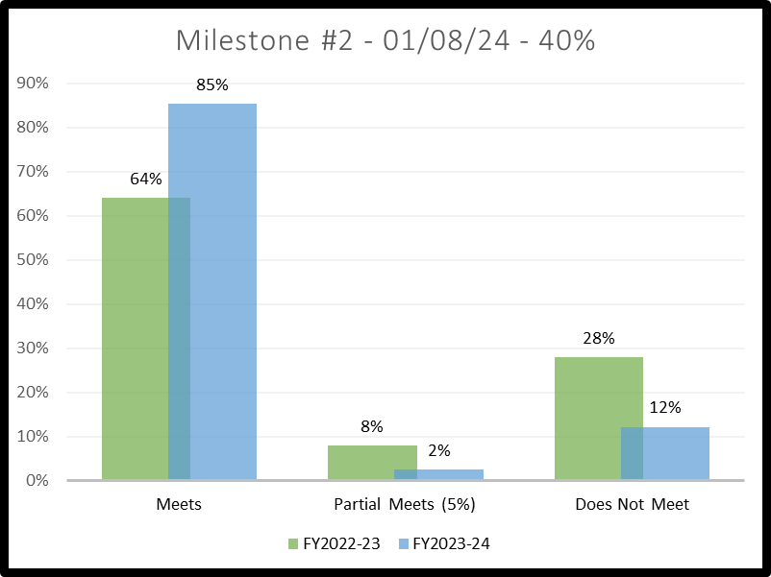
Milestone 2 Data
Reducing unrecoverable funding at year-end
Helps prevent cash flow issues
Allows for early detection of budget revision needs
Fulfillment of contractual agreement between School/CSI & CSI/CDE
Is included in the financial portion of PCARs reporting

Slide 13
CDE Open Competitive Grants
Opportunity | General Purpose | CSI Application Deadline | CDE Application Deadline
Early Literacy Professional Development Grant | Support Colorado educators in the implementation of scientifically- and evidence-based reading programming and strategies for (K-3) students. $1.12m total available funding. | 2/23/2024 | 2/28/2024
School Counselor Corp Grant | Increase the availability and implementation of effective school-based counseling to increase the state graduation rate and continue into postsecondary education. $30-50k Year 1, up to $90k Year 2-4 | 3/4/2024 | 3/7/2024
Early Literacy Grant | Improve students’ reading competency of the essential components of reading instruction into (K-3) teaching structures. $1.79m total available, 4-year funding period. | 3/8/2024 | 3/13/2024
Concurrent Enrollment Expansion and Innovation Grant | Providing grants to partnering LEPs and institutions of higher education to expand and innovate concurrent enrollment opportunities. Up to $50k per applicant, 1-year of funding. | 3/14/2024 | 3/18/2024
Student Wellness Grant | Centers for Disease Control and Prevention’s Whole School, Whole Community, Whole Child Model (WSCC) as a strategy to improve the health and well-being of children. $30k annually / $25k annually previously funded, 3-year funding period. | 3/18/2024 | 3/20/2024

Slide 14
More Information
Opportunity | General Purpose | CSI Application Deadline | CDE Application Deadline
Early Literacy Professional Development Grant | Support Colorado educators in the implementation of scientifically- and evidence-based reading programming and strategies for (K-3) students. $1.12m total available funding. | 2/23/2024 | 2/28/2024
School Counselor Corp Grant | Increase the availability and implementation of effective school-based counseling to increase the state graduation rate and continue into postsecondary education. $30-50k Year 1, up to $90k Year 2-4 | 3/4/2024 | 3/7/2024
Early Literacy Grant | Improve students’ reading competency of the essential components of reading instruction into (K-3) teaching structures. $1.79m total available, 4-year funding period. | 3/8/2024 | 3/13/2024
Concurrent Enrollment Expansion and Innovation Grant | Providing grants to partnering LEPs and institutions of higher education to expand and innovate concurrent enrollment opportunities. Up to $50k per applicant, 1-year of funding. | 3/14/2024 | 3/18/2024
Student Wellness Grant | Centers for Disease Control and Prevention’s Whole School, Whole Community, Whole Child Model (WSCC) as a strategy to improve the health and well-being of children. $30k annually / $25k annually previously funded, 3-year funding period. | 3/18/2024 | 3/20/2024

Slide 15
CDE GAINS Application Access Instructions
Accessing Applications GAINS Access Request Link *NEW* LEA Fiscal Representative Role
Marcie Robidart, Grants Fiscal & Accounting Manager
marcierobidart@csi.state.co.us
(720)315-4065
Authorized Representative
Andra Denton, Chief of Finance & Operations
andradenton@csi.state.co.us
(303) 503-9442
Email finance@csi.state.co.us Upon Completion *NEW*
GAINS automatically routes for signatures – have instance of notification not received
CDE Competitive Grants and Awards Forecast
CSI Grant & Funding Opportunities

Slide 16
Upcoming Grant Deadlines & Events
Date | Grant/Project | Category | Activity | Links
2/26/2024 | ESSA | CSI-wide | FY25 Title draft budgets released to schools
3/1/2024 | CHEG | Awarded Schools | Midyear Report Due | Reporting Link
3/12/2024 | CCLC | Awarded Schools | 2023-24 EOY Webinar (all cohorts) - Zoom 10am - 11:30am (link forthcoming)
3/15/2024 | CCLC | Awarded Schools | February Attendance Data due for submission (all Cohorts)
3/20/2024 | SHP-SLFRF | Awarded Schools | AFR Deadline to submit to CSI - Requirement, completed budget workbook and general ledger (01/01/23 - 12/31/23) | RFF@csi.state.co.us
3/26/2024 | CCSP | Awarded Schools | IFR Due (Expenses 07/01 - 03/15) | RFF@csi.state.co.us
3/29/2024 | SHP-SLFRF | Awarded Schools | Year 2 final budget and workplan due to CDE
3/31/2024 | CCLC | Awarded Schools | Y2023-24 Grant Award Reduction Request form due to CDE (all cohorts) Submit to your Lead Consultant
4/1/2024 | Milestone #3 | CSI-wide | Deliverable 60% reimbursable funds requested.
4/1/2024 | Milestone #3 | CSI-wide | Deadline for exception request forms | Exception Form

Slide 17
CSI School Shoutouts
Andrea Foust (The Academy of Charter Schools)
Halley Joseph (Prospect Academy)
Meeting deadlines, great communication, overall grant submission organization, and mentoring efforts.
Congratulations
Empowering Action for School Improvement (EASI)
Ricardo Flores Magon
Colorado Charter School Program (CCSP)
The Change Community School (opening FY25)

Slide 18
See you soon...
Thank you
Thank you!

Slide 19
Questions?
Next Session: Wednesday, March 20th, 2024
11:30am – 12:30pm
Registration Link
Session Feedback Survey
School Finance and Grant Training/Resources Link

