Slide 1
Charter School Institute McKinney-Vento and Serving Students
Experiencing Housing Instability
February 1, 2024
1

Slide 2
Introduction
Paula Gumina, State Coordinator
Education of Homeless Children & Youth Colorado Department of Education
2

Slide 3
Who is in the Room?

Slide 4
Objectives
Overview of McKinney-Vento Homeless Assistance Act
Preliminary data from the 2022-23SY
Challenges, questions, and promising practices that we are currently hearing from liaisons across the state
Review of meaningful resources to help you in supporting children, youth and families.
4

Slide 5
McKinney-Vento Basics
5

Slide 6
Highly Mobile Youth in Colorado
Highly Mobile Youth represent about 3%
of the total student population in Colorado*
Enough to fill over 275 yellow school buses!
1.9% Homeless Children & Youth
(16,540 students total, 2,034 of which were unaccompanied youth and 1,417 of which who received services in more than 1 school district)
1% Foster Care
(8,865 students)
0.02% Migrant
(2,203 students)
*886,517 total students enrolled in Colorado in 2021-22
6
Source: Dropout Prevention and Student Reengagement 2021- 22 Legislative Report https://www.cde.state.co.us/dropoutprevention/final2021-2022statepolicyreportdpse31623

Slide 7
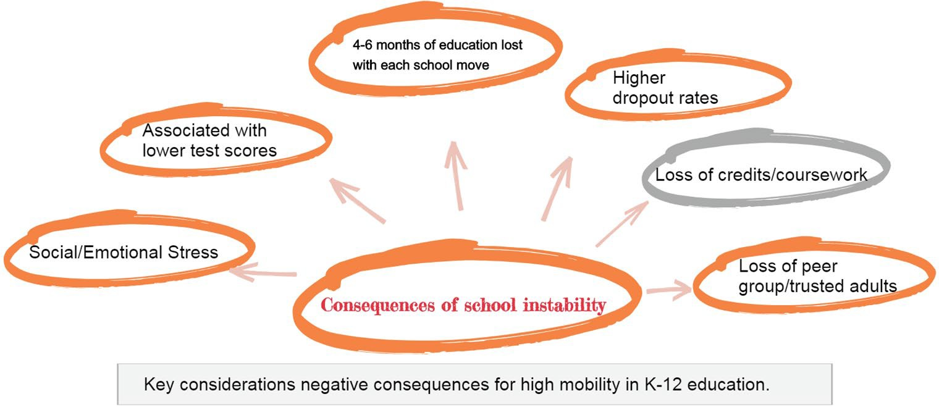
Impacts of High Mobility
7

Slide 8
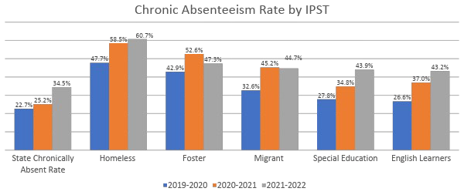
Colorado Chronic Absenteeism Rates
Comparison by student group in absenteeism rates over three school years
Source: CDE Office of Data Services and Office of Student Engagement and Dropout Prevention
*Note: Rates for 2019-2020 are slightly inaccurate due to changes in the way this rate was calculated.
8

Slide 9
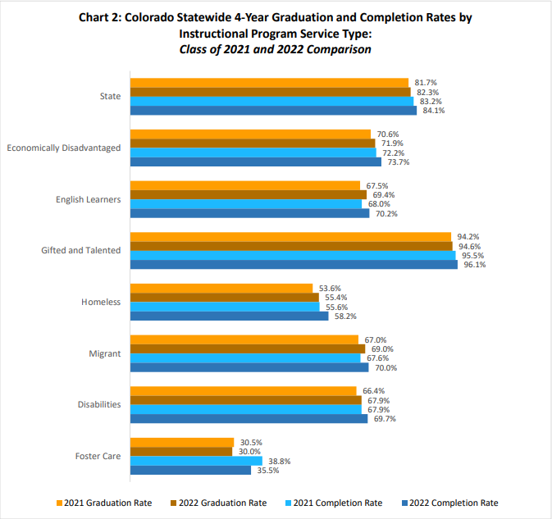
Colorado Graduation & Completion Rates
Comparison by student group (instructional program service type)
9
Source: CDE Office of Data Services and Office of Student Engagement and Dropout Prevention

Slide 10
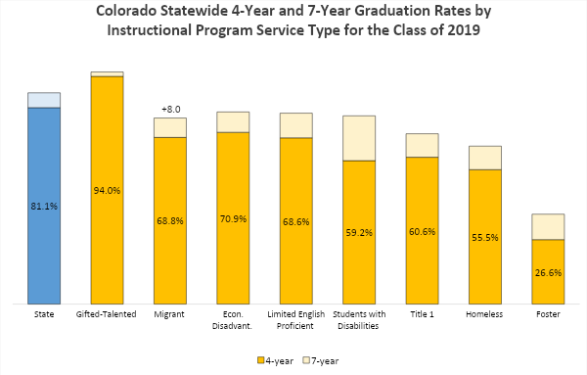
Colorado 4-year and 7-year Graduation Rates
+1.8
+6.1
+8.4
+10.2
+18.5
+9.7
+9.7
+10.5
10
Source: CDE Office of Data Services and Office of Student Engagement and Dropout Prevention
*Note: Starting in 2018, graduation rates included ASCENT and P-TECH students who were still enrolled but met

Slide 11
What is the McKinney-Vento Homeless Assistance Act?
The primary piece of federal legislation related to the education of children and youth experiencing homelessness
Subtitle VII-B of The McKinney-Vento Homeless Assistance Act authorizes the federal Education for Homeless Children and Youth (EHCY) Program
Reauthorized in December 2015 by Title IX, Part A, of the Every Student Succeeds Act (ESSA).
11

Slide 12
Under McKinney-Vento, the term “homeless” children and youth means:
Children who lack a fixed, regular, and adequate nighttime residence.
12

Slide 13
Children and youth who lack a fixed, regular and adequate primary nighttime residence
Fixed
Stable, Permanent, Stationary
not subject to change
Regular
Constant, Recurring, Consistent
Used on a predictable, routine, consistent basis Consider the relative permanence
Lawfully and reasonably sufficient
Sufficient for meeting the physical and psychological needs typically met in a home environment
Adequate
13
13

Slide 14
Examples
Sharing the housing of others due to loss of housing, economic hardship, or similar reason (sometimes referred to as doubled-up)
Living in motels, hotels, trailer parks, campgrounds due to lack of adequate alternative accommodations
Living in emergency or transitional shelters
Living in a public or private place not designed for ordinary use as a regular sleeping accommodation for humans (cars, parks, bus or train stations, abandoned buildings, substandard housing, etc.).
Unaccompanied youth living in the above circumstances
Migrant children and youth living in the above circumstances
14

Slide 15
Doubled-up
Shared housing or multigenerational living situations:
Who is included on the lease?
Who is contributing to household costs?
Does everyone have adequate space to sleep?
Is the living arrangement for everyone’s mutual benefit?
Are any members of the household looking for their own place to live?
Was one family already living in the space and another family moved in?
15

Slide 16
Substandard Housing
without adequate heat, electricity, or water;
with unsafe heat sources or electrical service;
with unsafe conditions, such as holes in flooring;
with a kitchen or plumbing that is inoperable; or
condemned by housing or other government authorities.
16

Slide 17
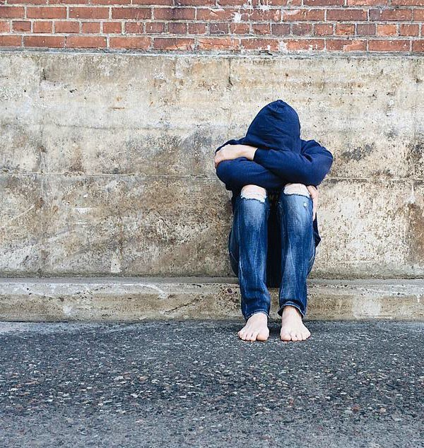
Unaccompanied Homeless Youth
Unaccompanied homeless youth are young people who lack safe, stable housing and who are not in the care of a parent or guardian
They live in a variety of temporary situations, including shelters, the homes of friends or relatives, cars, campgrounds, public parks, abandoned buildings, motels, and bus or train stations
Eligibility Flowchart : https://nche.ed.gov/wp-
content/uploads/2020/05/NCHE-Eligibility- Flowchart.pdf
Education for Homeless Children and Youth

Slide 18
“But the student chose to leave…”
A student may be an UHY regardless of whether the student was forced from the home or ran away.
Sometimes what has caused the separation between the student and the student’s parents may not be readily disclosed due to its sensitive or private nature.
Determinations of McKinney-Vento eligibility for unaccompanied students should be made on a case-by-case basis, focusing on the nature of the student’s current nighttime residence.
For more information, see NCHE's brief Supporting the Education of Unaccompanied Students Experiencing Homelessness at https://nche.ed.gov/wp-content/uploads/2018/10/youth.pdf
18

Slide 19
Ways Schools Can Support Students Experiencing Housing Instability
obtaining records for enrollment;
assessing the students’ academics
ensuring students have needed school supplies and basic need items;
providing time and space for a student who does not have a proper study environment outside of school to complete homework assignments or work on school projects;
ensuring that students are not punished for behavior related to their homelessness, such as tardiness or not completing homework, and providing support to address the behaviors;
waiving fees and removing barriers to students’ participation in extracurricular activities;
Meeting students and families where they are and connecting them to what they need
An easy to access resource or referral list to provide to families and youth who may not be familiar with community resources.

Slide 20
Important Topics

Slide 21
Educational Rights of McKinney- Vento Students
Access to a McKinney-Vento Liaison in their school district
Identification through outreach and coordination activities
Immediate enrollment with full and equal opportunity to succeed in school
Choice between the neighborhood school or the school of origin
(school last enrolled in or attended)
Transportation to the school of origin (including preschool)
Immediate access to free school meals and educational services for which they are eligible
Automatic eligibility for Title I, Part A of the Every Student Succeeds Act of 2015
Referrals to health care, dental, mental health and substance abuse, housing, and other appropriate services
Unaccompanied youth are informed of their status as independent students on the Free Application for Federal Student Aid (FAFSA)
21

Slide 22
School Stability
School of origin is the school attended when permanently housed or school in which last enrolled, including a preschool. 11432(g)(3)(I); Guidance N4; Fed. Data Guide
22

Slide 23
Best Interest Determinations
In determining best interest, the LEA shall:
Presume that keeping the student in the school of origin is in the student’s best interest. 11432(g)(3)(B)(i)-(ii)
Unless contrary to the request of the parent, guardian, or unaccompanied youth.
Consider student-centered factors, including the impact of mobility on achievement, education, health, and safety.
Give priority to the parent’s/guardian’s or unaccompanied youth’s request
23

Slide 24
School Stability cont.
If the LEA determines that it is not in the student’s best interest to attend the school of origin or the school requested by the parent, guardian or youth, the LEA must provide a written explanation of the reasons for its determination, in a manner and form understandable to such parent, guardian, or unaccompanied youth, including information regarding the right to appeal. 11432(g)(3)(B)(iii)
24

Slide 25
Transportation
McKinney-Vento students have the right to receive transportation to the school of origin at no charge for as long as they attend their school of origin, even if that school does not provide transportation for any other student.
When students remain in their school of origin, the LEA of origin and the LEA where the student currently resides share the responsibility for providing transportation to the school of origin.
There is no mileage limit for school of origin transportation, as school of origin placement is based on the student’s best interest.
25

Slide 26
Comparable Services
An LEA must provide services to each homeless child and youth that are comparable to services offered to other students in the LEA. (Section 722(g)(4)).
These services include:
public preschool programs and other educational programs or services for which a homeless student meets the eligibility criteria, programs for children with disabilities, programs for English learners, programs in career and technical education, programs for gifted and talented students, before-and after-school programs, school nutrition programs, and transportation. (Section 722(g)(4)).

Slide 27
Preliminary 2022-23 Data

Slide 28
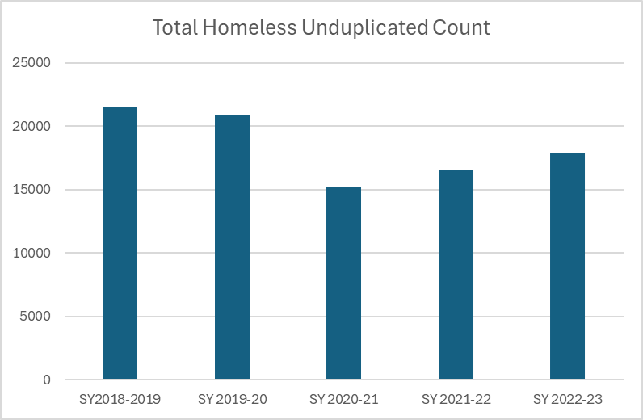
Total Homeless Unduplicated Count
21,560
20,821
17,894
16540
15,176
28
*The SY2022-23 data and has not yet been verified by the U.S. Department of Education

Slide 29
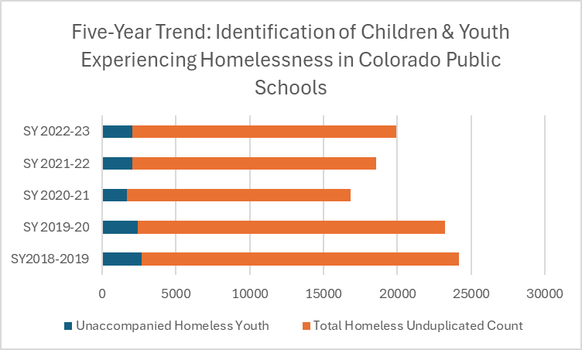
Five-Year Trend
2,045
29
*The SY2022-23 data and has not yet been verified by the U.S. Department of Education

Slide 30
Charter School Institute
Identified 179 McKinney- Vento Eligible Students
70% were living in doubled- up situations
42% Unaccompanied Homeless Youth
54% Latinx
12th Grade is highest identified grade level with 11th grade being second highest.
Top 25 highest Identifying LEAs in Colorado
State Comparison
17, 894 identified
71% living in Doubled-up
11% Unaccompanied Homeless Youth
56% Latinx
12th grade is the highest identified grade level with 1st grade being second highest

Slide 31
Resources
Q&A for Charter Schools
Homeless Education: Issue Briefs on an array of issues related to the McKinney-Vento Homeless Assistance Act and its implementation
The Most Frequently Asked Question on the Educational Rights of Children and Youth in Homeless Situations
Determining Homelessness by the Definition Homeless Education - Parents Poster
Spanish Parents Poster
Homeless Education - School-Aged Youth Poster
Spanish School-Aged Youth Poster
Higher Education Poster
Spanish Higher Education Poster

Slide 32
About NCHE
NCHE is the U.S. Department of Education’s technical assistance center for the federal Education for Homeless Children and Youth (EHCY) Program.
Website: https://nche.ed.gov/
Helpline: 800-308-2145 or homeless@serve.org
Products: https://nche.ed.gov/resources/
Webinars: https://nche.ed.gov/group-training/
Listserv: https://nche.ed.gov/resources/ (click Listserv tab)
Twitter: @NCHEducation | Facebook: facebook.com/NCHEducation

Slide 33
Questions
3
3

Slide 34
Thank you!
34

