Slide 1
CSI School Accountability
Training for CSI School Boards

Slide 2
Introduction
Charter authorizers are the oversight body responsible for the overall performance and compliance of the charter school.

Slide 3
Charter Contract
Charter School Institute Board of Directors
Charter School Board of Directors

Slide 4
Overview
The CSI Annual Review of Schools (CARS) Report is the report used to annually evaluate and accredit schools.
Notes:
Fulfill the statutory requirement to accredit schools
To align with authorizer best practice by providing an annual evaluation for schools to check their record and drive improvements

Slide 5
Why Annual Reports?
An annual public report provides clear, accurate performance data.
A comprehensive annual reporting process is critical to protect charter school autonomy, student rights, and the public interest, and ensures that schools are held to high standards.
Evaluates progress toward meeting the standards and targets stated in the charter contract, including essential compliance requirements.
Charter schools are built around the promise of greater autonomy in exchange for greater accountability, and the annual report provides an opportunity to review the charter school’s prior performance.

Slide 6
What is CARS?
CARS refers to the process for collecting, analyzing, and reporting data on school performance.
Data Collection
Reporting
Visuals
Assessments
Organizational Submissions
Audits
Site Visits
Analysis
Evaluate against metric criteria
Narrative
School-specific data
State Reporting
CARS
Notes:
Conversations with bond holders

Slide 7
Audience
Data from the CARS process is used to populate various tools to communicate school performance to key stakeholder groups.
CSI Board
Narrative evaluation of the performance data
School
Interactive dashboard presenting data across all performance indicators
Public
Visuals showing performance on key indicators
VISUALS DATA NARRATIVE
Notes:
How will they be the same?
How will they be different?

Slide 8
CSI Annual Review of Schools
Academic
Achievement
Finance
Enrollment
Organizational
Education Program
Growth
Postsecondary & Workforce Readiness
Operating Margin
Diversity, Equity of Access & Inclusion
Financial Management
School Operations & Environment
Debt
Balance Sheet
Governance

Slide 9
CARS Overview
In each of these three areas, the frameworks ask a fundamental question: how did the school perform last year?

Slide 10
Academic

Slide 11
Finance

Slide 12
Organizational

Slide 13
CARS Process Overview
Data Collection (Prior School Year)
Review Against Performance Frameworks (Fall)
Data Reporting (Winter)
Data are collected from a variety of sources, including assessment results, state reporting, financial and organizational submissions and audits.
Data are then reviewed against each of the measures within the CSI Performance Frameworks.
Data are analyzed and shared with stakeholders through CARS reporting tools.
*Accreditation rating of Year 1 schools is based off of level of risk identified in new school recommendation and fulfillment of milestones to date.
Notes:
Please use the following slides to outline the basic functions of the department and how the school will engage with your team throughout the 17-18 school year

Slide 14
CARS Timeline
CDE releases preliminary SPFs for districts to share with schools
CSI releases prelim CARS Report to schools and proposed accreditation rating
CSI engages in the request to reconsider process with schools and CDE as appropriate
State Board approves school SPF plan types
CSI Board approves school accreditation ratings
CDE releases student level data from prior year's assessments
.
Aug Sep Oct Nov Dec Jan … July

Slide 15
Assigning School Ratings

Slide 16
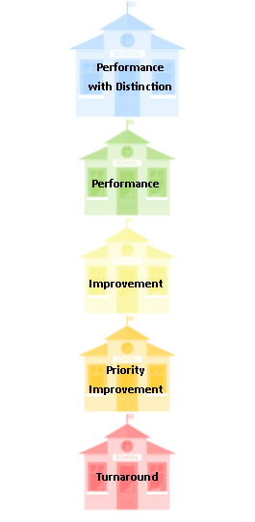
Accreditation Ratings
Awarded to any CSI school in the top 25% of schools in Colorado – this rating is unique to CSI
Schools in these categories are not mandated to receive the level of supports as the rating categories below. However, schools with declining performance may be required to receive additional supports.
Any school in these rating categories are placed on performance watch and receive additional supports and interventions, required by both CSI and the state.
Notes:
The CSI board uses CARS data during charter renewal
Schools use CARS data in improvement planning

Slide 17
Using the CARS Report
The CARS Report can be used to inform the development of the school Unified Improvement Plan
Board strategic planning can also incorporate information from the CARS Report or other CSI reports (renewal, expansion, etc.)
Evaluate
Plan
Implement
Analyze data
Prioritize areas of growth
Identify root causes
Select strategies to remedy root causes
Create action plan for each strategy
Follow timeline and monitor implementation benchmarks for each strategy

Slide 18
Resources
CSI Renewal Website (includes all renewal materials, site visit materials, and supplemental resources)
Annual accountability reports and resources
School Accountability One Pagers
Annotated CARS Report
CARS Handbook
CARS Dashboard

Slide 19
Thanks!
Any questions?
Contact me at:
ryanmarks@csi.state.co.us

