Slide 1
Early Childhood Mental Health

Slide 2
What is Early Childhood Mental Health & Why is it Important?
The developing capacity of the child from birth to 5 years old to form close and secure adult and peer relationships; experience, manage, and express a full range of emotions; and explore the environment and learn—all in the context of family, community, and culture.”
Notes:
Zero to Three, 2017
https://www.zerotothree.org/

Slide 3
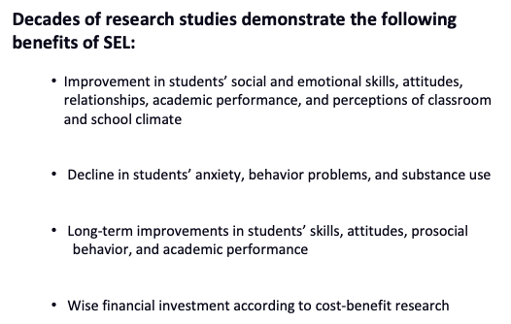
Impact of Social Emotional Learning on Academics
Notes:
Zero to Three, 2017
https://www.zerotothree.org/
Benefits of SEL
•We know from a large body of research on SEL that high-quality SEL programming leads to improved academic performance, decreases in anxiety and behavior issues, among other benefits.
•We also know from research beyond the traditional SEL field that there are additional insights to be gained that are relevant to SEL.
Meta-analysis source (first 3) Durlak, J.A., Weissberg, R.P., Dymnicki, A.B., Taylor, R.D., & Schellinger, K. (2011). The impact of enhancing students’ social and emotional learning: A meta-analysis of school-based universal interventions. Child Development: 82 (1), 405-432.
Financial investment (bottom): Belfield, C., Bowden, B., Klapp, A., Levin, H., Shand, R., & Zander, S. (2015). The Economic Value of Social and Emotional Learning. New York: Center for Benefit-Cost Studies in Education.

Slide 4
Long Term Implications
Early social emotional delays are associated with an increase in later challenges (Campbell et al., 2006)
Positive experiences can have positive long-term implications (Jones et al., 2015)
Early intervention is associated with fewer later problems (Briggs-Gowan et al., 2006; Zeanah & Zeanah, 2019)
Social Emotional Skills need to be explicitly taught & modeled
“Good Enough” relationships
Notes:
https://www.zerotothree.org/

Slide 5
Let’s Talk About Discipline
When we overreact to children’s behaviors, the results are lifechanging
If we punish kids for small things, they tend to act out later
The better we are at addressing racial bias & social stigma the better our responses are for children
Notes:
found that about 50,000 children in preschool and child care were suspended each year and 17,000 were expelled, meaning about 250 children per day are asked to leave temporarily or permanently,
https://www.k12dive.com/news/Trauma-from-preschool-expulsions-suspensions/640034/

Slide 6
Preschool Expulsion
There is extensive research on the long-term negative impacts for children who are suspended or expelled in the early years of their lives.
This is sometimes referred to as the “preschool to prison pipeline,” which, according to The Center for American Progress, “has become a powerful metaphor to capture the processes by which children are pushed out of school and into the criminal justice system
Notes:
CDE-Suspensions & Expulsions in Preschool
“Research indicates that young children who are suspended or expelled from school are several times more likely to experience disciplinary action later in their academic careers, drop out or disengage from high school, report feeling disconnected from school, and be incarcerated later in life” (HB19-1194).
.” By some estimates, preschool children are expelled at rates more than three times higher than children in K-12 settings. Another concerning trend is the disproportionality of which children are more likely to get suspended. According to Stegelin (2018), “Federal data indicate that a disproportionate number of male students representing minority populations are expelled, along with English Language Learners and students with disabilities, all of whom could benefit from daily attendance in preschool programs.”
https://www.npr.org/sections/ed/2016/09/05/490226345/preschool-suspensions-really-happen-and-thats-not-okay-with-connecticut

Slide 7
Is Exclusionary Discipline the same as Expulsion?
“Suspension”
“Soft Expulsion”
Disciplining a child by sending the child out of the classroom, such as to the director’s or principal’s office
Asking a family to pick up their child early because of behavioral issues
Telling a family the child “isn’t a good fit” or they can “no longer support” the child
Asking the family to pick up their child early so often the family misses or leaves work frequently
Notes:
Resource: What do exclusionary discipline practices look like in early childhood settings? Examples of exclusionary practices in early childhood SRI Education
https://www.sri.com/press/blog-archive/preventing-expulsions-in-early-childhood-and-supporting-all-childrens-success/

Slide 8
Long Term Implications of Labeling
Labeling children has impact…..
…..but we don’t want to ignore data
Notes:
https://www.zerotothree.org/

Slide 9
Celebrate Failure?
We know we don’t want to scare students when they fall, we want to say “what a great way you fell” or “caught yourself” because just saying, “be careful” isn’t helpful if I don’t know what to do……
What procedures are in place for you to celebrate failure?
Notes:
https://www.zerotothree.org/

Slide 10
Do You Like Me?
Growth mindset isn’t enough for lower SES backgrounds
Growth mindset AND skills
Am I welcome here? Am I valued here? Am I celebrated here?
When kids don’t like school, they tend to not do well in school
Notes:
https://www.apa.org/monitor/2022/01/lab-youth-school

Slide 11
Developmental Norms

Slide 12
15 Month Developmental Milestones
Copies other children while playing, like taking toys out of a container when another child does
Shows parent an object they like
Claps when excited
Hugs stuffed doll or other toy
Shows parent affection (hugs, cuddles, or kisses parent)
Reading regularly with young children stimulates optimal patterns of brain development and strengthens parent-child relationships at a critical time in child development, which, in turn, builds language, literacy, and social-emotional skills that last a lifetime.
Notes:
American Academy of Pediatrics: https://www.aap.org/en/patient-care/early-childhood/milestone-timeline/
Reading together is a great way to spend time with your child and encourage them to learn. It is never too early to start reading to your child. Try to point out colors, shapes, or characters to engage your child in the story, even if you make up a new one.

Slide 13
What to Say: 9-18 Months
Recognize when toddlers have comforted themselves. For example, say, “You found your bear and made yourself feel better.” Offer a hug. Smile and laugh with them.
Encourage toddlers to solve problems. For example, say, “You are working hard on that puzzle.” Help only when they show you that they need help.

Slide 14
18 Month Developmental Milestones
Moves away from caregiver, but looks to make sure caregiver is close by
Points to show caregiver something interesting
Puts hands out for caregiver to wash them
Looks at a few pages in a book with parent
Asists when caregiver is dressing them by pushing arm through sleeve or lifting up foot
Research shows internal motivation (aka curiosity) not external strategies, is what motivates young children to seek out new experiences and leads to greater success in school over the long term. Young children are born with innate curiosity. Healthy relationships early in life support a young child's curiosity by building safe environments for them to explore and learn.
Children use all of their senses to take in all this new information and use their developing skills to make sense of what they are seeing, hearing, tasting, smelling, and touching. Secure relationships build the trust that children need to exercise their curiosity.
Notes:
American Academy of Pediatrics: https://www.aap.org/en/patient-care/early-childhood/milestone-timeline/
Wondering rather than assuming we know.
Your child is learning so much very quickly. You can nurture their curiosity by exploring their interests together. Talk about what you are doing, answers their questions as honestly as possible, and ask them open-ended questions to understand how they see the world.
Each approach to nurturing and encouraging curiosity varies. You can nurture their natural interests and emotions by asking open-ended questions and wondering out loud. The most important takeaway is that children’s interests should be acknowledged and encouraged to support healthy social emotional development and future learning.

Slide 15
2 Year Developmental Milestones
Notices when others are hurt or upset, like pausing or looking sad when someone is crying
Looks at parent’s face to see how to react in a new situation.
Early emotional experiences between babies and their caregivers are crucial to the development of empathy. As caregivers nurture and care for infants, babies make crucial associations between positive human interactions, reward systems, and feelings of calm and safety. Children who feel safe, secure, and loved are eventually more sensitive to others' emotional needs.
Notes:
American Academy of Pediatrics: https://www.aap.org/en/patient-care/early-childhood/milestone-timeline/
You can nurture your child's emotional health and help them build relationships with other children. Feeling accepted and understood by you helps your child learn how to accept and understand others as he grows. Give your child your full attention while you listen to them express their emotions. Repeat back what you hear, telling your child you understand what they’re experiencing. Expressing emotions is an opportunity to connect with your child and coach them through a challenging feeling.

Slide 16
2.5 Year Developmental Milestones
Plays with and next to other children
Shows caregiver what they can do by saying, “Look at me!”
Follows simple routines when told, like helping to pick up toys when caregiver says, “It’s clean-up time.”
Executive function (EF) refers to a set of cognitive skills that control working memory, self-regulation, reasoning, and problem-solving. Adults can facilitate the development of a child’s executive function skills by establishing routines, modeling social behavior, and creating and maintaining supportive, reliable relationships.
Notes:
American Academy of Pediatrics: https://www.aap.org/en/patient-care/early-childhood/milestone-timeline/
Play is an important way for your child to learn how to build relationships. Does he/she attend child care or preschool? Or are you able to organize regular playdates? Learning to build friendships and play well together is an important part of getting them ready for kindergarten.

Slide 17
What To Say: Toddler
Establish, explain and model simple rules—like a bathroom routine—in ways they can understand. Use pictures to help support routines.
1
Ask children questions that apply to real problems and talk with them about different approaches to solving problems.
2
Encourage children to ask questions and seek answers by exploring and thinking about what they learn.
3
Notes:
PLAYbook-Colorado Department of Early Childhood

Slide 18
Offer Opportunities to Practice Negotiation
When children disagree, encourage them to talk to each other about what they want. “Liam, you wanted to use the large blocks to build an airplane, but Carlos started to create a boat. Share your idea with him and see if you can work out a plan.”
If plans have to be changed, remind the children that they have options. “You want the magic wand, but it’s still Emma’s turn. You can sit and wait, or you could pretend this cape is magic and wear it until Emma is done.”
Notes:
Reference:
https://illinoisearlylearning.org/tipsheets/self/

Slide 19
Toddler Developmental Empathy
Ask the toddler to pay attention to who is present and missing from activities (e.g., “Was Jenny at the playground today?”).
Read books and talk about friends and friendships, including diverse families & people.
Read books together that demonstrate how characters’ behaviors affect other characters.
Talk about what the toddler is feeling and how other children may be feeling, such as why they are crying or are upset.
Model comforting others.
Demonstrate and describe how to cooperate in daily activities (e.g., talk about waiting your turn
And in the grocery checkout line).
Notes:
Colorado Early Learning & Development Guidelines

Slide 20
When giving positive feedback
Start with:
• “I’m so appreciative that you...”
“It really pleases me when you...”
• “You have really learned how to...”
• “You must feel proud of yourself for...”
• “You’ve done a wonderful job at...”
Notes:
PLAYbook-Colorado Department of Early Childhood

Slide 21
Toddler Emotional Development
Provide regular and purposeful interactions that include holding, talking, cuddling, hugs, pats on the back, and other physical touches when appropriate.
Acknowledge uncooperative or negative behavior as a sign of asserting oneself.
Share and discuss books and pictures of people showing emotions.
Help the toddler identify feelings as they are occurring.
Provide recognition of the toddler’s response to activities or situations (e.g., “You don’t seem to like this game.”).
Notes:
Colorado Early Learning & Development Guidelines

Slide 22
3 Year Developmental Milestones
Calms down within 10 minutes after parent leaves, like at a childcare drop off
Notices other children and joins them to play
Self-regulation is the process that a child’s brain goes through that gives them the ability to control their behaviors and emotions in response to a particular situation. It’s having the skill to calm yourself down when you get upset, adjust to a change in environment or expectations, and handle frustration without outbursts. When children share, listen to others, or wait their turn, they are practicing self-control.
Notes:
American Academy of Pediatrics: https://www.aap.org/en/patient-care/early-childhood/milestone-timeline/

Slide 23
What to Say: 3 Year Olds
Toddlers will need help to build skills to calm themselves and regulate their emotions. You can:
Notice and identify the emotion.
Name and connect the emotion.
Pause and say nothing.
Support your child while they calm down.
Address the issue.
Notes:
American Academy of Pediatrics: https://www.aap.org/en/patient-care/early-childhood/milestone-timeline/

Slide 24
4 Year Developmental Milestones
Pretends to be something else during play (teacher, superhero, dog)
Asks to go play with children if none are around, like “Can I play with Alex?”
Comforts others who are hurt or sad, like hugging a crying friend
Avoids danger, like not jumping from tall heights at the playground
Likes to be a “helper”
Changes behavior based on where they are (place of worship, library, playground)
Emotional literacy is the ability to identify, understand, and respond to emotions in oneself and others in a healthy manner. Children who have a strong foundation in emotional literacy tolerate frustration better, get into fewer fights, and engage in less self-destructive behavior than children who do not have a strong foundation. These children are also healthier, less lonely, less impulsive, more focused, and they have greater academic achievement.
Notes:
American Academy of Pediatrics: https://www.aap.org/en/patient-care/early-childhood/milestone-timeline/

Slide 25
What to Say: 4 Year Olds
Helping them label their feelings can build their skill in controlling outbursts or other challenging behavior.
Model how to name your feelings (this really frustrates me) and express them in a healthy way.
It can also help to give them the words for how they are feeling in difficult situations (I can tell this makes you sad).
Notes:
American Academy of Pediatrics: https://www.aap.org/en/patient-care/early-childhood/milestone-timeline/

Slide 26
What to Say: 5 Year Olds
You can help children build and keep self-esteem:
Listen to and acknowledge a child’s thoughts and feelings.
Create situations that help children experience success. Set clear and appropriate expectations and over reasonable amounts of help.
Give your child a feeling of reasonable control over their life. Let them make small, everyday decisions for themselves.
Reinforce that children are lovable and capable.
Demonstrate that you have a positive view of yourself.
You can build a child's independence and self-esteem. As children grow, things like learning to dress, cook, or ride a bike are chances to build self-esteem and confidence. When teaching a child how to do something, show and help them at first. Then let them do what they can, even if they make mistakes.
Notes:
American Academy of Pediatrics: https://www.aap.org/en/patient-care/early-childhood/milestone-timeline/

Slide 27
5 Year Developmental Milestones
Follows rules or takes turns when playing games with other children
Sings, dances, or acts for parent
Does simple chores at home, like matching socks or clearing the table after eating
When children feel confident and secure, they're more likely to succeed in school and achieve personal goals. Having a positive self-image helps a child feel happy and capable of maintaining personal relationships. Self-esteem impacts decision-making, the ability to forge relationships, and emotional health and well-being.
Chores help children learn about healthy expectations and how they can independently care for themselves. Being involved in chores allows children to experience relational health through skills such as communicating needs, negotiating, cooperating and working as a team. This provides a sense of accomplishment and can boost a child’s self-esteem.
Notes:
American Academy of Pediatrics: https://www.aap.org/en/patient-care/early-childhood/milestone-timeline/

Slide 28
Modeling
You can help children develop their own coping skills by modeling your own positive social behavior during times of stress. Label when you feel stressed, overwhelmed and scared for children. Model the use of words to describe feelings. Share a time you were scared of something new and what you did to feel more comfortable. Model strategies to handle stress and manage your own emotions and behavior. Show choices children can copy such as taking a walk together, talking to a friend or listening to calming music.
Notes:
PLAYbook-Colorado Department of Early Childhood

Slide 29
Modeling Reading
Do we want humans who love to read? Are we people who love reading? Do we demonstrate our love for reading?
Play-based learning & social development
Notes:
PLAYbook-Colorado Department of Early Childhood

Slide 30
Adult Modeling

Slide 31
Modeling Acceptance
What would it cost you to assume that a student is doing their best
Notes:
PLAYbook-Colorado Department of Early Childhood

Slide 32
What To Do: Early Childhood
Show children you value their presence by offering a warm, personal greeting when they enter the setting and a “See you tomorrow” or “See you soon” as they leave. When a child is absent, let them know you missed them.
Pair a child who has difficulty making friends with a more skilled buddy to complete a fun activity together.
Notes:
Colorado Early Learning & Development Guidelines

Slide 33
Early Childhood Adult Modeling
Pause before you react to an incident in the setting; for example, a disagreement over a turn on the slide.
Ask the children who were involved how they feel about what has happened.
This acknowledges children’s feelings and also gives you a moment to figure out how you want to respond.
Notes:
Colorado Early Learning & Development Guidelines

Slide 34
Developmentally Appropriate Behaviors (maybe)
Tantrums
Anger
Aggression
Opposition
Crying
Anxiety
Disruptive Behavior

Slide 35
This is the Whole Reason We Are Here!
Instead of, “they’ll grow out of it” OR “this kid’s already so messed up”
This is developmentally appropriate; and/or;
This child needs interventions; and/or;
3) This student is a candidate for ChildFind
Let’s move to:
Notes:
https://www.cde.state.co.us/early/candbcomparison

Slide 36
Developmentally Concerning Behaviors (Birth to Three)
Difficulty regulating around routines (eating, sleeping)
Fussy
Difficult to console
Trouble forming relationships
Easily startled
Flat Affect

Slide 37
Developmentally Concerning Behaviors (Three to Five)
Compulsive Activities
Developmentally inappropriate tantrums
Withdrawn
Repeated aggression or impulsivity
Difficulty playing with others
Language/communication difficulties
Regression
Anxious or fearful in most situations

Slide 38
Reduce Stressors
GO Quiet: approach silently, use nonverbals, limit auditory processing demands
Ask Open-ended questions: skip directions & corrections, pause between questions, aim to understand perspective
Give Visual Support: Write, Draw or Display Directions
Offer Breaks: Go for a Walk, Take a Breath, Sit Together, Get Some Water
Get Creative: Play Calm music, move, dance, draw, create
Notes:
Inclusive Schooling

Slide 39
Reduce Stressors II
Show Compassion: Offer a smile, hug or a hand
Reduce the Size of the Group: Peer partners, stations, co-teaching, small groups
Reduce Inputs: Reduce clutter, increase space between students, use outdoor or other environments
Reduce Demands: reduce number of tasks/directions, provide choice for working together/peer, additional timeline, provide choices
Slow Down & Give Time: Count to 3, take 2 deep breaths, use a visual, peer turn and talk
Notes:
Inclusive Schooling

Slide 40
Best Practices for Mental Health
Safe environment
Safe relationships
Safe routines
Positive expectations

Slide 41
Adults Asking for Help
Instead of, “this child is on my last nerve”….
try…. “I need a break”….
Instead of, “this child is being so manipulative”…..
try…. “This child is difficult for me, and I need new ideas”….
Instead of, “are you pissing me off on purpose”….
try…. “I can see you’re trying your best, and I need a breath”….

Slide 42
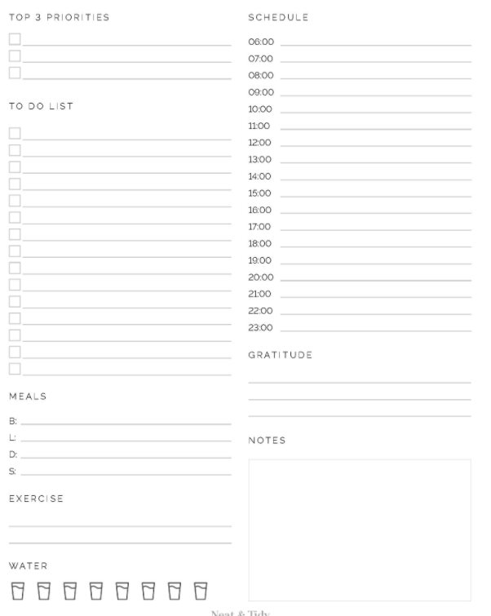
Adult Strategy: Recognize and track your signs of stress.
Practical Application:
Track the times you feel most stressed over the course of a week.
Plan to incorporate activities you enjoy with your class during that time (read-aloud, brain break, art, project work, or just play!).
Notes:
Rationale: Stressed adults are not as effective in supporting stressed/escalated students.
The stress management plan is designed for teens, but can be used for adults!
Tier III resource: How to Support a Staff Member with a mental health problem

Slide 43
Resources
Colorado ECMH Consultation-The Early Childhood Mental Health Support Line is a no-cost, confidential resource for anyone who cares for children under six. The support line can help you to better understand and support the well-being of the young children in your care, including children who may currently be struggling.
Colorado Early Learning & Development Guidelines
American Academy of Pediatrics: https://www.aap.org/en/patient-care/early-childhood/milestone-timeline/
PLAYbook-Colorado Department of Early Childhood
Guidelines for Developmentally Appropriate Practice in Action: Using Knowledge of Child Development and Learning in Context

Slide 44
Resources II
Can Reading Problems Affect Mental Health?
https://thinkingreadingwritings.wpcomstaging.com/2019/04/22/can-reading-problems-affect-mental-health/
The meta-analysis suggests that there is a statistically reliable association between poor reading and internalising problems, and between poor reading and anxiety.
Francis, D. A., Caruana, N., Hudson, J. L., & McArthur, G. M. (2019). The association between poor reading and internalising problems: A systematic review and meta-analysis. Clinical Psychology Review, 67, 45–60. https://doi.org/10.1016/j.cpr.2018.09.002
Poor readers were at greater risk for generalised anxiety and separation anxiety but not specific phobias, and that this increased risk was not attributable to a shared association with inattention.
Carroll, J. M., Maughan, B., Goodman, R., & Meltzer, H. (2005). Literacy difficulties and psychiatric disorders: Evidence for Comorbidity. Journal of Child Psychology and Psychiatry, 46(5), 524–532. https://doi.org/10.1111/j.1469-7610.2004.00366.x
Dyslexic children are at risk for mental health issues, and persistent emotional symptoms. Therefore, interventions regarding not only reading ability but also psychological conditions should be pursued.
Xiao, P., Zhu, K., Feng, Y., Jiang, Q., Xiang, Z., Zhang, Q., Wu, X., Fan, Y., Zou, L., Xiao, H., & Song, R. (2023). Associations between dyslexia and children’s Mental Health: Findings from a follow-up study in China. Psychiatry Research, 324, 115188. https://doi.org/10.1016/j.psychres.2023.115188

Slide 45
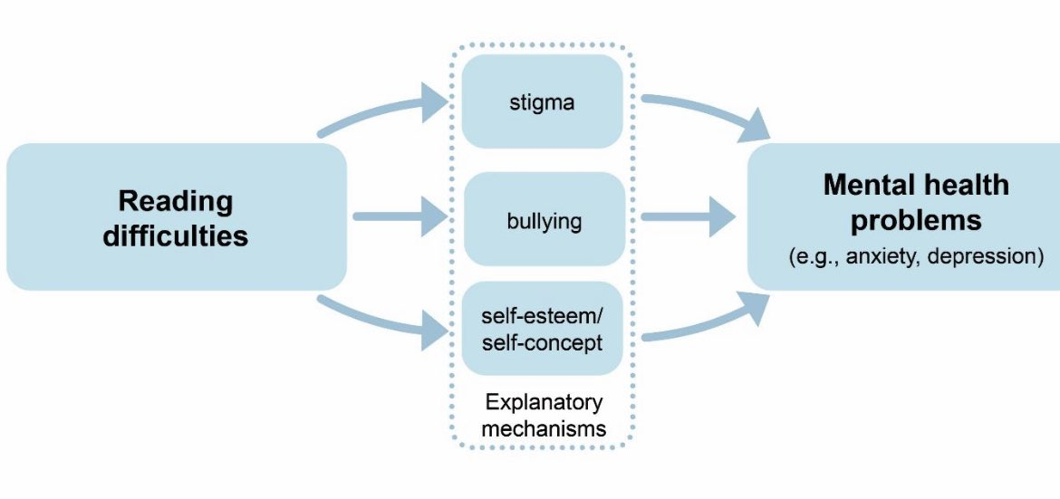
Resources III
Dyslexia and Allied Reading Difficulties and their Relationship with Mental Health Problems
Notes:
https://t.co/dRUO9aZdcr

