Slide 1
Entry, Exit, and Retention Coding and Dates
General Collection Training
Recorded March 2024
Notes:
Welcome to the Entry/Exit/Retention Coding Training for General Collections.
This training, recorded by the CSI data team, provides an overview of the appropriate use of Entry, Exit, and Retention codes.

Slide 2
Entry/Exit/Retention Codes & Dates
Entry, exit, & retention codes are data fields collected through the Student School Association (SSA) file.
Entry codes and dates show how and when the student enters a school
Exit codes and dates show how and when they have left a school.
Retention codes and dates show the student’s retention or promotion status for the upcoming school year.
These codes collectively can be used to document a student’s educational movement throughout a school year.
Entry Date | Entry Type
08222023 | 02
Exit Date | Exit Type
03052024 | 11
2
Notes:
Entry, exit, and retention codes are all data fields collected in the October Count and Student End of Year collection through the Student School Association (or SSA) file.
Entry codes show when and how a student enters a school and district.
Exit codes show when and how a student left a school or district.
Retention codes show the student’s retention or promotion status for the upcoming school year.
Entry, exit, and retention coding is used to document a student’s educational movement throughout the school year.
The purpose of the Entry, Exit, and Retention Codes and Dates is to capture where a student came from before entering a school or district and where they go after leaving a school or district.

Slide 3
The Importance: How Data is Used
By CDE
Graduation & Completion Rates
Dropout Rates
Mobility / Stability Rates
By CSI
CSI Annual Review of Schools (CARS)
Student Services Equity Screener
Other Analysis & Interim Assessments
3
Notes:
The Entry/Exit/Retention fields become very important in the October Count and End of Year collection as they show the history of a student's educational progress throughout the school year.
Accuracy of this data is important. CDE compiles this information and uses it to generate statewide graduation rates, completion and dropout rates, mobility rates, and school funding. These rates are largely compiled from the data in the Exit fields.
CSI also generates reports using this data for the CSI Annual Review of Schools (CARS), as well as provides schools with analytics, and more.
The following CDE links are provided to show how CDE interprets school Entry/Exit and Retention data and how the data is used and calculated by the state.
The following CSI links show how CSI uses this school data for a variety of purposes, including to determine state performance ratings and accreditation ratings.
Given the high-stakes nature of data from the End of Year and October Count, ensuring coding accuracy is a top priority.

Slide 4
Coding Resources
4

Slide 5
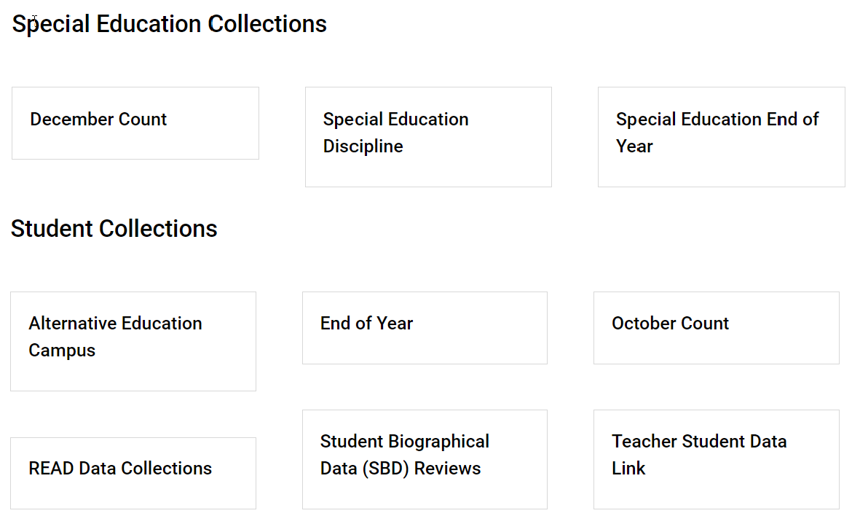
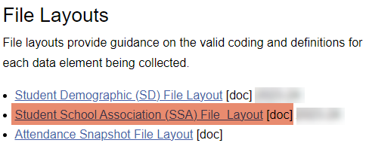
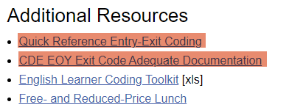
Entry/Exit Field Resources
https://resources.csi.state.co.us/data-submissions-library/
Within Each Collection:
5
Notes:
The Data Submission Library houses resources available to help with entry and exit coding as well as resolving errors associated with them. Within the Data Submission Library website page, you can access each of the Collections and the collection resources. Once you select a collection, there are resources available that will help specifically with Entry/Exit/Retention fields, which we’ll discuss on the following slides.

Slide 6
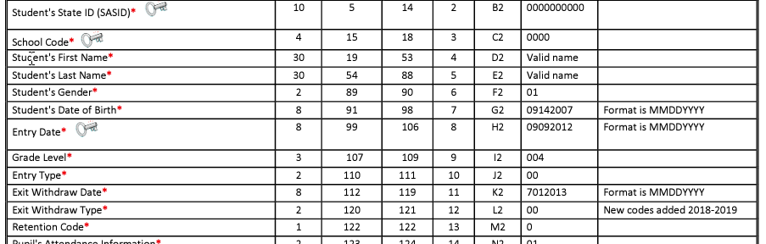
SSA File Layout
https://resources.csi.state.co.us/end-of-year/
6
Notes:
The five fields that will be captured for Entry/exit/retention are: Entry Date, Entry Type, Exit Withdraw Date, Exit Withdraw Type, and Retention Code.
All of these code options can be found on the SSA File Layout. The File Layout is a highly recommended resource as it contains all the codes, definitions and descriptions to ensure appropriate usage.
Access to this file can be found by clicking on the link in the slide or by visiting the CSI website, resource page.

Slide 7
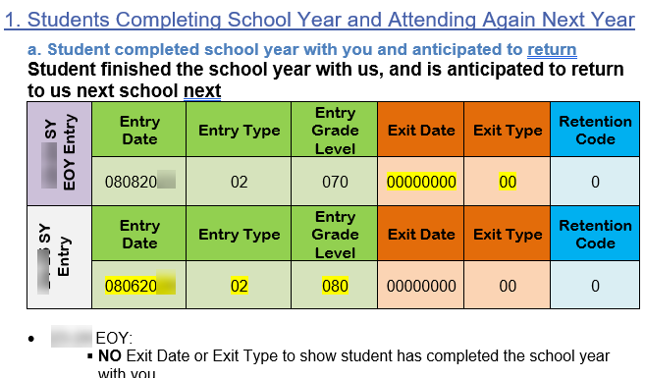
Entry/Exit Quick Reference Guide
https://resources.csi.state.co.us/end-of-year/
7
Notes:
Another resource that will be helpful is the Entry/Exit Fields Quick Reference Guide. This guide includes information and examples of coding and dating students in specific scenarios. Access to this file can be found by clicking on the link in the slide or by visiting the CSI website, resource page.

Slide 8
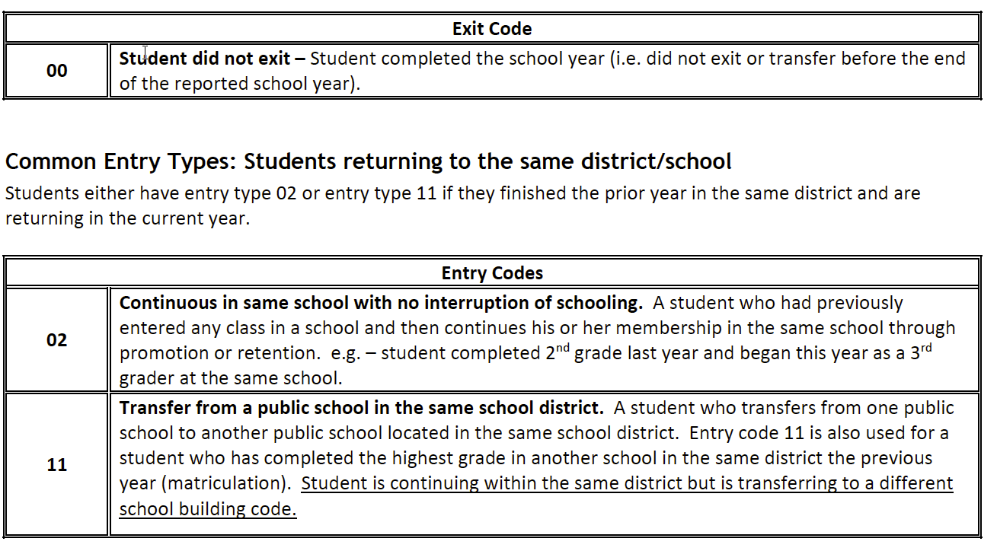
CDE Entry/Exit Codes Description
https://resources.csi.state.co.us/end-of-year/
8
Notes:
In addition, the Entry/Exit Code Description from CDE is a great detailed resource. The resources can help with code descriptions and errors.

Slide 9
Exit Code and Date Guidance
Notes:
The next section will go over several student scenarios and guidance for exit codes and exit dates.

Slide 10
Students Completing the School Year
Exit Type ‘00’ and Exit Date ‘0000000’ should be used for every student who completes the school year at your school, regardless of their anticipated enrollment status at the beginning of next year.
Why?
End Of Year (EOY) and SPED EOY is collecting information about what happened this school year.
October Count (OC) will collect information about what is going to happen the next school year.
10
Notes:
The first scenario we’ll walk through is for ALL students completing the school year.
Exit Type ‘ZERO FILLED’ and Exit Date ‘ZERO FILLED’ should be used for every student who completes the school year at your school, regardless of their anticipated enrollment status at the beginning of next year.
This is because the EOY and SPED EOY collection is collecting information about what happened this school year.
It is NOT collecting information about what is going to happen next year. (The October Count collection is collecting information about what is going to happen next school year.)

Slide 11
Zero-Fill Exit Codes/Dates for…
Students who you know are moving out of state or country over the summer and will not be returning.
Students who are transferring to a local school.
Students who are transitioning to home school.
Students who are skipping or repeating a grade.
Students who have withdrawn or transferred out in the last 3 weeks of the current school year or have completed all coursework early.
Students who have passed the highest grade in your school – except for students graduating high school.
Exit Date | Exit Type
00000000 | 00
Notes:
To reiterate, you should be zero-filling the exit type and exit date for all students who complete the school year at your school, regardless of their anticipated enrollment next year.
This means that the following scenarios would include a zero-filled exit code and zero-filled exit date:
Students who you know are moving out of state or country over the summer and will not be returning.
Students who are transferring to a local school.
Students who are transitioning to home school.
Students who are skipping or repeating a grade.
Students who have withdrawn or transferred out in the last 3 weeks of the current school year or have completed all coursework early.
Students who have passed the highest grade in your school – The only exception to zero filling this data is for students graduating high school. We will talk about this scenario later in this training.
Failure to follow this guidance may lead to students showing up as dropouts for your school and impacting your performance used in state and CSI accountability.

Slide 12
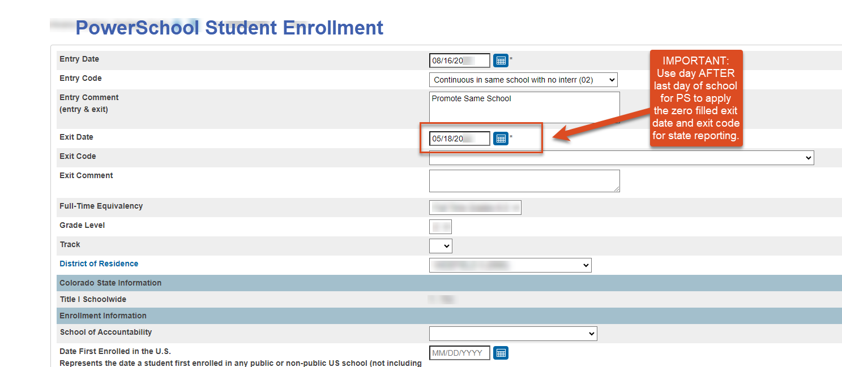
A Quick Note on PS Extract
IMPORTANT for PS Users: In student enrollments, use the default exit day of the DAY AFTER your last day of school. This will create a zero filled exit date and exit code in state reporting.
12
Notes:
An important note for PowerSchool users: Because PowerSchool requires an exit date entered for all student enrollment records and state reporting requires a zero filled exit date for all students that complete the year with you, PowerSchool has created a work around. Please use the date of the DAY AFTER your last day of school for all students. If a student exits prior to the end of school, you will update the exit date to show the students last day they attended at your school. However, for all other students, the default exit day is required to zero fill student exit dates to match CDE standards.
As seen in the example above, If a school’s last day of school is May 17th, then the exit date used for students will be May 18th. Once you extract an SSA file, you will notice that current students will have a zero filled exit date and exit code on the state report.

Slide 13
New School Year Roll-Over
In 2023-2024 Calendar
End code and date all students regardless of anticipated withdrawal
Exit Type: 00, Exit Date: 00000000
In 2024-2025 Calendar
SIS rolls-over to NEW school year.
One Day Entry/Exit record in NEW School Year.
Example:
Entry Date | Entry Type
08112024 | 02
Exit Date | Exit Type
08112025 | 13
MAXED-OUT Grade Level
Can you create enrollment records for one grade above?
If YES: When SIS rolls-over to NEW school year.
If NO: Contact CSI to submit an Error Exception Request
13
Notes:
When do you code these zero filled students who have completed the highest grade in your school or will transfer to another school for the following school year and will not be returning?
This is done once your SIS has rolled over to the new school year.
In the new calendar year, for transferring students, students moving out of state or country, and student moving to homeschool you will create a one-day Entry/Exit record.
To create the one-day entry/exit record, in the new calendar, the Entry Date can be any date in the new school year prior to the first day of school, with an Entry Type of 02. For PowerSchool users, this date must be the first day of school. You will then give the Exit Date as the same date, with the appropriate Exit Type, depending on if the student has transferred to home school, an out-of-state school, a local school, or another CSI school. Remember that all Exit Type codes are listed in the SSA File Layout.
This one-day Entry/Exit record will show up on the October Count collection. You will not mark these students as exclude from state reporting.
For students who have reached the highest grade level in your school you will want to decide if your SIS allow you to create an enrollment record the for next natural grade level progression? If ‘yes’, then once your SIS has rolled-over to the NEW school year you will create a one-day Entry/Exit record for that student. If ‘no’ and your SIS does not allow for enrollment records of a grade higher than what your school teaches, then you will need to request an exception for resulting errors by emailing CSI and communicating the situation. We will then request an exception to the error from CDE.

Slide 14
Coding Graduates
For high school graduates:
Exit Type: 90 or Similar
Exit Date: Graduation Date
NOTE: To avoid collection errors, this process should be done on grad day or after, keeping the students ZERO filled until graduation is official.
For elementary / middle school students completing the highest grade offered at your school:
Exit Type: 00
Exit Date: 00000000
Exit Date | Exit Type
05182024 | 90
Exit Date | Exit Type
00000000 | 00
14
Notes:
The next scenario on this slide addresses coding for students who have graduated your school.
All students who will be graduating High School should have an Exit Date of graduation day and an Exit Type code of 90 or similar graduation code. Please note: To avoid EOY collection errors, the data entry for these fields should occur on or after graduation day and should remain zero filled until then. This also minimizes accidental coding for students that did not graduate.
All elementary or middle school students ‘graduating’ from the highest grade offered at your school should have 0-filled Exit fields.

Slide 15
Coding for High School Students Taking Summer School to Graduate
Student Passed Summer School & Graduated
Exit Type: 90
Exit Date: Graduation Date with Cohort
Student Did Not Pass Summer School & Did Not Graduate
Exit Type: 00
Exit Date: 00000000
Retention: 01
Exit Date | Exit Type
05182024 | 90
Exit Date | Exit Type | Retention
00000000 | 00 | 01
15
Notes:
The next scenario addresses coding for high school students taking summer school courses in order to graduate.
For high school students attending summer school in order to meet graduation requirements, schools are encouraged to code the student as a returning, retention student UNTIL the student passed the course and graduation requirements. This process will help avoid accidental graduation codes for a students that do not graduate. It is much easier and less impactful for schools to fix accidental retention data, then it is to fix accidental graduate data.
While students are attending summer school or for students that do not pass Summer School, you will use a zero filled exit date, zero filled exit type, and retention code of 1. We will discuss more about retention codes later in this training.
Once the summer semester has ended and the final graduation status is known, you can update your EOY data. For students that pass summer school and graduate, the student should receive the graduation exit date used for their cohort and a graduation exit code.

Slide 16
Additional Notes Regarding Exit Coding

Slide 17
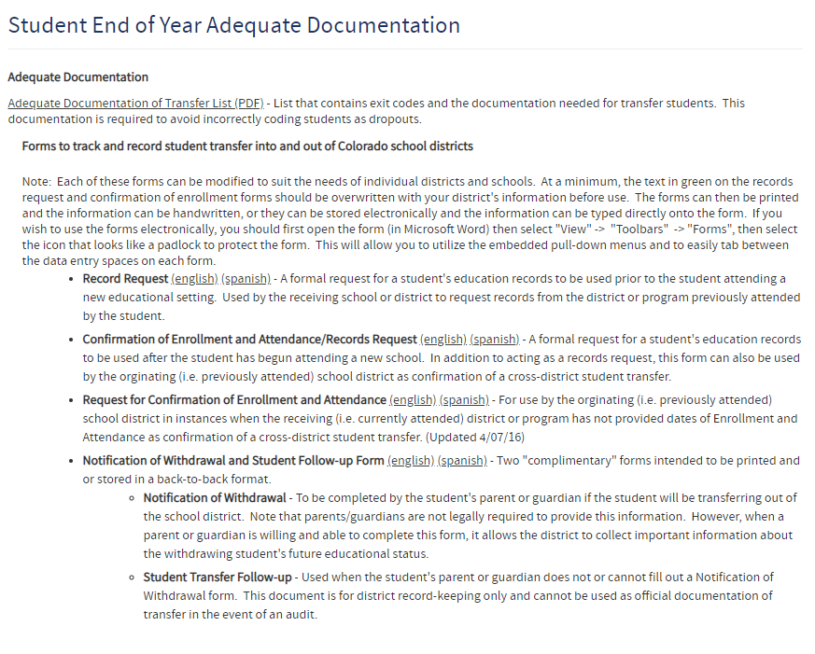
Adequate Documentation for Transfer Students
Adequate Documentation of Transfer List
Reduce dropout rates.
Improve graduation and completion rates.
What happens to a student when they leave your school.
17
Notes:
It is critical to collect adequate documents and maintain documentation regarding a students transfer. Having this documentation on hand will help to quickly clear up any issues that may arise during CDE validations in the fall and can help you complete the collection correctly and in a timely manner. It can also help to ensure accuracy of your graduate, dropout, and completion rates.
‘Adequate Documentation’ is recognized by CDE as forms, or other documentation, that track and record student transfers into and out of Colorado school districts. The Adequate Documentation of Transfers List’, compiled by CDE, lists the types of documentation that are required for different types of transfers. The most commonly used document is the Confirmation of Enrollment and Attendance. To access this list, you can use the link in this slide or visit the CSI website resource page.

Slide 18
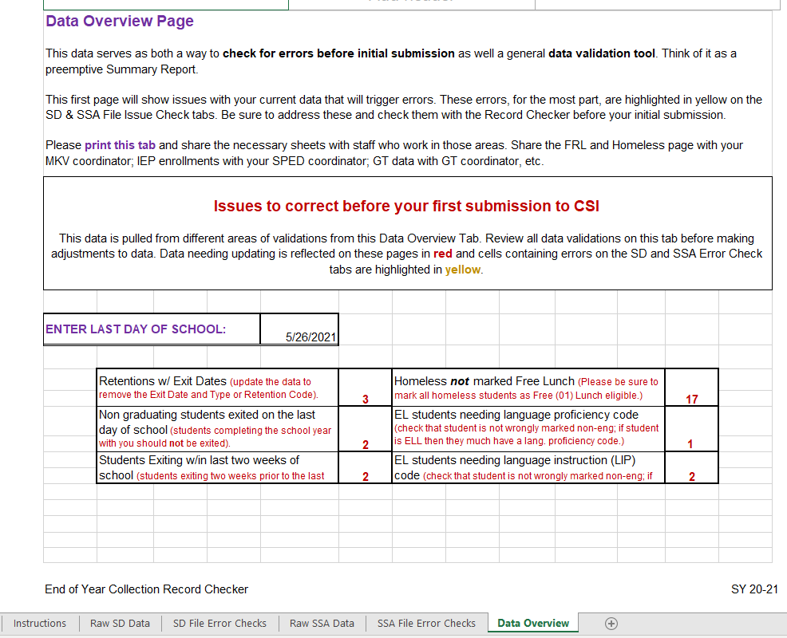
Exit Checks on Record Checker
18
Notes:
To help schools check for the types of Exits that could result in CDE accidently identifying the student as a drop out, we have included Exit Code validations for these students on the Data Overview tab of the Record Checker.
These two data points show you how many non-graduating students are being exited on the last day of school and how many students were exited within the last 3 weeks of school.
To properly calculate this data you will need to enter the date of your last day of school in the section provided.
Please review the Record Checker Training for more information on this topic.

Slide 19
Retention Coding
Notes:
Our final section will address retention coding.

Slide 20
When to Use Retention Coding
Student repeating a grade in the upcoming school year
Student is skipping a grade in the upcoming school year
12th grader participating in an approved postsecondary program in the upcoming year
12th grade with an IEP being retained for transition services
Notes:
Retention codes show the student’s retention or promotion status for the upcoming school year.
There are four main scenarios for when the Retention Coding is used:
Student is repeating a grade in the upcoming school year
Student is skipping a grade in the upcoming school year
12th grader participating in an approved postsecondary program in the upcoming year
12th grade with an IEP being retained for transition services
We’ll walk through each on the following slides.

Slide 21
Repeating a Grade
Students who are repeating a grade should be zero filled at the end of the school year
Once SIS rolls over to the next school year, students who are repeating a grade should receive the Entry Type 2, Exit Type 10 (reassigned a grade) with the natural grade progression. These students will NOT receive a retention code.
Students will receive a new enrollment record with the reassigned grade and Entry Type 10
EOY Entry 22-23 SY
SASID | First Name | Last Name | Entry Date | Grade | Entry Type | Exit Date | Exit Type | Retention
12345678 | Sam | Doe | 08092022 | 100 | 02 | 00000000 | 00 | 0
After SIS rolled over to 23-24 SY
One-day Entry/Exit Record
SASID | First Name | Last Name | Entry Date | Grade | Entry Type | Exit Date | Exit Type | Retention
12345678 | Sam | Doe | 08102023 | 110 | 02 | 08102023 | 10 | 0
New enrollment record
SASID | First Name | Last Name | Entry Date | Grade | Entry Type | Exit Date | Exit Type | Retention
12345678 | Sam | Doe | 08112023 | 100 | 10 | 00000000 | 00 | 0
21
Notes:
Students who are repeating a grade will include a ZERO filled exit date and type at the end of the school year.
Once your SIS is rolled over for the next school year, students who are repeating a grade should receive a One-Day record to include the natural grade progression, Entry type 02, and Exit Type 10 for grade reassignment.
A new enrollment record will then be created to include the reassigned grade, and Entry type 10.

Slide 22
Skipping a Grade Level
Students who are skipping a grade should be ZERO filled on the EOY Entry
Once SIS rolls over to the next school year, these students will receive a One-Day Entry/Exit with the grade they are skipping and Exit Type 10
These students should then receive a new enrollment records indicating the new grade level and Entry Type 10
EOY Entry 22-23 SY
SASID | First Name | Last Name | Entry Date | Grade | Entry Type | Exit Date | Exit Type
12345678 | Jane | Doe | 08092022 | 040 | 02 | 00000000 | 00
After SIS rolled over to 23-24 SY
One-day Entry/Exit Record
SASID | First Name | Last Name | Entry Date | Grade | Entry Type | Exit Date | Exit Type
12345678 | Jane | Doe | 08102023 | 050 | 02 | 08102023 | 10
New enrollment record
SASID | First Name | Last Name | Entry Date | Grade | Entry Type | Exit Date | Exit Type
12345678 | Jane | Doe | 08112023 | 060 | 10 | 0000000 | 00
22
Notes:
For a student who will skip a grade, the student’s record should show them as completing the grade they are currently in with a zero-filled exit date and exit type.
Once you have rolled your SIS over into the new school year, you will create a one-day Entry/Exit record for the student, exiting them from the natural grade progression with Exit Type code 10 .
You will then create a new enrollment record with the grade the student is being reassigned to, and an Entry Type of 10.

Slide 23
Summer School to Avoid Retention
Students taking summer school to avoid grade retention receive ZERO filled entry and exit type and retention code 1.
If the student is unsuccessful in summer school, these students should then receive a new enrollment records indicating the grade reassignment.
If the student is successful, the students will receive a grad date with their cohort, exit type 90, and retention code 0.
EOY Entry 22-23 SY
SASID | First Name | Last Name | Entry Date | Grade | Entry Type | Exit Date | Exit Type | Retention
12345678 | Sam | Doe | 08092022 | 120 | 02 | 00000000 | 00 | 1
After SIS rolled over to 23-24 SY
New enrollment record
SASID | First Name | Last Name | Entry Date | Grade | Entry Type | Exit Date | Exit Type | Retention
12345678 | Sam | Doe | 08102023 | 120 | 02 | 00000000 | 00 | 0
If 12th grader is repeating and transferring to another school
SASID | First Name | Last Name | Entry Date | Grade | Entry Type | Exit Date | Exit Type | Retention
12345678 | Sam | Doe | 08092023 | 120 | 02 | 08092023 | 13* | 0
23
Notes:
In the case that a student is taking summer school to avoid a grade retention, you will ZERO fill the exit date and code and include a retention code 1.
If the student in unsuccessful in summer school and still needs to repeat a grade, once your SIS has rolled over for the new school year, you will create a new enrollment record including the grade reassignment.
If the student completed the school year with you, was retained, but will be transferring to another school, your EOY submission will remain the same, but your new enrollment record in the new calendar will include a one- day record with the appropriate exit code and grade reassignment.

Slide 24
Graduate Accessing – Postsecondary Program
Graduates who are participating in an approved postsecondary program (ASCENT, P-TECH, and TREP) in the upcoming year should use Retention Code 2
Once SIS rolls over to the next school year, these students will receive a new enrollment
EOY Entry 22-23 SY
SASID | First Name | Last Name | Entry Date | Grade | Entry Type | Exit Date | Exit Type | Retention
12345678 | Sam | Doe | 08092022 | 012 | 02 | 05092023 | 90 | 2
After SIS rolled over to 23-24 SY
SASID | First Name | Last Name | Entry Date | Grade | Entry Type | Exit Date | Exit Type | Retention
12345678 | Sam | Doe | 08102023 | 012 | 90 | 0000000 | 00 | 0
24
Notes:
12th graders who are participating in an approved postsecondary program (ASCENT, P-TECH, and TREP) in the upcoming year will be exited with a Graduated exit code of 90 or similar and Retention Code of 2.
Once your SIS has rolled over to the new school year, the new enrollment record for that student will use grade 12 and a graduated Entry type code.

Slide 25
Graduates with IEPs Accessing- Transition Services
Graduates who are being retained for transition services in the upcoming year should use Retention Code 3
Once SIS rolls over to the next school year, these students will receive a new enrollment.
Retention code 3 will continue each year as long as the student continues services.
EOY Entry 22-23 SY
SASID | First Name | Last Name | Entry Date | Grade | Entry Type | Exit Date | Exit Type | Retention
12345678 | Sam | Doe | 08092022 | 012 | 02 | 05092023 | 90 | 3
After SIS rolled over to 23-24 SY
SASID | First Name | Last Name | Entry Date | Grade | Entry Type | Exit Date | Exit Type | Retention
12345678 | Sam | Doe | 08102023 | 012 | 90 | 05102024 | 27 | 3
25
Notes:
Graduating students with IEPs who are returning in the upcoming school year for transition services will have an Exit Code of 90 and a Retention code of 3.
Their entry for the following school year will be an Entry Code of 90 and the Retention code of 3 will continue to be used as long as the student continues to return for transition services.
If these students are not coded correctly in the End of Year collection it will trigger data issues and errors for the following year’s October Count collection. Additionally, this exit coding will trigger an error if the student does not have a disability reported on the SD file. While we do run validation checks between SPED EOY and EOY, you will want to work with your SPED coordinator to be sure that SPED students are being reported and exited properly for the End of Year collection.

Slide 26
Thank you
Send questions to: submissions_csi@csi.state.co.us
Notes:
If you have any questions, please email the Data Submissions Team. Thank you for reviewing this training.

