Slide 1
2023-24 SPED End of Year Training
What’s New and Reminders
Recorded February 2024
Notes:
Hello All,
Thanks so much for reviewing this training for the 23-24 Special Education End of Year Collection! This short recording focuses on anything new to keep in mind for the year and also some updates and reminders related to validation of the data. This training is ideal for staff that are returning in the role of data submissions and have a strong knowledge of the submissions process. It is also important for new staff to review this along with the general overview webinar to better understand any changes to fields or errors and what information should be validated across collections. Feel free to reach out to CSI if you have questions at any point!

Slide 2
New for SPED EOY
Gender Field Updates | Enrich Updates
Removal of Disability Coding Options | Combining SPED Record Checker and Validation Toolkit
Path 1 Fields/Referral Types Removed
Field Name Clarifications
Data Validation Reminders
Cross Collection issues with EOY and SPED Discipline
Mid-Year Exits and Disability Coding
Tuition Contract Scenarios
Warnings/Errors
Reminders, checks, and coding updates related to errors and warnings
2
Notes:
Here is a quick overview of the topics that we will be discussing today. First, we will look at the some of the changes that have occurred with the 23-24 file layouts with some removals and updates. We’ll also discuss any updates related to the implementation of school specific Enrich Instances along with the combining of a couple of CSI resources.. We’ll follow that up with some validation reminders that we have implemented recently for the collection and how this relates to some cross-collection issues and comparisons. Last, we’ll look at some Warnings and or Errors that have recently been added or changed and how to properly code them. Hopefully, utilizing the knowledge gained here may help with the error clearance process and overall accuracy of your numbers.

Slide 3
New for SPED EOY 23-24
Notes:
Alright, lets jump into some of the new updates to the file layouts for 23-24.

Slide 4
Gender Field Update
The Gender field has added coding option 03 – Nonbinary to all collections for both students and staff.
For further details, see the 23-24 Child File Layout and Definitions Document
Notes:
The first topic I want to discuss today is related to the Gender Field. CDE has added an additional coding option that can be selected for students and staff in all collections, which is code 03 - Nonbinary. Ensure this update has been added to your Plan Management System and use as needed moving forward! For more details, see the 23-24 Child File Layout and Definitions document.

Slide 5
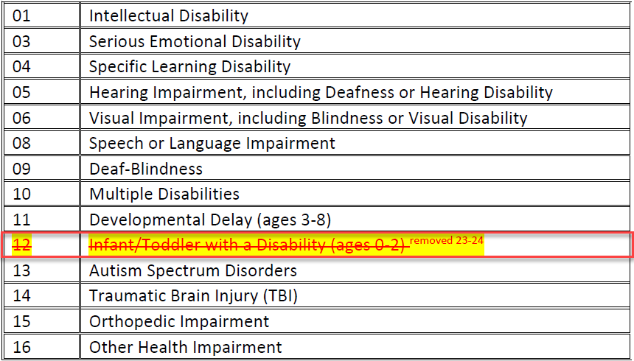
Removal of Disability Coding Option
Delay Codes Removed
Coding option 12 – Infant/Toddler with a Disability has been removed as a coding option for the Primary Disability Field.
For further details on these changes, see the Participation File Layout and Definitions Document for 23-24
Notes:
Next, I want to discuss an update to the Primary Disability Coding options. Coding option 12 – Infant/Toddler with a Disability has been removed as a valid option for 23-24. This relates to the removal of Path 1 data which we will discuss in the next slide!

Slide 6
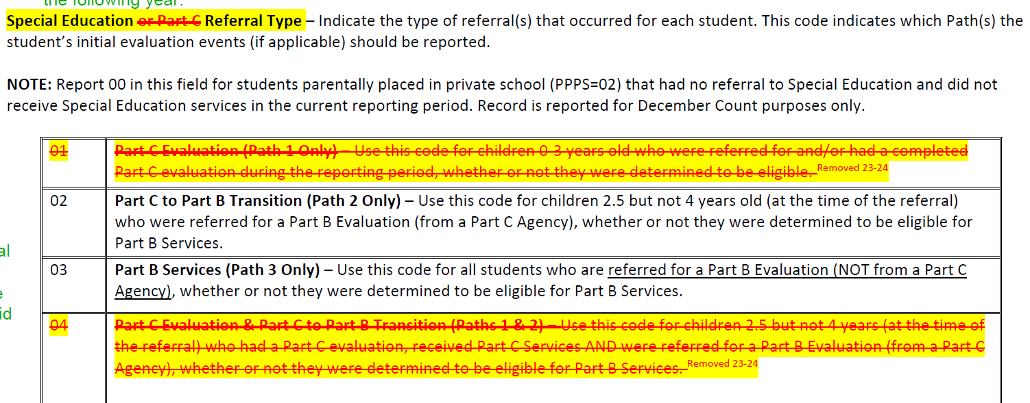
Path 1 Fields/Referral Types Removed
Path 1 data fields have officially been removed from the collection
Community Centered Boards will be responsible for the Part C evaluations
Given this, all related Special Education Referral Types related to Path 1 students have been removed as well. This includes 01, 04, and 05. These have always been 03 or 06 for CSI schools
The field name has also been updated to remove any references to Part C and now is Special Education Referral Type
Notes:
The next change I want to discuss also does not impact CSI schools very often but is a big change to the collection. CDE has officially removed all Path 1 fields from the collection as that responsibility has shifted to the Community Centered Boards as it relates to all Part C evaluations. Due to this, they have also removed coding options 01, 04, and 05 from the Special Education Referral options. CSI always uses 03 for newly tested and 06 for returning students anyways, so not a big change to your typical processes. The benefit to this for CSI schools would be a file with less fields to sort through!

Slide 7
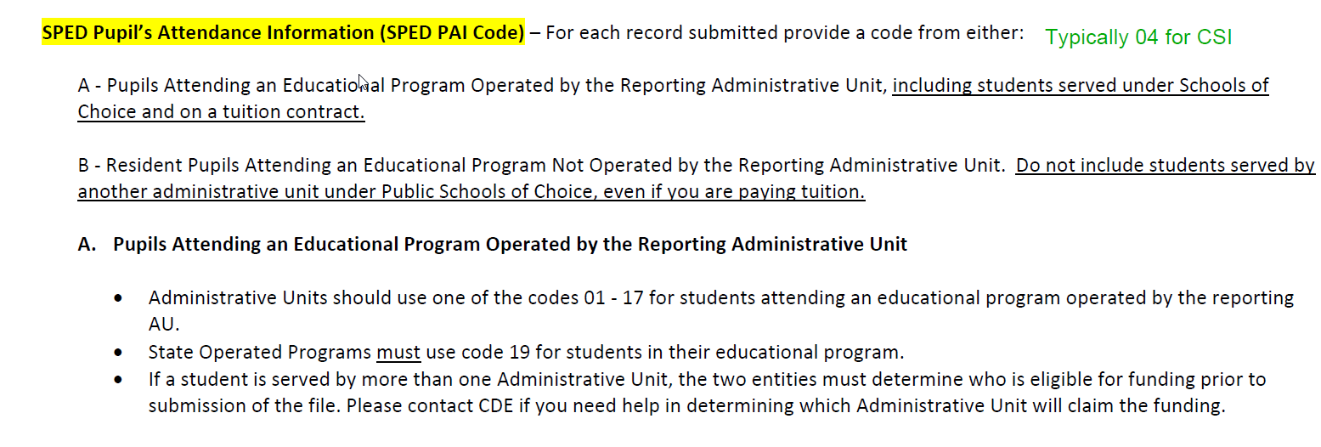
Field Names Clarified
The term “SPED” was added to the beginning of both the Pupils Attendance Information and Basis of Exit field to further indicate field is related to Special Education Reporting when working with multiple collections.
Pupils Attendance Information SPED Pupils Attendance Information
Basis of Exit SPED Basis of Exit
Notes:
In addition to the changes to coding options, CDE has also added clarification to two field names. Both the Pupils Attendance Information and Basis of Exit fields have been updated to include the term “SPED” in front of them for added clarification when working with multiple collections or completing cross collection reviews. So now you should see SPED Pupils Attendance Information and SPED Basis of Exit.

Slide 8
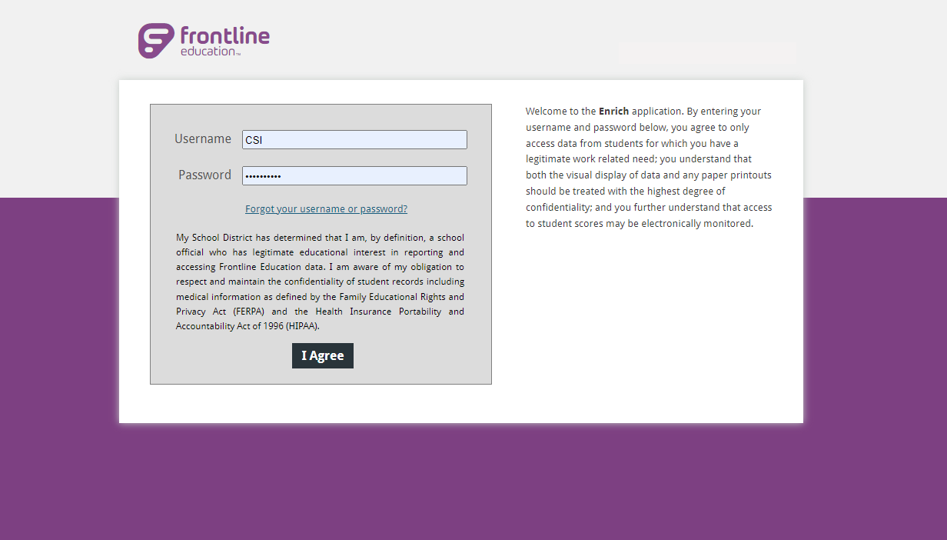
Enrich Updates
Schools using Enrich should have been moved to their own instance in time for SPED EOY.
Contact the CSI SPED Team if this has not occurred or there are still concerns.
Schools should work to ensure all students on IEPs are added to the system, so files can be successfully extracted.
School using Starting Point files for December Count should now be able to extract files. If issues persist, contact the CSI Submissions Team to discuss.
Notes:
Let's jump into a few Enrich updates to discuss. At the beginning of the school year, it was decided that all schools should be on their own instance of Enrich. This was primarily due to file extract issues and the inability for schools to extract school specific files. This process ended up taking longer than we thought, leading several schools to have to use Starting Point files in December Count. It is anticipated that we are all through with these migrations, so schools should ensure all data is added for students with IEPs in order to successfully extract from Enrich. Please reach out to the CSI SPED Team if you are still having issues.

Slide 9
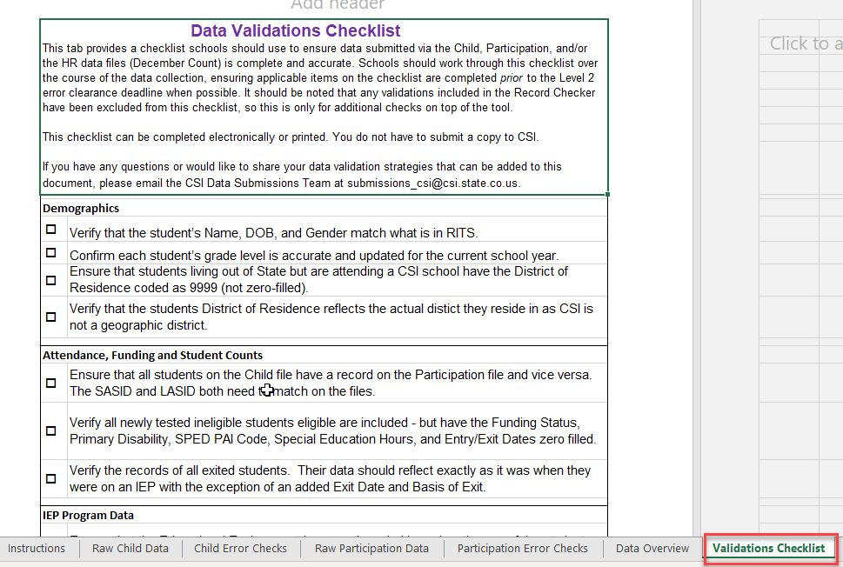
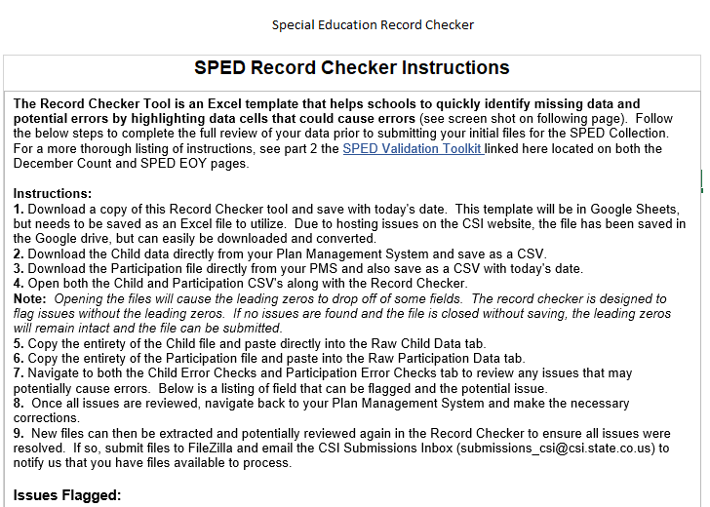
Record Checker and Validation Toolkit
Both the Record Checker Tool and SPED Validation Toolkit contain several helpful data entry checks and error clearance assistance tools for schools to use in previous collection years.
Many of the error clearance checks and reminders overlapped across the two resources.
Due to this, they have been combined into one document called the Record Checker and Validation Toolkit.
The original tabs of the Record Checker remain relatively unchanged; however a new validation tab was added. This is a pared down version of the Validation Toolkit containing only checks that are not being flagged in the Record Checker.
Notes:
We have one more update to mention regarding the 23-24 SPED EOY collection resources. As you may be aware, we have both a SPED Record Checker and validation toolkit listed in our website resources. We have found there was quite a bit of overlap between the two resources which could cause duplicate work and confusion. Due to this we decided to merge the two resources into one called the SPED Record Checker and Validation Toolkit. The record checker is the same as it has always been with the exception of adding an additional Validation Checks tab. This tab contains additional details or issues we have discovered that are not currently being flagged in the Checker. It is recommended that schools utilize the checker and complete the checklist of other areas to look into. Doing all of this will provide the most accurate data all while reducing the number of errors received on initial submittal.

Slide 10
Data Validation Updates/Reminders
Notes:
Next, let’s take a look at some validation reminders. These are some validations that CSI completes in June, but schools should be doing their own reviews and corrections throughout the process, but certainly in late May to ensure all coding is correct.

Slide 11
EOY and SPED EOY Exit Consistency
Graduates and Dropouts Ensure you are working with your EOY Counterpart, other staff and families to verify: Consistent reporting of Graduates and Dropouts Similar or matching Exit Dates Other Exits Verify that any student who exits the school has consistent information as it pertains to: Matching Exit Types (with adequate documentation) Similar or matching Exit Dates Students exiting SPED EOY to general education don’t need to be exited in EOY Ensure school has received student's adequate documentation and utilize the Adequate Documentation of Transfer List prior to coding an Exit Type. ***Compare all students exit information in both systems at time of exit. A full review should be completed by early June***
Notes:
So, in terms of a helpful validation check- as you are completing the SPED EOY process, you must work with your End of Year counterpart, other staff and families to verify the reporting of graduates and dropouts along with ensuring that exit dates match or are very similar in both collections depending on the circumstance. Really when talking about both collections, it is important to ensure all fields match and any discrepancies between the two are resolved. This includes disability information and any type of exits that have occurred. You want to verify that anytime a student exits the school, they have consistent information related to exit dates and exit types. If a student does exit special education to regular education, they do not need to be exited in end of year.
Another important point to remember is that anytime a student exits, the school needs to have the adequate documentation based on the exit type. For a full list of documentation required by exit type, see the link listed in this slide.

Slide 12
SPED Mid-Year Exit Details
CDE has confirmed that students exited from Special Education to Regular Education need to be coded in the following way:
Students should have a current year Exit Date with an Exit Type of 09 – Transferred to Regular Education for the SPED EOY collection
Students should not have an Exit Date or Exit Type coded on the EOY Collection
Both Collections should have an accurate (non-zero filled) Disability coded based on when the student was in SPED. This should remain for the entirety of the year regardless of when the student was exited
If discrepancies are found, see the SPED EOY & EOY Cross Collection Exit Coding Discrepancies Document
Notes:
Continuing a little further with Exit information, this slide shows exactly how students who exit should be coded for both collections. Students who exit from Special Education to Regular Education will have a valid exit date and an 09 Exit Type – Transferred to Regular Education. If they remain in the school, they should not be exited from regular EOY. In terms of Disability, for students who exit Special Education or the school entirely, their disability should be coded as their actual disability while they were in SPED. I see this often where once they exit SPED, their disability is changed for one or both collections, but in actuality it should remain as a non-zero filled disability for the rest of the year for both SPED EOY and EOY.

Slide 13
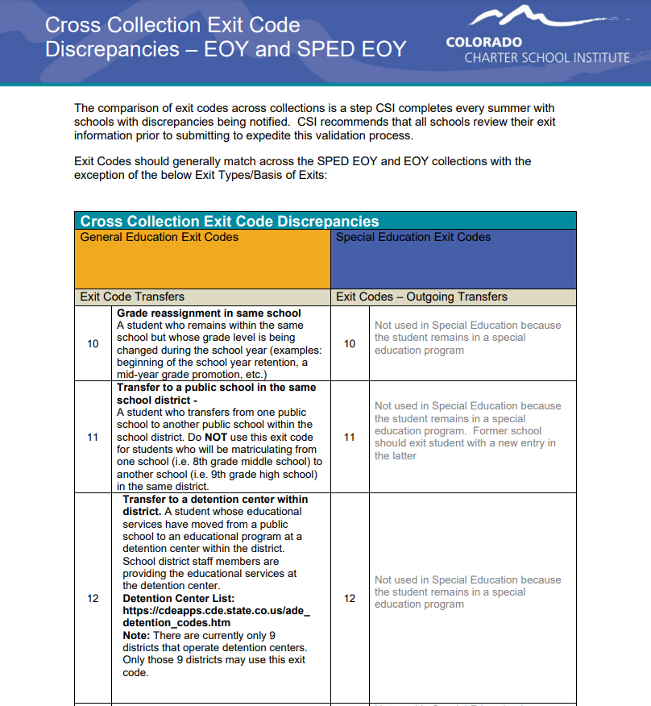
SPED EOY & EOY Cross Collection Exit Coding Discrepancies
Exit Coding typically should match across the two collections
Specific Exit Types may be available in one collection but not the other
This document shows the differences that can occur in exit types
Exit Coding Discrepancies Document
Notes:
Continuing a little further with Exit information, this slide shows the SPED EOY - EOY Cross collection exit coding discrepancies resource. You probably are already aware of the importance of exiting students correctly when they exit special education or the school and how this should match up with regular EOY coding. There are some instances where the Basis of Exit will not match up exactly, for instance if a student exits to regular education, which would be a 09 in SPED EOY but no exit should show in EOY. This document will go through all the exit types that do not match up and how they should be coded. If not listed there then they should match up and CSI does a comparison of those over the summer where changes are required.

Slide 14
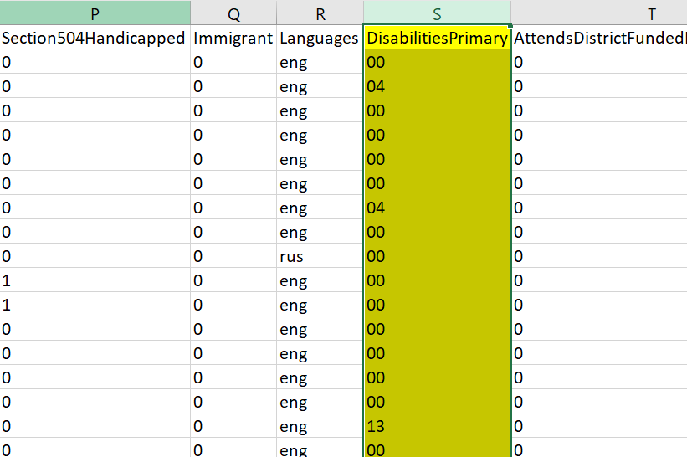
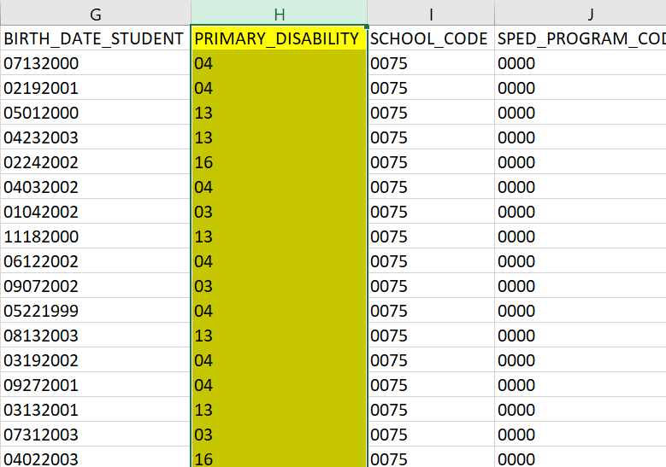
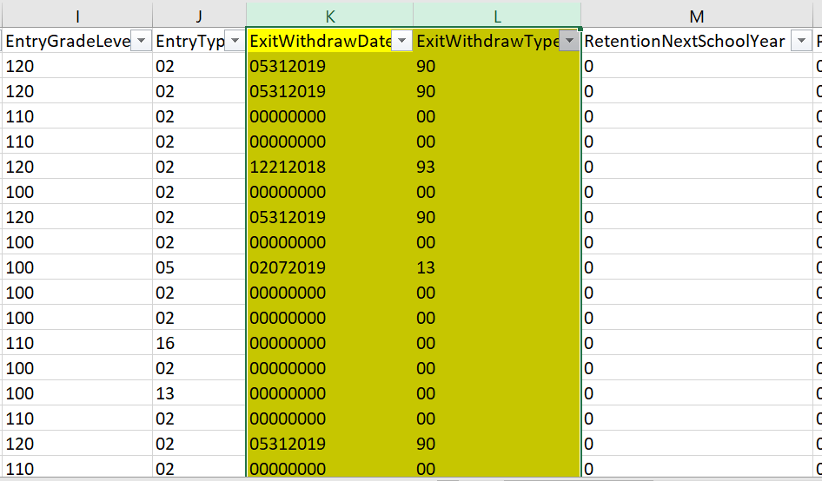
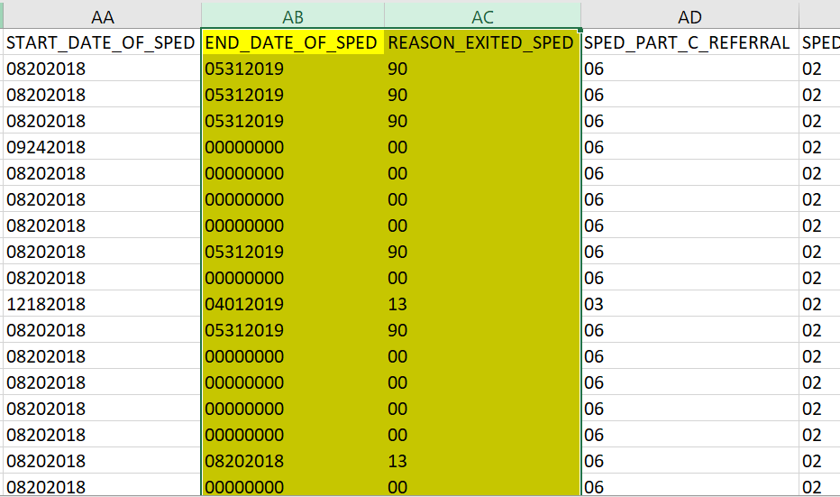
EOY and SPED EOY Discrepancies
Review both the SD and SSA File (EOY) and the Participation File (SPED EOY) checking:
Disabilities | Exit Dates match or are similar | Exit Types match
Participation File
Student Demographic (SD) File
Participation File
Student School Association(SSA) File
Notes:
So you may be thinking about “What is the best process to complete review of exit and disability information?” We’ll this slide is a high level overview of what should be completed. Essentially, you will need to work with your End of year staff to review the SD and SSA files to compare with your participation file. The fields you are looking at on each of these are the Disabilities, Exit Dates and Exit Types to see if they match across collections. You can always use filters on each file to filter only on students with exits for each and see if they match up. This can be done using the SD and Participation file to compare disabilities as well. If you discover any discrepancies, ensure you are updating the SIS or plan Management System for the collection that is incorrect and resubmit files.

Slide 15
Expulsions
Basis of Exit code 50-”Expulsion” will be cross referenced with the School Discipline collection and students reported as 03-”Expulsion-did not receive educational services during expulsion”. A student who is expelled and is receiving SPED services during expulsion is not considered exited for SPED EOY.
SPED EOY Expulsions
School
Discipline Expulsions
Notes:
When it comes to a student with a reported exit code of 50 or expulsion, please remember that in most cases student who are expelled will continue to receive special education services, therefore are not considered exited for SPED EOY purposes. Also, this information will be cross referenced with the School Discipline collection and students reported with an 03 – Expulsion – DID Not receive educational services during the expulsion. As mentioned, most students will continue to receive services, so ensure that they are coded consistently across both collections.

Slide 16
Tuition Contract Scenarios
Tuition Contract Students may not happen often but the coding these correctly is necessary to report accurate data. To do this, it is important to understand what should be entered and the differences between December Count and SPED EOY.
December Count Schools are paying tuition, so should report students in December Count for funding purposes. Ensure the following fields are reported as: Pupils Attendance Info = 31 District Code = 8001* School Code = 0000 District of Attendance = District the School/BOCES is in.** Funding Code = 50 Entry Date = First day of school or date started prior to 12/01. Exit Date = Zero filled | SPED EOY Student is not being served at the school due to high level of needs. Ensure student is reported with: Entry Date = First day of school or start date Exit Date = Last day student physically attended school. Basis of Exit = 13
*District Code of 8001 will flag a DC120 error as CSI is not a geographic district. CSI must submit an exception for all tuition contract students
**District of Attendance Codes in Colorado: https://cedar.cde.state.co.us/edulibdir/Organization%20Codes-en-us.xlsx
Notes:
The last area I want to discuss in terms of validation is Tuition Contract Scenarios. A tuition contract is used when a student has a higher level of need than a school can provide, so they essentially send the student to a school with a better fit but the CSI school continues to pay for the student. Although this does not happen often, it is important to code students accurately when you do encounter one of these situation. It should be noted that the coding will differ greatly between December Count and SPED EOY. For December Count, a student must have a Pupils Attendance of 31, a zero filled school code, ad an updated District of Attendance depending on where they are going. The student should not be exited as the school is still paying for the student's education, therefore should be counted in December Count. As far as SPED EOY, the student is no longer receiving services at your school, therefore should be exited on the last day they attended. The other district will be reporting that student. As you can see, the coding differs quite a bit and it is important to follow these guidelines to ensure the reporting is accurate.

Slide 17
Warnings and Errors
Notes:
Let’s now take a look at some warnings or errors that may have been updated recently or tend to trip staff up often.

Slide 18
SY295 and SY296 Warnings Review
SY295 – Indicates a student is being exited from End of Year, but not SPED EOY. Review to ensure all students have been exited, however does not show discrepancy in type.
SY296 – Indicates a student is being reported by a different district in the next school year.
Not very applicable to CSI schools due to deadlines. Can be used late in the collection
Good reminder to exit students that are no longer attending in the district
Avoids SY108 errors in the subsequent year
Notes:
The SY295 and 296 Warnings were added to assist with the previously mentioned discrepancies between End of Year and SPED EOY. They also help with the SY108 errors in subsequent years, which we will cover on the next slide. The SY295 indicates a student is being exited from the EOY collection, but not SPED EOY. This can be very helpful as you are doing the discrepancy comparison I mentioned as it will remind you of students who will need to be exited. The SY296 on the other hand may not be very helpful to CSI schools given the deadlines we have in place. Essentially, it will flag anyone that is being reported at another district in the subsequent October Count Collection, but you have not exited them. As I said, with the SPED EOY deadlines and timing for October Count, this may not be helpful, but can be a good reminder to exit students no longer in the district to avoid the SY108 errors in the next SPED EOY collection.

Slide 19
Exit Code Reminders – SY108
Students not exited in the prior SPED EOY collection (21-22) and are not included in the 22-23 SPED EOY files will receive the SY108 error. Resolving SY108 Error: Schools need to include a record in your child and participation files of all the students who did not return from the prior year, and you should exit them as of the first day of school. Or CSI will provide schools a separate error report only containing this error with the blank Basis of Exit highlighted. Ensure you have adequate documentation, code with the correct exit type and return to CSI.
19
Notes:
So as I mentioned in the previous slide, this one covers the SY108 error details and the two options to correct. Any students reported as active and not exited during the 22-23 SPED EOY collection and are not reported in the 23-24 collection will receive a SY108 error. To resolve this error, schools two options. First, you can provide a one-day record on both your child and participation files exiting them on the first day of school with the appropriate Basis of Exit. Second, CSI will provide schools with this error a separate error report that only includes these students with a highlighted blank basis of exit. You want to ensure that you have adequate documentation of exit and complete the appropriate exit for each student. This file will be submitted to CSI and we will make the appropriate updates in the data pipeline. This process will ensure that all exits are included in the data CDE is required to report and that all records are accounted for.

Slide 20
SY108 and Unknown Exit Types by Grade
Accuracy is key in coding the proper exit types of students flagged for an SY108 Schools should use any exit paperwork and/or adequate documentation to determine the proper exit type. In terms of grade levels, keep in mind: PK-6: Student exited over the summer and no documentation is available – Use 06 – Exit to an Unknown Educational Setting 40 – Drop out cannot be used for these students 7-12 If student exits and no documentation is available, use 40 – Discontinued Schooling/Drop out Students under the age of 18 must have an approved exception request through CDE (via CSI) to code a student as a drop out. Be sure to check with all documentation available, discuss with general submissions staff, and review the SIS details prior to coding as a 40. An attempt to contact the student must also be made
20
Notes:
So diving into the SY108’s and in particular the exit types available, this slide lays out how to exit a student based on their grade level. First, any student in PK-6 cannot be exited as a 40 or drop out. Rather, the best option if no documentation is available is to code them as an 06 – Exit to an unknown educational setting. As far as grades 7-12, if you have no documentation available on a student and don’t know where they went, the only option you have is a 40 or drop out. Keep in mind that if the student is under 18 and you are reporting them as a dropout, an approved exception request must be completed with CDE. CSI will facilitate this process by providing an explanation to CDE why an under age student is considered a drop out. This is why adequate documentation and follow up with exited students is vital in determining where they continued their schooling. You can always check with the data submissions staff at your school to see what information they have on a student that may be helpful!

Slide 21
SY260 Duplicate Warning/Error Review
SY260 – Indicates students being reported at another district during the same timeframe your school is reporting them.
School 1
School 2
Courtesy of clipartmonk.com
Warning changed to an error much earlier in the process than in previous years
Review each students Entry and Exit Dates for accuracy and address prior to the duplicate phase (if possible)
Notify CSI if student is being flagged, but attendance dates are correct
If dates are incorrect, make the necessary changes and resubmit
Notes:
Next on to SY260 duplicate errors. These errors have historically been warnings until the duplicate phase, which is one of the last steps. In recent years, CDE turned these warnings into errors much earlier during the error clearance process, which is why I mention it. The SY260 indicates that another district is reporting a student you are reported during the same timeframe. Your goal when you see these, either warnings or errors, is to review the Entry and Exit dates for this student to make sure they are accurate. If so, you can notify CSI that the dates are accurate, and we will reach out to the other district to make changes on their end. If the dates are incorrect, make changes and resubmit to ensure the issue has been corrected. Hopefully, doing this process much earlier will ensure that all students who attended your school are being counted accurately in the collection.

Slide 22
Timelines and Deadlines
Notes:
The last thing I want to touch on is the timelines and due dates for this collection.

Slide 23
SPED EOY Timelines and Deadlines
Deadline | Task
03/14/2024 | Submit initial files (Child, Participation)
05/09/2024 | Schools must have all Level 1 (Child/Participation) errors cleared
06/06/2024 | Schools must have all Level 2 (HR and December Count-Staff) errors cleared
Second week of June* | CSI will provide Data Summary Reports to schools
6/20/2024** | Submit Signed Certification Agreements to CSI
*Dependent upon all schools clearing errors by specified deadlines
**Any requests for changes must be received by CSI on or before 6/17/2024
For more details on this and other collection timelines, see the CSI Data Submissions Calendar
Also, keep an eye out for the CSI Weekly Update Email, which provides collection announcements and the schools current status within each collection
Notes:
In looking at the deadlines for this collection, the first would be the initial submission which is due on March 14th but can be submitted earlier if you would like. Next, we have the level 1 error clearance set for May 9th and Level 2 due June 6th. All signed certifications must be returned to CSI by June 20th, 2024. It is important to note that when you receive your summary reports is dependent on when the school is able to clear all errors, so the earlier the better as all changes have to be submitted by 6/17. For a calendar representation of this and all other collection deadlines, see the CSI Data Submissions Calendar linked in this slide. Also, you’ll want to keep your eye out for the CSI weekly update email, which will provide you collection updates as well as the current status of each collection.

Slide 24
Thank you for Reviewing this Training
Contact the Submissions Inbox with Questions:
Submissions_CSI@csi.state.co.us
Notes:
Thanks again for reviewing the “New This Year” training for the 23-24 Special Education End of Year collection. If you have questions or concerns, don’t hesitate to contact the submissions inbox and a member of the submission team will be more than happy to assist! Have a great day!

