Slide 1
CSI ESSER Use of Funds
2023-2024 update

Slide 2
ESSER Overall Spending Updates
ESSER I
ESSER II
ESSER III
$1.5M
*all school funding
Award period ended Sept 30, 2022
$6.3M
*CSI Admin less than 1%
Award period ended Sept 30, 2023
$14.2M
*CSI Admin 1%
Award period ends Sept 30, 2024
89% of funding spent down as of 12/1/2023

Slide 3
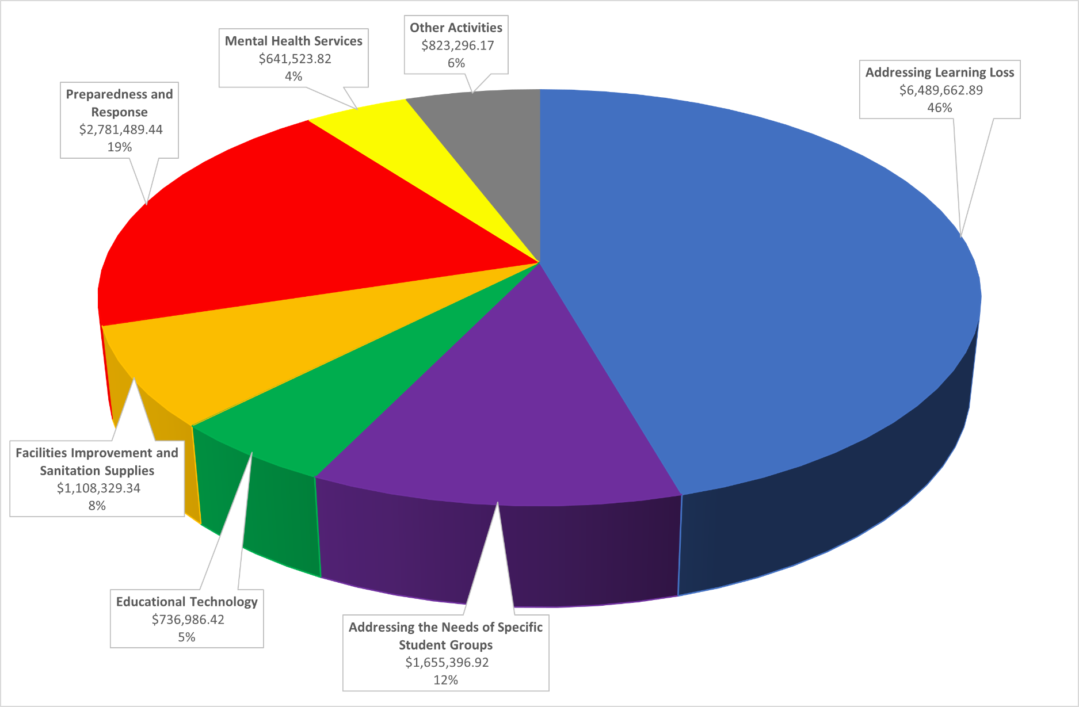
ESSER III – Updated Fund Use Budgeted activities as of December 2023

Slide 4
ESSER ARP Supplemental Funding
Additional funding awarded for mental health services and supports
ESSER II – ARP $78,540 ESSER III – ARP $71,029
Budgeted in FY23 & FY24 as high need set-asides to provide direct services to students on IEPs. The funds will be allocated using the High Need SPED identification process performed by CSI Special Education Coordinators and awards approved by our Director of Special Education.

