Slide 1
Identification for Gifted Education Services
Updated Guidance 2024

Slide 2
Agenda
Requirements for Identification Procedures
New Guidance on collecting a Body of Evidence and making Determination decisions
Practice

Slide 3
The Exceptional Children’s Education Act (ECEA) requires all public schools in Colorado to identify and serve students between the ages of four and twenty-one
Notes:
We are looking to identify students who need special provisions in order for their educational needs to be met.

Slide 4
Identification Procedures
Referral
Review Team
Body of Evidence (BOE)
Determination
4 Required Components

Slide 5
Referrals must provide multiple avenues PK-12
Transfer student ALP and BOE
45 days to review ALP; 60 days to communicate next steps to family
Student, Family, Community, School staff
30 days to collect and review BOE and communicate next steps to family & referrer
Assessment Data Review
Universal Screening
When does this occur? Who reviews? When does it become a referral?
When does this occur? Who reviews? When does it become a referral?

Slide 6
Review Team must be more than 1 person; must have at least 1 person trained
3-5 members
Gifted Lead trained in gifted identification
Classroom teacher
Data expert
SPED, ELD, Counselor, School Psychologist
Use a data discussion protocol to evaluate BOE
Use a review team form to document decisions

Slide 7
Robust Body of Evidence
3 Sources
2 Types of Data
Robust Body of Evidence

Slide 8
Written Letter of Determination
Collect more data (RtI/MTSS) or Talent Pool or Watch List
Student does not qualify.
Student qualifies in at least one area of giftedness and requires ALP development
Notes:
What did the team determine?
How will the student be served?
In which area did the student qualify?
What are the next steps for parent and school?
Inform of grievance process.
COPY in the cumulative file

Slide 9
Questions about the 4 Components

Slide 10
BOE is CDE Priority
3 Sources
2 Types of Data
Robust Body of Evidence

Slide 11
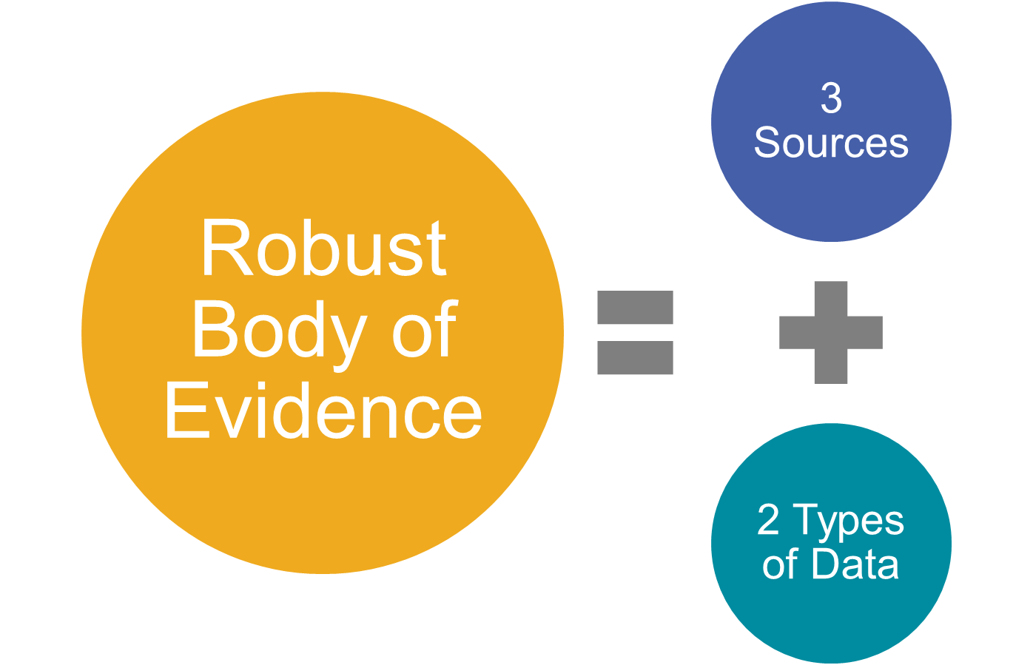
At Least 3 Sources of Data multiple sources
Cognitive
Individual IQ test
Group administered cognitive test/screener
Achievement
Nationally norm-reference test
Criterion norm-referenced test
Observation
Norm-referenced Observation Scale
Anecdotal record
Performance
Checklist
Curriculum-based test
Perception survey
Portfolio
Juried Performance
Contest/Competition
Classroom performance
CDE Matrix of Commonly Used Assessment Measures

Slide 12
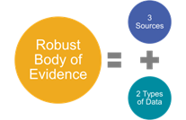
2 Required Types of Data
Quantitative assessment provides numerical scores or ratings that can be analyzed or quantified.
Norm-referenced test (e.g., cognitive and achievement
Qualitative assessment provides interpretive and descriptive information about certain attributes, characteristics, behaviors or performances.
Rubric
Criterion-referenced test (e.g., state assessment and curriculum-based measures)
Performance
Observation
Checklist
Interview

Slide 13
1 Qualifying Data Point supported by additional data in BOE
95th percentile or higher on a standardized nationally normed test
OR
95th percentile or higher (Advanced/Distinguished) on a standardized criterion referenced test
OR
95th percentile or higher on a nationally normed observation scale
OR
A rating on a performance assessment that indicates exceptionality/distinguished compared to age mates

Slide 14
Questions about the 3-2-1 Body of Evidence Criteria?

Slide 15
Data Discussion Protocol
Does the BOE have at least 3 data sources (cognitive, achievement, observation, performance)?
Does the BOE have 2 data types (qualitative, quantitative)?
Does the BOE have at least 1 qualifying data point?
Is the qualifying data point supported or refuted by additional data in the BOE?
Which area(s) of ID are supported?
https://resources.csi.state.co.us/wp-content/uploads/2024/01/BOE-for-Review.pdf

Slide 16
No two children are identical; therefore, no two bodies of evidence will be exactly identical. The ability to leverage multiple pathways (various combinations of evidence) for identification allows for increased access for all students, especially typically underserved students.
-CDE Gifted Identification Handbook

Slide 17
Resources
Please complete a Quick Check for Understanding
Exceptional Childrens’ Education Act Rules
CDE Gifted Identification Guidance Handbook
CDE Protocol & Review Team Form
CSI Gifted Identification Webpage

