Slide 1
Budget - Statutory Requirements
Colorado Charter School Institute
CSI Finance

Slide 2
Agenda
Budget Timeline and Due Dates
What to Present to Board
Other Budget Statutes
Monitoring and Analysis
Budget Purpose
Resources

Slide 3
Purpose of a Budget
Provides a plan of financial operation
Reflects educational values and needs of schools
Promotes rational decision-making
Required by statute C.R.S. 22-44-103
Assists board members and administrators in educational planning and prioritization of school operations through the allocation of resources

Slide 4
Budget Timeline
Post notice of Proposed Budget
Board adopts Proposed Budget
Submit Proposed Budget to board
Submit Proposed Amended Budget to the board
Board adopts Amended Budget
Optional Supplemental Budget
Before 6/01
Within 10 days
Before 7/01
By 1/31
After 1/31
**Board resolutions are required for adoption and use of beginning fund balance**

Slide 5
CSI Budget Deadlines
Adopted Budget
Due to CSI by June 30th
Include:
1) Signed and dated budget/appropriation resolution
2) Uniform Budget Summary (C.R.S. 22-44-105(1)(d.5))
3) Detail budget document that contains the current year budget, amount estimated to be expended for the current fiscal year, and the amount budgeted for the ensuing fiscal year
4) Resolution to spend beginning fund balance if needed

Slide 6
CSI Budget Deadlines Cont.
AmendedBudget
Due to CSI by January 31st
Include:
1) Signed and dated budget/appropriation resolution
2) Uniform Budget Summary
4) Resolution to spend beginning fund balance if needed
3) Detail budget document with prior year budget, final prior year actuals, and current year proposed amended budget

Slide 7
What to Present to the Board
Detail Budget
Uniform Budget Summary
Appropriation Resolution
Use of Beginning Fund Balance Resolution (if needed)

Slide 8
Detail Budget Contents
Annual Adopted Budget must include:
Uniform Budget Summary C.R.S. 22-44-105(1)(d.5)
TABOR reserve C.R.S. 22-44-105(1)(c.5)
SPED reserve
Pupil count C.R.S. 22-44-105(1)(b)
Summarized revenues by source and expenditures by fund, function, and object C.R.S. 22-44-105(1)(c.7)
Detailed budget format (C.R.S. 22-44-105 (c)) to include:
Description of the expenditure
Amount to be budgeted for the current fiscal year
Amount estimated to be expended for the current year
Amount budgeted for the ensuing fiscal year

Slide 9
Detail Budget Contents (cont.)
Annual Amended Budget must include:
Uniform Budget Summary C.R.S. 22-44-105(1)(d.5)
TABOR reserve C.R.S. 22-44-105(1)(c.5)
SPED reserve
Pupil count C.R.S. 22-44-105(1)(b)
Summarized revenues by source and expenditures by fund, function, and object C.R.S. 22-44-105(1)(c.7)
Detailed budget format (C.R.S. 22-44-105 (c)) to include:
Description of the expenditure
Prior year final approved budget
Prior year final actuals (audit)
Current year proposed amended budget to be approved by the board

Slide 10
Reserves
TABOR – C.R.S. 22-44-105(1)(c.5)
Taxpayer Bill of Rights - Article X, Section 20 of Colorado Constitution
3% of schools fiscal year spending excluding bonded debt service
Fiscal year spending means all expenditures and reserve increases, except those from gifts, federal funds, collections for another government, pension contributions by employees and pension fund earnings, reserve transfers or expenditures, damage awards, or property sales
SPED – CSI Requirement
Implemented to assist schools in ensuring they have funding available for severe needs students
$100 per funded pupil, not to exceed $90,000

Slide 11
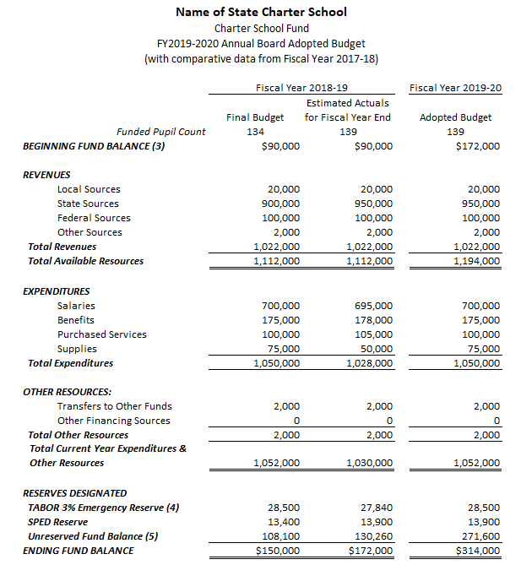
Sample Detail Budget

Slide 12
Uniform Budget Summary
Required by statute C.R.S 22-44-105(1)(d.5)
Total expenditures and appropriated reserves on this summary must tie to the board appropriated amount (line 176)
Must include (C.R.S. 22-44-105(1)(d.5)(I-V):
Beginning fund balance
Anticipated ending fund balance
Anticipated fund revenues for the budget year
Anticipated transfers and allocations for the budget year
Anticipated expenditures for the budget year
Amount of reserves

Slide 13
Uniform Budget Summary B
Uniform Budget Summary (cont.)
Should sum to $0 (line 198)
Must designate if reserves are appropriated or non-appropriated
Indicates whether you need a beginning fund balance resolution
If line 200 says “yes”, use of beginning fund balance is required
Appropriating reserves may cause you to require a use of beginning fund balance resolution

Slide 14
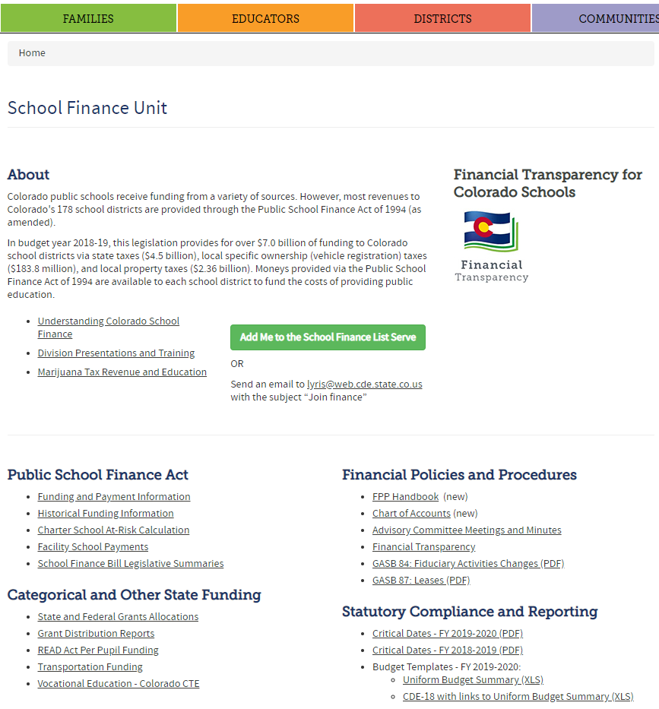
Uniform Budget Summary C
Uniform Budget Summary (cont.)
Where to find it: http://www.cde.state.co.us/cdefinance

Slide 15
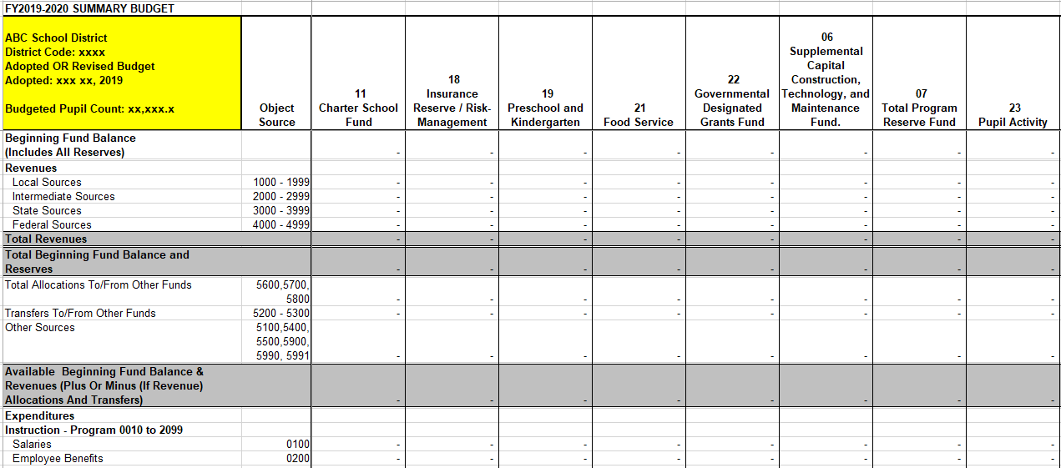
Uniform Budget Summary D
Uniform Budget Summary (cont.)
Fill in budget information based on CDE chart of accounts
You can delete unused columns (but not rows)

Slide 16
Uniform Budget Summary E
Uniform Budget Summary
Appropriated Reserves Section
May cause the use of beginning fund balance
CDE Chart of Accounts
-Object 0840
-Programs 9XXX as indicated on summary
Budgeted Ending Fund Balance
Will not cause the use of beginning fund balance resolution
CDE Chart of Accounts
-Balance sheet codes for fund equity as indicated on summary
-Option use of program

Slide 17
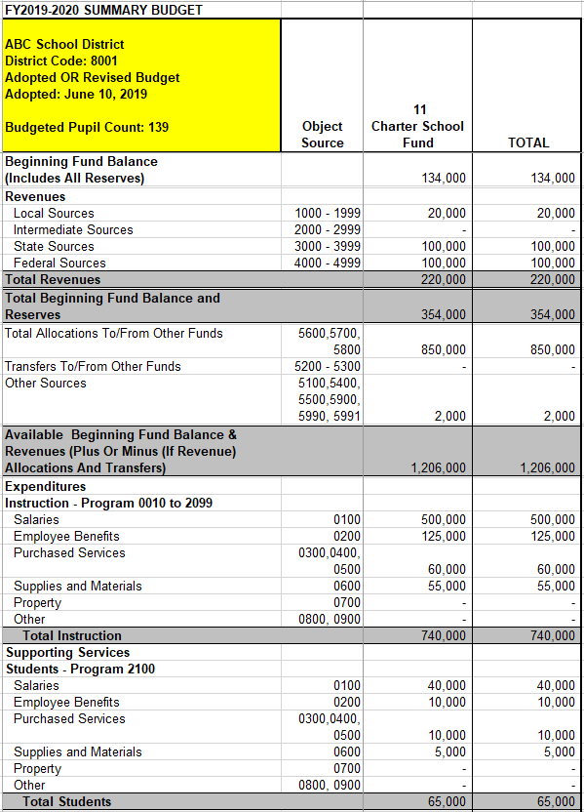
Uniform Budget Summary 1
Uniform Budget Summary
Example

Slide 18
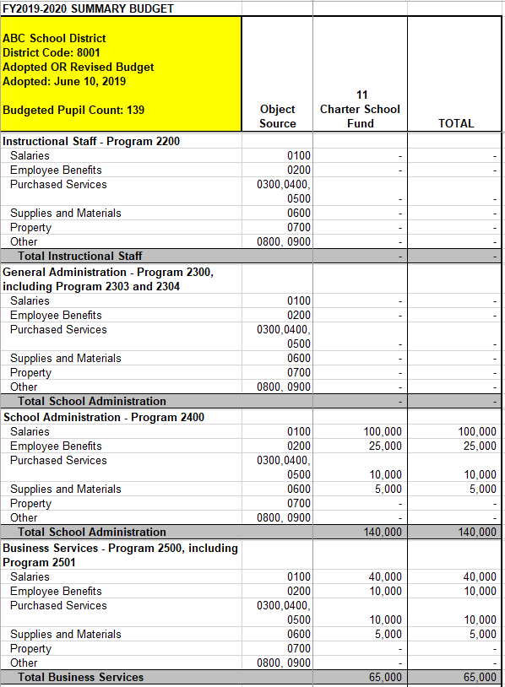
Uniform Budget Summary 2
Uniform Budget Summary
Example

Slide 19
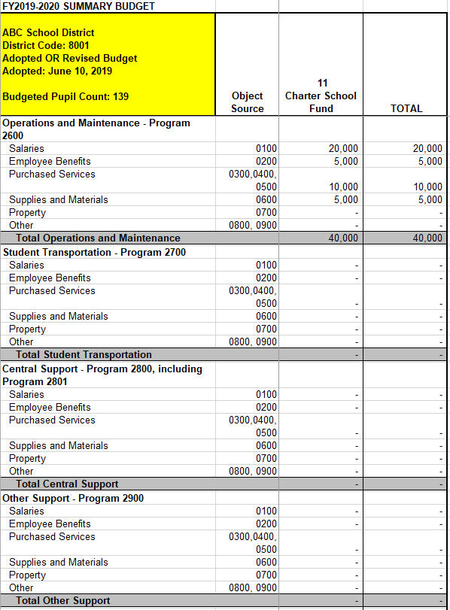
Uniform Budget Summary 3
Uniform Budget Summary
Example

Slide 20
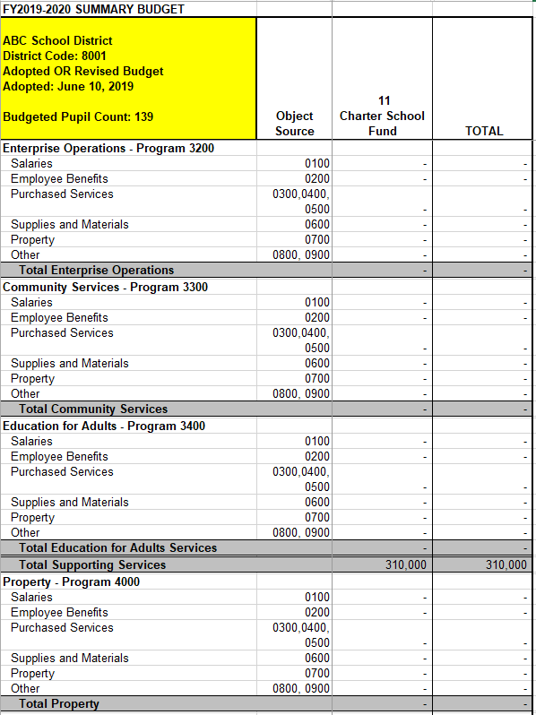
Uniform Budget Summary 4
Uniform Budget Summary
Example

Slide 21
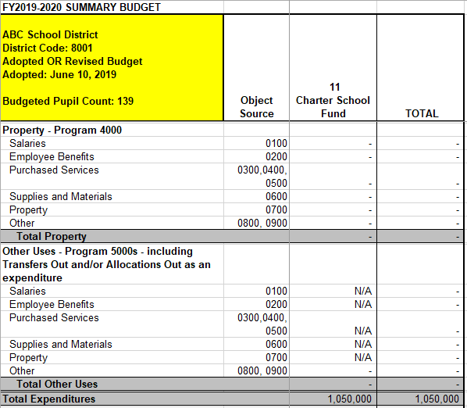
Uniform Budget Summary 5
Uniform Budget Summary
Example

Slide 22
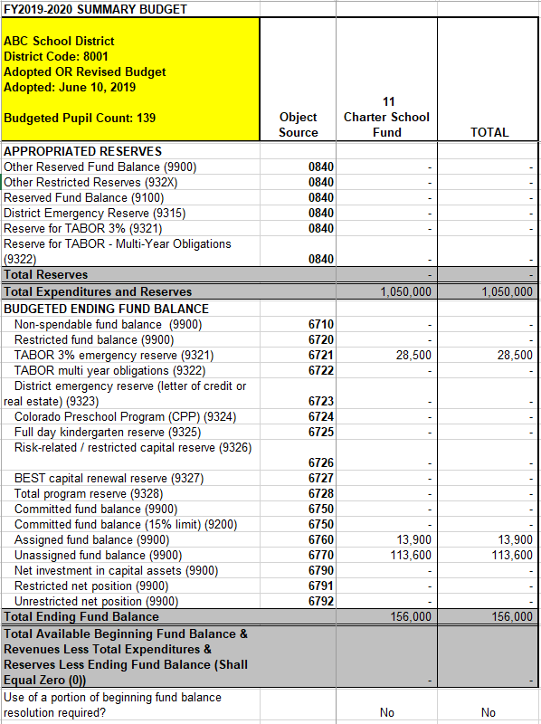
Uniform Budget Summary 6
Uniform Budget Summary
Example

Slide 23
Appropriation
What is an appropriation?
C.R.S. 22-44-102(1) “Appropriation” means the setting aside by resolution of a specified amount of money for a fund with an authorization to make expenditures and incur obligations of the purposes thereof

Slide 24
Appropriation (cont.)
Appropriation Resolution C.R.S. 22-44-107(1)
Sample appropriation resolution and language on CSI website
https://resources.csi.state.co.us/financial-services-library/
“Be it resolved by the Board of Education of _________ Charter School in _________ County, that the amounts shown in the following schedule be appropriated to each fund as specified in the Adopted Budget for the ensuing fiscal year beginning July 1, 20XX and ending June 30, 20XX.”
List funds and specify the appropriated amount for each fund. A sample is shown on the next slide.
The amount appropriated cannot exceed the amount in the adopted budget. C.R.S. 22-44-107(2)
Requires the words “Adopted Budget”, the name of the school, the date of adoption and the signature of the president of the board C.R.S. 22-44-110(4)

Slide 25
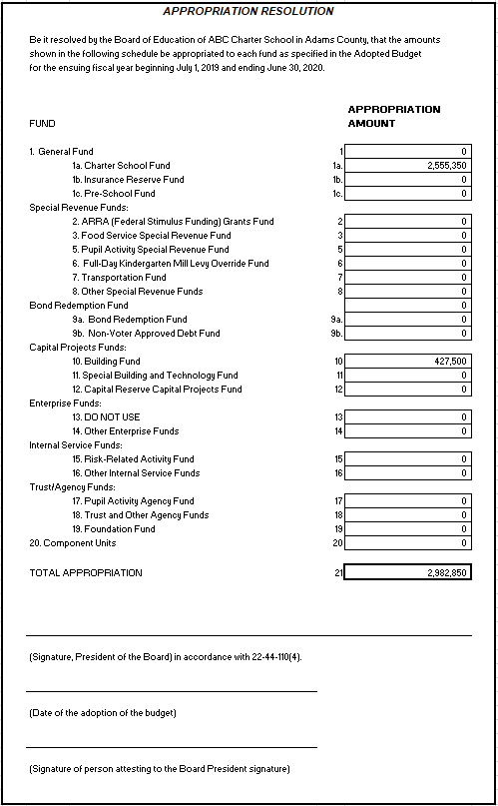
Sample Appropriation
The amount appropriated is the amount the board approves to be spent in the specific period of time
Should match the Uniform Budget Summary Line 176 – Total Expenditures and Reserves
The amount appropriated cannot exceed the amount in the adopted budget

Slide 26
Use of Beginning Fund Balance
If the budget includes the use of beginning fund balance, you must have a board resolution C.R.S 22-44-105(1.5)(a)
Resolution at a minimum, must include these items:
Amount of beginning fund balance to be spent
State why expenditures(s) is/are needed
State plan to ensure that the use of beginning fund balance will not lead to an ongoing deficit
If at any time during the fiscal year following the adoption of the budget, the board determines that the use of an additional portion of beginning fund balance is necessary, the board should adopt another resolution before using additional portion of fund balance. C.R.S 22-44-105(1.5)(a)

Slide 27
Use of Beginning Fund Balance (cont.)
Comparison of reporting differences Appropriated vs. Non-Appropriated Fund Balances/Reserves
Total Budgeted Expenditures and Appropriated Reserves is the amount appropriated by the board.

Slide 28
Use of Beginning Fund Balance (cont.) 3
Use of Beginning Fund Balance (cont.)
Sample resolution (short version):
BE IT RESOLVED: In accordance with C.R.S. 22-44-105, the Board of Education authorizes the use of a portion of the Fiscal Year 2019-20 Beginning Fund Balance from the General Fund in the amount of $xx,xxx for the following purposes: $xx,xxx authorized in the General Fund for “___________”.
BE IT FURTHER RESOLVED, that the use of this portion of the beginning fund balance for the purposes set forth above will not lead to an ongoing deficit, provided the use of the funds from the fund balance is one time only.
NOTE: This resolution is needed even if it is only appropriated in the budget and not actual spent.

Slide 29
Notice of Budget
Notice of Budget C.R.S. 22-44-109
Public notice must be given of proposed budget within 10 days after submission of the proposed budget
NOTICE OF PROPOSED SCHOOL BUDGET
Notice is herby given that a proposed budget has been submitted to the Board of Education of ____________(name of charter school) for the fiscal year beginning July 1, 20__ and has been filed in the office of _____________ where it is available for public inspection. Such proposed budget will be considered for adoption at a ________________ (regular or special) meeting of the Board of Education of said Charter School at _____________ (place) on __________(date) at __________(time). Any person paying school taxes in said district may at any time prior to the final adoption of the budget file or register his objections thereto.

Slide 30
Supplemental Budgets
If money for a specific purpose subsequently becomes available to meet a “contingency”, which is defined as: “an act of God or the public enemy, or some event which could not have been reasonably foreseen at the time of adoption of the budget of a school district,” C.R.S. 22-44-102(3), a supplemental budget for expenditures not to exceed the amount of said money may be adopted and appropriation of said money made. C.R.S. 22-44-110(5).
A supplemental budget and the appropriation resolution must be adopted before expenditures relative to the supplemental budget are made.

Slide 31
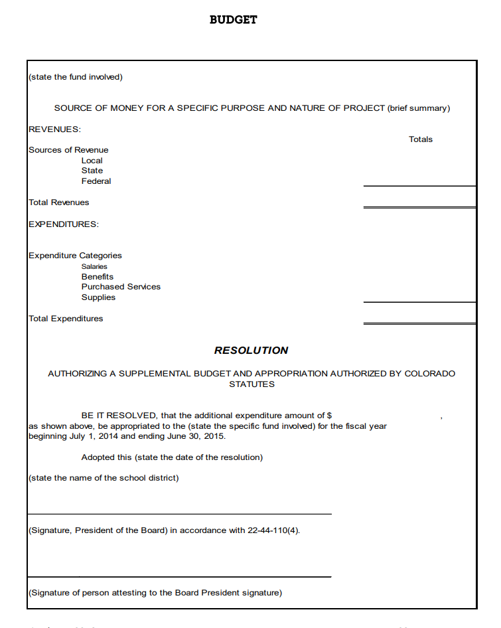
Supplemental Budget
Sample

Slide 32
Failure to Adopt a Budget
If either the budget or the appropriate resolution is not adopted, then 90% of the last duly adopted budget appropriation resolution shall be deemed to be budgeted and appropriated.
C.R.S. 22-44-104

Slide 33
Cannot Budget Deficit
Budgets adopted by the board cannot have expenditures, interfund transfers and reserves that exceed the available revenues and beginning fund balance.
C.R.S. 22-44-105(1.5)(a)

Slide 34
Budget - Filing
A copy of the adopted budget and the appropriation resolution must be placed on file in the school’s administrative office where it is available for inspections throughout the fiscal year.
C.R.S. 22-44-111(1)

Slide 35
Monitoring and Analysis
The school board must review the financial condition of the school against the annual budget at least quarterly. C.R.S. 22-45-102(1)(a)&(b)
The report to the board must include:
Actual expenditures and revenue as of the date of the report for each of the several funds budgeted by the school for the fiscal year
Expressed in dollar amounts
Expressed in percentages of the annual budget
Actual expenditures and revenue for each fund for the same period in the preceding fiscal year
Expressed in dollar amounts
Expressed in percentages of the annual budget
Expected year-end balances
Expressed in dollar amounts
Expressed in percentages of the annual bud
Comparison of the expected year-end fund balances with the amount budgeted for that fiscal year

Slide 36
Monitoring and Analysis (cont.)
Time-of-year comparison: Compare the percentage of the year which has elapsed with the percentage of the budget which has been expended or the percentage of revenue received.
Comparison of prior year: Compare the dollar amount or percentage of total budget spent in the prior year to dollar amount or percentage of total budget spent in the current year.
Comparison to source documentation: Compare budget to actual costs by reviewing documents received after the establishment of the budget to ensure budget adequacy.

Slide 37
Sample Quarterly Report

Slide 38
Resources
Statutes pertaining to budget:
C.R.S. 22-44-102(1) – Definition Appropriation
C.R.S. 22-44-102(3) – Definition Contingency
C.R.S. 22-44-103 – Budget Required
C.R.S. 22-44.104 – Failure to adopt a budget or appropriation
C.R.S. 22-44-105(1)(b) – Allow for comparisons of revenues/expenditures among schools by pupil
C.R.S. 22-44-105(1)(c) – Detail of budget
C.R.S. 22-44-105(1)(c.5) – TABOR
C.R.S. 22-44-105(1)(d.5) – Uniform summary sheet
C.R.S. 22-44-105(1.5)(a) – Budget expenditures cannot exceed available revenues and beginning fund balance
C.R.S. 22-44-105(1.5)(a)&(c) – Use of beginning fund equity
C.R.S. 22-44-106(2) – Budgetary reserves
C.R.S. 22-44-107 – Appropriation resolution
C.R.S. 22-44-108(1)(c) – Preparation of budget (submit to board 30 days prior to beginning fiscal year)
C.R.S. 22-44-109 – Notice of proposed budget
C.R.S. 22-44-110(4) – Adoption of budget
C.R.S. 22-44-110(5) – Supplemental budget
C.R.S. 22-45-102(1)(a) & (b) – Quarterly Reports to the Board
C.R.S. 22-30.5-111.7 – Charter schools shall comply with all state financial and budget rules, regulations and financial reporting requirements with which the authorizer is required to comply
TABOR Amendment – Article X Section 20 (5) of the state constitution
To view Colorado Revised Statutes: http://leg.colorado.gov/colorado-revised-statutes
To view Colorado Constitution: http://leg.colorado.gov/colorado-constitution

Slide 39
Resources cont.
CDE
Uniform budget summary and sample appropriation resolution found in the budget templates:
http://www.cde.state.co.us/cdefinance >Budget Templates - FY 2018 >Uniform Budget Summary
CDE Chart of Accounts
http://www.cde.state.co.us/cdefinance/sfCOA.htm
CSI Templates
Quarterly financial report
https://resources.csi.state.co.us/financial-services-library/ >Under Financial Reporting
Annual budget
Supplemental budget
Sample Use of BFB authorization resolution
Sample Appropriation Resolution
https://resources.csi.state.co.us/financial-services-library/ >Under Budget Process
Financial Policies and Procedures Handbook
http://www.cde.state.co.us/cdefinance/fpphandbook

