Slide 1
Transition IEP Guidance

Slide 2
How do we help students identify the next step?

Slide 3
Why transition planning?
It’s a legal requirement –
The IDEA provides that beginning not later than the IEP in effect when the child turns 16 (or younger if determined appropriate by the IEP team) the IEP must include:
Appropriate measurable postsecondary goals based on age-appropriate transition assessments; and
The transition services (including courses of study) needed to assist the child in reaching those goals.
– See 20 U.S.C. § 1414(d)(1)(A)(i)(VIII) & 34 C.F.R. § 300.320(b)

Slide 4
Reminder: State laws cannot contradict IDEA and they can’t provide less than what federal law requires. However, state laws can offer more protections to students and parents.
IDEA
Transition services must begin not later than the first IEP to be in effect when the student turns 16, or younger, if determined appropriate by the IEP Team
ECEA
Transition services must begin with the first IEP developed when the student is age 15, but no later than the end of 9th grade, or earlier if deemed appropriate by the IEP Team
Transition services must be updated annually.

Slide 5
Transition Services Defined

Slide 6
What are transition services (1 of 3)?
“Transition services” means a “coordinated set of activities:”
that is designed to be within a results-oriented process that is focused on improving the academic and functional achievement of the child with a disability to facilitate the child’s movement from school to post-school activities, including postsecondary education, vocational education, integrated (supported) employment, continuing and adult education, adult services, independent living, or community participation;
– See 20 U.S.C. § 1401(34)(A); 34 C.F.R. § 300.43(a)(1).

Slide 7
What are transition services (2 of 3)?
“Transition services” means a “coordinated set of activities” (cont’d):
that is based on the individual child’s needs, taking into account the child’s strengths, preferences, and interests; and includes:
instruction, related services, community experiences, the development of employment and other post-school adult living objectives, and, if appropriate, acquisition of daily living skills and provision of a functional vocational evaluation.
– See 20 U.S.C. § 1401(34)(B) & (C); 34 C.F.R. § 300.43(a)(2).

Slide 8
What are transition services (3 of 3)?
Designed to facilitate the student’s movement from school to post-school activities, including
- postsecondary education,
- vocational education,
-integrated employment (including supported employment),
-continuing and adult education,
-adult services,
- independent living,
- or community participation

Slide 9
Required Elements of Transition Planning

Slide 10
Indicator 13 – Required Elements (1 of 2)
Percent of youth with IEPs aged 16 and above with an IEP that includes
1. appropriate measurable postsecondary goals
2. that are annually updated and
3. based upon an age-appropriate transition assessments,
4. transition services,
5. including courses of study, that will reasonably enable the student to meet those postsecondary goals, and

Slide 11
Indicator 13 – Required Elements (2 of 2)
6. annual IEP goals related to the student’s transition services needs.
7. There also must be evidence that the student was invited to the IEP Team meeting where transition services are to be discussed and
8. evidence that, if appropriate, a representative of any participating agency was invited to the IEP Team meeting with the prior consent of the parent or student who has reached the age of majority.
(20 U.S.C. 1416(a)(3)(B))

Slide 12
Spirit of the IDEA
LETTER of the Law
Focus on IDEA Regulation for transition
Identify Minimal Requirements
Compliance with IDEA only
Narrow Impact on Adult Outcomes
SPIRIT of the Law
Understand the Spirit and Intent of IDEA
Identify Possibilities for a Quality Adult Life
Expand the Focus of Transition Planning and Services
Large Impact on Adult Outcomes for Students with Disabilities

Slide 13
Why is this important?
Without a plan, goals are simply dreams
Attaining progression in life requires thoughtful planning
Resources, support, and networks must be constructed
We cannot simply “hope” young adults will “make it”
This is a relay, not a punt!

Slide 14
Writing Secondary Transition IEPs (Indicator 13)
Writing Quality Secondary Transition IEPs that include the
Required Elements of Indicator 13

Slide 15
The Foundation of Effective Transition Planning
Six-step transition planning sequence:
Step One - Age-Appropriate Transition Assessments Identify a student’s strengths, interests, needs, and preferences
Step Two - Using Transition Assessments - Write Measurable Post-Secondary Goals In: Education/Training, Career/Employment and Independent Living Skills (where appropriate)
Step Three - Write Measurable Annual IEP Goals
Step Four - Identify Transition Services
Step Five - Write Courses of Study
Step Six - Coordinate with Adult Agencies
Notes:
Comprehensive Age-Appropriate Transition Assessment
The key to answering the right questions is to individualize the transition process for each student and identify outcomes as they prepare to leave the school system and enter adult life

Slide 16
“Golden Thread”
AssessmentS
Present Levels of Performance
Strengths, Needs, Preferences, Aptitude
Postsecondary Goals
Annual Transition Goals
Courses of Study
Transition Services
Notes:
Consider the IEP as a “growth development plan” for a student from which each element of the document builds from one another and are interconnected.

Slide 17
Comprehensive Age-Appropriate Transition Assessments
Identify: Strengths, Interests, Needs, Preferences
What is Transition Assessment?
“the ongoing process of collecting data on the individual’s needs (think performance), preferences, and interests as they relate to the demands of current and future working, educational, living, and personal and social environments. Assessment data serve as the common thread in the transition process and form the basis for defining goals and services to be included in the [IEP].”
Sitlington, Neubert, & Leconte, Career Development for Exceptional Individuals, 1997, p. 70-71 (emphasis added).

Slide 18
Comprehensive Age-Appropriate Transition Assessments
Identify: Strengths, Interests, Needs, Preferences
What is Required?
There must be evidence that the student’s measurable postsecondary goals were based on age-appropriate transition assessment (Sec. 300.320 (b) – Individuals with Disabilities Education Act)
It must be individualized
Comprehensive – more than one assessment
Be Student Driven as much as possible; including students with a significant disability
Conducted or reviewed each year beginning at age 15
Age-appropriate, chronological age - content, environments, instruction, and/or materials
may necessitate adaptations to their administration for some students so that meaningful data is obtained
http://www.nsttac.org/content/age-appropriate-transition-assessment/

Slide 19
Comprehensive Age-Appropriate Transition Assessments
Identify: Strengths, Interests, Needs, Preferences
Transition Assessment Domains:
Employment/Career Interest
College Readiness/Postsecondary Training
Self-Determination/Self-Advocacy
Independent Living/Adult Living Skills

Slide 20
Types of Transition Assessments
An authentic transition assessment process includes:
Formal
Structural assessments or inquiries
Often researched based, norm referenced, or standardized
Time specific
Informal
Procedures are less structured
Not norm-referenced
Allow assessment of student performance over time
Includes data collected from a variety of individuals

Slide 21
Transition Assessment Examples
Formal
Informal
Achievement tests
Aptitude tests
Adaptive behavior scales
Intellectual functioning assessment
Temperament inventories
Self-determination scales
Pre-vocational / Employability scales
Interest inventories
Learning Style Inventories
Interest inventories
Situational assessments
Interviews
Direct observation
Case file reviews
Curriculum-based assessment
Social history
Rating scales for specific areas
Notes:
Kacy

Slide 22
AAT Assessments
What: Assessment of the student’s current strengths, skills, preferences, interests, talents, needs, and challenges in relation to the future
Focus: Concentrate attention on the potential impact of the current skills, interests, and needs on future plans and adult life goals.
Implications: What impact will this have on what the student needs to learn now: Is yearly progress sufficient: What supports are needed? Do we need more information?
The Gap
Future Plans and
Adult Life Goals
Required Skills
And
Knowledge
What is the difference between the current skills and knowledge and the required future skills?
Annual Goals
Age 15
Age 16
Age 17
Age 18
What are the yearly sequential steps
required to achieve the needed skills?
Transition Services Needed
What services and supports will be needed to make the required progress?
*From Ohio Center for Low Incidence Disabilities

Slide 23
Viewing Data Through a Transition Lens
Viewing all assessments through a transition lens will provide a rich narrative of the student’s skills and abilities by considering these questions:
Does the skills assessment match the skills needed to reach the intended postsecondary goals?
Is there a gap between current skills and skills needed to meet post-secondary goals? (annual transition goals)
How can you and other teachers/adults assist the student in building the skills/knowledge required to close the gap and move toward the postsecondary goals? (transition services)

Slide 24
Transition Assessments Is:
The most critical element to determining appropriate and measurable PSGs
Central to the transition and IEP planning process (everything falls into place from here)
A cycle – assess, gather data over the course of a calendar year, review results at the annual IEP, and do it all over again.

Slide 25
Student Needs and Impact of Disability
How does the student’s disability affect his/her involvement and progress in the general curriculum and participation in appropriate activities?
For students of transition age, how does the student’s disability affect his/her attainment of the postsecondary goals?
IDEA 300.324(a)(ii) concerns of parent
IDEA 300.320(a)(1)(i) How the child’s disability affects the child’s involvement and progress—in the general curriculum and participation in appropriate activities

Slide 26
How Do You Begin?
Employment
Independent
Living Skills
Education/ Training
Self-Determination
Notes:
Abby
Facilitator Notes: “Transition assessment should address three areas: employment, education and training, and as necessary independent living.”
Involve both student and family
Information provided from multiple sources (people and assessments)
Not a one-time event

Slide 27
Preferences, Interests, Needs, Strengths, (PINS)
What are my preferences?
What are my interests?
What are my needs?
What are my strengths?

Slide 28
Help the student answer these questions
Who am I?
When and where am I at my best? (Conditions for employment)
What are my unique talents and interests?
What are my main barriers to succeeding after high school?
What do I want for my future?
What are my options in my community?

Slide 29
Student-Centered Process
Selection of assessments depends on the student’s vision of career, education, and independent living aspirations
Relevant members of the IEP team should provide input into the assessment
Parents
Teachers
VR counselor
School counselor

Slide 30
Common assessments to begin with…..
Transition Planning Inventory
Parent Survey
Student Interviews
Interest surveys

Slide 31
How Do You Begin the Transition Planning Process?
What do you already know about the student?
Academics
Past transition assessments, if possible
Past IEPs
Functional performance
Disability designation - individualized adult agency linkages
Observational data - interaction with peers and adults
Behavioral and attendance information
Teacher feedback - general and special education teachers
Notes:
Rachel

Slide 32
How Do You Begin the Transition Planning Process?
What do you already know about the student?
Health history and plans
ACCESS scores
Accommodations and/or modifications
Outside agency reports
Technology
Notes:
Rachel

Slide 33
What Do I Still Need to Know?
Current strengths, interests, preferences, and needs
Strengths, needs, and Interests
Current functional performance
College Readiness Assessment
College Planning Worksheet
The student’s hopes and dreams for a good life - postsecondary goals
CDE Transition Student Interview
My Action Plan
Notes:
Abby
Facilitator Notes: “Transition assessment should address three areas: employment, education and training, and as necessary independent living.”
Involve both student and family

Slide 34
What Do I Still Need to Know?
Parent vision
#1 Strength Based Family Interview
Level of self-determination
Academic Self-Advocacy Questionnaire
**The Informal Assessments for Transition Planning tool has transition assessments for several domains that are simple and easy to give to multiple students at once.

Slide 35
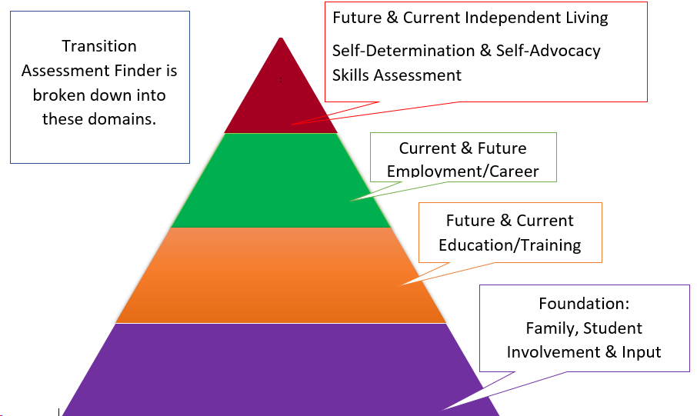
Pyramid of the Transition Assessment Finder and Resource Tool
Notes:
Rachel

Slide 36
Selecting Appropriate Transition Assessments
Assessment Finder & Resource Tool
Transition Assessment Bank
Education
Employment
Family Input/Engagement
Independent Living Skills
Self-Advocacy
Transition Interviews
Informal Transition Assessment – Multiple Domains
Student Self-Assessment – Multiple Domains
Age-Appropriate Transition Assessment Toolkit 3rd Edition
Notes:
Rachel first and Abby will present the bank nd toolkit 2nd

Slide 37
Comprehensive Age-Appropriate Transition Assessments
Identify: Strengths, Interests, Needs, Preferences
Case study:
Jenny
This is what we know about Jenny…
Jenny is an 11th-grade student who has previously completed the O’Net Interest Profiler and the 123 Career Assessment.
Jenny’s interest inventories and independent research has identified an interest in architecture and design.
Jenny has previously identified a PSG of being an architect and attending a four-year college to study architecture.
Jenny tests significantly below her peers in district assessments, especially in mathematics, however, her scores in writing are comparable to peers her age when applying the accommodations of predictive text and/or speech-to-text.
Case study:
Jenny
Case study:
Jenny

Slide 38
Comprehensive Age-Appropriate Transition Assessments
Identify: Strengths, Interests, Needs, Preferences
Case study:
Jenny
This is what we know about Jenny…
Jenny completed the PSAT as a 10th grader and has signed up to take the SAT. She has also taken part in various district assessments in reading, writing, and math. Her academic assessment data indicates the following:
The College Board has set college readiness benchmarks for each grade. In 10th grade, with a score at or above 430 in the Evidence-Based Reading and Writing section of the PSAT 10 and at or above 480 in Math, a student is identified as on track to be college-ready by graduation from high school.
Case study:
Jenny
Case study:
Jenny

Slide 39
Comprehensive Age-Appropriate Transition Assessments
Identify: Strengths, Interests, Needs, Preferences
Case study:
Jenny
This is what we know about Jenny…..
Jenny’s PSAT scores:
Reading & Writing ‘Needs to Strengthen Skills’ (score of 380- score range of 320-1520),
Math ‘Significantly Below Average – Did Not Reach Benchmark’ (score of 240- score range 160-760).
Case study:
Jenny
Case study:
Jenny

Slide 40
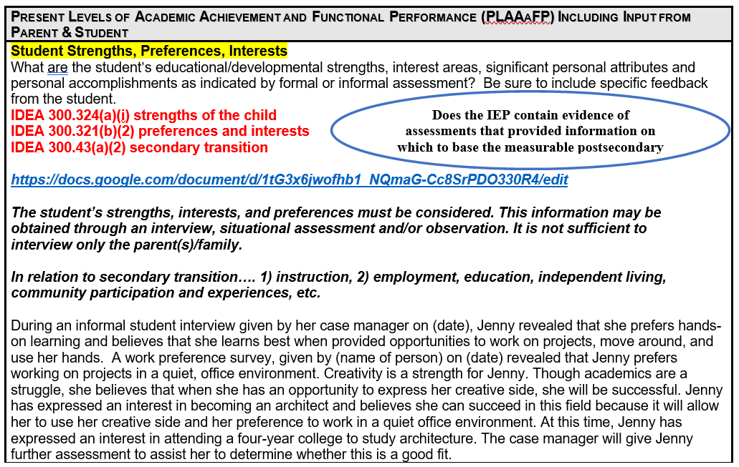
Strengths, preferences, interests
Notes:
Sec. 300.324 (a) (1)
Statute/Regs Main » Regulations » Part B » Subpart D » Section 300.324 » a » 1
(1) General. In developing each child’s IEP, the IEP Team must consider—
(i) The strengths of the child;
(ii) The concerns of the parents for enhancing the education of their child;
(iii) The results of the initial or most recent evaluation of the child; and
(iv) The academic, developmental, and functional needs of the child.
Sec. 300.321 (b)
Statute/Regs Main » Regulations » Part B » Subpart D » Section 300.321 » b
(b) Transition services participants.
(1) In accordance with paragraph (a)(7) of this section, the public agency must invite a child with a disability to attend the child’s IEP Team meeting if a purpose of the meeting will be the consideration of the postsecondary goals for the child and the transition services needed to assist the child in reaching those goals under §300.320(b).
(2) If the child does not attend the IEP Team meeting, the public agency must take other steps to ensure that the child’s preferences and interests are considered.
(3) To the extent appropriate, with the consent of the parents or a child who has reached the age of majority, in implementing the requirements of paragraph (b)(1) of this section, the public agency must invite a representative of any participating agency that is likely to be responsible for providing or paying for transition services.
Sec. 300.43 Transition services
Statute/Regs Main » Regulations » Part B » Subpart A » Section 300.43
300.43 Transition services.
(a) Transition services means a coordinated set of activities for a child with a disability that—
(1) Is designed to be within a results-oriented process, that is focused on improving the academic and functional achievement of the child with a disability to facilitate the child’s movement from school to post-school activities, including postsecondary education, vocational education, integrated employment (including supported employment), continuing and adult education, adult services, independent living, or community participation;
(2) Is based on the individual child’s needs, taking into account the child’s strengths, preferences, and interests; and includes—
(i) Instruction;
(ii) Related services;
(iii) Community experiences;
(iv) The development of employment and other post-school adult living objectives; and
(v) If appropriate, acquisition of daily living skills and provision of a functional vocational evaluation.
(b) Transition services for children with disabilities may be special education, if provided as specially designed instruction, or a related service, if required to assist a child with a disability to benefit from special education.
https://sites.ed.gov/idea/files/Secondary_Transition_2-1-07.pdf

Slide 41
Present Levels of Performance Summary
Include results of the initial or most recent evaluation, including, if appropriate, the results of any interventions, progress monitoring, and gap analyses.
IDEA 300.320(a)(1) present levels of academic achievement and functional performance
IDEA 300.324(a)(iii) Results of initial or most recent evaluation
Jenny qualifies for special education services for a specific learning disability, which impacts reading comprehension, written expression, and math computation (Woodcock Johnson-III).
Jenny receives instruction and is successful in general education settings with additional support on strategies for math computation and writing mechanics (report card, teacher report).
Jenny uses a word processor and speech-to-text technology for written assignments and audio recordings for text. Also, she receives extended time on written and math computation assignments.

Slide 42
Present Levels of Performance Summary
Include results of initial or most recent evaluation, including, if appropriate, the results of any interventions, progress monitoring and gap analyses.
IDEA 300.320(a)(1) present levels of academic achievement and functional performance
IDEA 300.324(a)(iii) Results of initial or most recent evaluation
For English Language Arts, Jenny struggles to comprehend 8th-grade level fiction. For writing, she needs support with organization and writing mechanics (teacher reports). Jenny currently demonstrates that she can produce proficient written products with her accommodations at the 11th-grade level 50% (2 out of 4 trials) of the time (based on quarterly grade-level writing rubrics).

Slide 43
Present Levels of Performance Summary
Include results of initial or most recent evaluation, including, if appropriate, the results of any interventions, progress monitoring and gap analyses.
IDEA 300.320(a)(1) present levels of academic achievement and functional performance
IDEA 300.324(a)(iii) Results of initial or most recent evaluation
When Jenny hurries through her work, she makes multiple mistakes, especially when solving multiple-step problems (math teacher report). She currently demonstrates that she can independently solve eighth-grade-level multi-step problems with 50% accuracy.

Slide 44
Present Levels of Performance Summary
Include results of initial or most recent evaluation, including, if appropriate, the results of any interventions, progress monitoring and gap analyses.
IDEA 300.320(a)(1) present levels of academic achievement and functional performance
IDEA 300.324(a)(iii) Results of initial or most recent evaluation
It is best practice to include the name of the assessment, the date given or reviewed, the name and title of the person administering or reviewing the assessment, and a summary of the results written so that families understand the results.
Jenny’s current index scores on CO state testing do not meet freshman index scores for any 4-year public school in the state of CO.
Jenny tests significantly below her peers on district assessments, especially in mathematics; however, her scores in writing are comparable to peers her age when applying the accommodations of predictive text and/or speech-to-text.
Last year, Jenny identified a PSG of being an architect and attending a four-year college to study architecture. When preparing for this year’s IEP meeting, Jenny indicated that this continues to be her goal to work in this field after graduation.

Slide 45
Present Levels of Performance Summary
Include results of initial or most recent evaluation, including, if appropriate, the results of any interventions, progress monitoring and gap analyses.
IDEA 300.320(a)(1) present levels of academic achievement and functional performance
IDEA 300.324(a)(iii) Results of initial or most recent evaluation
Functional: Jenny does not feel comfortable advocating for her needs with new adults (transition survey, interview with family). She needs to improve her self-advocacy skills (AIR Self-Determination Scale, survey, interviews). Based on teacher reports, Jenny discusses her needs with new adults 60% of the time. Jenny demonstrates an aptitude for working with her hands (teacher report, career interest inventory) and a particular interest in working in a field that allows her to be creative.
She has articulated dreams for her future – working in the architecture field and living on her own with a roommate (survey, interview). Jenny needs guidance and instruction on the skills to advocate for her needs when she attends college and when she lives on her own. (interview).

Slide 46
Present Levels of Performance Summary
Include results of initial or most recent evaluation, including, if appropriate, the results of any interventions, progress monitoring and gap analyses.
IDEA 300.320(a)(1) present levels of academic achievement and functional performance
IDEA 300.324(a)(iii) Results of initial or most recent evaluation
** Summary:
Looking at Jenny’s assessments through a “transition lens” indicates a significant gap was identified between her current level and her PSG of attending a 4-year college to study architecture.
Math ‘Significantly Below Average – Did Not Reach Benchmark’ (score of 240- score range 160-760) currently demonstrates that she can independently solve eighth grade-level multi-step problems with 50% accuracy. (Math calculation skills)
Jenny’s reading and writing scored 140, 380- 430 or above required for 4-year university. Attending Community College allows Jenny to take remedial math and language arts courses to improve her scores and skills.
Reading & Writing ‘Needs to Strengthen Skills’ (score of 380- score range of 320-1520) For English Language Arts, Jenny struggles to comprehend 8th grade level fiction. (Reading comprehension strategies).
For writing, she needs support with organization and writing mechanics (teacher reports)
**Jenny’s goal was to attend a 4-year college, but after researching with her case manager, Jenny decided that a community college would be a better fit.

Slide 47
Transition Assessment #1: O’NET Interest Profiler results
Jenny’s Interest Code RCA
Realistic — Realistic occupations frequently involve work activities that include practical, hands-on problems and solutions. They often deal with plants, animals, and real-world materials like wood, tools, and machinery. Many of the occupations require working outside and do not involve a lot of paperwork or working closely with others.
Conventional — Conventional occupations frequently involve following set procedures and routines. These occupations can include working with data and details more than with ideas. Usually, there is a clear line of authority to follow.
Artistic — Artistic occupations frequently involve working with forms, designs, and patterns. They often require self-expression, and the work can be done without following a clear set of rules.
Jenny’s Interests: Architecture and Design.
Notes:
https://www.onetcenter.org/reports/IP_Manual.html

Slide 48
Transition Assessment #2:
Interest Profiler/123 Career Test Results:
Hollands codes: ARICES
Jenny preferred “Artistic” the most, followed by “Realistic” and “Investigative”. Artistic (25%), Realistic (23%), Investigative (18%), Conventional (17%)
Artistic: creative, original, independent, chaotic, inventive, media, graphics
Realistic: practical, physical, concrete, hands-on, machine, and tool-oriented
Investigative: analytical, intellectual, scientific, explorative, thinker
Conventional: detail-oriented, organizing, clerical
Suggested occupations that align with Jenny’s personality type and interests:
Photographer: 76%, artistic coach 56% (leads art activities), Drafter 53%, mechanical engineering technician 52%
**Based on these results, Jenny’s career choice of architecture aligns with her interests and personality type

Slide 49
Transition Assessment #3:
Independent Living Post-Secondary Goal Worksheet Summary
Household and Money Management: Jenny can manage money at this time (count money, budget, pay taxes, monthly bills).
Transportation: Selects appropriate transportation, has driver’s license, navigates independently throughout the community.
Laws and Policies: Needs to learn about voting and political understanding of laws and decision making
Community Involvement: participates in recreational and leisure activities, locates and uses community services, plans wardrobe, responds appropriately to environmental cues
Personal Safety & Interpersonal Relationships: performs basic first aid, seeks medical assistance, practices community safety routines (avoid unsafe locations, asks for directions)
Self Advocacy: Positively she can resolve conflicts through reasoning, she responds appropriately through typical exchanges with others. She cannot express her strengths and needs when asking for help or when needed. She is unable to express preferences appropriately, which includes identifying short- and long-term goals, nor appropriately advocate for herself in a variety of settings.
Remember You must have data to determine if an Independent Living Skills Goal is warranted, or not, for every student with an IEP!
Notes:
Would benefit from Ind. living goal for advocating for success in her current classes and move her toward meeting her post-school goal of attending college.

Slide 50
The Foundation of Effective Transition Planning
Transition Services Flowchart
Step One - Age-Appropriate Transition Assessments Identify a student’s strengths, interests, needs, and preferences
Step Two - Using Transition Assessments - Write Measurable Post-Secondary Goals In: Education/Training, Career/Employment and Independent Living Skills (where appropriate)
Step Three - Write Measurable Annual IEP Goals
Step Four - Identify Transition Services
Step Five - Write Courses of Study
Step Six - Coordinate with Adult Agencies
Comprehensive Age-Appropriate Transition Assessment
The key to answering the right questions is to individualize the transition process for each student and identify outcomes as they prepare to leave the school system and enter adult life

Slide 51
To be attained after high school
Updated annually
Based on transition assessment
Reviewed within the last 12 months
Required for education/training and career/employment
Independent living skills, as appropriate
Use active, not passive voice
Stated as what the student “will do.”
Focus on the Next Big Step

Slide 52
Begins at age 15 or by the end of 9th grade
Education/training
Career/Employment
Independent living, as appropriate
Goals must:
Measurable, countable
Updated annually
Use active, not passive voice
Stated as what the student “will do.”
Appropriate and measurable
Example: After high school, Molly will attend Colorado State College and major in accounting.

Slide 53
Where will the student work or engage in productive activities after graduation?
Where and how will the student continue to learn and/or develop skills after graduation?
Where is the student going to live and how will he or she access adult services, participate in the community and have fun after graduation?
Answer the following questions:
Example: After high school, Yolly will attend a 4-year college and major in accounting.

Slide 54
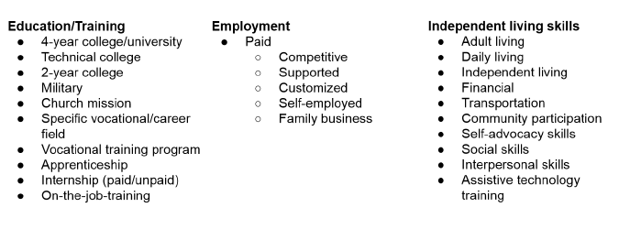
Postsecondary Goal Definitions

Slide 55
Postsecondary goals are required in training/education and career/employment
If the IEP team determines that a postsecondary goal for independent living skills is not needed, it is best practice to indicate, “based on assessment data, no goal is needed.” (transition assessment data documented in the IEP)

Slide 56
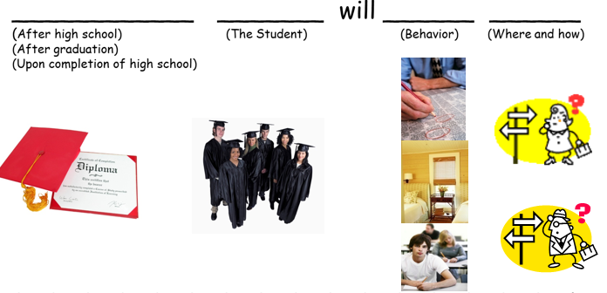
How do you write postsecondary goals?
Here is one way:

Slide 57
After graduating from high school, Maria will enroll in welding courses at Colorado Technical College.
Goals must:
After exiting secondary education, Greta will maintain a budget and pay all their utility bills on time.
Sandy will work full-time in the construction industry after high school.
Examples of goals that meet requirements

Slide 58
Peety wants to work with animals at a shelter or vet office.
Fluffy will learn vocation skills in a post high school program
Allison plans to enroll in a four-year university after graduating from high school.
Examples of goals that do not meet requirements

Slide 59
Career/employment: Upon completion of public education, Jenny will obtain employment in the field of architecture.
Education/Training: Upon completion of public education, Jenny will attend a community college to complete a 2-year degree in Architectural Drafting.
Independent living: Upon completion of public education, Jenny will advocate for her needs in order to express her choices in college and work settings and to maintain an independent lifestyle.
*Are the PSGs aligned to Jenny’s PINS as identified through the transition assessment process?

Slide 60
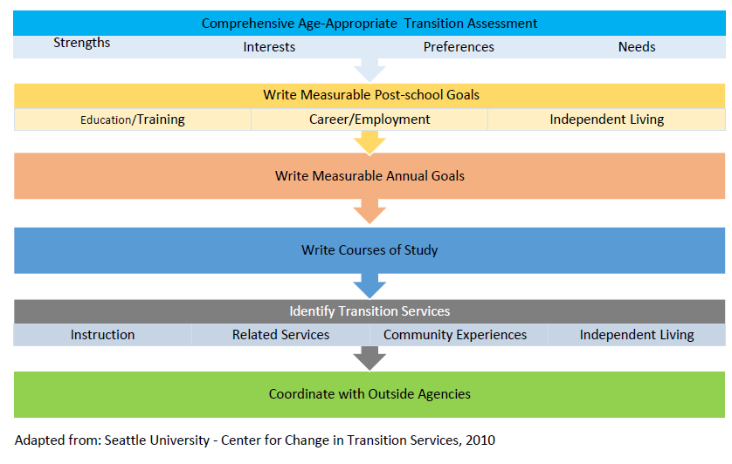
The Foundation of Effective Transition Planning
Transition Services Flowchart
Step One - Age-Appropriate Transition Assessments Identify a student’s strengths, interests, needs, and preferences
Step Two - Using Transition Assessments - Write Measurable Post-Secondary Goals In: Education/Training, Career/Employment and Independent Living Skills (where appropriate)
Step Three - Write Measurable Annual IEP Goals
Step Four - Identify Transition Services
Step Five - Write Courses of Study
Step Six - Coordinate with Adult Agencies
Comprehensive Age-Appropriate Transition Assessment
The key to answering the right questions is to individualize the transition process for each student and identify outcomes as they prepare to leave the school system and enter adult life

Slide 61
~Postsecondary annual goals must be related to the student’s transition services.
~ Postsecondary annual goals state what the student will do or learn within the next year that will close an identified skill deficit related to transition services.
~ Postsecondary annual goals should focus on skill/strategy development, not activity completion.
~Must link to PSG (at least one….why not all-why else would we have a goal?)
What must I consider when writing annual IEP goals?

Slide 62
~ All annual goals must be measurable (300.320(a)(2)(i)).
~All postsecondary annual goals/objectives should be SMART
~~The use of online resources (e.g., O’NET) will assist with identifying the necessary knowledge base.
~Annual goals should link to an academic standard, but a standard is not, by itself, an annual goal.
What must I consider when writing annual IEP goals?

Slide 63
Industry Standards (Competency Skills)
Identify skills required/useful for choosing a field of work/profession
Assure students are working on the “right” skills
Align course of study to PSGs
Provide clear context for Transition Focused Assessment

Slide 64
State Content Standards
Provide appropriate grade-level academic skill targets
Ensure alignment with the general education curriculum
Provide an academic roadmap to graduation
Colorado Academic Standards with EEOs
(https://www.cde.state.co.us/coextendedeo)

Slide 65
~Developing postsecondary annual goals requires a thorough understanding of the skills, knowledge, and admission/job requirements for the specific postsecondary goals.
Refer to: http://www.cde.state.co.us/cdesped/guidance_alps_ieps
What must I consider when writing annual IEP goals?

Slide 66
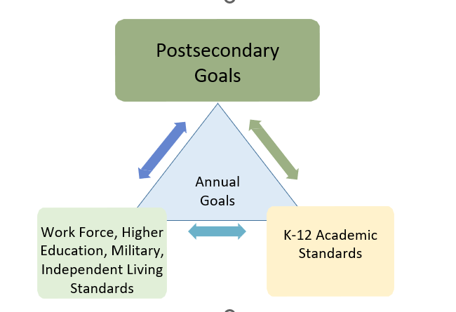
Write Measurable IEP Annual Goals
Notes:
All postsecondary annual goals/objectives should be SMART: o Strategic and Specific o Measurable (may be measurable by objectives) o Attainable (use Action words--you should be able to literally see what is happening) o Results Driven (Realistic and Relevant) o Time Bound

Slide 67
Aligning Annual IEP Goals
Target
Provide
Answer
Target minimum functional level of competence for entry into the next system up
Provide a “reference” to this level of competence
Answer the “but how do you know” factor

Slide 68
Industry Standards
Identify
Identify skills required/useful for choosing a field of work/profession
Provide
Provide clear context for Transition Focused Assessment
Assure
Assure students are working on the “right” skills
Align
Align Goals, Course of Study, Transition Services to PSGs

Slide 69
Industry Resources
O*Net : http://www.onetonline.org/
Community College Essential Skills: http://www.aims.edu/student/das/essential/
ASVAB Scores & Education Levels:
https://asvabbootcamp.com/blog/asvab-scores-2017/

Slide 70
Activities, skills and tasks necessary to work as an architect related to Jenny’s interests & desires (O*NET Summary Report for 17-1011.00 Architects, except landscape and naval)
Reading Comprehension — Understanding written sentences and paragraphs in work-related documents.
Estimating the Quantifiable Characteristics of Products, Events, or Information — Estimating sizes, distances, and quantities; or determining time, costs, resources, or materials needed to perform a work activity
Prepare information regarding design, structure specifications, materials, color, equipment, estimated costs, or construction time.
Begin with the end in mind...
A career exploration tool for job analysis with detailed descriptions of the workforce:
https://www.onetonline.org/
https://www.onetonline.org/
https://www.onetonline.org/link/summary/17-1011.00

Slide 71
Activities, skills and tasks necessary to work as an architect related to Jenny’s interests & desires (O*NET Summary Report for 17-1011.00 Architects, except landscape and naval)
Writing — Communicating effectively in writing as appropriate for the needs of the audience.
- Consult with clients to determine functional or spatial requirements of structures.
- Providing documentation, detailed instructions, Getting Information — Observing, receiving, and otherwise obtaining information from all relevant sources. - Computer-aided design CAD software
Begin with the end in mind...
A career exploration tool for job analysis with detailed descriptions of the workforce:
https://www.onetonline.org/
https://www.onetonline.org/
https://www.onetonline.org/link/summary/17-1011.00

Slide 72
Activities, skills and tasks necessary to work as an architect related to Jenny’s interests & desires (O*NET Summary Report for 17-1011.00 Architects, except landscape and naval)
Mathematics — Using mathematics to solve problems.
Mathematics — Knowledge of arithmetic, algebra, geometry, calculus, statistics, and their applications
- Understanding written sentences & paragraphs in work-related documents.
- The ability to communicate information & ideas in writing so others will understand.
Begin with the end in mind...
A career exploration tool for job analysis with detailed descriptions of the workforce:
https://www.onetonline.org/
https://www.onetonline.org/
https://www.onetonline.org/link/summary/17-1011.00

Slide 73
Activities, skills and tasks necessary to work as an architect related to Jenny’s interests & desires (O*NET Summary Report for 17-1011.00 Architects, except landscape and naval)
The ability to develop specific goals and plans to prioritize, organize, and accomplish your work.
Negotiation — Bringing others together and trying to reconcile differences.
Begin with the end in mind...
A career exploration tool for job analysis with detailed descriptions of the workforce:
https://www.onetonline.org/
https://www.onetonline.org/
https://www.onetonline.org/link/summary/17-1011.00

Slide 74
Putting it all together….
Clearly identify PSGs: Employment, Education, Independent Living Skills
Examine skills needed for PSGs: O*NET and/or other resources
Examine academic areas of need: translate to state content standards
Find “overlap” of skills between the two

Slide 75
Jenny’s needs/skills?
Reading & Writing ‘Needs to Strengthen Skills’ (Reading comprehension strategies).
Math ‘Significantly Below Average – (Math calculation skills)
For writing, she needs support with organization and writing mechanics
Self Advocacy: Positively she can resolve conflicts through reasoning, she responds appropriately through typical exchanges with others. She is unable to express strengths and needs when asking for help or for accommodations when needed. She is unable to express preferences appropriately, which includes identifying short- and long-term goals, appropriately able to advocate for herself in a variety of settings.
Jenny’s goal was to attend a 4-year college, but after researching with her case manager, Jenny decided that a community college would be a better fit.

Slide 76
Colorado Academic Standards with EEOs
https://www.cde.state.co.us/coextendedeo
https://www.cde.state.co.us/apps/standards/
Colorado Academic Standards with EEOs in tables
https://www.cde.state.co.us/cdesped/eeo-rwc-table
https://www.cde.state.co.us/cdesped/eeo-math-table
Activities, Skills & Tasks to
Colorado Academic
Standards
O*Net Online | Jenny’s Skills | 2020 Colorado Academic Standards & Grade Level Expectations
Mathematics — Knowledge of arithmetic, algebra, geometry, calculus, statistics, and their applications. Use of math to solve problems (O*NET Summary Report for Architects, Except Landscape and Naval 17-1011.00) https://www.onetonline.org/link/summary/17-1011.00 https://architizer.com/blog/practice/details/do-you-need-to-be-good-at-math-to-be-an-architect/ | Math ‘Significantly Below Average – Did Not Reach Benchmark’ (score of 240- score range 160-760) (Math calculation skills) Jenny receives instruction and is successful in general education settings with additional support on strategies for math computation and writing mechanics She currently demonstrates that she can independently solve grade-level multi-step problems with 50% accuracy. Is there enough information to create a skill-based math goal? (Assessment Data) | High School/Standard 1. Number And Quantity. HS.N-Q.A. Quantities: Reason quantitatively and use units to solve problems. Choose a level of accuracy appropriate to limitations on measurement when reporting quantities. (CCSS: HS.N-Q.A.3) High School/Standard 2. Algebra & Functions. HS.F-IF.B. Interpreting Functions: Interpret functions that arise in applications in terms of the context.
Notes:
Gail

Slide 77
Colorado Academic Standards with EEOs
https://www.cde.state.co.us/coextendedeo
Colorado Academic Standards with EEOs in tables
https://www.cde.state.co.us/cdesped/eeo-rwc-table
https://www.cde.state.co.us/cdesped/eeo-math-table
Activities, Skills & Tasks to
Colorado Academic
Standards
O*Net Online | Jenny’s Skills | 2020 Colorado Academic Standards & Grade Level Expectations
Reading work-related information. Administer construction contracts Gather information related to projects Read operating and maintenance manuals, studies, or reports (O*NET Summary Report for Architects, Except Landscape and Naval 17-1011.00) | Needs to Strengthen Skills’ (score of 380- score range of 320-1520) (Reading comprehension strategies) Struggles with comprehending 8th grade level fiction Additional reading assessment data? (Assessment Data) | High School/Standard Standard 2. Reading/Writing/Communicating. Reading for all Purposes. Understand how language influences the comprehension of narrative, argumentative, and informational texts. (CCSS: L.11-12.6)
Notes:
Gail

Slide 78
O*Net Online | Jenny’s Skills | 2020 Colorado Academic Standards & Grade Level Expectations
Communicate well with customers, employers & other individuals. The ability to communicate information and ideas in speaking so others will understand | Jenny does not feel comfortable advocating for her needs with new adults. She needs to improve her self-advocacy skills. Jenny discusses her needs with new adults 60% of the time. | Comprehensive Health High School, Standard 3. Social and Emotional Wellness. Students Can: a. Connect how setting a personal goal contributes to positive mental, emotional, and social wellness. b. Define a clear, attainable personal goal. c. Describe steps needed to reach personal goals. d. Apply concepts to self-reflect on the progress and success of personal goals.
The ability to communicate information & ideas in writing so others will understand. | For writing, she needs support with organization and writing mechanics. Proficient written products with her accommodations at the 11th grade level 50% (2 out of 4 trials) of the time. | 11/12 Grade Band/Standard 3. Writing & Composition. Use a recursive writing process to produce, publish, and update individual or shared writing projects in response to ongoing feedback.
Notes:
Gail

Slide 79
Notes:
All postsecondary annual goals/objectives should be SMART: o Strategic and Specific o Measurable (may be measurable by objectives) o Attainable (use Action words--you should be able to literally see what is happening) o Results Driven (Realistic and Relevant) o Time Bound

Slide 80
Annual goals must be related to the student’s transition services!
Career/Employment – Reading Comprehension:
In order to comprehend information while attending a community college and to understand work-related documents as an Architectural drafter, when given a grade-level reading passage, by March 11, 2023, Jenny will demonstrate reading strategies (use pen or pencil to self-monitor, use a question list to guide comprehension while reading, stop at the end of a paragraph to note key details, etc.) to determine the meaning of words and phrases as they are used in context to make sense of the passage resulting in correct responses to questions with 80% accuracy in 4 out of 5 trials as measured quarterly by informal reading assessments.

Slide 81
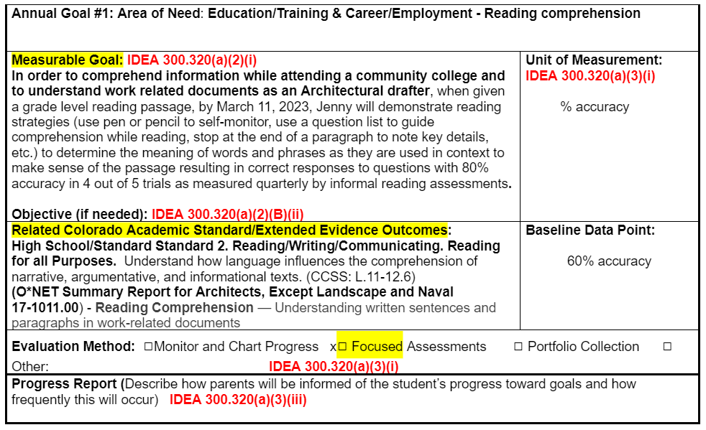

Slide 82
Education/Training - Math:
In order to prepare to attend a community college for architectural drafting and calculate scaled blueprints, when given a set of equations, Jenny will determine which operation to use (add, subtract, multiply, and divide real numbers), and apply appropriate computational strategies, e.g., mental mathematics, paper and pencil, calculator to accurately solve grade level equations 8/10 times with 80% accuracy by March 11, 2023, as measured by formative and district assessments.

Slide 83
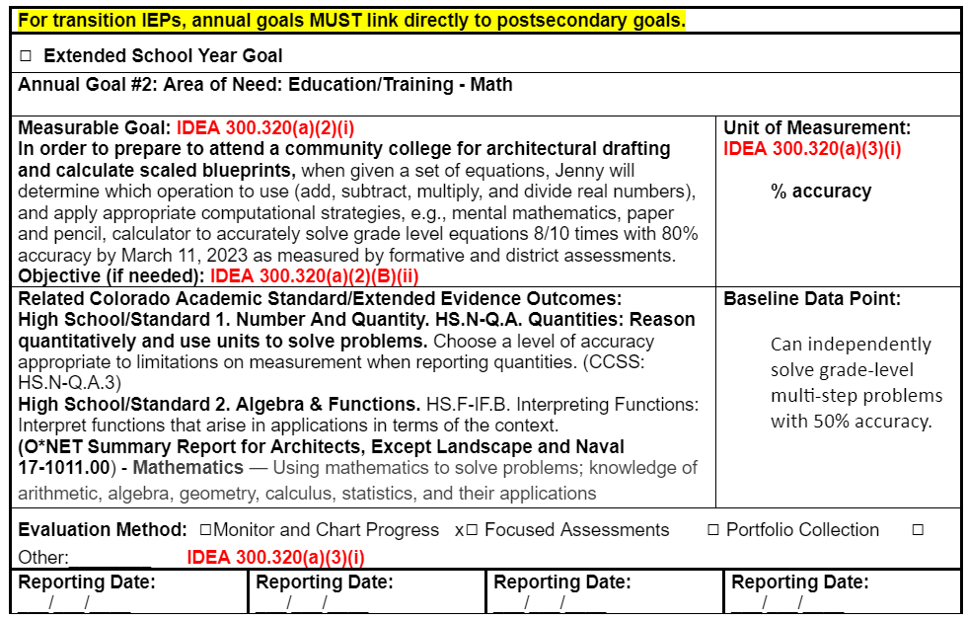

Slide 84
Measurable Postsecondary Independent Living Goal – Let’s practice! What goal would you write?
PSG: After high school, Jenny will advocate for herself on the job, community, and in adult life when necessary.
Baseline: Jenny does not feel comfortable advocating for her needs with new adults. (transition survey, interview with family). She needs to improve her self-advocacy skills (AIR Self-Determination Scale, survey, interviews). Advocates 60% of the time.
Activity or skill: Communicate well with customers, employees & other individuals to be addressed
Standard: Comprehensive Health High School, Standard 3. Social Emotional Wellness

Slide 85
Independent Living – Self Advocacy:
In order to advocate for her needs to meet deadlines in college, complete her degree as an Architectural Drafter and maintain employment to support an independent lifestyle, during instructional situations when presented with a new concept or assignment to process independently, by March 11, 2023, Jenny will demonstrate the ability to organize her language to communicate her needs tailored to the situation (use clear language to express a need, request a meeting time, ask questions during independent reading time, etc.) 80% of the time or 8 out of 10 opportunities, in order to make sense of reading content measured bi-weekly by teacher- created curriculum-based measures, checklists, and work samples.

Slide 86
Measurable Postsecondary Education/Training Goal
Career/Employment
After graduation from high school, Jenny will be employed as an architectural drafter.
In order to communicate effectively in writing with co-workers on the job as an architectural drafter, when given a writing prompt by March 2023, Jenny will independently follow the writing process (plan, rough draft, revise, and finalize) to produce a proficient written product (memo, informational paragraph, notes summary, etc.) 100% of the time (4 out of 4 trials), as measured quarterly by grade level writing rubrics.

Slide 87
The Foundation of Effective Transition Planning
Transition Services Flowchart
Step One - Age-Appropriate Transition Assessments Identify a student’s strengths, interests, needs, and preferences
Step Two - Using Transition Assessments - Write Measurable Post-Secondary Goals In: Education/Training, Career/Employment and Independent Living Skills (where appropriate)
Step Three - Write Measurable Annual IEP Goals
Step Four - Identify Transition Services
Step Five - Write Courses of Study
Step Six - Coordinate with Adult Agencies
Comprehensive Age-Appropriate Transition Assessment
The key to answering the right questions is to individualize the transition process for each student and identify outcomes as they prepare to leave the school system and enter adult life

Slide 88
Transition services include:
instruction,
related services,
community experiences,
the development of employment and other post-school adult living objectives, and,
if appropriate,
acquisition of daily living skills and
provision of a functional vocational evaluation.
– See 34 C.F.R. 300.43(a)(2).
What are the transition services?

Slide 89
A Coordinated set of activities based on individual student’s needs that help facilitate movement toward postsecondary goals
Experiences students participate in each academic year to achieve their postsecondary goals
Specific services that are needed to assist the student to develop skills and knowledge
Specially designed instruction
They are the activities/strategies/steps/actions that the community of adults, including special/general education teachers, counselors, outside agencies, parents, community members, etc. provides to help the student progress toward his/her postsecondary goals
Must be related to annual goals
What are the transition services?

Slide 90
Transition services should be stated as, “The (e.g., special education teacher, case manager, OT, reading teacher, counselor, parents, etc.) will provide…” and not stated as what the student needs or what the student will do.
Identify service providers by title, not name.
Avoid the generic “staff” or “team” will provide….
If writing services as support, the support should be clearly defined (e.g., support in life skills to include direct instruction in cooking and making purchases).
Transition services may include the facilitation of linkages and/or referrals to adult agencies; however, you may not commit another agency to provide services without the involvement and approval of that agency
What are the transition services?

Slide 91
Tour or research postsecondary programs
Research and contact local college disability services
Instruction in self-advocacy/disability awareness
Internships/job shadows
Apply for Vocational Rehabilitation services
Instruction in budgeting
Instruction (math, reading, writing, etc.) needed for employment, college success, or to live independently
Examples of transition activities?

Slide 92
Learn to use public transportation
Work-based learning experiences
Pre-Employment Transition Services (Pre-ETS)
Learn strategies for advocating for accommodations and other learning needs
Direct instruction to learn reading comprehension strategies and improve mathematical problem-solving
**Each must be re-written to state which adult will provide the service or activity
Examples of transition activities?

Slide 93
Transition services must be specific and individualized and must state what the adults will provide.
The case manager will assist Ben in researching the eligibility requirements and services provided by the college disability access center.
The general education teacher will provide direct instruction in reading comprehension and written expression to Marty.
The family will work with the special education teacher to create a system in the home where Cecile practices budgeting for outings, cooking meals, using safety precautions, and being aware of strangers.
The physical therapist will work with David on comfortably accessing his environment that may include getting in and out of the vehicle that transports him to and from job sites and community activities.

Slide 94
What transition services, experiences, and/or specialized instruction does Jenny need to facilitate movement toward her postsecondary goals?
Career/Employment:
Education/Training:
Community/Participation:
Adult Living/Independent Living Skills (where appropriate):

Slide 95
SAT preparation to assist with improving performance to close the achievement gap, prepare for the demands of college, and improve successful completion of a 2-year degree in Architectural Drafting
The case manager will provide direct instruction to Jenny in locating and enrolling in an SAT preparation course to assist in improving her performance to close the achievement gap.
Architect research to explore different careers in this area; research to include math components to meet interests and needs
The vocational exploration teacher will assist Jenny in researching and identifying additional careers in the architecture field as well as the math requirements for areas of interest.

Slide 96
*Complete further O’NET and transition assessments to investigate alternative career options based on her interests and strengths
Research possible careers that align with interests and aptitude which include drawing, designing, and creating that do not include 4 years of college
The resource teacher will assist and provide opportunities for Jenny to complete further O’NET assessments to investigate alternative career options based on her interests and strengths, and research careers that align with her interests and aptitudes (drawing, designing, and creating that do not include 4 years of college).
Set up possible job shadow experiences that align with Jenny’s interests and achievement levels
Since Jenny has been determined eligible for DVR services, the case manager will work with the DVR counselor to set up a job shadow that aligns with Jenny’s interests.

Slide 97
The Foundation of Effective Transition Planning
Transition Services Flowchart
Step One - Age-Appropriate Transition Assessments Identify a student’s strengths, interests, needs, and preferences
Step Two - Using Transition Assessments - Write Measurable Post-Secondary Goals In: Education/Training, Career/Employment and Independent Living Skills (where appropriate)
Step Three - Write Measurable Annual IEP Goals
Step Four - Identify Transition Services
Step Five - Write Courses of Study
Step Six - Coordinate with Adult Agencies
Comprehensive Age-Appropriate Transition Assessment
The key to answering the right questions is to individualize the transition process for each student and identify outcomes as they prepare to leave the school system and enter adult life

Slide 98
IEP includes documentation of courses of study that will assist the student in reaching the
postsecondary goals.
Simply stating “Will complete graduation requirements.” will not meet compliance.
The courses of study describe the classes needed by the student to gain the skills needed to close the gaps to reach the identified postsecondary goals.
What are the courses of study?

Slide 99
The description may be an individualized list of courses and/or a narrative focusing on specific skills/knowledge to be learned in a class.
A course of study that exemplifies best practice would include a multi-year description of coursework from the student’s current grade to the anticipated exit year.
What are the courses of study?

Slide 100
~What courses will the student take to build the skills necessary to meet their postsecondary goals?
~Is this course of study aligned with the student’s postsecondary goals?
~Aligned to transition services. Identifies where the adults will provide the instruction

Slide 101
~Aligns to annual goal - in which class is the skill taught
~A multi-year description of coursework to achieve the student’s desired post-school goals from the student’s current to anticipated exit year (Storms, O’Leary, & Williams, 2000)

Slide 102
Triangulating: Courses of Study
Postsecondary Goals
Postsecondary Goals
Needs
Annual
Goals
Courses of Study
Work Force, Higher Education, Military, Independent Living Standards
State Content Standards
Work Force, Higher Education, Military, Independent Living Standards
Graduation Requirements

Slide 103
Triangulated Courses of Study Example
Tray will complete the required coursework for graduation with a standard diploma. He is currently taking Everyday Algebra, Earth/Space, World Geography, 10th English, and Intervention Affective Needs. All of these courses align with the Higher Education Admission Requirements (HEAR) to prepare Tray for the Armed Services Vocational Aptitude Battery (ASVAB), which aligns with his goal of enlisting in the U.S. military. Throughout the remainder of Tray's high school career, he will continue to meet graduation requirements and will take electives such as Electronics (11th grade), Computer Programming (10th grade), and P.E. (10-12) which directly relate to his post-secondary goal of enlisting in the Marines.
ASVAB SCORES & EDUCATION LEVELS http://usmilitary.about.com/cs/genjoin/a/asvabminimum.htm

Slide 104
Triangulated Courses of Study Example
PSG Ed/Tr: In order for Harrison to be prepared to meet the entrance requirements for college credit at Bel-Rea Institute of Animal Technology, he will take the district-required courses in math, science, social studies, language arts, PE, and Career/Technical Education. In the area of science, he will take biology and chemistry. In the area of math, he will take geometry. In addition to the general education requirements, he will receive direct instruction in basic reading skills and reading comprehension. In order to avoid a need for remediation when entering the college system, Harrison will also enroll in LEAD (Learning and Educating About Disabilities) to learn to advocate for his academic needs and better understand his own learning strengths.
https://cte.careertech.org/sites/default/files/PlanPathways-CareerCluster-AG-AnimalSystems.pdf

Slide 105
In addition to the required credits for graduation:
Enroll in math classes in 11th and 12th grade along with additional math prep/specialized instruction
11th Grade: Enroll in CAD Drawing and Computer Technology to prepare for designing and architecture
11th Grade: Enroll in Study Skills class to prepare for secondary education demands and practice self-advocacy skills
11th Grade: Civics/Government to prepare for voting and advocating for her rights and responsibilities

Slide 106
In addition to the required credits for graduation:
12th Grade: Drafting and Graphic Design to learn prerequisite skills for Architectural Design
12th Grade: College Prep Seminar Course to complete for college entrance requirements and prepare for coursework demands
12th Grade: Paid work experience in her area of interest for Work Study credit(s)

Slide 107
The Foundation of Effective Transition Planning
Transition Services Flowchart
Step One - Age-Appropriate Transition Assessments Identify a student’s strengths, interests, needs, and preferences
Step Two - Using Transition Assessments - Write Measurable Post-Secondary Goals In: Education/Training, Career/Employment and Independent Living Skills (where appropriate)
Step Three - Write Measurable Annual IEP Goals
Step Four - Identify Transition Services
Step Five - Write Courses of Study
Step Six - Coordinate with Adult Agencies
Comprehensive Age-Appropriate Transition Assessment
The key to answering the right questions is to individualize the transition process for each student and identify outcomes as they prepare to leave the school system and enter adult life

Slide 108
The LEA Must Take a Leadership Role
Under the IDEA, LEAs are responsible for actively facilitating linkages and referrals to adult agencies.
However, LEAs may not invite outside agencies to participate in IEP meetings without parental consent. See 34 CFR § 300.321(b)(3).
LEAs may not commit other agencies to provide services without the involvement and approval of that agency.

Slide 109
The LEA Must Take a Leadership Role
If an outside agency (or other non-LEA resource) fails to provide the transition services described in the IEP, the LEA must reconvene the IEP team and provide alternate transition services. 34 C.F.R. § 300.324(c)(1).

Slide 110
A representative from any agency that is likely to provide or pay for transition services during the current school year (§300.344(b)(3)) must be invited to the IEP meeting.
There must be evidence of parental consent dated prior to IEP meeting invitation date to the agency
You must have written consent from parents before you invite an agency representative to attend any IEP meeting. This written consent must be obtained each time you invite an outside agency.
If an agency [e.g., Department of Youth Corrections (DYC), Department of Human Services (DHS), Guardian ad litem (GAL)] has a custodial role with the student, parental consent to invite this agency representative is not required.
When do I invite an outside agency representative?

Slide 111
IDEA requires that the student’s Individual Education Program (IEP) include statements of interagency responsibilities or any linkages that are needed for the student to successfully transition (§300.347(b)(2)).
SWAP providers are district/BOCES employees so parental consent is not required for them to be invited to an IEP meeting. However, written parental consent is required to invite the DVR counselor.
When do I invite an outside agency representative?

Slide 112
The Division of Vocational Rehabilitation and/or the community-centered board are critical connections for students.
Do not commit an outside agency to services without their knowledge/input.
If outside agencies attend a meeting at the invitation of the parents, document the attendance somewhere on the IEP. For example, it could be included in the meeting notes or noted in the IEP participant’s section, “attended by parent permission.”
When do I invite an outside agency representative?

Slide 113
Just a note about DVR…..
Students who are potentially eligible for DVR services can be referred for Pre-Employment Transition Services (Pre-ETS).
DVR cannot be written into an IEP because they are an eligibility program.
Because DVR is an eligibility program and plans are continuously reviewed, services can at any time change for a variety of reasons.
Should a district put a service in an IEP, essentially, they are liable to ensure its provision and DVR is not. However, when a district chooses to do this without collaborative efforts with DVR it can result in legal problems for both partners.

Slide 114
Just a note about DVR…..
Unless someone has been determined eligible to receive services, another entity cannot make promises on the services DVR will provide or that DVR will determine someone eligible.
If an individual were eligible and a district wanted to include those services to be provided by DVR, you might state the following:
~ Vocational-related services will be provided in accordance with the individualized plan for employment with DVR
~When a service is determined necessary and appropriate for an individual to receive, the DVR Counselor shares service provider options that are appropriate for an individual to make an informed choice about whom they will work with. Hence, the district can also not guarantee that SWAP will be the service provider.

Slide 115
IMPORTANT!
It is critical that you familiarize yourself and develop relationships with outside agencies!
Talk about relevant agencies with students and families early.
If an outside agency fails to provide services outlined in the IEP, the LEA must reconvene the team and provide alter transition services.

Slide 116
For Jenny, the important linkages are as follows:
Jenny has been made eligible for DVR services. She will receive services in accordance with her individual plan for employment as determined by her DVR counselor.
The case manager is collaborating with the SWAP provider to provide pre-employment skills (including self-advocacy) and career exploration.
A representative from the local community college’s Disability Access Services Center will be invited to discuss Accuplacer information and college accommodations.

Slide 117
The Foundation of Effective Transition Planning
Transition Services Flowchart
Step One - Age-Appropriate Transition Assessments Identify a student’s strengths, interests, needs, and preferences
Step Two - Using Transition Assessments - Write Measurable Post-Secondary Goals In: Education/Training, Career/Employment and Independent Living Skills (where appropriate)
Step Three - Write Measurable Annual IEP Goals
Step Four - Identify Transition Services
Step Five - Write Courses of Study
Step Six - Coordinate with Adult Agencies
Comprehensive Age-Appropriate Transition Assessment
The key to answering the right questions is to individualize the transition process for each student and identify outcomes as they prepare to leave the school system and enter adult life

Slide 118
The student was invited to the IEP meeting where transition services are to be discussed. 34 C.F.R § 300.321
There must be evidence of an invitation to the student.
Notice of Meeting addressed specifically to the student (may be co-addressed with parents), a copy of a separate invitation to the student, or documentation of verbal invitation.
The inclusion of the student’s name on the list of who will be invited on the parental Notice of Meeting does not constitute an invitation to the student.
Evidence needed that student was invited to the meeting

Slide 119
The student was invited to the IEP meeting where transition services are to be discussed. 34 C.F.R § 300.321
A student’s signature of attendance on the participants’ page of the IEP will not meet this compliance requirement.
There must be documentation of an invitation that specifically names the student and is dated prior to the date of the meeting.
If the student is invited but does not attend the meeting, the AU/LEA must take other steps to ensure that the student’s preferences and interests were considered.
Evidence needed that student was invited to the meeting

Slide 120
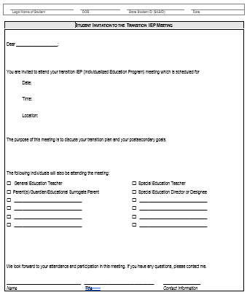
Student Invitation (optional form)
Student Invitation

Slide 121
Compliant Transition IEPs include:
Comprehensive assessment
Individualized postsecondary goals and planning
Annual goals aligned with postsecondary goals and related to transition services
Coordinated set of transition services and course of study
Planning that is inclusive of:
Parent and student input
Appropriate outside agency input/support
Updated annually
Indicate that the purpose of the meeting is to discuss transition services
Evidence that the student was invited

Slide 122
“Golden Thread”
AssessmentS
Present Levels of Performance
Strengths, Needs, Preferences, Aptitude
Postsecondary Goals
Annual Transition Goals
Courses of Study
Transition Services
Notes:
Consider the IEP as a “growth development plan” for a student from which each element of the document builds from one another and are interconnected.

Slide 123
Planning for the IEP Meeting
Plan for the meeting
Summarize transition assessment information to identify strengths, preferences, interests, and needs to develop an IEP/transition plan
Gather information from interagency team members
Collect & summarize general education teacher input
Update functional and academic performance according to identified progress monitoring strategies and/or formal assessments (re-eval)
Teach and assist Jenny to run IEP as independently as possible
Collect parent input prior to the meeting and gather and plan feedback during/after IEP

Slide 124
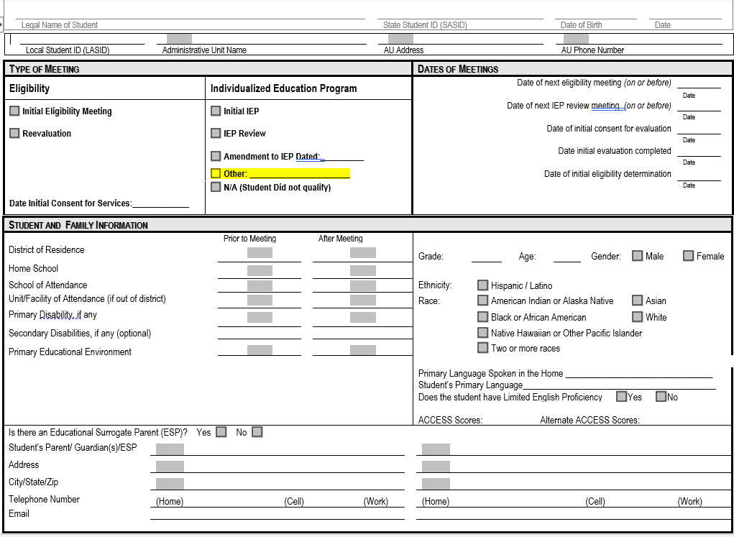
Secondary Transition IEPs
Transition

Slide 125
Ensure IEP is Updated Annually
Ensure that the IEP is
updated annually
Administer ongoing transition assessments annually; one preferably formal (Best Practice) (Follow your director’s guidance)
Update post-school goals, transition plan, and annual goals for updated transition information to drive results and services
Use new assessment/progress monitoring data to drive decisions and determine what is, or is not, working:
Formative and summative assessments
SAT test scores and 11th grade CMAS score
District reading, writing, and math assessment data
Accuplacer scores and placement results
Teacher feedback and observation
General education and interagency input on performance

Slide 126
Resources to Use
Assessment Finder & Resource Tool
Transition Assessment Bank
Transition Assessment Toolkit #3rd Edition
Successful Transition Planning Form
Postschools Goals for SSNs

Slide 127
Resources
Courses of Study Resources
https://careertech.org/career-clusters
ACT Workkeys Score Finder
http://profiles.keytrain.com/profile_search/#type:standard/title:29-2056.00%20/is_green:off/is_bright:of
O’NET
http://www.onetonline.org
O’NET Job Zone Explanations
https://www.onetonline.org/help/online/zones & https://www.onetonline.org/help/online/svp
Job Accommodations
https://askjan.org
Military ASVAB Scores
https://www.thebalance.com/minimum-required-asvab-scores-and-education-level-3332646
National Secondary Transition Technical Assistance Center
http://www.nsttac.org/content/age-appropriate-transition-assessment/

Slide 128
Additional CDE Resources
Writing Quality Secondary Transition IEPs that include the
Required Elements of Indicator 13
Standard Record Review Protocol (PDF)
Standard Record Review Instructions (PDF)

