Slide 1
CSI Grant & Finance Session
November 2023

Slide 2
Agenda
CSI Finance Team Introduction
School Finance: School Finance Act: FY25 PPR &Task Force
Grants: McKinney-Vento Awarding
Grants: CDE GAINS – Access & Competitive Grants
Grants: RFF Timeline Review
Grants: Stipends & Indirect Cost Refresher
Grants: Upcoming Deadlines
Notes:
Welcome! Its busy day and thanks for being here to help with the move, learn about finance and some of our work. Today you'll hear from, Ilene Agustin our School Nutrition Manager, and Marcie Robidart our Grants Fiscal and Acct'ing Manager and myself. Review Agenda

Slide 3
CSI Finance Team
Chief Finance & Ops Officer
Controller
School Nutrition Program Manager
Staff Accountant
Senior Grant & Procurement Analyst
Grants & Accounting Tech
Grants Fiscal & Accounting Manager
School Finance Manager
Nutrition and Data Specialist
Grants & Accounting Tech
Notes:
Quick overview of the team. Our team supports CSI and Schools. Today we're going to provide a deeper look at some of our work because it is evolving – as in SFA - or it relates to the work you might be doing currently or in the year to come. We want to provide clarity on tasks that intersect with the finance team and ensure that you have the right contact to reach out if you have questions.

Slide 4
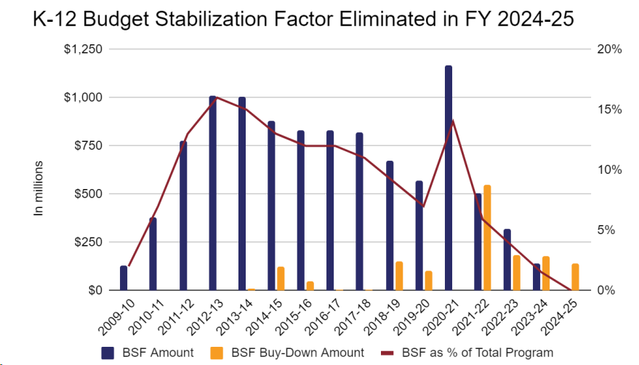
School Finance FY2024-25
6.6% Increase to PPR, approx. $705

Slide 5
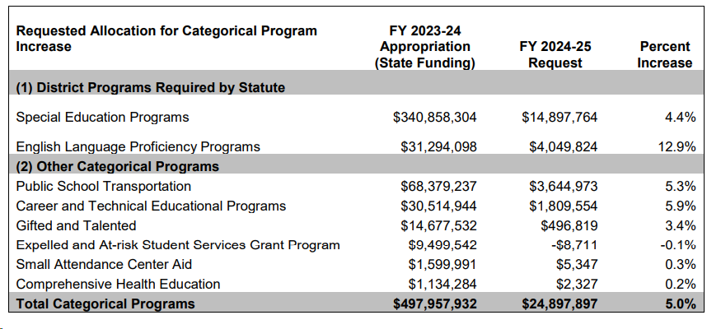
Categorical FY2024-25
Notes:
With Prop HH not passing the Gov'r has called a special session, more to come on that.

Slide 6
SB23-287 - Finance Task Force
Charge of the Task Force
Eliminating the use of multiplicative indexes
Recalibrating the cost of living factor
Revising the size factor
Notes:
Eliminating the use of multiplicative indexes for cost of living, personnel and non-personnel costs, and district size;
Recalibrating the cost of living factor, capping the cost of living factor, or alternative methods to account for the cost of living, including through categorical funding. A recommendation concerning a revised cost of living factor must be able to regularly change as a result of the biennial cost of living study;
Prioritizing student needs in the formula, including measures, to the extent possible, that align the at-risk factor, English Language Learner factor, and special education categorical funding based upon available evidenced-based research on student-centered funding that has a direct impact on student outcomes;
Revising the size factor to incorporate considerations other than or in addition to student enrollment, including the remoteness of a school district; and
Securing equalization in mill levy overrides for Institute charter schools based upon the school district where the Institute charter school is geographically located, including considerations for students who do not reside in the school district where the Institute charter school is geographically located, multi-district online programs, and total program funding.

Slide 7
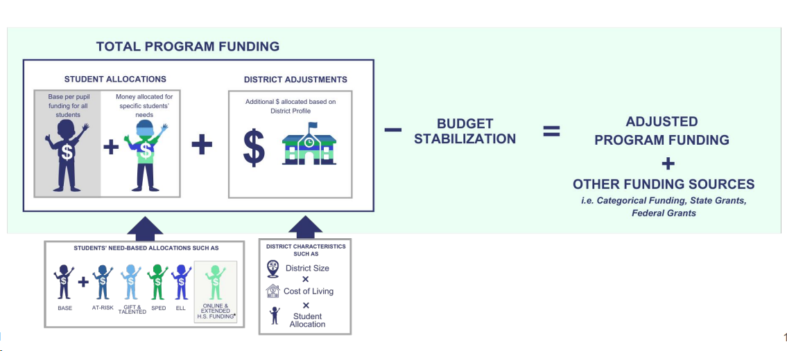
Finance Task Force

Slide 8
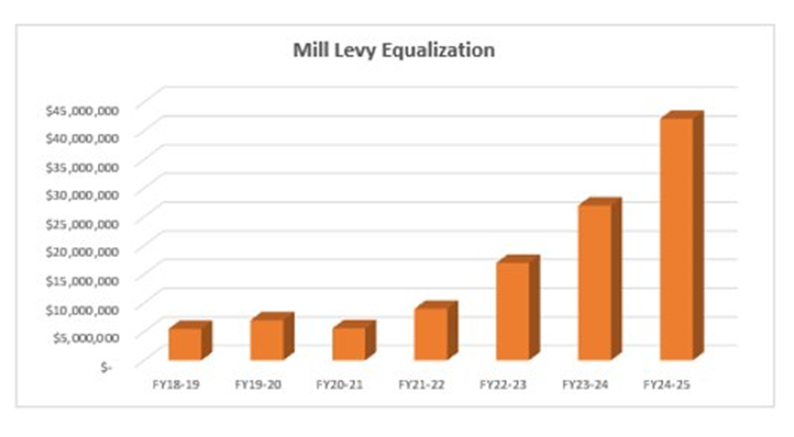
Finance Task Force – Mill Levy
Securing equalization in mill levy overrides
Notes:
Last year CSI received $27M for MLE and full funding to come next year. This is now decided by legislators. The process is, CSI calcs it sends it to OSBP, presents and defends it to JBC and then XXX outcome. Even this year, we ran through the whole process and will have to present in Dec.
Running MLE through the task force was a hope to simplify the process through the SFA, and formula which is how we get to a # any way. And elimiate steps so the $$ flows more freely to CSI/ schools. Lots of convo here.

Slide 9
CDE Charter School Cohort
To join Charter School Cohort send email to Glenn Gustafson:
gustafson_g@cde.state.co.us
To join the School Finance ListServ-Send email to:
FINANCE-subscribe-request@cdelist.cde.state.co.us
Notes:
ART -

Slide 10
McKinney Vento Awarding
Final verification phase – October count
Funds will be awarded late-November to early-December
FY2023-24 per pupil allocation $750
Schools may begin spending funds on pupils who have been verified
McKinney-Vento eligibility is ongoing throughout the year
McKinney-Vento FAQ
Link to Residency Questionnaires
Betsy Basch, CSI MV Liasson, (303) 532-7395, betsybasch@csi.state.co.us

Slide 11
McKinney Vento Allowable Use of Funds
Meet basic needs (clothing, supplies, health)
Provide transportation to and from school
Provide after-school and/or summer programs
Provide emergency food while the student is in school, including breakfast, lunch, and snacks
Pay for student projects and/or field trips
Support supplemental instruction
Provide outreach activities to homeless parents

Slide 12
CDE GAINS ACCESS
GAINS, grant applications, competitive budget revision requests and reporting
Competitive grants cycles are starting to run through the system now
Building Excellent Schools Today (BEST)
Computer Science Education Grant (CSED)
Colorado Charter School Program (CCSP)
USDA Equipment Assistance Grant
Melissa Allen, melissaallen@csi.state.co.us
School contacts will need to exist as a user in the system to receive access to applications
CSI cannot assign access to individual school applications
CDE Competitive Grants and Awards Forecast

Slide 13
RFF Timeline Review Process
Three procedural set of steps for complete processing
School process
Should follow school policies and procedures
Create drawdown/disbursement (RFF) in GV
CSI process
Review RFF back-up documentation
Follow-up for additional docs or clarifications
Request is added to a consolidated request list
CSI requests the funds from the CDE accounting
CSI requests the funds from CDE Grants Fiscal
CDE process (4-6 weeks from CDE deadline date)
CDE Grants Fiscal pulls requests
Routed to CDE Program Department for budgetary check
Routed to CDE accounting
CDE accounting approves CSI accounting step
CDE creates a secondary accounting step to move the funds

Slide 14
RFF Timeline Review CSI/CDE Deadlines
Drawdowns/Disbursement must be drawn down by the CSI deadline to be processed in the current round of funding requests to the CDE
Deadlines have been added to the FY2023-24 Grant Codes & Classification Summary
Funding Type | CSI Deadline | CDE Deadline
Categorical Federal | 23rd | 1st
*Competitive Federal | 9th | 15th
Categorical State | Revolving | N/A

Slide 15
Stipends/Incentive Pay
Awarded for work above and beyond normal job duties, usually requiring additional hours or taking place outside of normal school hours
Awarded an incentive pay for highly qualified staff
Back-up Requirements
Must be paid within payroll
Payroll summary/pay stub with stipend/incentive pay clearly broken out
Signed stipend agreement
Employee Name
Description of work to be completed or condition for stipend
Payment schedule
Signature of both employee & supervisor

Slide 16
Indirect Costs
Costs which are related to objective but are not traceable in an economically feasible manner.
Share of accounting, procurement and human resources associated to objective
Minimal office supplies
Proportionate cost of space, utilities, maintenance dedicated to activity
De Minimis indirect cost rate 10%
May opt to take less
Only apply to some federal competitive grants and must be listed in the CDE approved budget
Use of funds follows general fund rules
Accounting treatment support CDE Chart of Accounts (state.co.us) Page 193
Excluded items Capitalized Equipment, Contract Services exceeding $25k (per contract)
Back-up Requirement
Signed Indirect Cost Rate Acknowledgement Form
Indirect Cost Rate Acknowledgement Template

Slide 17
Upcoming Grant Deadlines
Date | Grant/Project | Submission Category | Activity | Links
11/15/2023 | CCLC | Awarded School | October Attendance Data due for submission (all Cohorts) | Reporting Link
11/15/2023 | SHP-SLFRF | Awarded School | Year 2 Projected Workplan Due
11/20/2023 | EWP | Awarded School | Deadline for Annual Financial Report (AFR)
12/9/2023 | SHP-SLFRF | Awarded School | Deadline to submit prior month expenditure RFF in GrantVantage
12/15/2023 | CCLC | Awarded School | November Attendance Data due for submission (all Cohorts) | Reporting Link
1/8/2024 | Milestone #2 | CSI-wide | Grant Milestone (40%) - All awarded competitive and categorical
1/8/2024 | Milestone #2 | CSI-wide | Deadline to submit extension request forms
1/8/2024 | ESSER III | CSI-wide | 2nd Quarter Revision Deadline *not required
1/10/2024 | SNW | Awarded School | Mid-year report due to the CDE
1/31/2024 | ECEA | CSI-wide | Deadline to submit Quarter 2 IFR

Slide 18
See you soon...
Thank you
Thank you!

Slide 19
Questions?
Next Session: Wednesday, December 20th, 2023
11:30am – 12:30pm
Registration Link
Session Feedback Survey
School Finance and Grant Training/Resources Link

