Slide 1
Section 504 Module 5
CSI Reviews of 504 Plans and Programs

Slide 2
Why 504 Plan Review?
To assess our 504 compliance as an AU
To identify areas to target for support and training
Increases in OCR complaints even more reason to make sure we are providing quality 504 processes and programs

Slide 3
CSI Guidance Manual

Slide 4
Table of contents
Contents
Section 1: Overview ...................................................................................................................................... 3
Section 2: What is Section 504?.................................................................................................................... 4
Background Information ........................................................................................................................... 4
Section 504 Eligibility Protections............................................................................................................. 4
Section 504 Protections and Americans with Disabilities Act (ADA) ........................................................ 6
Section 504 and the Individuals with Disabilities Education Act (IDEA) ................................................... 6
CSI Grievance Processes............................................................................................................................ 9
Section 2: Section 504 Evaluation Process.................................................................................................. 12
The Section 504 Process ......................................................................................................................... 12
Annual Review Best Practices ................................................................................................................. 14
Section 3: Section 504 Accommodation Plans............................................................................................ 15
Determining Appropriate Accommodations........................................................................................... 15
Section 504 Accommodations and/or Services ...................................................................................... 15
Section 504 Eligible Students Who Do Not Require a Plan..................................................................... 16
Section 504 Transfer Student Best Practices .......................................................................................... 16
Section 4: Discipline .................................................................................................................................... 17
Guidelines for When Students with Disabilities are Being Disciplined ................................................... 17
Manifestation Meeting Guidelines ......................................................................................................... 18
Section 5: Frequently Asked Questions ...................................................................................................... 20
Appendix A: CSI’s 504 Plan Review ............................................................................................................. 22
Appendix B: Sample Accommodations ....................................................................................................... 26
Sample Accomodations: Environmental, Organizational, Behavioral, Presentation, and Evaluation.... 26
Sample Accommodations According to Disability .................................................................................. 27
Allergies............................................................................................................................................... 28
Arthritis ............................................................................................................................................... 28
Asthma ................................................................................................................................................ 29
Attention Deficit Disorder (ADD) & Attention Deficit Hyperactive Disorder (ADHD) ......................... 30
Biploar Disorder .................................................................................................................................. 31
Cancer ................................................................................................................................................. 32
Cerebral Palsy...................................................................................................................................... 33
Chronic Infectious Diseases (i.e. Acquired Immune Deficiency Syndrome) ....................................... 33
Cystic Fibrosis...................................................................................................................................... 34
1

Slide 5
504 Plan Review Process
CSI will review the plan using your uploaded forms in your school 504 folder in the shared G-Drive. You should have received an invite to view folder if new coordinator this year.
Once uploaded to your folder, send me an email heading/subject: “SASID for Review.”
Email me at BrianPrintz@csi.state.co.us
Do not include any student names in the email and/or attach plans.
Complete the Self-Appraisal Form
Feedback will be sent to 504 Coordinators and School Leader

Slide 6
504 Evaluation, Eligibility and Plan Reviews
Upload documents to G-Drive per instructions (your submissions staff should know the process): or see:
CSI Submissions Handbook, p. 23
Referral form (if one used)
Signed Consent for evaluation
Notice(s) of Meeting (multiple if rescheduled)
Evaluation/eligibility report with supporting documentation (private report if one exists)
Accommodation Plan
Signed parent consent for service (located on plan)

Slide 7
Requirements: Notification Components
Notice of Meeting (NOM) includes:
Parent contact information
The reason for the meeting and/or school action(s)
Date of the meeting

Slide 8
Requirements: Notification Types
Consent for Evaluation for initials and reevaluations
NOMs for Eligibility Meetings, Annual Plan Meetings, Manifestation Determination Reviews
Placement into 504 program/changes of placement (covered by Eligibility Determination and Accommodation Plan forms)
Yearly notification regarding parental rights

Slide 9
Requirements: Evaluation
Team members were multidisciplinary and includes parents, teachers, students (when appropriate), and other necessary personnel.
The eligibility team was made up of a group knowledgeable persons about the child, the meaning of the evaluation data, and the placement options.
The evaluations drew from a variety of sources so that the possibility of error in determination was minimized and sources of evaluative information were listed.
Tests and other evaluation materials included those tailored to evaluate specific areas of educational need and not those merely designed to provide a single intelligent quotient.

Slide 10
Evaluation Cont.
The information obtained from the evaluations was documented and considers all significant factors related to the student's disability.
The identified area of difficulty represents a substantial limitation on a major life activity.
A summary of evaluation was included and captures results from all evaluation sources.
A determination of protection of rights under Section 504 was included.

Slide 11
Accommodation Plan
The duration of services and accommodations were listed.
A periodic review/assessment occurred at least annually, and the date of the next review was listed.
The accommodations and services provided were clearly explained.
The accommodations and services provided address the student's identified area of difficulty and needs.

Slide 12
Accommodation Plan Cont.
The plan identifies the area of physical and/or mental impairment that substantially limits one or more major life activities.
Parent permission for service provision was obtained before services were provided.
The provision of services decision was made by a multidisciplinary committee.
The Section 504 team was made up of a group knowledgeable persons about the child, the meaning of the evaluation data, and the placement options.

Slide 13
Important Components
How has your school team assessed the students on 504 plans; their access and progress this school year?
Have the students on Section 504 plans consistently accessed their education while online? (What evidence and/or documentation do you have for this?)
How is the school documenting implementation of accommodations and services along with tracking school communication with parents?
How have teachers been made aware of each student’s 504 accommodations?

Slide 14
504 Program Review-HR
Human Resources:
There is an identified person who monitors and understands the school’s 504 process and students and CSI has been notified of changes to assigned coordinator
The 504 Coordinator and school staff have engaged in professional development related to 504

Slide 15
504 Program Review- P & P
Process and Procedures:
The referral procedures include referrals from an RtI/MTSS process and parents
Referral procedures includes the determination of whether a student has a physical or mental impairment that substantially limits a major life activity
The identification process is collaborative, and determination is made by a multi-disciplinary committee which includes parents, teachers, students (when appropriate) and other necessary personnel

Slide 16
504 Program Review- P & P-2
Processes and procedures are in place to ensure that children are not misclassified, unnecessarily labeled as having a disability, or incorrectly placed based on inappropriate selection, administration, or interpretation of evaluation materials
504 plans are not considered during the acceptance process

Slide 17
504 Program Review- Student Records
Student Records:
Every identified student has an evaluation to determine eligibility and evaluation data is included online in the student record
The online school records database Section 504 count matches the current caseload
School files are kept confidential and secured with access appropriately documented. Access to student records (online/hard copy) is limited to staff with a legitimate interest

Slide 18
504 Program Review- Student Records-2
Student Records:
Hard files at school are in a locked cabinet and secured
The school follows the record destruction process

Slide 19
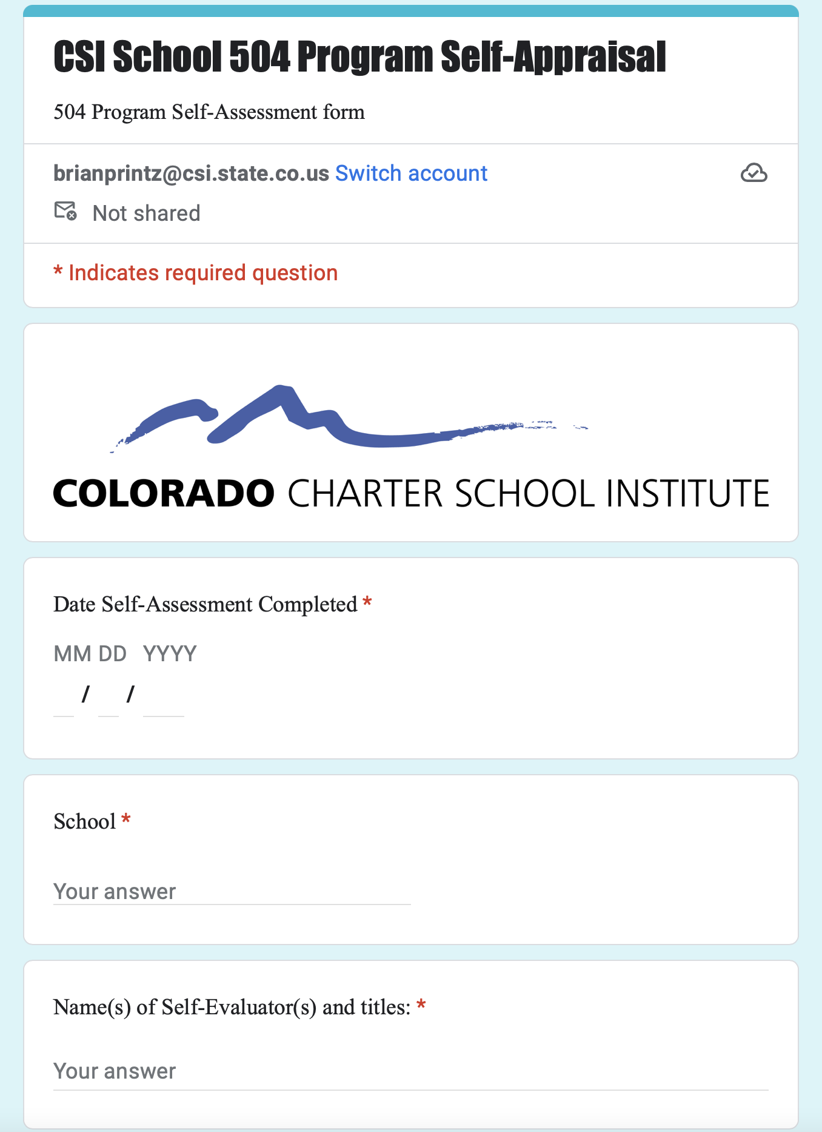
504 Program Self-Appraisal
CSI School 504 Program Self-Appraisal Form
I will email the link to all 504 Contacts. Schools can choose who to complete. Use it as an opportunity for reflection and program improvement. Takes about 10 minutes.

