Slide 1
2023-2024 ACCESS for ELLs Training
Kali Winn
District Assessment Coordinator
November 8, 2023

Slide 2
Note
This training is intended to support School Assessment Coordinators in preparing their school for the annual administration of the WIDA ACCESS suite of assessments, including ACCESS for ELLs 1-12 (online & paper), Kindergarten ACCESS for ELLs, and Alternate ACCESS.

Slide 3
Agenda
About ACCESS
Testing Requirements
Dates
Updates
Resources: WIDA and DRC
Resources: Colorado
Accommodations
Test Materials
Test Environment
Resources: Students and Educators
Contacts
Questions

Slide 4
WIDA, DRC, and the ACCESS Assessments

Slide 5
Standards Based Assessment
In Colorado, the standards based English language proficiency assessments are:
ACCESS for ELLs
Kindergarten ACCESS
Alternate ACCESS
The ACCESS assessments are standards based:
Developed by WIDA, CAL (Center for Applied Linguistics), and WIDA members
Criterion-based
Colorado adopted the WIDA standards as the Colorado English Language Proficiency (CELP) Standards

Slide 6
Test Forms
We have a responsibility to protect the privacy and ensure the security of our students.
Children’s Online Privacy Protection Act of 1998, 15 U.S.C. 6501-6505
ACCESS Online 1-12
By default of test design, the Writing domain for grades 1-3 is via paper test booklet
ACCESS Paper 1-12 (IEP/504 required)
Speaking and Listening are delivered via CD
Speaking is scored locally
Kindergarten ACCESS
Paper
Administered 1:1
Scored locally
Alternate ACCESS K-12
Paper
Administered 1:1
Scored locally

Slide 7
WIDA
WIDA is part of the University of Wisconsin–Madison and is housed in the Wisconsin Center for Education Research (WCER), one of the first, largest, and most productive education research centers in the world.
Research-based system of language standards, assessments, professional learning and educator assistance.
WIDA members consist of 41 domestic states and territories and approximately 500 international schools throughout the world

Slide 8
DRC
Data Recognition Corporation (DRC)
DRC is a long-standing WIDA partner responsible for the administration, scoring, and reporting for the ACCESS, Alternate ACCESS, and online WIDA Screener assessments
DRC offers assessments for pre–K, K–12, and adult education markets, across the U.S. and internationally.
WIDA and DRC administer the ACCESS assessments to 2.5 million students each year.

Slide 9
Knowledge Check #1

Slide 10
Testing Requirements

Slide 11
Requirements
All Multilingual Learners (NEP and LEP), including students with disabilities, must participate in the state English language proficiency assessment system (WIDA ACCESS).
An English language proficiency assessment is required by federal and state law and is guaranteed to students under Civil Rights law of 1964 and The Office for Civil Rights Memorandum of 1970.
Federal Law
Title IA
20 U.S.C. 6301 §1111(b)(2)(C)(v)(II)(dd)
20 U.S.C. 6301 §1111(b)(3)(C)(ix)(III) & (x)
20 U.S.C. 6301 §1111(b)(6) & (7)
Title IIIA
State Law
Colorado Senate Bill 109 – C.R.S. 22-24-106 ELP Assessment
Colorado House Bill 14-1298 – C.R.S. 22-24-101 English Language Proficiency Act (ELPA)

Slide 12
Students who are NEP/LEP and have an IEP/504
The educational team (ML and IEP or 504 as applicable), which must include the family, determines whether the student will take ACCESS for ELLs or Kindergarten ACCESS with or without accommodations or, for a student with the most significant cognitive disability, meets the participation requirements for the alternate assessment.
According to federal requirements, there must be evidence of alignment between a student’s educational plan, instruction, and the accommodations provided on any of the state assessments, as well as any determinations for students to participate in Alternate ACCESS.

Slide 13
ACCESS Participation
Three participation options exist:
The student participates in ACCESS for ELLs or Kindergarten ACCESS without an accommodation.
The student participates in ACCESS for ELLs or Kindergarten ACCESS with accommodation(s)*.
The student participates in Alternate ACCESS only for students with the most significant cognitive disabilities.
Note: It is not appropriate or ethical to give the Alternate ACCESS to students who do not qualify to take the assessment.
*Accommodations are practices and procedures that provide equitable access during instruction and assessment for students who have a documented need. To use accommodations on ACCESS for ELLs accommodations must be determined by the student’s educational team and documented in the student’s IEP or 504.

Slide 14
Knowledge Check #2

Slide 15
Dates

Slide 16
ACCESS State Established Dates
Initial Materials order window: Closed 10/31
Paper materials as documented in IEP/504 Plans
Order placed to CSI through G Drive
Student Data Pull for WIDA AMS: 11/03/23
Online, K and Alternate materials are based on this information
No action required
Verification of School Training form: 11/08/23
Form is due 01/08/24
WIDA AMS opens: 11/29/23
UAR (scribe) submission: 11/27/23

Slide 17
ACCESS State Established Dates Cont.
Materials arrive: 12/14/23, will send to schools based on winter break schedules
Additional Materials order window: 12/18/23 – 02/02/24
Handwriting response booklets
Test Window: 01/08/24 – 02/09/24
Enrollment testing cutoff: 02/02/24
Return materials: 02/12/24
Results ACCESS for ELLs & Kindergarten ACCESS:
04/29/24* (downloadable reports)
05/09/24* (printed reports)
Results Alternate ACCESS:
09/12/24* (downloadable reports)
10/02/24 * (downloadable reports)
*Tentative

Slide 18
ACCESS School Established Dates
School trainings
Testing schedule
Distribution of results
ISRs are to be shared with parents/guardians as soon as practicable. Please keep in mind, the reports are confidential and distribution of both electronic and/or hard copy reports must be in accordance with state and federal privacy laws, and local school board policy

Slide 19
Knowledge Check #3

Slide 20
What’s New?

Slide 21
Spring 2024 Updates Part 1
Kindergarten Alternate
ACCESS Online, Paper, & Alternate assessment training courses completion window
October 1, 2023 – January 8, 2024

Slide 22
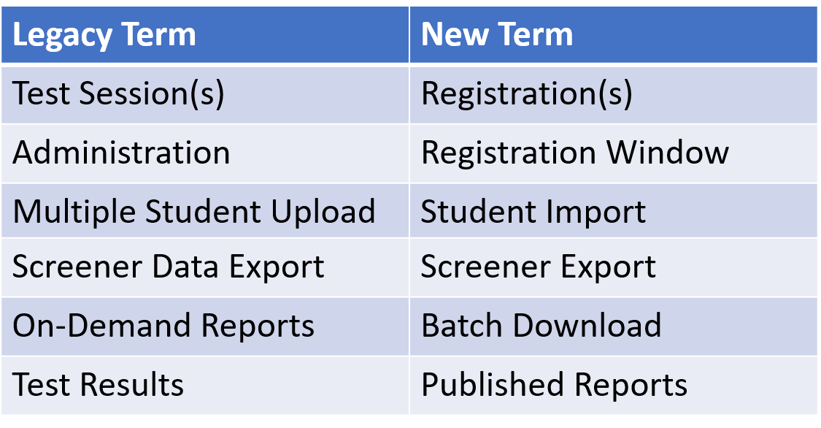
Spring 2024 Updates Part 2
WIDA AMS layout and terminology

Slide 23
Spring 2024 Updates Part 3
Paper 1-12 is available only through IEP/504 documentation
Test Administrator information will be collected for all paper 1-12 tests
Transfer Requests are submitted through WIDA AMS
Invalidation code requests are through CDE
Reason Not Tested Codes entered in WIDA AMS

Slide 24
Reminder
Only school email addresses in WIDA AMS and the WIDA Secure Portal

Slide 25
Knowledge Check #4

Slide 26
Resources: WIDA and DRC

Slide 27
Resource Documents
WIDA/DRC
District and School Coordinator Manual
Test Administrator Manual
Test Administrator Essentials
WIDA AMS User Guide
Accessibility and Accommodations Manual

Slide 28
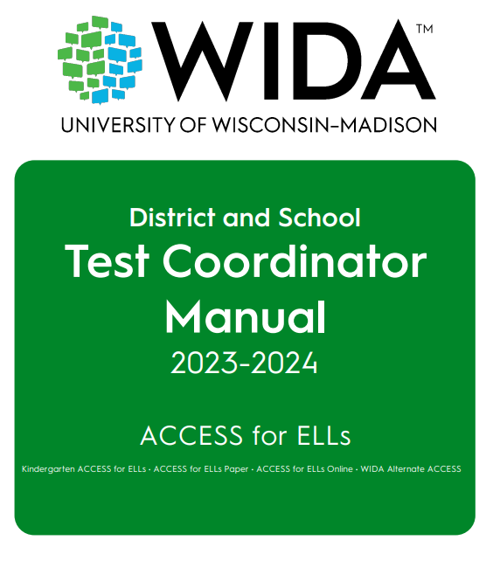
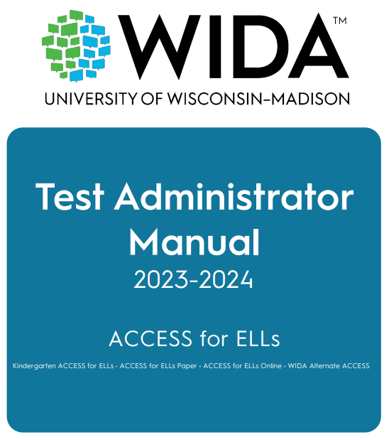
WIDA Role Manuals
District and School Manual (DSM)
For Test Coordinators
Test Administrator Manual (TAM)
For Test Administrators

Slide 29
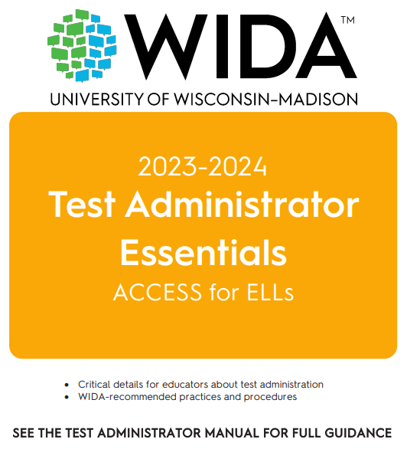
Test Administrator Essentials Manual
Test Administrator Essentials

Slide 30
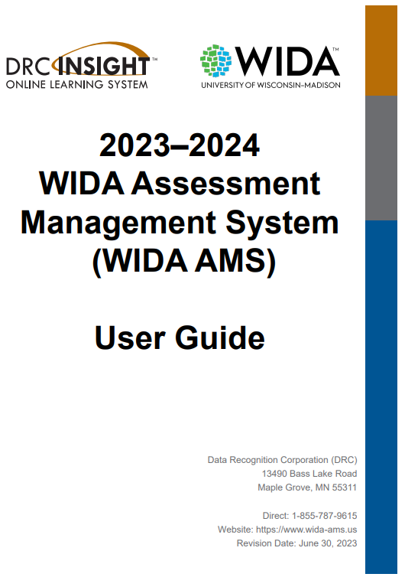
WIDA AMS User Guide
WIDA AMS User Guide

Slide 31
WIDA Assessment Management System (WIDA AMS)
Designated staff may:
Access user guides or software downloads
Add students
Designate accommodations
Create test sessions
Print test tickets
View/print reports
Access the Student Status Dashboard
Submit Transfer Requests
Enter Reason Not Tested codes

Slide 32
Resources: Colorado

Slide 33
CDE Resource Documents
CDE Office of Culturally and Linguistically Diverse Education
Identification
Language Proficiency Coding
Redesignation

Slide 34
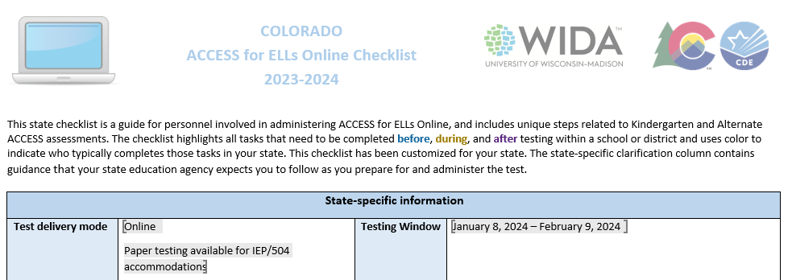
Colorado Checklist
Colorado Online Checklist
New this year

Slide 35
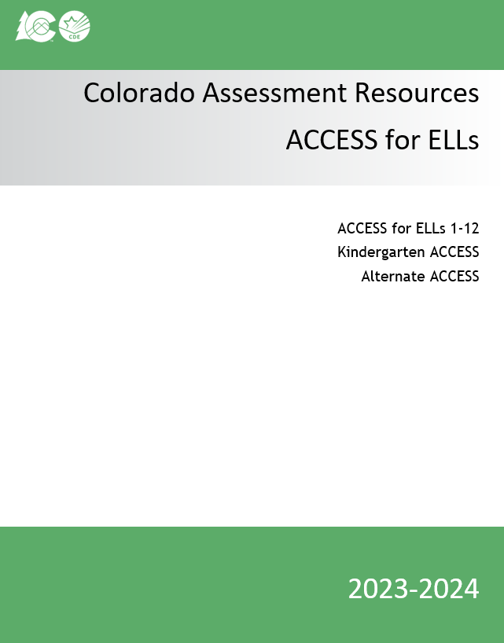
Colorado Assessment Resources
Colorado Assessment Resources
New this year

Slide 36
Security and Training

Slide 37
Colorado Security Agreement
ACCESS Assessments are secure tests

Slide 38
Intellectual Property
All WIDA assessments and related materials are the copyright of the Board of Regents of the University of Wisconsin System. Should an egregious security incident occur compromising WIDA’s intellectual property remedies for violations will be governed by Wisconsin State Statutes.

Slide 39
Security Actions
Use a chain of custody form
Do not leave materials unattended (includes test tickets, used scratch paper, etc.)
Keep testing materials in a secure area when not in use
Prepare a quiet secure testing environment
Actively proctor
Do not view, discuss, or reveal the contents of the test or student responses
Do not duplicate any portion of the test materials
Do not retain or discard WIDA ACCESS published materials
Kindergarten, Paper, Online 1–3, and Alternate Scripts are secure and must be returned
Account for all secure test materials at the end of the testing window
Creation of an exhaustive list of actions to maintain the security of the assessment is not realistic. Always refer to the general guidelines and expectations of assessment security for assessments in Colorado (and set forth by WIDA) when making decisions on best practices with assessment administration and materials.
https://resources.csi.state.co.us/

Slide 40
Test Administrator Requirements
TAs must be employed by the school or
Preferably, TAs will be:
Licensed teachers, licensed administrators, instructional support para-professionals, substitute teachers who hold a teaching certificate, school psychologists, school social workers, school librarians, school counselors, or speech pathologists
School employees may administer assessments at the grade levels of their own children, but they may not administer the test to their own children or relatives, nor be in the testing environment during testing.
For Kindergarten ACCESS or Alternate ACCESS, the TA needs to be able to model clear standard pronunciation of the English phonemes that may impact student responses.
TAs administering the Alternate ACCESS must hold a State of Colorado educator license.

Slide 41
Training Requirements
Test Administrators must:
Be trained annually
Complete the requirements of the school annual WIDA ACCESS training
Participate in WIDA’s online training modules
Independently pass the quiz(zes) that correspond(s) to the assessment being administered
October 1, 2023 – January 8, 2024
Read instructions in the TAM and familiarize themselves with test administration procedures prior to administering the test
Be trained on specific accommodations if administering assessments in which students are provided accommodations
Submit to their SAC a signed Security Agreement
Notes
SACs must submit Paper Test administrator names with materials order
Student teachers may not serve as Test Administrators who are in charge of administering WIDA ACCESS. They may serve as proctors who assist the Test Administrators.

Slide 42
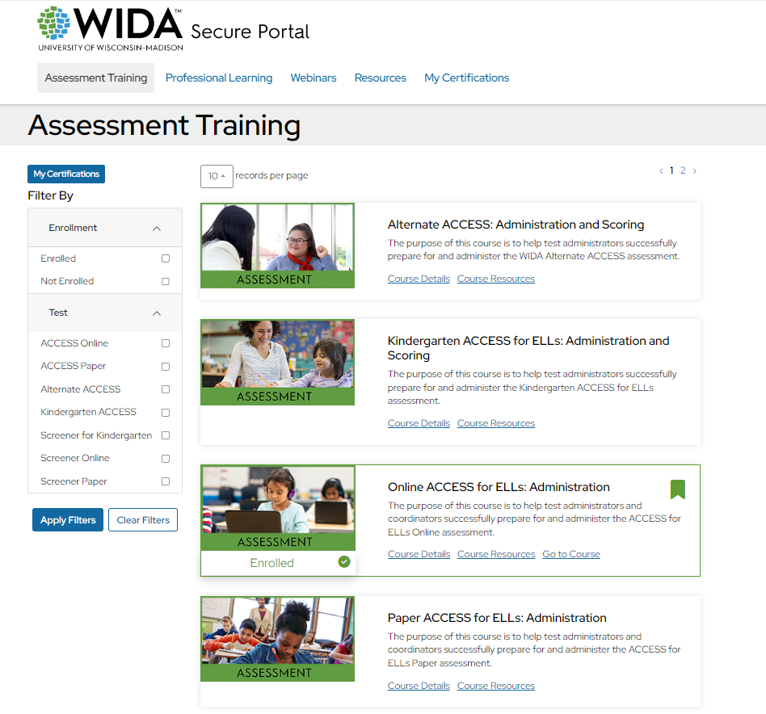
WIDA Quizzes
Quizzes in the WIDA secure portal are available after completing the modules

Slide 43
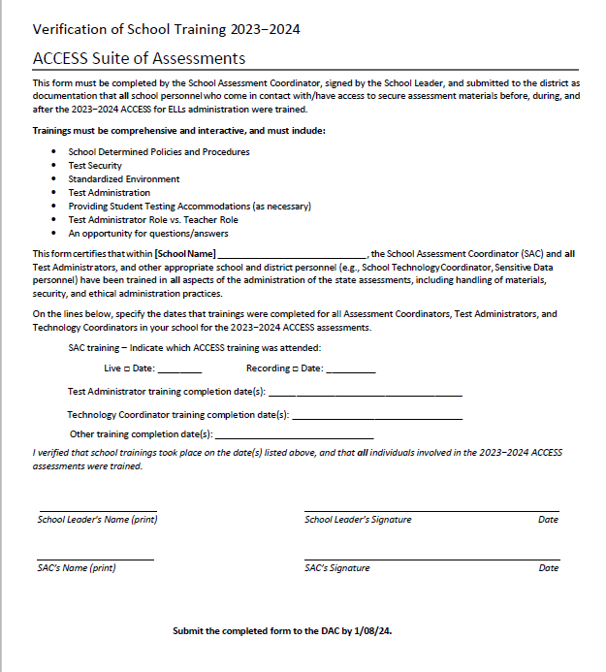
Verification of School Training
Verification of School Training Form

Slide 44
Knowledge Check #5

Slide 45
Accommodations

Slide 46
Accommodation Requirements
Monitor accommodation assignment so that only students with an IEP or 504 are provided accommodations on an English language proficiency assessment
Paper 1–12 requires an IEP or 504

Slide 47
Accessibility and Accommodations
Colorado Accommodations Crosswalk
CSI Resource Site - Accommodations
WIDA Accessibility and Accommodations Manual

Slide 48
Accommodations FAQ
Manual Control of item audio
When Manual Control of item audio is indicated in WIDA AMS it activates for all domains
The Colorado crosswalk indicates that it is an accommodation for Listening
In-person human reader (w/repeat if indicated by the IEP)
In Colorado, this accommodation is only allowed for paper testing. This accommodation requires a script that is ordered through DRC Customer Service.
This accommodation is appropriate when a student cannot access a audio from a computer or CD requires that the student looks at a speaker’s face/lips.

Slide 49
Online Accommodations
Accommodations that must be pre-assigned via WIDA AMS
Manual Control of Item Audio
Repeat Item Audio
Extended Speaking Response Time
Do not broadly assign extended speaking time to all IEP/504 students who have extended time – be intentional about assigning this accommodation to students who need extended time specifically for speech issues.

Slide 50
Unique Accommodation Request (UAR)
Only one Unique Accommodation applies to ACCESS for ELLs.
Scribe (which includes Speech-to-Text) for the Writing Domain
UAR for ACCESS is due November 27
Guidance
Form*
*Do not email completed UAR forms, IEPs, and supporting data. SACs send UAR files to CSI through G Drive. Notify kaliwinn@csi.state.co.us when all ACCESS UAR files are posted for review.

Slide 51
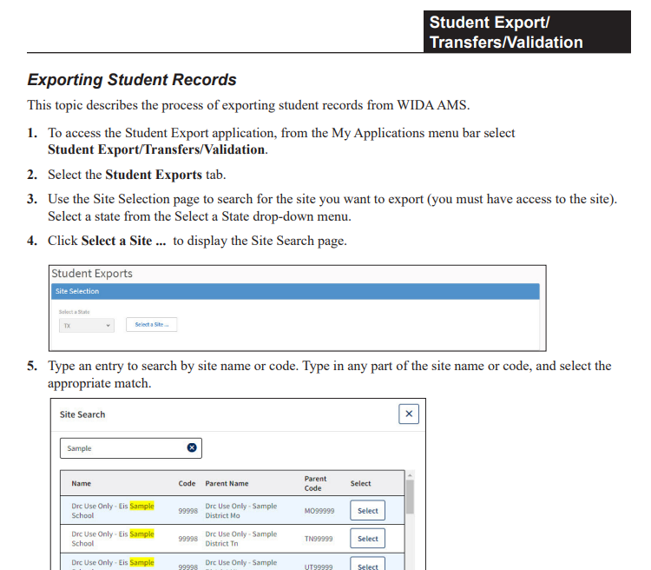
Accommodation Assignment
Check accommodations assignment, use the Student Export feature in WIDA AMS.
Exporting Student Records instructions begin on p. 65, of the WIDA AMS User Guide.

Slide 52
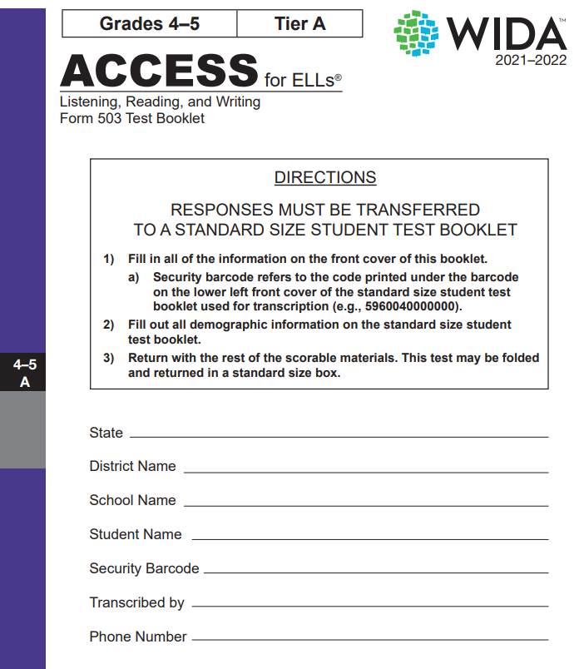
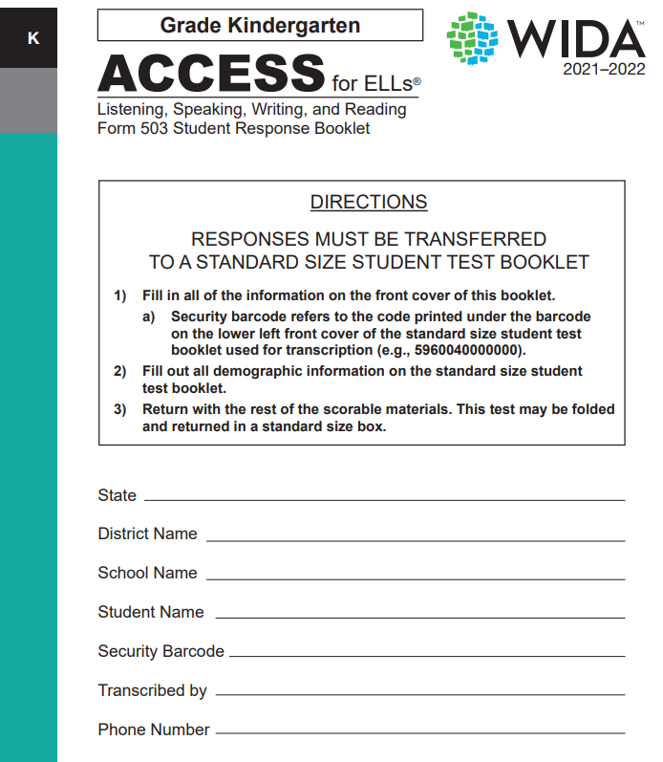
Paper Accommodated Form: Large Print

Slide 53
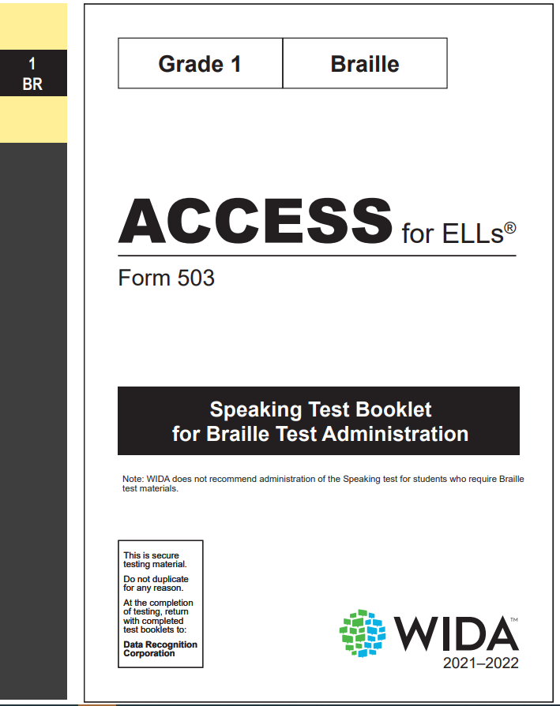
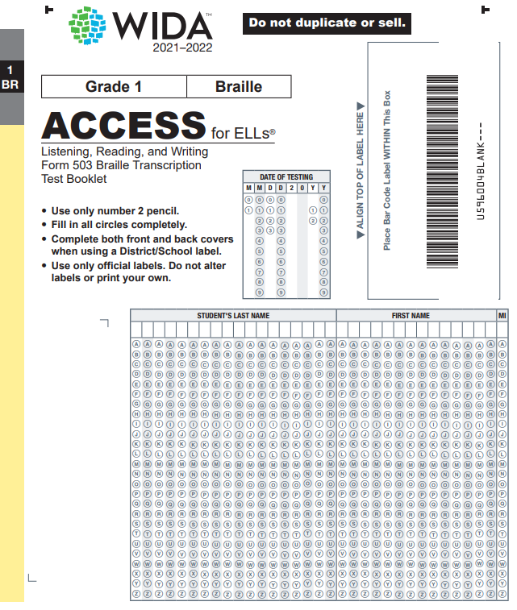
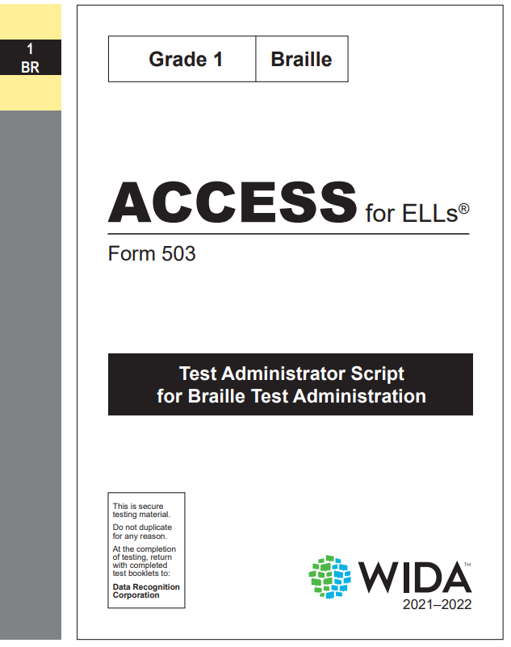
Paper Accommodated Form: Braille

Slide 54
Accessibility
If and when handwriting (HW) response is used as an accessibility feature (grades 4–12):
Handwriting response booklets need to be ordered during the additional materials order window
Place your order accordingly to ensure secure storage upon receipt.
Students in grades 4–12 who handwrite their Writing responses must be placed into a handwriting response (HW) session.

Slide 55
Materials

Slide 56
Materials Ordering
Online, Kindergarten, and Alternate test materials are ordered automatically through the data pulled for the PreID upload
Data is pulled from the initial October Count snapshot in the Student Interchange
Students indicated as NEP or LEP under Language Proficiency
Alternate testers are indicated using the “Alternate Assessment Participation” field
The following require active order placement to CSI through G Drive:
1–12 paper
Accommodated forms
Large print
Braille

Slide 57
Ordering paper materials through G Drive
On 12/15/23, an additional materials order Excel file will be sent to all SACs
ALL Paper 1–12 materials (initial and additional) will be ordered by CDE using the data provided by the SAC in the Excel file uploaded to G Drive

Slide 58
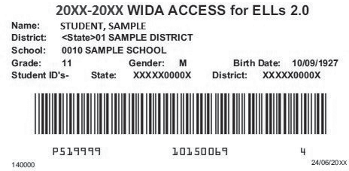
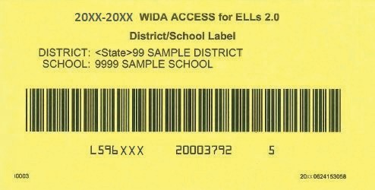
Labels
PreID label for ALL Students (reported as NEP/LEP) in the Student Interchange
District/School (3 pages), use when no PreID label is available
Scoreable materials need a label!
Reminder: Keep all Pre-ID or District/School labels until the end of the window.

Slide 59
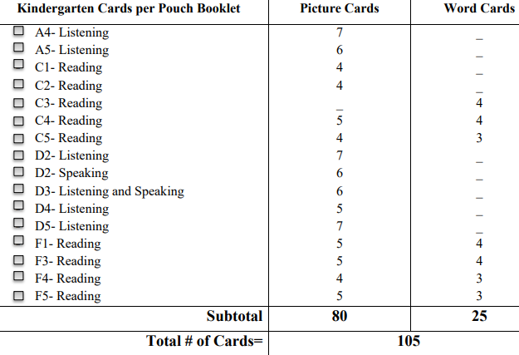
Kindergarten Materials
Kindergarten
Student Storybook
Student Response Booklet
Test Administrator's Script
Student Activity Board
Cards
Card Pouch Booklet
At least two number 2 pencils

Slide 60
Alternate ACCESS K-12
Test Administrator's Script
Test Booklet
Student Response Booklet (make sure it is the correct grade level)
At least two number 2 pencils

Slide 61
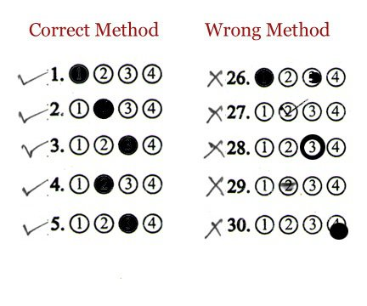
Student Responses: Kindergarten & Alternate ACCESS

Slide 62
Knowledge Check #6

Slide 63
Test Environment

Slide 64
Environment
Follows state of Colorado standardized testing expectations
Prepare a quiet secure testing environment
Post do not disturb and no cell phone use signs
Limit timers, bells, announcements, etc.
Keep cell phones and other like devices out of the testing area
Actively proctor
Follow seating chart/computer assignment

Slide 65
Timing
Untimed does not mean unlimited testing time
Use time estimates in the ACCESS for ELLs Test Administrator Manual & Colorado average testing times
Use of the Test Monitoring Application (TMA) in WIDA AMS allows Test Monitors to monitor student testing activity throughout the duration of their test using a secure dashboard.
Using the TMA is encouraged

Slide 66
Online Testing Order
In either order but first
Listening and Reading
Listening and Reading determine Writing and Speaking tier
In either order after Listening and Reading
Writing and Speaking

Slide 67
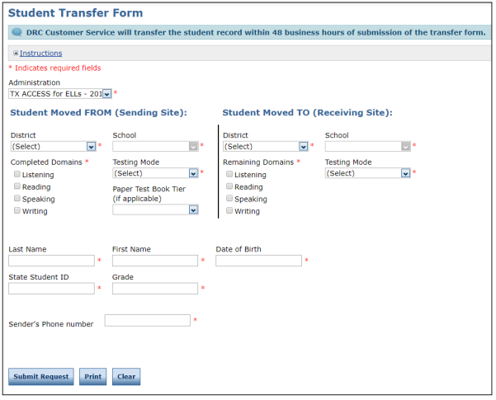
Student Transfers through WIDA AMS
See WIDA AMS User Guide pp. 70–71

Slide 68
Online Testing Reminders
Double-check test tickets are for the correct students
Make sure testing devices are charged
Headphones and microphones are reliable
Have back up devices (computer/Chromebook/tablets, and headphones/microphone) available
Have a plan in place in case of internet outages
How long do you wait?
How many test attempts are appropriate?
When to stop and try again the next day?
Follow DRC guidelines and do not overtax the system

Slide 69
Knowledge Check #7

Slide 70
Preparing Students

Slide 71
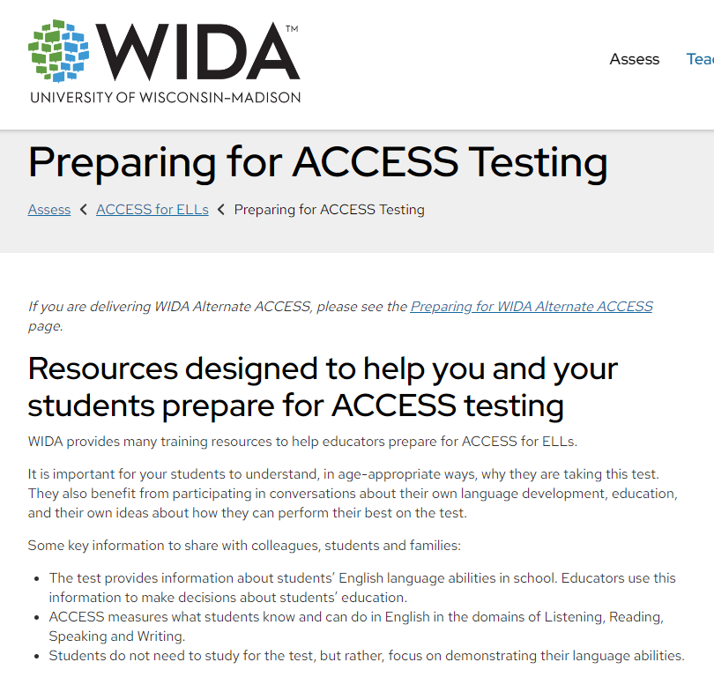
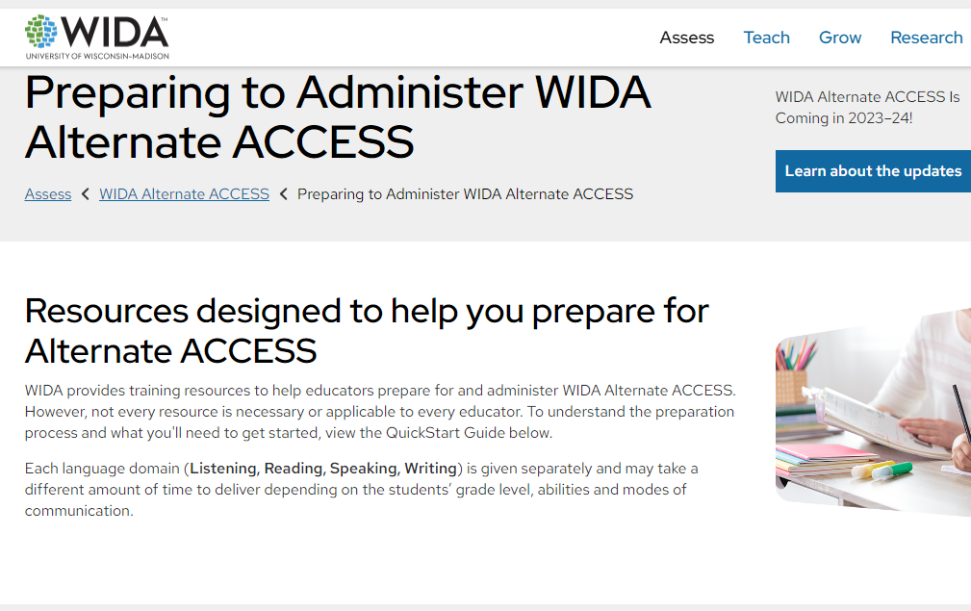
Preparation
Preparing for ACCESS Testing
Preparing for WIDA Alternate ACCESS

Slide 72
Professional Development
WIDA has free eLearning courses available to all educators in the Colorado public K–12 school system.
Virtual Self-Paced Workshops are available September 1, 2023, to August 31, 2024
To participate educators must have a WIDA Secure Portal account.
The Workshops are aligned to the English Learner Quality Standards. To view a list of the Workshops and which standards they align to, review the WIDA Self-Paced Workshop FAQs.
CDE’s Office of Culturally and Linguistically Diverse Education
Professional Learning Opportunities

Slide 73
Before Administration
SACs complete and submit the Security Agreement to CSI
All others involved in ACCESS testing complete and submit the security agreement to the SAC
Order necessary materials (1–12 paper materials as needed by IEP/504)
School-provided annual training(s)
SACs complete and submit
Verification of School Training (By 01/08/24)
List of TAs who administer paper grades 1–12
Test administrators need to pass the quiz/quizzes (by 01/08/24) that align to the assessment they will administer.

Slide 74
Involvement

Slide 75
Assessment Development Events
WIDA and Colorado’s test development partners work hard to create an assessment that:
Reflects the diversity of multilingual learners
Positively portrays students with a range of backgrounds
Carefully avoids topics or situations that may evoke a negative reaction
WIDA invites educators to participate in review of test content in development.
If you would like to contribute to WIDA test development work, please visit the Building a WIDA Assessment page to learn more and apply.

Slide 76
Participation
Educator participation is critical to Colorado's state assessment development and validation process. Colorado educators may serve on committees related to CMAS, CoAlt, and CSLA.
State Assessment Development Flyer
Register for assessment development committee selection

Slide 77
Final Points

Slide 78
Vendor Contacts
Contact the WIDA Client Services Center for questions regarding:
ACCESS for ELLs quizzes and certification
WIDA account usernames and passwords
WIDA eLearning
WIDA Screener Online and Paper quizzes and materials
help@wida.us​
1-866-276-7735​
Contact Data Recognition Corp (DRC) for questions regarding:
WIDA AMS
WIDA AMS logins
Test ordering and returning
Printing and test tickets
Editing student grade information
Generic test sessions
Tier reports
Pre ID labels
Entering accommodations
Using Chromebooks and iPads
DRC Central Office Services (COS) Device
WIDA@datarecognitioncorp.com
1-855-787-9615

Slide 79
2023-2024 Trainings
https://docs.google.com/document/d/1WkE8OKZHKcCbf76mPpLKqfOOYaKFVG8EnHtJaf39uUs/edit?usp=sharing

Slide 80
Contact
Kali Winn
kaliwinn@csi.state.co.us
303-532-7403
Scheduling: https://calendly.com/kali_winn

Slide 81
Final Questions
Final Questions?

