Slide 1
Brown Bag Lunch Series
Training for CSI School Governing Boards
October 2023

Slide 2
Welcome!

Slide 3
Agenda
Meet CSI & updates
Annual Budget Review
Strategic Boards
Board Resources

Slide 4
Our Mission
Our mission is to foster high-quality
charter public school choices
for all students.

Slide 5
We believe that behind every successful charter school is a high-performing governing board.
THANK YOU for committing your time, energy, and expertise to a CSI charter school!

Slide 6
Introductions

Slide 7
CSI Governance Contact
Tom McMillen
Senior Director, Governance and Legal Supports
TomMcMillen@csi.state.co.us

Slide 8
Introductions
In the Chat, please introduce yourself with:
Your Name
School Name
Number of Years on the Board

Slide 9
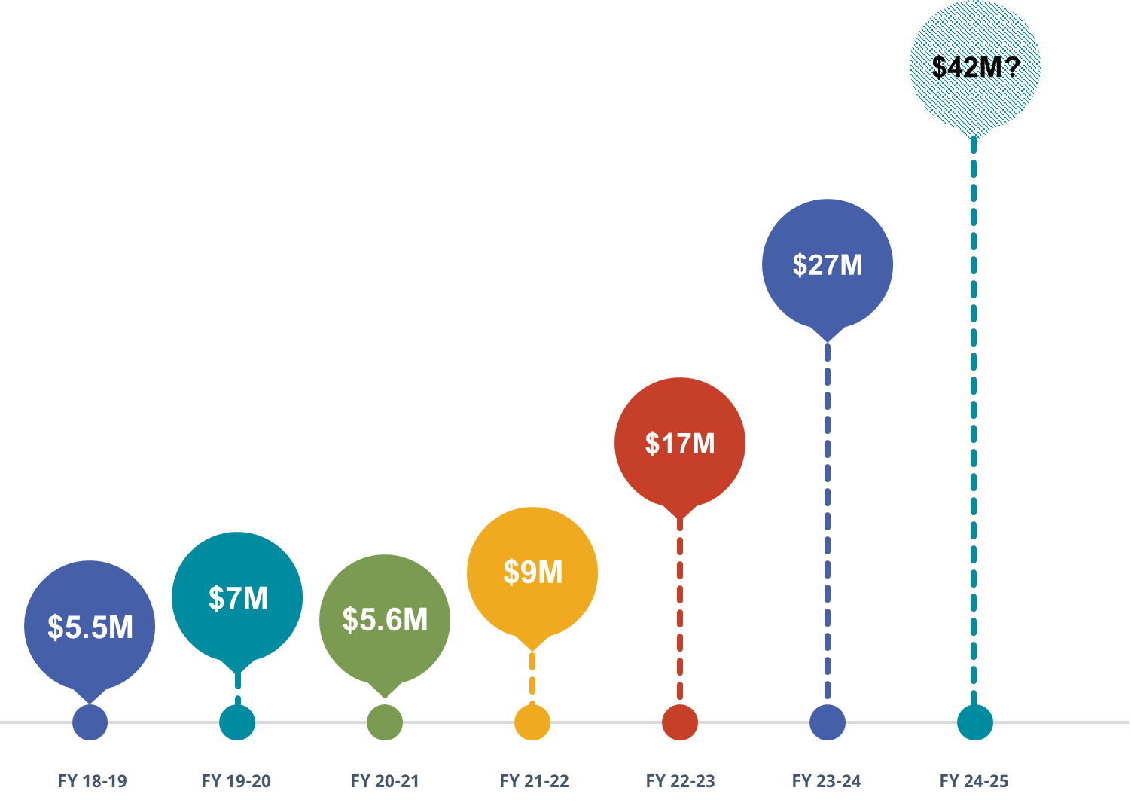
Mill Levy Override Equalization
HB 17-1375 requires school districts to distribute at least 95% of funding received from MLO to all its public schools, including district charter schools.
Given CSI schools don’t have access to local tax revenue, HB17-1375 created the Mill Levy Equalization Fund.
It is up to the Legislature to annually appropriate money in the Fund.

Slide 10
MLE Updates
FY2023-24 MLE for CSI school's is $1,400 per FPC
unless capped by your geographic district.
FY2024-25 each school will be funded at the same level as the geographic district for residence.
Several districts are going for additional MLO in Nov.
CSI MLE request has been submitted to Office of State Planning and Budgeting (OSPB)

Slide 11
Annual Budget Review

Slide 12
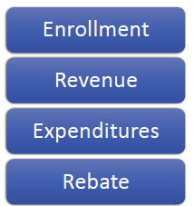
FY 2023-24 Budget

Slide 13
CSI FY 2023-24 Budget
CSI budget is reported as two parts, Appropriation 18A and 18D/F
18A is our administrative budget, 3% of PPR received from schools.
18D/F is the budget for state and federal funds.
Notes:
We’ll start with 18A and talk through components of 18D/F

Slide 14
Budgeted Enrollment
Notes:
CSI budget will be based on LY FPC held flat and adjusted for known factors.
There is 1 school transferring – 2 Rivers, 1 school merging with another CEC.
2 schools are opening in FY23 projected at about 100 students each.
- FY22 CSI FPC was 20,428*
- CSI budget is based on enrollment held flat and adjusted for opening, transferring and merging schools.

Slide 15
Revenue - Appropriation 18A
CSI Admin – 3% of PPR
Per Pupil Revenue (PPR) increased 10.6% from prior year
Declining enrollment, 16 schools
Increased FPC’s and total PPR
16% increase or $900K increase over FY23
Notes:
Talk through declining enrollment -
PPR increase - CSI admin per pupil FY23 - $284, FY24 - $307- or $23+
Between April and May estimated rev runs$ 18.5M
School funding - Rural funding added, SpEd Funding 22% increase, 4% set aside for CSI and carve outs.

Slide 16
Expenditures – Appropriation 18A
Expenditures
Staff
Adding positions, COLA increases
Operating down 19%
Reductions in professional services, lease cost, travel and misc.
Year over year change down 4%
Rebate
Estimated at $95 per student
Operating 2.0%
Notes:
Salary exp is up for the positions added spring of last year (3+1)→ seeing a full year. COLA increases on par w/ state.
Operating exp is down due to move, equip, registration (some conferences skip years) “other”
PPR increase - CSI admin per pupil FY23 - $284, FY24 - $307- or $23+ after rebate (aprox $212/ student)

Slide 17
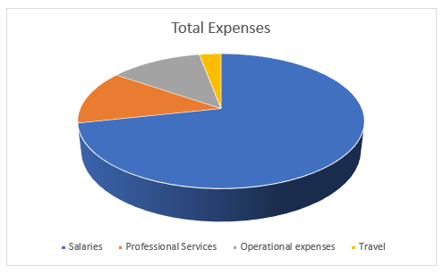
Where we invest

Slide 18
Revenue - Appropriation 18D/F
Federal grant – ESSER, Title
State grants – ECEA
Notes:
Talk through declining enrollment -
PPR increase - CSI admin per pupil FY23 - $284, FY24 - $307- or $23+
Between April and May estimated rev runs$ 18.5M
School funding - Rural funding added, SpEd Funding 22% increase, 4% set aside for CSI and carve outs.

Slide 19
Expenditures – Appropriation 18D/F
Expenditures
Decrease in salary cost
Staff – 9.4 FTE, shift cost to 18A
Increase to Workshops, 84%
School events, various staff groups
Increase to Professional Development for Special Education Staff at schools
Year over year change down 8%
Notes:
Salary exp is up for the positions added spring of last year (3+1)→ seeing a full year. COLA increases on par w/ state.
Operating exp is down due to move, equip, registration (some conferences skip years) “other”
PPR increase - CSI admin per pupil FY23 - $284, FY24 - $307- or $23+ after rebate (aprox $212/ student)

Slide 20
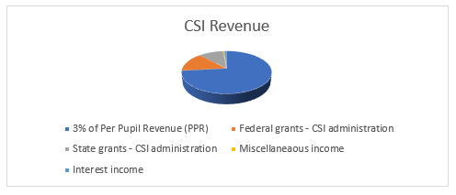
Revenue - Appropriation 18A,D/F
Total Revenue, 13% increase
Notes:
Talk through declining enrollment -
PPR increase - CSI admin per pupil FY23 - $284, FY24 - $307- or $23+
Between April and May estimated rev runs$ 18.5M
School funding - Rural funding added, SpEd Funding 22% increase, 4% set aside for CSI and carve outs.

Slide 21
Expenditures – Appropriation 18A,D/F
Total Expenses, 4% decrease
Notes:
Salary exp is up for the positions added spring of last year (3+1)→ seeing a full year. COLA increases on par w/ state.
Operating exp is down due to move, equip, registration (some conferences skip years) “other”
PPR increase - CSI admin per pupil FY23 - $284, FY24 - $307- or $23+ after rebate (aprox $212/ student)

Slide 22
Summary of Budget
 | CSI Operating Budget
 | Category | Source | $$
 | Total Rev |  | $ 268,229,826
 | School Revenue | PPR & Grants | $ 259,231,840
 | CSI Admin - 3% PPR | 18A | $ 6,596,561
 | Fed/ State Rev - | 18D/F | $ 2,401,425
 | Total Exp |  | $ 268,049,810
 | School Pass Through | PPR & Grants | $ 259,231,840
 | Admin Exp | 18A/D/F | $ 6,779,229
 | Reserve Adjustment |  | $ 180,016
 | Assistance fund Interest* |  | $ 8,400
 | Rebate | to schools | $ 2,030,341
https://www.csi.state.co.us/about/transparency/
Notes:
Salary exp is up for the positions added spring of last year (3+1)→ seeing a full year. COLA increases on par w/ state.
Operating exp is down due to move, equip, registration (some conferences skip years) “other”
PPR increase - CSI admin per pupil FY23 - $284, FY24 - $307- or $23+ after rebate (aprox $212/ student)

Slide 23
Consolidated Budget
Consolidated Budget
Title I, II, III, IV

Slide 24
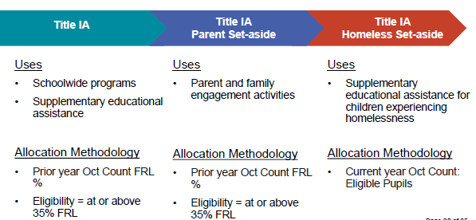
CSI Title IA Allocation Process

Slide 25
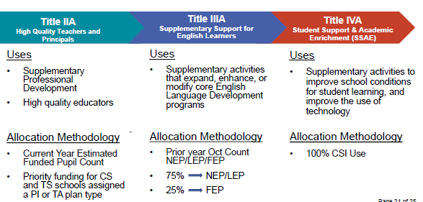
CSI Title II, III, and IV

Slide 26
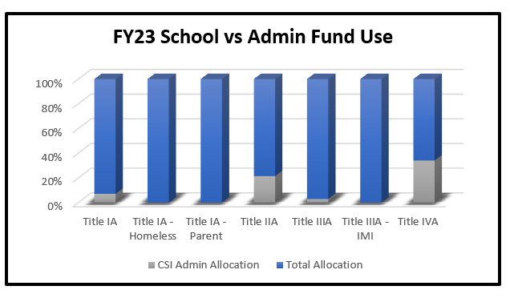
Title Funding
Title Funding

Slide 27
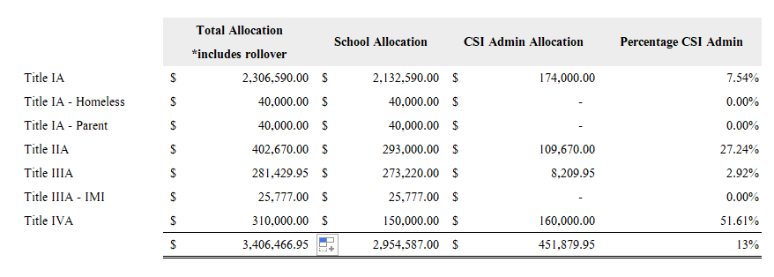
Title Funding Continued
Title Funding

Slide 28
Looking ahead…

Slide 29
Legislative Update

Slide 30
Legislative & Policy Updates
2023 Legislative Session
60+ bills introduced related to K-12 education; more than 40 enacted.
Some advocacy wins to include CSI & CSI schools, including:
SB 23-004 (mental health professionals), SB 23-094 (transportation task force), HB 23-1198 (STEM teacher externship program), and SB 23-258 (educator prep advisory committee)
Some major finance wins for CSI schools, including:
an increase in statewide average per-pupil funding;
an increase in special education funding;
A boost in Charter School Capital Construction funding;
Adjustments to make the BEST grant program more equitable for charters; and
a commitment to fully fund CSI schools by 2024-25!

Slide 31
Legislative & Policy Updates
Policy Guidance and Supports
Recent changes to state law, regulation and CSI Board Policy will impact school policies and practice.
To support schools in ongoing policy development, we have released guidance and/or sample policies that address:
Colorado Open Records Act Requests (SB 23-286)
Physical Intervention, Restraints and Seclusion (HB 23-1191; HB 22-1376; 1CCR 301-45)
Medication Administration (CSI Board Policies: Medication Administration; Administration of Medical Marijuana; Students with Food Allergies)
Non-discrimination (HB 21-1108; CSI Board Policy: Nondiscrimination)

Slide 32
Legislative & Policy Updates
Available for download on the L&P Resource Page
https://resources.csi.state.co.us/legal-and-policy-library/
Also, keep an eye out for…
Suspension/Expulsion Policy Guidance
to align with HB 23-1291.
Title IX, Harassment and Discrimination Policy Guidance
to align with revised regulations (anticipated for release in Spring 2024) and SB 23-296.

Slide 33
Legislative & Policy Updates
Remote Learning Due to Emergency School Closure
CDE) has granted flexibility for schools to implement a maximum of five Remote Learning Option days in lieu of canceling scheduled contact day(s) to protect the health, safety or welfare of students.
To access this flexibility, school should adopt a board policy or resolution that meets requirements established by CDE and develop a Remote Learning Option Plan.
A sample resolution is available for download here:
https://resources.csi.state.co.us/remote-learning-due-to-emergency-school-closure/

Slide 34
Board Member Resources

Slide 35
Strategies to Employ for Fall!
Recognizing strengths and challenges
Governance-Needs-Assessment.xlsx (live.com)
Conducting Head of School evaluations:
School-Leader-Eval-Toolkit.FINAL_.pdf (state.co.us)
Sample School Calendar:
Sample-Board-Meeting-Calendar-Focus-Questions.pdf (state.co.us)
School Dashboards: Examples?
Microsoft Word - EBP Introduction to Board Level Academic Dashboards.docx (edboards.org)
Notes:
Charter public schools are open to all. Public schools must use a fair & transparent enrollment selection process. Misconception #3 “Charter schools are not held accountable.” The state holds all public schools, including charter public schools, accountable for academic performance. Each public school, including charter public schools, receives a plan rating based on its academic performance by the state. FACT: CSI schools are evaluated against additional measures, including performance in academics, finance, and operations. Rule and law prohibit discrimination based on academic ability or the need for special education services. Charter public schools offer unique educational models to meet the unique needs of their communities.
CSI schools serve students that CSI State are reflective of the state average for emerging multilingual learners, students of color, and students with a 504 plan, and continue to increase service to students with special needs.

Slide 36
From these choices, which are your board's greatest strengths and greatest challenges?
Compliance with Sunshine Law and CORA
Understanding of board legal responsibilities
Boards fully staffed with needed members
School operations dashboard created and reviewed
Succession plans for departing board members
Strategic plan created and regularly reviewed
Head of School evaluation process underway
Understanding of budget and audit
Functional board committees
Efficient Board meetings

Slide 37
Communications Poll
Podcast
Blog
Office Hours
None

Slide 38
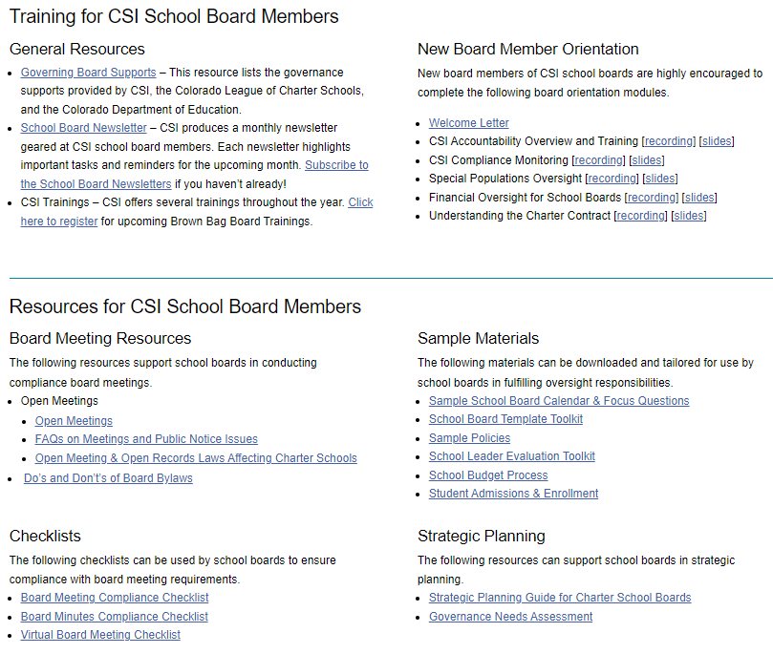
CSI Governance Resource Library
Topics:
CSI Authorization
Board Membership & Recruitment
Strategic Planning
Board Meetings
School Leadership
Charter Contract

Slide 39
Types of Resources
Guidance
School Leader Evaluation
Open Meetings
Tools
Board Meeting Compliance Checklist
Governance Needs Assessment
Samples
Board Meeting Calendar, Agenda, Minute Templates
Sample Policy Language
Trainings
Orientation for New Board Members

Slide 40
Orientation for New CSI School Board Members
CSI School Accountability
Understanding the CSI-School Charter Contract
CSI Compliance Monitoring
CSI Financial Oversight
CSI Special Populations Oversight

Slide 41
Save the Dates
Brown Bag Lunch Board Trainings
Thursday, October 12, 2023
Thursday, December 7, 2023
Thursday, February 8, 2024
Thursday, May 30, 2024
At least one board member from every CSI school will be required to attend these webinars.

Slide 42
Save the Dates
CDE Board Fundamentals
Friday, October 27
Board Fundamentals (Fall)
Date: Friday, October 27th, 2023
Time: 9:00 a.m.- 12:30 p.m.
Location: Virtual Meeting via Zoom Meetings
Details: Please Join the Schools of Choice Unit for Board Fundamentals. This fall, we will revisit the basics to renew our understanding of our roles as governance members. We will also discuss issues geared toward strengthening our practices to support our school leaders, staff, and students.
Register Here | After registering, you will receive a confirmation email containing information about joining the meeting.

Slide 43
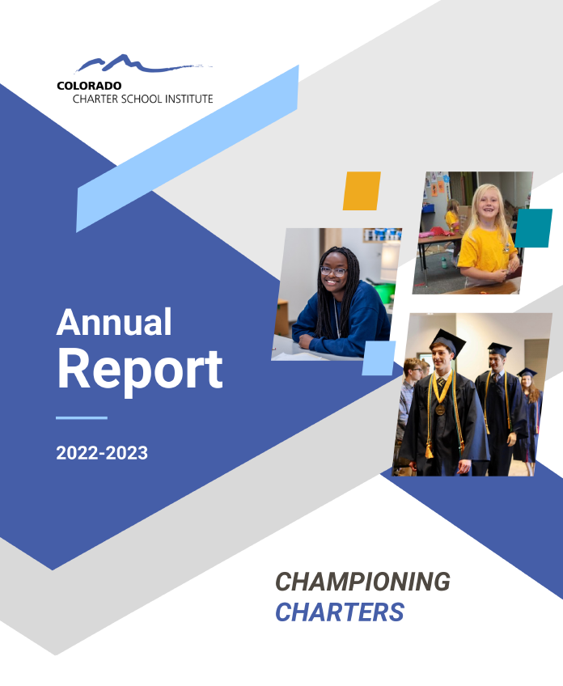
CSI Annual Report
Contents
Who We Are
Our Why
Who We Serve
Organizational Performance
Championing Charters
Looking Ahead
Explore the 22-23 Annual Report
Send any feedback to Communications_CSI@csi.state.co.us

Slide 44
Questions?

