Slide 1
CSI School Leaders Call
September 14, 2023

Slide 2
Agenda
CSI Updates
School Leader Events
Reminders, Upcoming Deadlines
Notes:
Note for familiar faces, new leaders should add name, school in the chat.

Slide 3
CSI Updates

Slide 4
Team Updates
Welcome to our Senior Director of Governance and Legal Supports
Tom McMillen
Congrats to Magaly! (now a Grants Technician)
Open Position: Office Administrator

Slide 5
CSI School Crisis Protocol
Increase in school crisis over the past several years
Working definition of crisis:
Emergency during school hours or school event (lockdown, evacuation, etc)
Death of student or staff member
In response, formed CSI school crisis team
Terry, Janet, Betsy, Jess
Crisis team has completed the FEMA Incident Command System Training
CSI staff member learns of school crisis
Staff member contact CSI Public Information Officer (Terry) and Incident Commander (Janet)
IC and PIO deploy relevant CSI staff and resources as necessary, manages communications
Notes:
During meeting- share phone numbers in chat, have school leaders program into phone

Slide 6
CSI School Crisis Protocol Next Steps
Next up:
Survey on safety and crisis needs and CSI support
School Safety Management Plan due Oct 1
Safety/crisis response session during November 3rd meeting
In the event of crisis at your school call or text both:
Terry Croy Lewis
720-626-2647
Janet Dinnen
720-357-7435

Slide 7
School Leader Events

Slide 8
Regional Leadership Lunches
Grand Junction: 9/22 from 11-1 @ The Ale House
Denver: Pick One!
10/3 from 11-1 @ Hacienda Colorado (near 470/I-25)
10/4 from 12-2 @ Comida (Stanley Marketplace)
Northern Colorado: 10/13 from 11-1 @ Academy of Arts & Knowledge (catered lunch)
Colorado Springs: 10/20 from 11-1 @ Colorado Springs Charter Academy (catered lunch)
RSVP HERE

Slide 9
November 3
All School Leaders Gathering
Lowry Conference Center
9:00am-3:00pm
Registration is Open
Session topics include:
Addressing absenteeism
Trends in safety and crisis response
Networking
Questions? Want to present?
Email jessicawelch@csi.state.so.us

Slide 10
Board Brown Bag Lunches
School leaders are always encouraged to attend, too!

Slide 11
Departmental Reminders & Upcoming Deadlines

Slide 12
Organizational Submissions & Audits
Submit via Google Classroom
https://resources.csi.state.co.us/organizational-submissions/

Slide 13
Assessment & Accountability Timelines
Data Release
RELEASED -ACCESS proficiency and growth data -CMAS proficiency and growth^ -PSAT/SAT proficiency and growth -Graduation rate -Dropout rate -Matriculation rate
SPF/DPF
Preliminary SPF/DPF released
CARS
Academic CARS to be was released on Sept. 1st
Organizational and Financial section to be released in mid-November
AEC SPF target release date is mid-September
Request to Reconsider process will occur in mid-September
^includes on-track growth for informational purposes

Slide 14
Assessment & Accountability
Other notes
Migration to Google Drive
Support with interim assessment analysis
Board and school leader training on state and CSI accountability

Slide 15
Based on school ratings with academic data, nearly 75% of CSI schools earned a Performance or Distinction rating in 2023.

Slide 16
But there was also an increase in schools on Performance Watch with two schools earning Priority Improvement plan type.

Slide 17
There was also a decrease in schools with Insufficient State Data. But 9.1% of schools (4) do not have a state plan type.

Slide 18
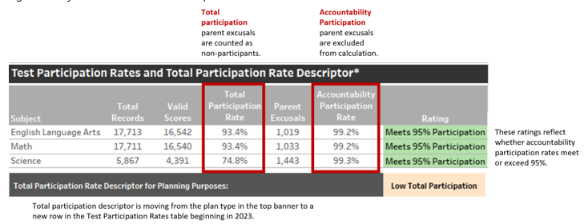
There were three schools that saw their state plan type decreased due to participation.

Slide 19
We have three new schools that are in the process of having their ratings finalized through the PCARS rating system.

Slide 20
Next steps…
Meet with school leaders and boards for schools on Performance Watch
Review Request to Reconsider eligibility and options
Finalize PCARS ratings for new schools
Evaluate options for accrediting schools with an Insufficient State Data plan type

Slide 21
Finance & Ops
Finance Sessions
1st meeting September 19th and then every 3rd Wednesday monthly
Deadlines:
9/29 - Draft Audit, Data Pipeline, Exemptions (new schools)
10/16 - Final Audit, Accreditation
10/20 - Quarter 1 report
Grant Milestones
5 milestones this year
20% spend each Quarter and 100% for final RFF

Slide 22
October Count
Monday, October 2, 2023
Check in often to ensure your data and finance staff are seeing similar total and funded pupil counts!
Reach out to CSI’s Finance Team if your actuals are lower than budgeted!
Reach out to Submissions_CSI@csi.state.co.us with questions!

Slide 23
See you soon!
October 9th: League Summit
September/October: Regional Leadership Lunches
October 12th: School Leaders Call & Brown Bag Board Training
November 3rd: All School Leaders Meeting

