Slide 1
23-24 Kindergarten School Readiness Training

Slide 2
Agenda
School Readiness
Overview
CDE Guide Implementation Guide
CSI Resource site School Readiness
Assessment requirements
Approved assessments SBE approved KSR Assessment Tools
Waivers
KSR Assessment Timeline
CDE Resources Data Collection and submission Implementation Guide
School Readiness Plan Requirements
Requirements for Individual Learning Plans in Kindergarten

Slide 3
School Readiness promotes a start early approach to school. With a strong, early start Colorado children will be more likely to continually success in school. School readiness supports teachers’ ability to create responsive learning environments that ensure academic and developmental growth for students.
Notes:
Remove for 21-22

Slide 4
School Readiness
Waiver is to replace state approved assessment with local assessment
Senate Bill 08-212, Colorado’s Achievement Plan for Kids (CAP4K) requires:
Assessing Kindergarten students in the following areas:
Physical well-being and motor development
Social and emotional development
Language and comprehension development
Cognition
Math
Literacy (these two categories fall under “General Knowledge”)
Individual School Readiness Plans
Fall data reporting of population-level results
Waiver does not exempt school from ISRPs or data reporting

Slide 5
Timeline
All K students assessed within the first 60 calendar days of school.
Results of assessment used to inform Individual School Readiness Plan
School Readiness data collection file due October 27, 2022

Slide 6
Approved Assessments
For all approved assessments, schools are responsible for purchasing directly from vendor.
CDE has approved additional assessments
Training on specific assessments is provided through the vendor (or vendor provided materials). CSI does not provide assessment-specific training.

Slide 7
Schools with approved waivers
Schools with waivers submitted an assessment replacement plan
The assessment replacement plan must be implemented within the same timeline as non-waiver assessments
Must still submit data collection file

Slide 8
Individual School Readiness Plans
Required by CAP4K (state law)
Must be informed by SR assessment
Every kindergartener must have one
However….
That’s where the requirements ends.
CDE example template

Slide 9
New Template for the data collection this year!
Notes:
Update 21-22

Slide 10
Example Data

Slide 11
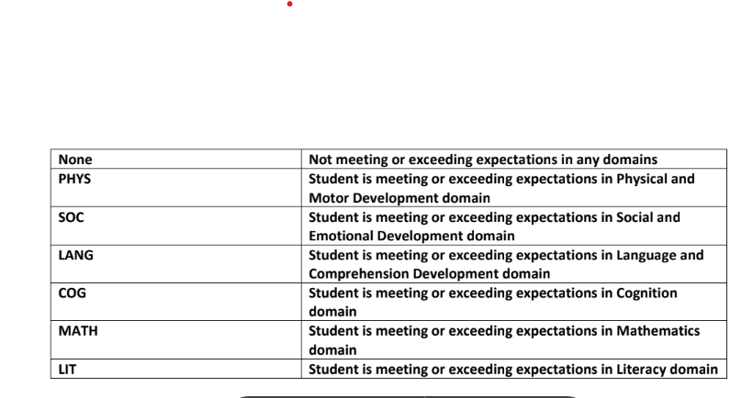
What’s included (fields)
School Code= xxxx
District Code= 8001
Total number of students= Total K enrollment
Domain= SOC, PHY, LANG, LIT, COG, MATH, none
(pre-filled on template)
Total number of students in Domain
Notes:
Highlight-changed in 21-22

Slide 12
What’s included (fields)
Total number of females in domain
Of the number entered in previous field, how many are female
Total number of males in domain
Ditto above, but for males
Total number of nonbinary in domain
Ditto above, but for nonbinary
P.S the three cells above should equal the total number of students in that domain
Total number of students NOT eligible for FRL in domain
Total number of students from initial domain count that are NOT eligible for FRL
Total number of students eligible for FRL in domain
Are you seeing a pattern? A note on this field. If a school is aggregating by hand, this portion will need to be completed by the person on staff with access to FRL info. This is confidential information, and should only be accessible by a few people at your school.
Total number of students whose eligibility is unknown for FRL in domain

Slide 13
More fields…
Total number of Hispanic or Latino students in domain
Total number of students who are American Indian or Alaskan native
Total number of students who are Asian
Total number of students who are Black or African American
Total number of students who are White
Total number of students who are Hawaiian or other Pacific Islander
Total number of students who are Two or More Races (can’t be in another column as well or will mess up the addition)
Total number of students whose ethnicity is unknown

Slide 14
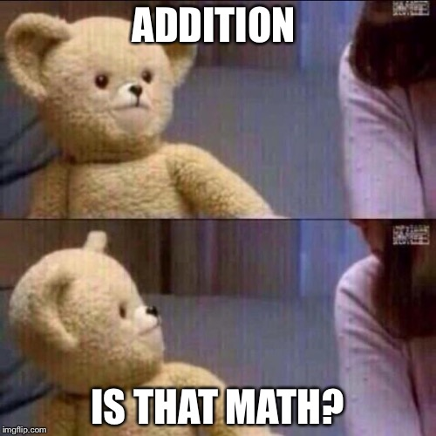
Issues to avoid
Check your math- do the cells add up?
You guys, really that’s it.

Slide 15
SR Data Collection Due Date
October 27, 2022
Notes:
Make due date Oct 29, 2021

Slide 16
Submitting SR collection
willynwebb@csi.state.co.us

Slide 17
Quick Check and Contact Information
Quick Check Form, please complete to show your understanding, your participation, and to provide feedback!
Contact Willyn Webb, willynwebb@csi.state.co.us
303-532-6262

