Slide 1
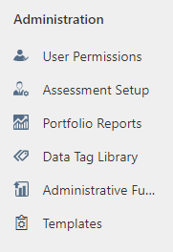
Generating Recipient Drawdown (RFF) Report In GrantVantage
This document describes the process within GrantVantage to generate consolidated request for funds (RFF) reporting. This report aids schools in identifying milestone status and RFFs that need attention.
Step 1 - Single click Portfolio Reports under Administration from the left side of the GrantVantage home screen.
*Your screen may have fewer options than the example below*

Slide 2
Step 2 – Single-click Recipient Drawdown Report from the Report Name dropdown.
*Your screen may have fewer options than the example below*

Slide 3
Step 3 – Set project status to Active Projects and drawdown status to All. Adjust Period Dates accordingly. Refresh report screen. Download report to see individual RFF detail.
Refresh Icon
Download Report

Slide 4
Planned = RFF has been submitted and has not yet been reviewed by CSI
Approved = RFF is approved and not yet been paid
Paid = RFF is approved and paid
Denied/Requested = RFF pending additional back-up or clarification
Step 4 – Review submitted RFFs and address anything that has been denied or is sitting in requested status.

