Slide 1
2023-24 December Count Collection
What’s New and Reminders
Recorded: September 2023
Notes:
Hello All,
Thanks so much for reviewing this training for the 23-24 Special Education December Count Collection! This short recording focuses on any updates for the year, some reminders related to validation of the data, and some warning clearing assistance. This training is ideal for staff that are returning in the role of data submissions and have a strong knowledge of the submissions process. It is also important for new staff to review this along with the general overview webinar to better understand any changes to fields or errors and what information should be validated across collections. Feel free to reach out to CSI if you have questions at any point!

Slide 2
Agenda
New for December Count
03 – Nonbinary added as Gender option | “SPED” added to the beginning of both the Pupils Attendance and Basis of Exit fields
Removal of Disability Code 12 – Infant/Toddler with Disability | Special Ed or Part C Referral Type changed to Special Ed Referral Type
All Path 1 fields officially removed/SPED Referral
Data Validation/Collaboration Reminders
Cross Collection issues with HR
Populating EDIDs on the Participation File – IC
Warnings/Errors
SPED Staff in December Count
SAM Warnings
Duplicate Warnings
2
Notes:
Here is a quick overview of the topics that we will be discussing today. First, we will discuss the updates and changes that have occurred within the collection, in particular file layout changes. This includes the removal and additions of fields and coding options available to you, including the removal of all Path 1 fields. Next, we’ll cover some validation and collaboration reminders related to working with your Human Resource staff to clear errors and populating EDIDs in IC. Last, we’ll look at some Warnings that could potentially turn into errors and require updates from the school. These are related to SPED Staff Coding, SAM Warnings, and Duplicate Warnings. Hopefully, utilizing the knowledge gained here may help with the error clearance process and overall accuracy of your numbers.

Slide 3
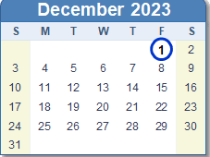
December Count Reminder
Reminder!!!
The purpose of December Count is to accurately report all students with IEPs and actively receiving services as of December 1st so that schools will receive funding and resources to best support their education and Services.
You do not need to report students who exited prior or entered after this date
Student can also be exited with a valid Exit Date and Basis of Exit.
Notes:
To begin, I want to talk about the purpose of the December Count Collection. The purpose is to accurately record data about students with IEPs as of December 1st, so that schools may receive appropriate funding and resources to best support their education and services. This information is used for all the listed options here, but most importantly as you know would be the funding for special education students.

Slide 4
New for December Count 2023-24
Notes:
Let’s jump right into the some of the updates for the 23-24 school year!

Slide 5
Gender Field Update
The Gender field has added coding option 03 – Nonbinary to all collections for both students and staff.
For further details, see the 23-24 Child File Layout and Definitions Document
Notes:
The first topic I want to discuss today is related to the Gender Field. CDE has added an additional coding option that can be selected for students and staff in all collections, which is code 03 - Nonbinary. Ensure this update has been added to your Plan Management System and use as needed moving forward! For more details, see the 23-24 Child File Layout and Definitions document.

Slide 6
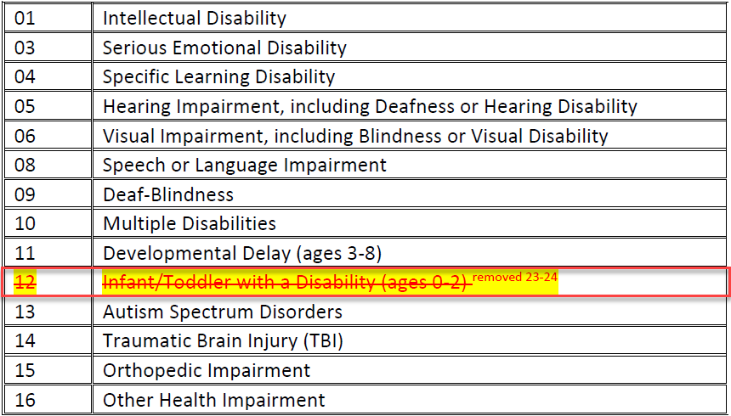
Removal of Disability Coding Option
Delay Codes Removed
Coding option 12 – Infant/Toddler with a Disability has been removed as a coding option for the Primary Disability Field.
For further details on these changes, see the Participation File Layout and Definitions Document for 23-24
Notes:
Next, I want to discuss an update to the Primary Disability Coding options. Coding option 12 – Infant/Toddler with a Disability has been removed as a valid option for 23-24. This relates to the removal of Path 1 data which we will discuss in the next slide!

Slide 7
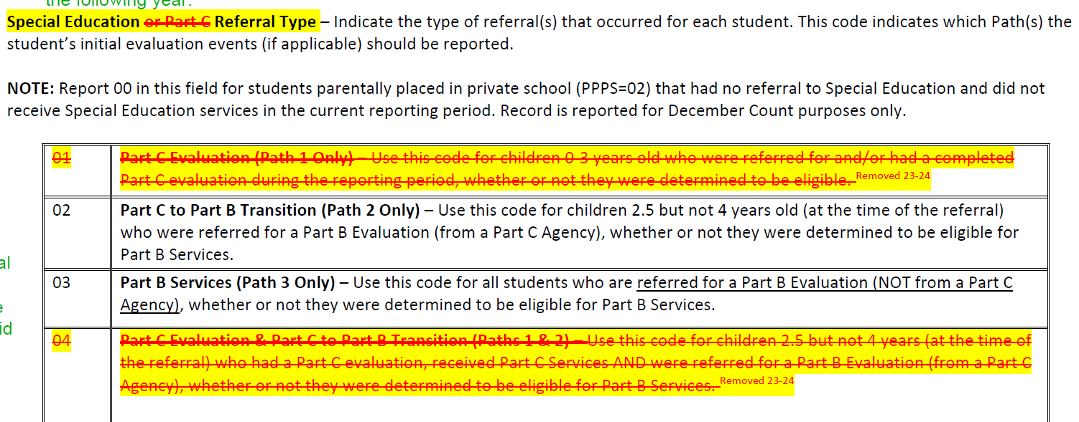
Path 1 Fields/Referral Types Removed
Path 1 data fields have officially been removed from the collection
Community Centered Boards will be responsible for the Part C evaluations
Given this, all related Special Education Referral Types related to Path 1 students have been removed as well. This includes 01, 04, and 05. These have always been 03 or 06 for CSI schools
The field name has also been updated to remove any references to Part C and now is Special Education Referral Type
Notes:
The next change I want to discuss also does not impact CSI schools very often but is a big change to the collection. CDE has officially removed all Path 1 fields from the collection as that responsibility has shifted to the Community Centered Boards as it relates to all Part C evaluations. Due to this, they have also removed coding options 01, 04, and 05 from the Special Education Referral options. CSI always uses 03 for newly tested and 06 for returning students anyways, so not a big change to your typical processes. The benefit to this for CSI schools would be a file with less fields to sort through!

Slide 8
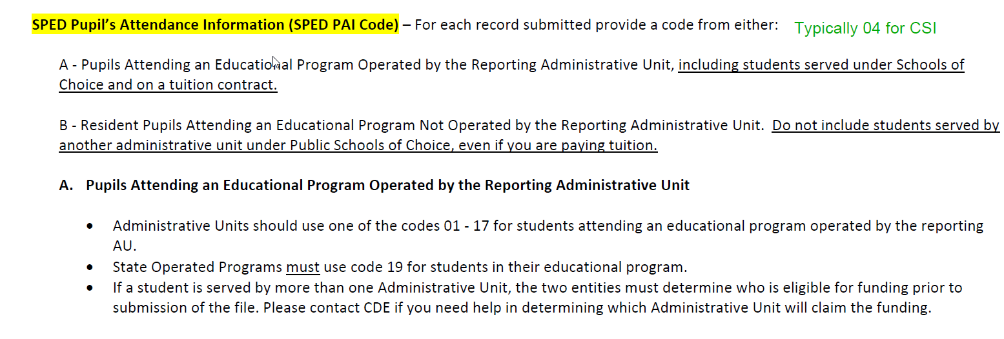
Field Names Clarified
The term “SPED” was added to the beginning of both the Pupils Attendance Information and Basis of Exit field to further indicate field is related to Special Education Reporting when working with multiple collections.
Pupils Attendance Information SPED Pupils Attendance Information
Basis of Exit SPED Basis of Exit
Notes:
In addition to the changes to coding options, CDE has also added clarification to two field names. Both the Pupils Attendance Information and Basis of Exit fields have been updated to include the term “SPED” in front of them for added clarification when working with multiple collections or completing cross collection reviews. So now you should see SPED Pupils Attendance Information and SPED Basis of Exit.

Slide 9
Enrich Updates
Schools using Enrich will be moved from the CSI shared system to their own instance of Enrich over the next few months. This is due to schools not having the ability to extract their own files for data collections.
Matt Hudson or your CSI SPED Coordinator has reached out to schools to provide information and Implementation updates.
You’ll need to work with Frontline on a timing and details.
If the school's implementation is very close to the December Count Deadline, you will have the opportunity to use starting point files for one more year. Schools should have the ability and all students added by 23-24 SPED EOY.
Notes:
With the new year starting, I also wanted to inform you of some updates occurring with Enrich this year. Our SPED Team has most likely already contacted your school regarding this update but wanted to keep everyone in the loop. Schools using Enrich will be moved from the CSI shared system to their own instance of Enrich. This is primarily due to the inability of schools to extract their own files directly from Enrich for all state data collections. Your school will need to work with Enrich on the timing of this and all related details. This process will not happen quickly as there are a lot of schools to go through, so if your implementation is very close to the December Count initial submission, you will have the opportunity to request starting point files for one more collection. All schools should be fully implemented and have all students added by SPED EOY. To help with this, we even have delayed the initial submission, which is a couple of weeks later than typical. Please reach out to CSI if you have questions on this.

Slide 10
Data Validation/Collaboration
Notes:
Next, lets talk about the need for Collaboration of school staff and some necessary validation of that data in order to provide accurate and error free data. The December Count and Human Resource collections are closely tied as it relates to Special Education staff, so being sure that the staff in those roles collaborate and coordinate a plan moving forward is vital to the success of both collections.

Slide 11
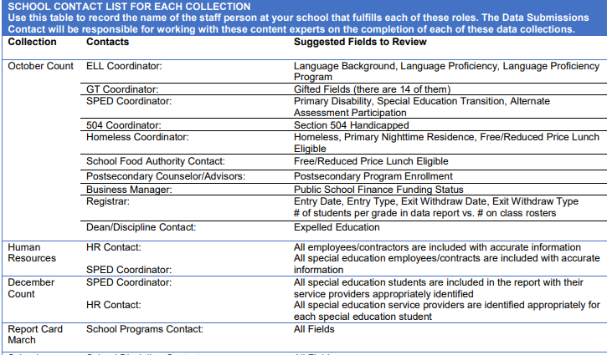
Across Collection Collaboration
School SPED Staff must collaborate with the Human Resources Staff at your school completing December Count. This is due to:
December Count errors may require changes to either the SP or SA files to resolve
Involves inconsistencies with data entered by HR Staff, including:
SPED Flag
Grade Levels Taught
FTE and Funding Source issues
Be sure you are reaching out to your schools HR Staff to inquire about any cross-collection errors that may have occurred
Available in the Data Submissions Handbook
Notes:
Now you may be asking yourselves, how are the two collections related and what can be done to ensure success? The short answer to this is collaboration across collection staff. During this collection, we really want to emphasize the need of you as Special Education Staff to collaborate with your schools Human Resources staff to clear errors. As Special Education staff are working through their collection, they may encounter errors particularly on the Level 2 Staff error files that will require changes to the HR files, so being proactive and reaching out to them early in this process is especially important. CSI does try to provide both contacts this information throughout the process, particularly when issues are discovered, but collaborating with those staff and developing a plan will be key to the success of both collections.

Slide 12
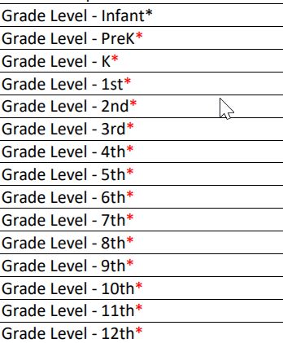
EDID Fields and the HR Collection
December Count Fields
The EDIDs and grade levels used for students in December Count must match the corresponding staff grade levels assigned on the HR files for that EDID with the SPED Flag always being “1”
HR Collection Fields
Notes:
Taking this cross collaboration details a step further, this slide shows the main fields being impacted and are the EDID, Grade level, and SPED Flag. Staff working the December Count collection must provide appropriate EDID providers within the participation file along with ensuring all students grade levels are accurately coded. In turn, the HR staff must include all those special education staff within their files and a Special Education flag of 1. All staff coded this way will be pulled into the December Count snapshot rather than the HR. Not only that, the grade levels taught selected in the HR files must match the grade levels of the students with their EDID being used on the Participation file. If not, then there will be level 2 staff errors in December Count that may need to be cleared by updating the HR files. This is why the collaboration and validation of this data is so vital.

Slide 13
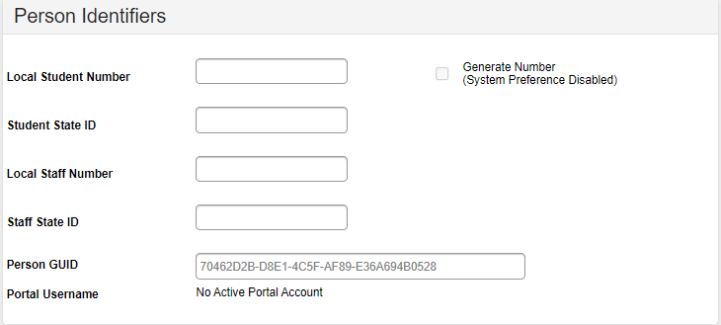
EDIDs not Showing up in the Participation File – Infinite Campus
Adding Special Education staff correctly to HR and IC is important to ensure they show up on the Participation file and avoids errors for both collections.
Follow these Steps:
Verify all Special Education staff are included on both files with the correct EDID
Verify their Special Education Assignment =1
Provide a Job Classification, Teaching Subject Area (1700) and Admin/Instructional Area (0002) that is applicable for SPED Staff
Ensure the EDID is added to the Staff State ID section in IC by going to:
Census→People→District Assignment
13
***Share this with applicable HR Staff if IC updates are completed by them***
Notes:
So, our schools ran into this issue in the past in IC so I thought I should mention it. We have previously seen the staff persons EDID not showing up on the December Count files as an EDID provider. This has caused both December Count and HR issues. To ensure that the EDID populates correctly on the files, please follow all the bulleted steps, which include(READ STEPS). Adding the correct EDID in this IC setup as mentioned in the last bullet definitely was the primary issue, but if all are followed, the EDID should successfully show up. I should note that if you are not the one completing updates on the staff records in IC, please mention this to the applicable staff member.

Slide 14
Warning/Error Reminders
Notes:
Next, lets talk about the some common warnings and issues that will need to be addressed prior to them potentially becoming errors.

Slide 15
Special Education Staff Requirements
Staff whose EDID is used within the December Count Collection must have the appropriate licensing qualifications to serve Special Education students. The requirement is at both a Federal (IDEA) and State (ECEA) level. Staff are determined qualified by:
Holding a valid CDE license for the assignment
Holding an age level endorsement for the ages of students served
Serving a majority of special education students with the same identified area of need as the staff’s special education endorsement; this is the 50% caseload match for:
JCC 202 Teacher, Special Education
JCC 238 Speech-Language Pathologist
Staff with licensing or endorsement issues will receive SAM Warning on the December Count Level 2 Staff Error report!
Notes:
So jumping into the warnings, I wanted to discuss the requirements special education staff must have in order to be reported as a Special Education Teacher or Speech Language Pathologist for the December Count collection. Staff whose EDID is being used for December Count must have the appropriate licensing and qualifications as of December 1st to serve this sub-set of students. To be eligible a staff person must be:
Holding a valid CDE license for the assignment
Holding an age level endorsement for the ages of students served
Serving a majority of special education students with the same identified area of need as the staff’s special education endorsement; this is the 50% caseload match for the two roles I just mentioned.
If particular staff do not meet these requirements, they will receive a Staff Approval Matrix or SAM warning on December Count level 2 staff report. CSI does review each of these warnings and will probably be reaching out to you, so just ensure all staff have the appropriate endorsements on their license.

Slide 16
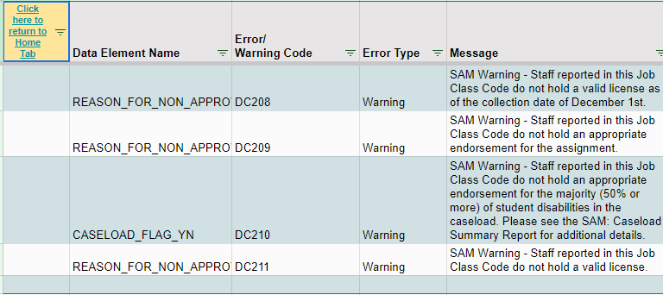
Staff Approval Matrix (SAM) Warnings
Staff Approval Matrix or SAM warnings must be addressed in all cases they occur. This involves:
December Count submissions staff working with the HR team at the school to determine if the staff person was appropriately licensed prior to December 1st.
Notify the Human Resources department as soon as possible to allow time to make any adjustments
The CSI SPED Director/Coordinators will be reviewing all SAM warnings and reaching out to schools for corrections
Collaboration between the SPED Staff, the HR Staff and CSI is necessary to correct these issues!
Notes:
So what should you do if you receive a SAM Warning or even prior to that to ensure accurate data? You want to be sure that (READ Slide)
As mentioned, our SPED Director Matt Hudson will be reaching out to all schools with this type of warning for clarification. Licensing and qualifications as well as case load are extremely important when working with Special Education students, so flagging anyone without the proper licensure or caseloads is key to correcting the issue and ensuring only applicable staff are in that role. Sometimes it may be just the case that a license is still being processed and in other situations, it may be discovered that the person is coded in the wrong role, so taking these warnings seriously and reaching out is extremely important.

Slide 17
DC154 Duplicate
The DC 154 indicates another district is also reporting the student as being funded on 12/1. This warning will need to be addressed or it will become an error during the duplicate phase. Schools should:
Review the Entry and Exit Dates for the impacted student to ensure the student was in attendance as of December 1st.
If not, the student does not need to be reported for December Count.
If the student was in attendance, reach out to CSI with details and we will contact the other district for adjustments.
Notes:
The last warning I would like to discuss is the DC154 or duplicate warning. This indicates that another district is reporting the same student in attendance on December 1st and is coded as being fully funded. This will only flag as a level 2 warning but must be addressed as it will come up during the duplicate phase of the collection. You should thoroughly review any student receiving this warning and ensure they are receiving services and was in attendance as of December 1st. If not, then you do not need to report this student or report as exited prior to 12/1. If the student was in attendance, CSI will reach out to the other district to have them correct the issue on their end.

Slide 18
Timelines and Deadlines
Notes:
Lastly, lets talk about timelines and deadlines for the collection!

Slide 19
SPED EOY Timelines and Deadlines
Deadline | Task
11/07/2023 | Submit initial files (Child, Participation)
12/05/2023 | Schools must have all Level 1 (Child/Participation) errors cleared
01/11/2024 | Schools must have all Level 2 (HR and December Count-Staff) errors cleared
Second week of Jan* | CSI will provide Data Summary Reports to schools
1/25/2024** | Submit Signed Certification Agreements to CSI
*Dependent upon all schools clearing errors by specified deadlines
**Any requests for changes must be received by CSI on or before 1/22/2024
Notes:
In terms of timelines and deadlines that must be met for the 23-24 December Count collection. First, we have a date of 11/07 to have all your initial child and participation files submitted with level 1 error clearance for those files being on December 5th. All school must have both level 1 and 2 errors cleared by January 11th, 2024, and you will receive your summary report shortly thereafter. The date to review, sign and return those is January 25th. If after reviewing, you notice some changes that need to be made to your data, please submit those updated files to CSI by January 22nd to ensure files can be processed and a new summary report delivered to meet the deadline.

Slide 20
Thank you for Reviewing this Training
Contact the Submissions Inbox with Questions:
Submissions_CSI@csi.state.co.us
Notes:
Thank you so much for reviewing this training for the 23-24 December Count Data Collection. If you have questions, don’t hesitate to reach out to CSI and we are more than happy to assist you!

