Slide 1
ELD Coordinator Training 2023-2024
August 9, 2023

Slide 2
Today’s Agenda:
ELD coordinator role
Identification Procedures
WIDA Screener
Program Requirements
CLDE PD requirement
ACCESS results & growth reports
Upcoming trainings
Monthly Power Hours (virtual)
Padlet
WIDA Screener Refresher 8/16
Title III and Migrant Education
CSI contact info

Slide 3
For Your Reference:
CSI Resource Site
Standardized Identification Process
Standardized Redesignation Process
Padlet for PD Opportunities
Monthly ELD Power Hours
ELD Guidebook

Slide 4
Identification Procedures

Slide 5
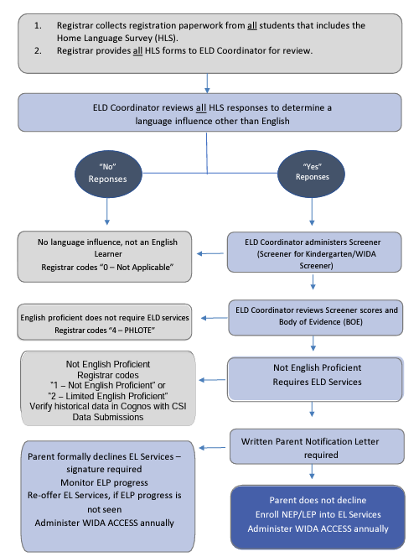
Standardized Identification

Slide 6
Home Language Survey

Slide 7
Home Language Survey
OCR/DOJ HLS: 3 approved questions
Have you reviewed your school’s Home
Language Survey?
1
2
3
What is the primary language used in the home, regardless of the language spoken by the student?
What is the language most often spoken by the student?
What is the language that the student first acquired?

Slide 8
Identification Process
Step 1: Administer the Home Language Survey (HLS) to all newly enrolling students as part of the school’s enrollment process.
Step 2: Review Home Language Survey to determine a language influence other than English.
If a language influence other than English is determined…
Step 3: Administer WIDA Screener & gather Body of Evidence.

Slide 9
Body of Evidence:
Determining Placement of English Learners
WIDA Screener results
Family Interview
Student Academic Record
Local school or district assessment
Informal assessments
Teacher input
Student Profile
(Examine the students’ cumulative file)

Slide 10
Identification Process Cont…
Step 4: Student is identified as an English Learner, parent notification/informed consent for placement
Prior to providing services to a newly identified (NEP/LEP) student, the school must notify parents in writing.
There are very specific requirements related to what is included in the communication. Additional info, and example letters, click here.
Every Student Succeeds Act (ESSA) requires schools to inform parents of eligibility for EL placement in a timely manner.
Step 5: Update SIS with EL designation.
*PRIOR TO OCTOBER COUNT DATE!!

Slide 11
Identification Timeline
•30 days from first day of school (prior to October Count)
•Late registration/enrollment= 14 days (After October Count)

Slide 12
New student with Yes on HLS: Screened and identified within 30 days
Parent Notification within 30 days of identification
Update coding

Slide 13
Systemize your filing processes
Print the WIDA Screener Score Report.
Make a copy of the parent notification letter.
Update coding/identification in your SIS.
File in the student’s cumulative folder.
*** These processes are essential in the event of an audit, turnover among your staff, or if the student transfers to another school.

Slide 14
Check for understanding:
Multilingual learners must be identified within:
30 days from the first day of school prior to October count or 14 days after October count
14 days from the first day of school prior to October count or 30 days after October count

Slide 15
Questions or Comments?

Slide 16
WIDA
Screener

Slide 17
WIDA Screener
Students with a YES on Home Language Survey (or if there is other evidence of language influence) take placement assessment.
Grades 1-12: All four domains
Note: 1st Semester 1st graders take all four domains of Kinder test
Refer to grade level clusters for the correct test
Kindergarten: First semester – only listening and speaking
Second semester – All four domains
*If your school utilizes the paper Screener, audio files & reusable booklets need to be purchased beforehand from the WIDA store (one time purchase).

Slide 18
WIDA Screener cont.…
All educators who will administer/score the WIDA Screener assessment must complete the training modules annually.
Your School Assessment Coordinator can give you a log in for WIDA if you do not have one.
WIDA provides you with a certificate of completion.
CSI contact will verify completion via WIDA portal, no need to submit certificates.
Notes:
Confirm that training does not need to be repeated annually.

Slide 19
WIDA Screener continued
WIDA AMS is used to update student information, create test sessions, print test tickets, score responses, and WIDA Screener management.
Students test within the DRC Insight App
Note: There are updates to WIDA AMS and DRC this year.
Notes:
DRC/AMS access from Kali?

Slide 20
Plan on 1-2 hours for WIDA Screener training modules.
All staff administering/scoring must complete the training modules.
Screener may be administered in groups.
~80 minutes (untimed but this is a general time frame for planning)

Slide 21
Where to find the training modules:
www.wida.us
Log in to the WIDA Secure Portal
Assessment Training
WIDA Screener Online Administration
WIDA Screener Paper Administration
Speaking and Writing Scoring (Both paper and online administration)

Slide 22
WIDA Screener Score Interpretation

Slide 23
Screener Check for Understanding:
All educators who will administer/score the WIDA Screener assessment must complete the training modules annually.
True
b. False

Slide 24
Questions or Comments? 2
Questions or Comments?

Slide 25
EL Program Requirements

Slide 26
EL Program Plans
All identified students (NEP/LEP) must be enrolled in and receive adequate and appropriate English language development through the identified language instruction educational program.
Schools must ensure students receiving EL services attain English proficiency, develop high levels of academic content knowledge and meet state achievement standards, including immigrant and refugee children and youth.
Schools must provide a high-quality, standards-based language instruction program.

Slide 27
Examples of Programming
☐ English as a Second Language (ESL) or English Language Development (ELD): instruction usually provided in English with little use of the ELs’ primary language. Example - pull-out ESL groups or designated ELD block ☐ Dual Language or Two-Way Immersion: instruction provided in English and another language. Examples – Native language content classes, first language literacy class, L1 literacy, primary language literacy ☐ Transitional Bilingual Education or Early – Exit Bilingual Education: instruction in students’ primary language and English ☐ Content Classes with Integrated ESL Support (Examples: Push-in ESL, Co-Teaching, Sheltered English, Specially Designed Academic Instruction, Structured English Immersion, Sheltered grade level content courses.) ☐ Newcomer Program (designed for students who are new to the US)

Slide 28
What ELD is…
- •-"'IP"

Slide 29
Frequently Asked Questions
How much time are we required to provide ELD services for students each day?
No state requirement. However, The Office of Civil Rights recommends a NEP/LEP student receive an average of 45 minutes a day.
Have you reviewed your school’s EL Program Plan?
If not- let me know and I’ll email you a copy! Plans should be updated as needed and resubmitted to CSI annually.
Can families opt out of services?
Yes, but they cannot opt out of testing requirements. Your school is still held accountable for student progress on state assessments, regardless of whether students opt out of services.

Slide 30
Program Plans
OELA English Learner Toolkit
Infinite Campus
PowerSchool
ColorinColorado
Early College of Arvada (Jacob Bader)
Individual Student Plan
Pinnacle Charter School (Tamara Soweidy)
Elementary ELD Plan
Secondary ELD Plan

Slide 31
Program Plan Check for Understanding:
Have you reviewed your school’s EL Program Plan?
Yes, and I have sent/plan to send a copy to Rachel.
No, but I have scheduled a time to meet with my team to review the plan.
No, and I will schedule a time to meet with my team to review the plan.

Slide 32
Questions or Comments? 3
Questions or Comments?

Slide 33
ACCESS

Slide 34
DEFINITIONS NEP- Non-English Proficient LEP- Limited English Proficient
FEP- Fluent English Proficient
FELL- Former English Language Learner
*PHLOTE- Primary Home Language Other Than English

Slide 35
EL Language Sequence

Slide 36
EL Language Sequence cont.

Slide 37
FALL- Returning Students
Annual Review of Placement
Schools are required to…
✓Evaluate and document student progress in acquiring
both English Language Proficiency and Academic Content Proficiency
✓Conduct a formal review process to make decisions about placement
Move from NEP to LEP
Move from LEP to FEP
Move from FEP to LEP
FEP Monitor 1 or 2
Exit 1 or 2
Process should be standardized!

Slide 38
FALL- Returning Students continued
Considerations-
When do redesignation/placement conversation happen?
Who ensures returning students are correctly coded in school SIS in the fall?
How are NEP/LEP students supported throughout the day?

Slide 39
Redesignation: NEP to LEP
No specific criteria for NEP to LEP reclassification
School level decision with standardized, documented procedure
What Body of Evidence, including norm- referenced data, will the school use to determine English Language Proficiency AND English Content Proficiency?
What are the minimum cut scores your school uses?
Recommendation: ACCESS Score of at least a 3.0

Slide 40
Redesignation: LEP to FEP
CDE has identified pathways to redesignation
ACCESS data (4.0 overall and 4.0 Literacy) & BOE
Alternate ACCESS data (P1 overall and P1 Literacy) & BOE
Upon redesignation to FEP, a school is no longer required to provide ELD services but must monitor student data for a minimum of 2 years.

Slide 41
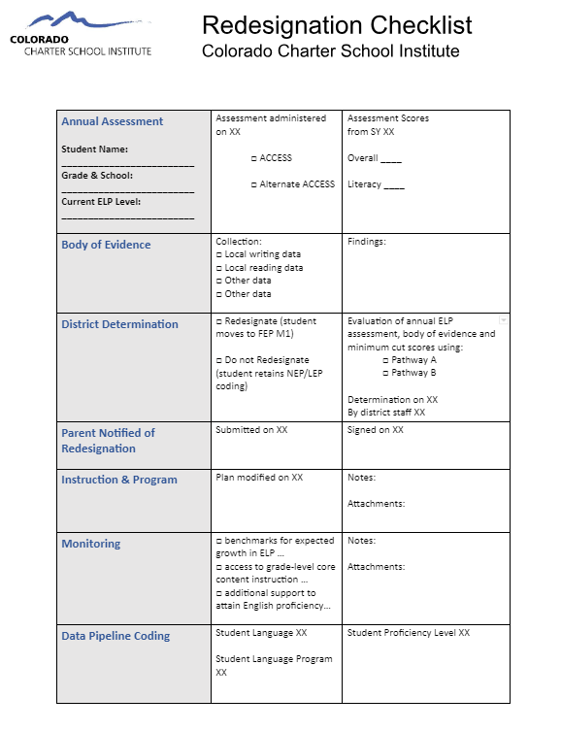
Redesignation Checklist

Slide 42
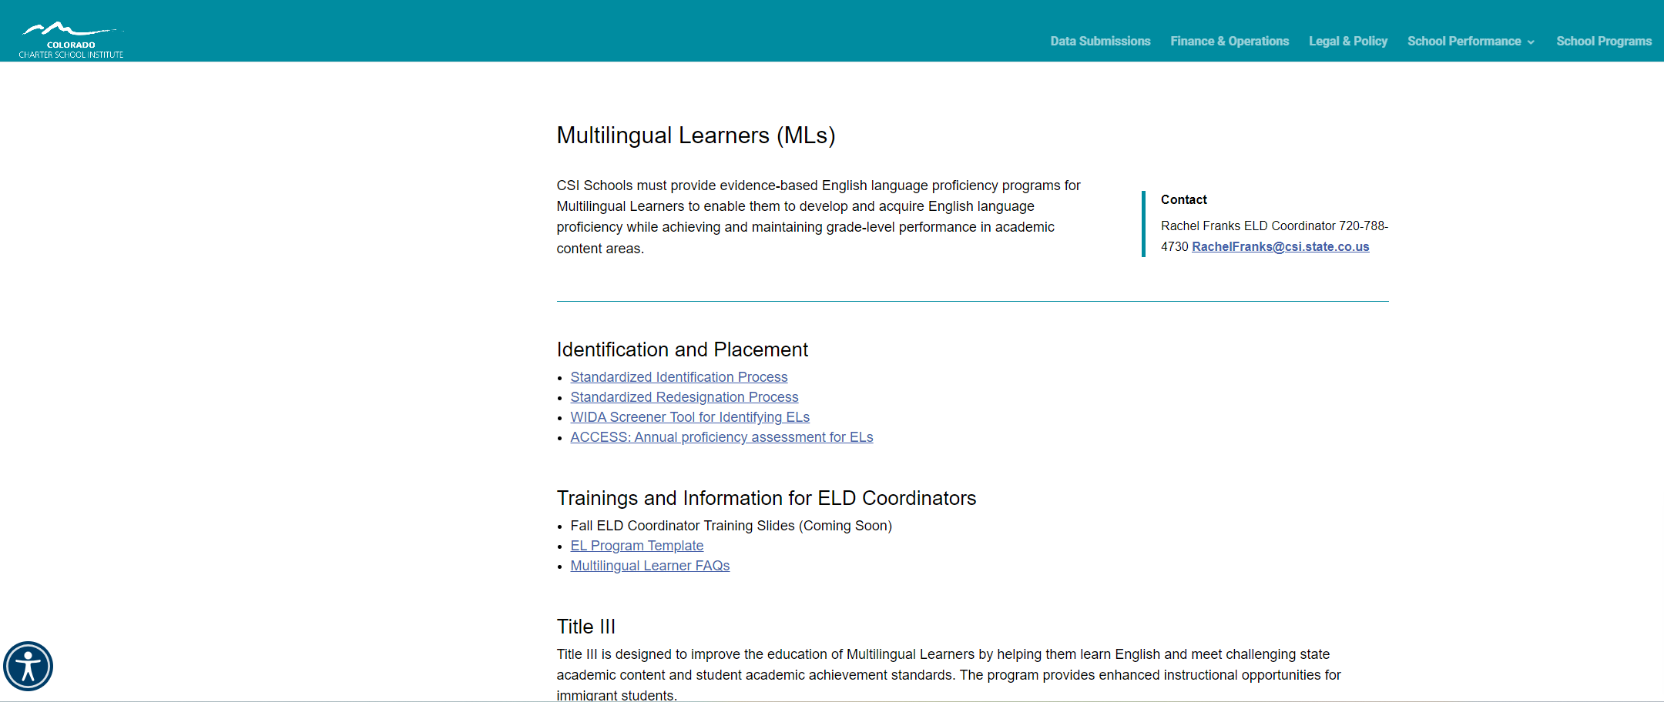
CSI Resource Site

Slide 43
Redesignation Process
Redesignation and placement decisions
Update SIS with new coding prior to October Count
Teachers notified as soon as updated placement decided

Slide 44
ACCESS Results
Achievement results available through WIDA AMS site.
Coordinate with school leader/school assessment coordinator to gain access to growth results and previous school year data.
New this year: Paper testing in grades 1-12 will only be available for students who need paper testing as an accommodation as documented in their IEP/504 Plan.
Testing Window:
January 8th, 2024 - February 9th, 2024.

Slide 45
Interpreting ACCESS growth
SGP: Student growth percentile
AGP: Adequate Student Growth Percentile (AGP) required for this student to be considered "on-track-to-standard"

Slide 46
October Count Coding
ACCESS test rosters are pulled from the preliminary list
October 2nd – All students coded correctly
Audit – WIDA Screener Score Reports should be printed and filed!

Slide 47
Coding Check for Understanding:
Coding must be completed in your SIS for accurate ACCESS rosters by:
a. January 8, 2024
b. August 16, 2023
c. October 2, 2023

Slide 48
Professional Development and Title III

Slide 49
Professional Development
Teachers working with ELLs must receive ongoing professional development related to supporting ELLs in the classroom.
Schools receive ELPA (state), Title III, and Title I money, which must be used to support ELLs, including ongoing, targeted professional development.
CDE Licensing Requirement
Licensed educators seeking to renew their professional license must complete or demonstrate completion of professional development activities equivalent to 45 clock/contact hours.

Slide 50
CSI Provided PD/Training Opportunities
Monthly virtual PD Power Hours
In-depth Workshops - TBA
Aligned with CLDE standards, may be used for license renewal requirement
Click here to access a Google doc with links to monthly Power Hours!

Slide 51
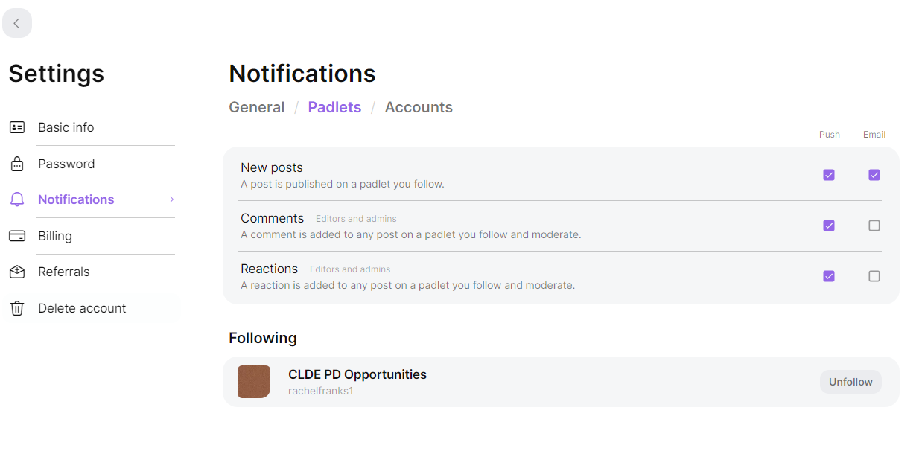
Padlet
CLDE PD Opportunities
To be notified of updates: Settings > Notifications > Padlets > New Posts

Slide 52
WIDA Screener Overview/Refresher
August 16, 2023 8:00-9:00am
Note: This does not replace the WIDA trainings. Anyone administering the WIDA Screener must complete the trainings in the WIDA Secure Portal.

Slide 53
Title III
Title III, Part A is a supplemental grant under the Elementary and Secondary Education Act (ESEA) that is designed to improve and enhance the education of English learners (ELs) in becoming proficient in English, as well as meeting the Colorado Academic Content standards.
Annual local education agency (LEA), including district or consortia, allocations are based on the number of English learners reported through the annual Student October Count.
CDE Quick Reference Guide
ELPA vs. Title III – Required and Allowable Uses (CSI Resource Site)

Slide 54
Migrant Education
** Please work with school personnel (registrar, office staff, etc.) to finalize a system.
Parent/Guardian completes enrollment form or School Food Authority form and indicates migrant status.
Upload the form to G Drive (you should have access to this).
Email Rachel that a form has been uploaded.
I will contact our regional liaison.
Liaison will contact the school with resources and services.

Slide 55
Migrant Education (CDE)
The Migrant Education Program (MEP) provides supplemental support to eligible migrant children and youth. The purpose of the program is to ensure that migratory children are not penalized in any manner by disparities among curriculum, graduation requirements, academic content and student academic achievement standards, and ensure that migratory children are provided with appropriate educational services and opportunities so they can succeed in school and graduate from high school being postsecondary education or employment ready.
The Migrant Education Program may serve children from birth to the age of 21 who are eligible for a free public education under State Law. In order to qualify for services, children must have moved within the past three years, across state or school district lines with or to join a migrant parent or guardian who has obtained qualifying temporary or seasonal employment in agriculture, fishing, or dairy.

Slide 56
What to expect from me
Quarterly email communication
Monthly Power Hours (with reminders)
Tentative in-person workshop(s)
1:1 meetings by request (in person or virtually)
Reach out anytime!!!
Follow up email today with recording, action items, and needs survey.

Slide 57
Final Poll:
I left today with a clear understanding of my roles and responsibilities as the ELD Coordinator at my school.
a. Agree
b. Neutral
c. Disagree

Slide 58
For Your Reference:
CSI Resource Site
Standardized Identification Process
Standardized Redesignation Process
Padlet for PD Opportunities
Monthly ELD Power Hours
ELD Guidebook

Slide 59
CSI ELD
Support Contacts
ELD Coordinator
Rachel Franks
rachelfranks@csi.state.co.us
720-788-4730
WIDA testing support
Kali Winn
Assessment Coordinator
KaliWinn@csi.state.co.us 303-532-7403

