Slide 1
23-24 READ Act
Fall Training

Slide 2
Agenda
READ Act
CSI Resource Site Tour
Newsletter Listserv
Podcast Plan
23-24 Early Learning Calendar
Components of the READ Act
Programming
Assessment and Identification of SRD
READ Plans
READ Data Collections

Slide 3
CSI Resource Site Tour
Find and share one thing from the Early Learning page.
Find and share one thing on the READ Act home page and share one thing you see.
Find and share one link to a resource and where it takes you.
Quiz
What are the three sections of the Early Learning section?
Where will you find the archived Ready, Set, READ newsletters?
What types of resources are there for for READ plan guidance?

Slide 4
RReady, Set, READ!
Newsletter, share your successes, pictures and celebrations.
Podcast, share your ideas for episodes, get
interviewed
Listserv, email willynwebb4@gmail.com

Slide 5
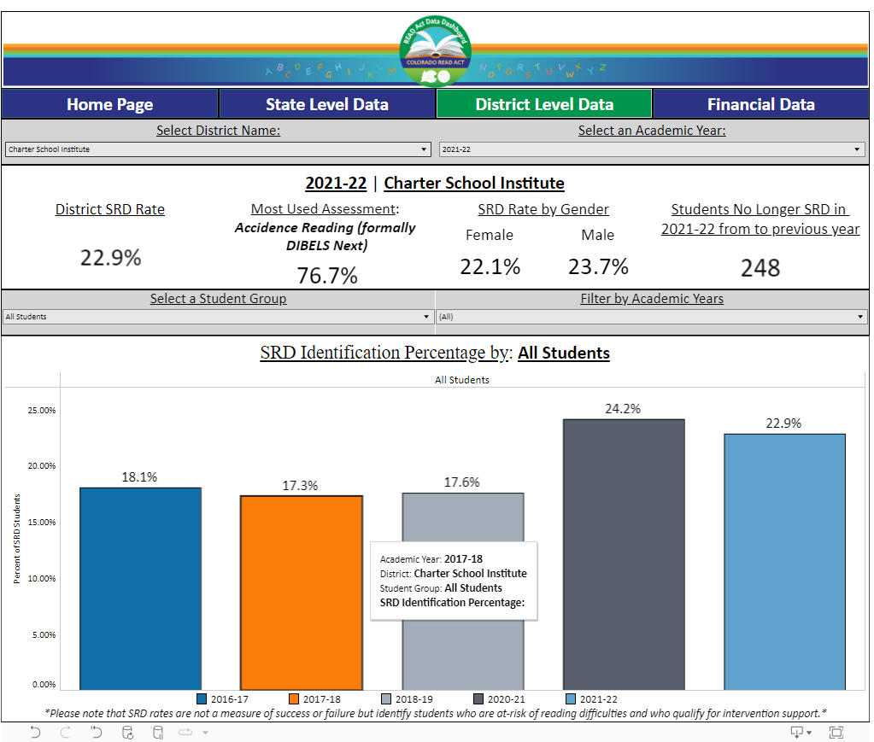
READ Data Dashboard

Slide 6
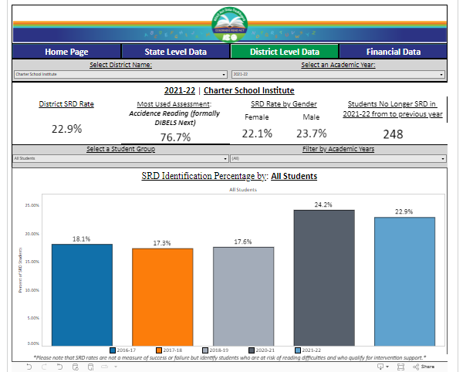
SRDs Exits Added to CARS 3.0
You may have heard that READ Plan exits as a data point has been added to the CARS 3.0.
The question added is “How is the school supporting schools to read at grade level?”
This is data already collected and requires no more work for the schools.
It will elevate the efforts you are making without rating you on it. READ plan
exits (students no longer SRD) are reported at the district/authorizer level on the CDE READ Act Data Dashboard

Slide 7
READ Act Approved Lists
Instructional Programming
Core
Supplemental
Intervention
Professional Development

Slide 8
READ Assessment Overview
Assess
Identify and Plan
Data Submission
All K-3 students
Identify students with SRD (significant reading deficiencies)
Create/update READ plans
Communicate with parents
May: Submit EOY assessment data
Within 30 (K=60) days of the first day of school
Repeat MOY and EOY

Slide 9
READ Assessment Requirements
Assessment Requirement | Kindergarten | 1st-3rd grade
Administer approved interim assessment to ALL K-3 students | During first 90 calendar days of school year. If administered within first 60 calendar days of school year, may count as literacy component of the school readiness assessment. | Within first 30 calendar days of a student's first date of attendance
If a student scores below the cut-score on the approved interim assessment, the student must be assessed using a state board approved diagnostic assessment within 60 calendar days of the initial administration of the interim reading assessment.
Repeat assessment process at Middle of Year (depending on charter contract) and End of Year (required)

Slide 10
READ Assessment and ELLs
ELLs must be assessed under the READ act. The ONLY exception is for designated NEPs who are also new (1st year) to a US school.
**Note: this does not mean new to your school- must be new to the US schooling system.
Funding implications
Follow same guidelines for READ plans; however, consider including ELD- specific goals
Rachel Franks, ELD Coordinator rachelfranks@csi.state.co.us
READ Plans & ELD Presentation Sept 13th

Slide 11
READ Assessment and SpEd
Three pathways:
General READ implementation using selected approved assessment
If there is an accessibility issue with the school’s assessment of choice, assess with one of the other state-approved assessments that will yield a valid score
If student is unable to access any of the approved assessments, CDE has established alternative assessment pathways. Reach out to CSI for support.

Slide 12
Identifying SRD In grades K-3, a determination that a child has a significant reading deficiency in English will be based on: In grades K-3, a determination that a child has a significant reading deficiency in English will be based on
3.02(A) A child scoring below the cut-score for a significant reading deficiency on a state board approved interim assessment and
3.02(B) Results from a state board approved
diagnostic assessment that identifies a student’s
significant reading deficiency in one or more of the following components of reading: phonemic awareness; phonics; vocabulary development; reading fluency including oral skills and reading:
;
and
3.02(C) A body of evidence
Not part of Spring Data Collection at this time (may change).

Slide 13
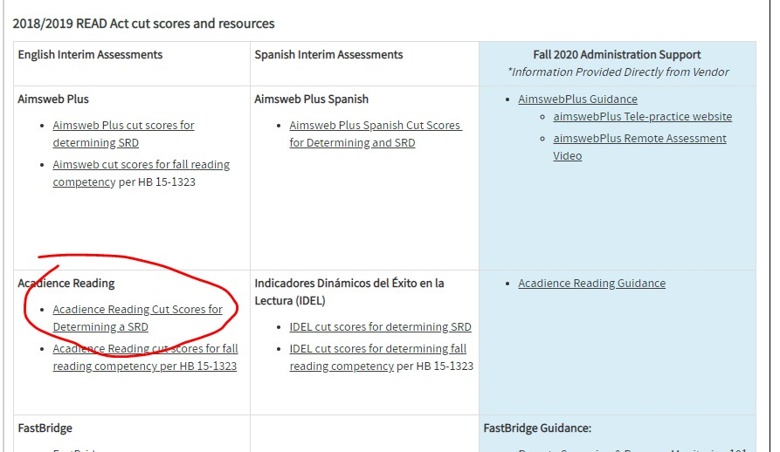
Identifying SRD
3.02(A) A child scoring below the cut-score
Cut Scores

Slide 14
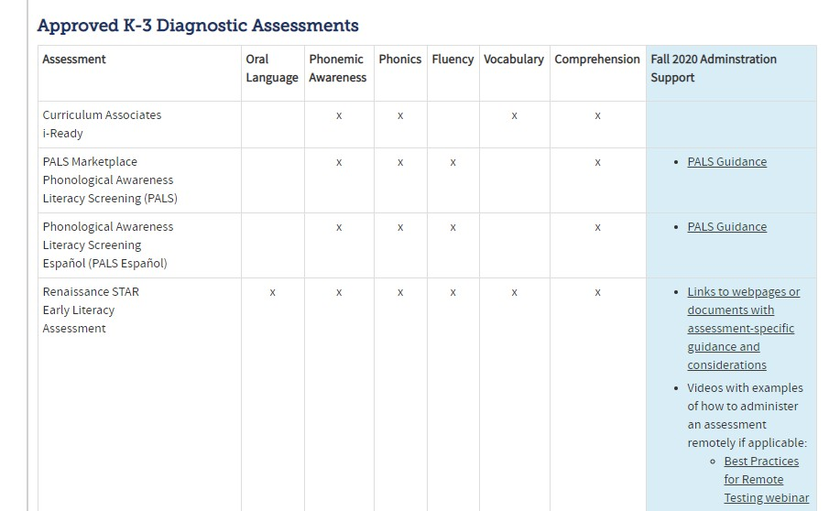
Identifying SRD & Targeting Interventions
3.02(B) Results from a state board approved diagnostic assessment (approved list)

Slide 15
Identifying SRD-Scores Count
3.02(C) A body of evidence
“Within 60 days of the interim assessment, an approved diagnostic assessment must be given to determine /confirm specific areas of skill deficiency. Rule specifies that during this 60 day window, the student should receive scientifically- based and evidence-based core and intervention instruction, and a body of evidence should be collected”
“A body of evidence, at a minimum, shall include scores
on formative or interim assessments and work that a
student independently produces in a classroom,
including but not limited to the school readiness assessment”

Slide 16
Quick Check Poll
Is a child SRD if he/she scores below the cut score on the interim, but not on the diagnostic?
Should a student with a home language other than English be given the assessment in his/her native language?
Does the body of evidence trump the assessment scores?

Slide 17
READ Plans
Required regardless of instruction delivery model
Schools must use the results of the diagnostic assessment to create a READ plan
Schools monitor ongoing progress using approved interim assessment
Student remains on a READ Plan until they reach grade-level proficiency in reading

Slide 18
READ Plan: Resources
CDE READ Plan Resources
READ Plan Checklist
READ Plan Sample
Writing goals and objectives for READ Plans
READ Plans and IEPs/ READ Plans and ELLs
Sample Parent Communication
Template
READ and other plans
Working Group

Slide 19
READ Plan: Contents
Interim and diagnostic assessment results, including specific deficiencies identified
EOY goal as well as ongoing (short-term) goals
Interventions/services (beyond 90m universal instruction)
Progress monitoring (how/when is it happening)
Family communication and involvement in supporting literacy objectives
Supplemental services

Slide 20
Updating Current READ plans
READ plans, once in place, must be updated at least once a year
How do you know if a newly enrolling student comes in with a READ plan?

Slide 21
Exiting READ Plans
K-3: Students may be exited from their plan once they reach grade level proficiency in reading (according to state-approved interim assessment)

Slide 22
READ Data Collection Timeline
Training in March
Each school’s file is due to CSI on or before May 18 (this date may change)
Clearing errors takes several weeks; someone at your school must be available to resolve errors through early June.
Summary file available in G-Drive in July.

Slide 23
Support for Success!
Support:
Newsletter, Podcast, Connections
CSI Resource Site
Contact:
Willyn Webb willynwebb@csi.state.co.us
• 303-532-6262

Slide 24
READ: What to do now…
1 2
3
Create or implement system to ensure READ timeline is adhered to.
60 day diagnostic window
Set assessment windows
Choose a platform for plans.
Develop Parent communication plan.
Think about parent involvement.
Collect Data with the Spring Data Collection in mind.
Implement READ plan interventions, meetings, cycles of progress monitoring and plan review.
Email your READ assessment calendar to Willyn by Aug 25th
Fill out the Quick Check!

Slide 25
H Helpful Links
23-24 Early Learning Calendar
Literacy Transparency Icon & Instructions
CSI Resource Site
READ Plan Checklist
CDE Guidance READ Act and English Learners

