Slide 1
The Data Submissions Process Step 5 (Review & Certify Data)
Data Submissions
Recorded July 2023
Notes:
Welcome to the CSI Data Submissions Team Beginning of the Year Training series. In this module, we will discuss Step 5 of the Data Submissions Process, which focuses on reviewing and certifying data.

Slide 2
The Data Submissions Process
2
Notes:
The Data Submissions Process is made up of five steps, as seen here. In this module, we will highlight Step 5, which includes the final review and certification of data.

Slide 3
Data Collection Summary Report
Reports provided by CSI (in G-Drive) upon Level 1 and 2 error clearance (if applicable)
Team effort to review & certify accuracy of data
All staff involved with data should review applicable sections (i.e. SPED staff, EL staff, Registrar, etc.)
Last opportunity for schools to make final edits
Note: Early error clearance will provide an opportunity for more time to review and reach out to CSI for changes if necessary
Notes:
Once you have submitted a set of files that are error-free at the state level, then the CSI data submissions team will provide a summary and certification report. This provides relevant school contacts with the opportunity to review both the raw data and aggregated counts of the data the school has submitted.
While school data submissions contacts should be reviewing data throughout the collection, the summary report serves as the last opportunity for schools to make final edits. This review includes not only the school’s data submissions contact, but also relevant staff identified within the certification tab of the report.

Slide 4
Importance of Thorough Review
Schools are responsible for thoroughly reviewing data for accuracy. An internal process for this review is recommend. The collection data reported to the State and Federally is used for:
Funding
Accountability
Compliance Monitoring
In addition, CSI uses the data for the CSI Annual Review of Schools (CARS), Student Screener, enrollment projections, the determination of tiered supports, among others.
Please review all data thoroughly and reach out to CSI when changes or updates are necessary
4
Notes:
As you are reviewing your summary report, it is important to keep in mind that the data for each collection is used for Funding, Accountability and Compliance Monitoring, so a thorough review is necessary to ensure you stand behind what you submit. The information also is used for several CSI specific monitoring including CARS, the student screener, enrollment projections and tiered supports, among others. If issues are identified at this step, please reach out to CSI to request changes.

Slide 5
Data Validation Process
Read instructions and review the counts in the summary tab
If issues discovered, filter the Snapshot tab to determine specific students/staff
Reach out to staff for Special Population data review (EL, SPED, Discipline etc.)
Verify the accuracy of Exit Dates and Types – paying attention to dropouts(40) and graduates(90)
If discrepancies are discovered, submit new files and reach out to CSI
Once correct, ensure all applicable parties sign and return by the deadline
Review all collection-specific tabs for accuracy
5
Notes:
In terms of the actual steps that should be done during your summary report validation review, this slide lists them in order and includes (READ STEPS). Hopefully, this will give you a better picture of what should be done and when in terms of validating the summary report.

Slide 6
Summary Report Tabs
Varies depending on Collection. All should include an Instructions tab, a Snapshot tab and a Certification Page
Remaining tabs will vary based on collection and information necessary to review
All tabs should be reviewed thoroughly and involve multiple staff depending on specialties
October Count
December Count
Human Resources
6
Notes:
Each summary report contains a variety of tabs to review and is dependent on which collection you are working with. For example you will see the different tabs associated with October Count, December Count and Human Resources listed here. The common tabs among all three would be the Instructions, the Snapshot and the Certification tabs. It is important that each tab is reviewed thoroughly by yourself and all other applicable staff, regardless of what collection you are working on.

Slide 7
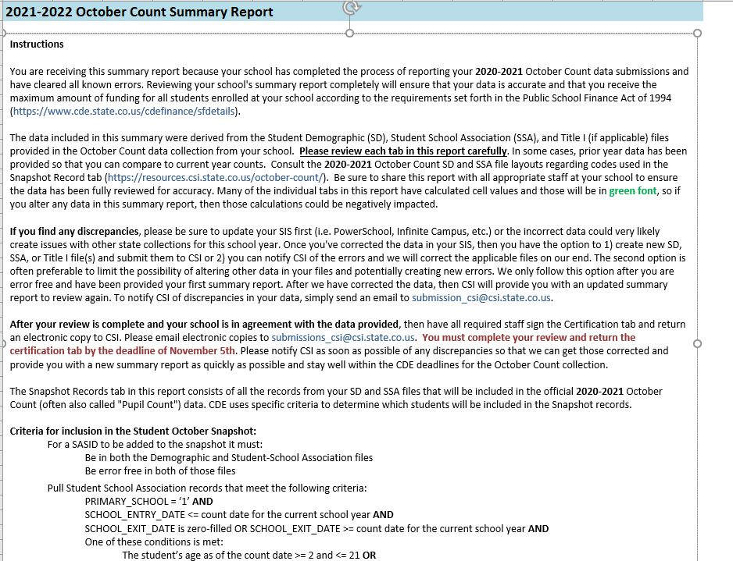
Instructions Tab
Always read the instructions tab first.
Provides details on data files utilized and snapshot inclusion
Ensure you follow the data discrepancy process instructions
Includes descriptions of all tabs report contains
Shows file update and signature deadline dates
7
Notes:
When reviewing a summary report, the first tab should always be the instructions tab. Some additional details regarding this tab are listed on this slide and include:
(READ Slide)
So really this tab provides you all the information you need to know in proceeding to the actual data reports and counts tabs of this document.
Ensuring you read and fully understand the instructions and due dates is key in moving forward with your review.

Slide 8
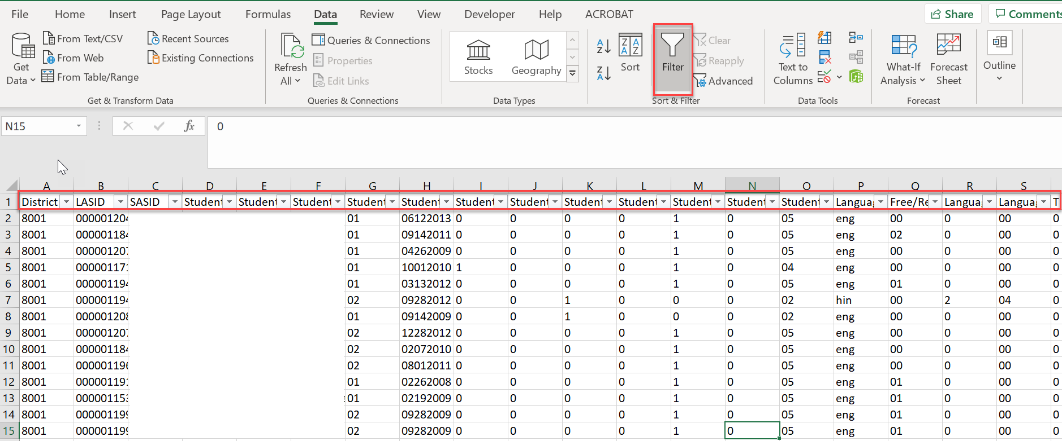
Snapshot Tab
The snapshot tab is a listing of error-free students, staff or other collection specific information that is being reported to the state.
Snapshot data can be filtered to review specific sub-sets (i.e. grade level, gender, exit types, Language, FRL, etc.) of students that make up the total counts on the summary tab.
Review to ensure that all are not only reported on all files but are being included in the snapshot.
8
Notes:
The next common tab across collections that we will discuss is the Snapshot tab.
The snapshot tab is the total listing of error-free students, staff or other collection specific information that is being reported to the state.
Snapshot data can be filtered to review specific sub-sets (i.e. grade level, gender, exit types, Language, FRL, etc.) of students that make up the total counts on the summary tab.
Review to ensure that all students, staff etc. are not only reported on all files, but are being included in the snapshot.
This really gives you a full picture of the raw data submitted by the school and makes up the numbers in the counts on any summarizing details the report has.

Slide 9
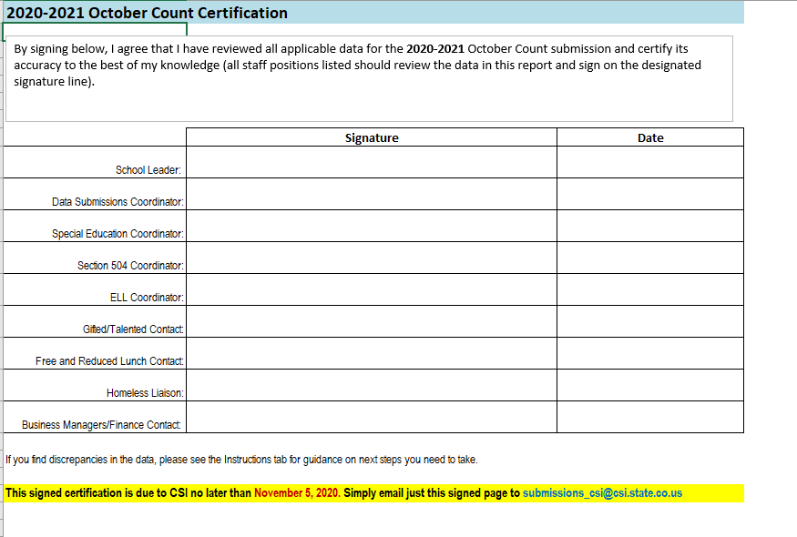
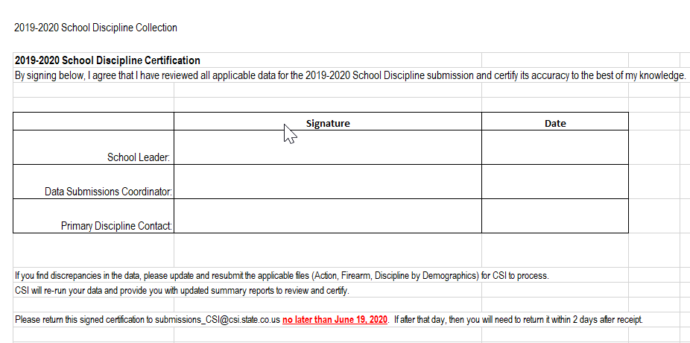
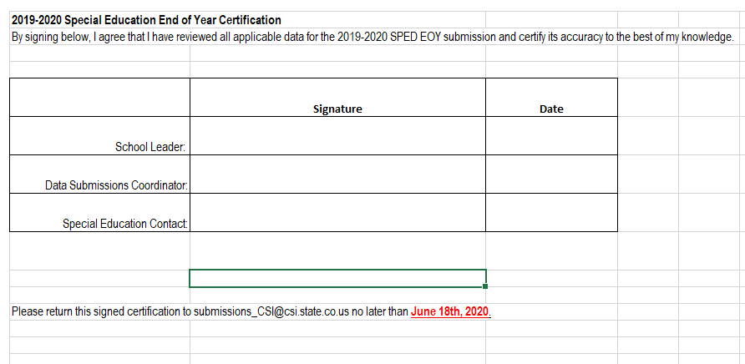
Certification Tab
Collection certifications require a team effort on reviewing data and signatures.
Ensure that all team members are aware that they will need to review and sign off on the data.
Allow plenty of time before final deadline to review in case changes are needed.
9
Notes:
Lastly, we have the certification tab. Each report will have a certification tab in which all applicable staff must sign to attest to the accuracy of the data included in the report. As you can see here in these screenshots, the number of staff who needs to sign the certification really varies based on the collection and what information is being collected. For example the October Count collection requires many staff to sign, including the special education coordinator, the 504 coordinator, the ELL coordinator among several others, while the school discipline collection only requires the school leader, the data submissions coordinator and the Primary Discipline contact. This is important to note to ensure all staff have adequate time to review their pertinent sections of the report and sign off on it.

Slide 10
Thank you!
For questions contact the CSI Submissions Inbox at: submissions_csi@csi.state.co.us
Notes:
Thanks so much for reviewing this training on summary certification reports. If you have questions while reviewing, feel free to reach out to the submissions inbox! Have a great day!

