Slide 1
The Data Submissions Process Step 4 (Troubleshooting & Resolving Errors)
Data Submissions
Recorded July 2023
Notes:
Welcome to the CSI Data Submissions Team Beginning of the Year Training series. In this module, we will discuss Step 4 of the Data Submissions Process, which focuses on troubleshooting and resolving errors in data.

Slide 2
The Data Submissions Process
2
Notes:
The Data Submissions Process is made up of five steps, as seen here.
The first step is to prepare for the data collection by reviewing all relevant resources.
The next step (Step 2) is to collect, enter, and update data in the school’s student information system (or SIS). For most CSI schools, PowerSchool or Infinite Campus is the SIS.
Then, in Step 3, school contacts will then submit files to CSI.
In Step 4, the one we will be discussing in this training,, school contacts will review and correct any errors that arise.
Finally, in Step 5, the collection cycle is completed with the final review and certification of data.
You’ll notice that steps 2-4 will be repeated until the data is error-free, which can take multiple iterations depending on the data collection. Keep in mind that all the steps are outlined in the data submissions handbook as well.

Slide 3
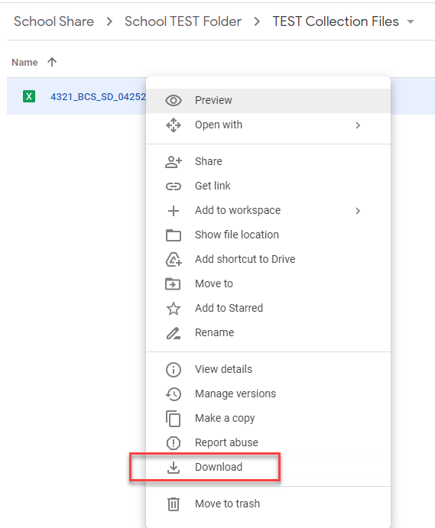
Download Error Reports from G-Drive
Navigate to the Error Reports folder within the appropriate collection folder.
To download a file to your computer, simply right click on the file and then pick the Download option
You cannot drag and drop files from shared folders in G-Drive to your computer.
Available Resources:
G-Drive Instructions: https://resources.csi.state.co.us/data-security/
Notes:
The first step is to download the error reports from G-Drive.
In the respective collection folder, navigate to the error report folder.
To download a file to your computer, simply right click on the file and then pick the Download option
You cannot drag and drop files from shared folders in G-Drive to your computer.

Slide 4
State Reporting Error Types
Level 1 Errors – Errors related to specific file that you are working on. Typically, you will see one error report for each file submitted (if applicable).
Level 2 Errors – Errors due to discrepancies across files in a collection or even across collections. Clearing errors will require understanding on which file contains information that is incorrect. Not all collections have Level 2 errors (ex. School Discipline)
Additional Errors – CSI provided additional errors not included in error reports. Will require additional steps to clear
SE404 errors for Student Interchange
SY108 errors for SPED Interchange
SP149 errors for the Student Demographic file (OC and EOY)
Warnings – All warnings should be reviewed for data accuracy and adjustments should be made if necessary. Several warnings will turn into errors at later phases of a collection.
4
Notes:
Next, now that you have reviewed and submitted your files, lets talk about the types of errors you may receive:
Level 1 (read)
Level 2 (read)
Additional errors: These may or may not be on your traditional error report depending on the error type and have caused confusion for several schools in the past so I thought I’d touch on them.
SE404 – this is a level 2 error on the student interchange and involves students who have a zero filled exit in the previous year, but no record this year. This means either they were anticipated in coming back or left so late in the year that they couldn’t be exited. These errors are different as there is no record of the student on the file, yet they are flagging for an error. Typically to resolve, the school should create a one day record for the student in the current year or reach out to CSI and we can submit an exception.
SY108 – This essentially is the same as an SE404 error, but for special education. These will definitely come in a separate file where you can provide a basis of exit and resubmit to us.
SP149 – You will see these errors on your October Count and EOY SD submissions, but CSI will take care of those. Essentially these students are at multiple CSI schools within the same year, so CSI has a process to remove a duplicate SD record on those. One way that you can help with these is be sure each student receiving this error has accurate entry and exit dates and has either an entry or exit type of 11 – transfer in the same district. We will be reaching out if this is not done, so being proactive helps.
Also, you will typically see warnings within most submissions. Make sure to review all warnings carefully and make changes if necessary.

Slide 5
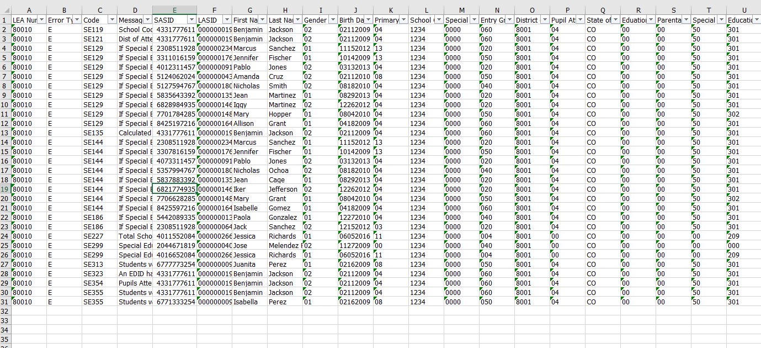
Reviewing Error/Warning Reports
Errors should be resolved within the school’s SIS. Corrections should not be made on error reports.
All warnings should be reviewed for accuracy and updated if necessary.
After updating the SIS, schools should submit new files to CSI for processing
5
Notes:
This is a screenshot of a typical error report with all the PII replaced with fake information. I added this to emphasize the approaches that can be taken when going through your error reports, which can seem quite daunting. This is definitely person specific, but error reports can always be filtered and worked through in various ways, but I found that filtering by SASID or error code is the best approaches. These corrections should never be made on error reports and always in your SIS. As another reminder, please review all warnings for accuracy. If the data is correct, leave as is, but if not then make the appropriate updates.

Slide 6
Error Clearance Approach
Reports can be filtered in many ways to complete error clearance, including:
By Name or SASID
By Error Code
6
Notes:
As mentioned in the previous slide, there are two main approaches to error clearance and both involve using the filter option. This is located on the Data tab under sort and filter. The first option is to filter by name or SASID. That way you can clear up all the errors on that specific person while on their record in your SIS or plan management system. The other option would be to filter by error code and correct the same issue on all students impacted. Both work well and it tends to be personal preference. As you are going through your errors, be sure to try and address all issues prior to submitting again rather than fixing a couple things and resubmitting. If you don’t know what an error means, you can always review our troubleshooting errors spreadsheet and then reaching out to CSI if it still doesn’t make sense. We would rather you clarify than guess on how to clear an error.

Slide 7
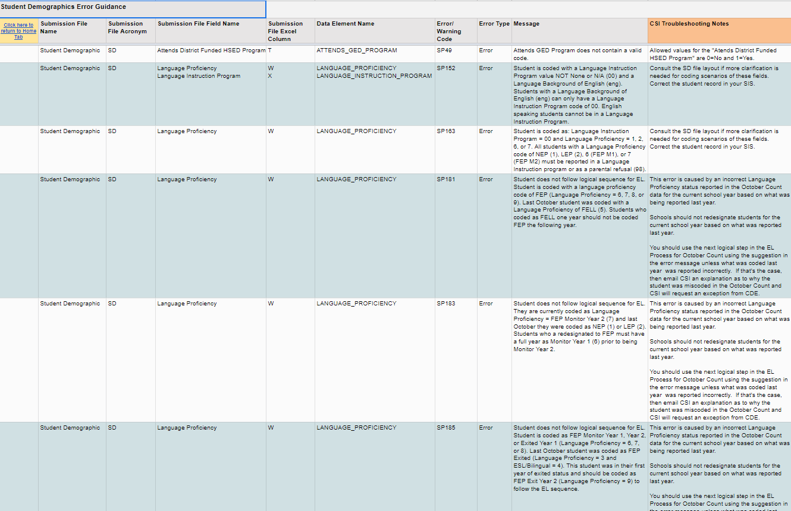
CSI Troubleshooting Errors Resource
One of the strongest tools you have access to.
24 tabs of common errors across all collections
Living document: we always appreciate hearing your troubleshooting solutions
Better when used in conjunction with collection specific File Layout – CSI additions
Available Resources:
CSI Troubleshooting Document: https://resources.csi.state.co.us/troubleshooting-errors/
Notes:
So when talking about the troubleshooting document, (read slide).
Essentially it has a tab for each file submitted in each collection, as well as level 2 and showing each error that you may potentially encounter.
This gets updated each year and CSI adds notes to most errors showing CSI specific tips on correcting the errors.
Sometimes the error message can be confusing, so hopefully this hopefully will provide clarification. As mentioned, if you encounter errors that may not have the best guidance, but you have figured out how to resolve, feel free to let us know and we can add to the troubleshooting doc!

Slide 8
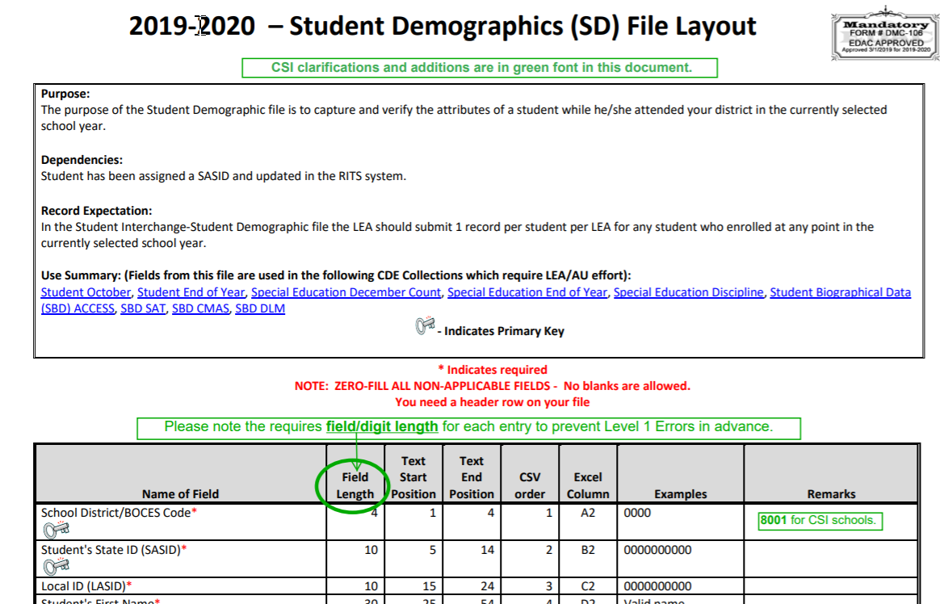
Troubleshooting Errors Resource and File Layout and Definition Documents
Available Resources:
SD File Layout and Definitions Document: https://resources.csi.state.co.us/student-demographic-file-layout-csi-additions/
SSA File Layout and Definitions Document: https://resources.csi.state.co.us/student-school-association-file-layout-csi-additions/
8
Notes:
So as mentioned in the previous slide, the troubleshooting document can be used in conjunction with the File Layout and Definitions documents to assist in clearing errors. Each tab of the document shows the actual field name that is generally being impacted and can be tied directly to the field names located on the File Layout.
If you navigate to that field within the file layout, you will see a definition of that field and potential coding options that can be used.
As you can see here, the School District/BOCES followed by the SASID and LASID.
Hopefully using these in conjunction with one another will make error clearance an easier process!

Slide 9
Other Error Clearance Resources
Resources listed below are available for most collections
Resource | Description
Data Validation Strategies Checklist/Toolkits | Previously discussed, but is a great option when reviewing errors to determine the correct coding
CSI Collection Specific Trainings | CSI posts collection specific trainings annually for each collection and includes a “General Overview” and a “New This Year” training
Coding Scenarios Documents | Many collections have coding scenarios documents to determine correct coding in topics such as: English Learners. SPED Participation, Human Resources, etc.
CSI Staff – Submissions Inbox | If all resources have been reviewed and you still need assistance, reach out to the submissions inbox at: csi_submissions@csi.state.co.us
All collection resource pages can be accessed from CSI Data Submissions Library
9
Notes:
This slide lists all the other Resources CSI has that may be helpful during error clearance or any other step of the process. These will be described further in other boot camp modules and also collection specific trainings, but it is good to be familiar with these when going through the error clearance process. First you have the data validation strategies checklist, which goes through common errors, issues or questions and how they should be coded. You also have collection specific trainings and the coding scenarios documents, which are specific to some collections. It helps determine the best coding options given specific scenarios. Lastly, once all resources are reviewed and you are still unsure how to clear errors, feel free to reach out to the CSI submissions inbox and we will be more than willing to help!

Slide 10
Exception Requests
CSI believes it is more important to submit accurate data over error free. If you feel your data is correct, follow these steps:
Discuss error with CSI submissions staff
Submit the request in writing to the CSI Submissions Inbox
CSI will process the request with CDE
CDE will review the request and either approve it or provide additional coding options for the scenario and contact CSI
CSI will contact school to notify if exception was approved or additional file changes are necessary
10
Notes:
If you believe you have a circumstance where the data for a student is completely accurate, but you are still receiving errors? This might be a perfect situation for submitting an exception request and to do so, you must follow these important steps:
Discuss error with CSI submissions staff
Submit the request in writing to the CSI Submissions Inbox
CSI will process the request with CDE
CDE will review the request and either approve it or provide additional coding options for the scenario and contact CSI
CSI will contact school to notify if exception was approved or additional file changes are necessary
I can’t emphasize enough that CSI has a strong belief that data should be accurate over error free. Making changes just to clear errors, but reducing the accuracy of that data is not recommended and following this process of exception requests allow schools to provide error free data that is accurate!

Slide 11
Step 4 Resources & Supports
For additional support, consider reviewing of the following resources and optional exercises.
Resources to Review:
Securely sharing data with CSI Webinar
G-Drive Instructions
CSI Troubleshooting Errors Resource
11
Notes:
That concludes our module on Step 4 of the Data Submissions Process. For additional support and practice regarding the topics addressed in this module, please take a moment to review the resources listed here and consider completing the optional exercises.

Slide 12
Thank you!
For questions contact the CSI Submissions Inbox at: submissions_csi@csi.state.co.us
Notes:
Thanks so much for reviewing the step 4 – troubleshooting and resolving errors module. If you have questions, reach out to CSI, otherwise feel free to continue on to the step 5 module on summary certification reports.

