Slide 1
The Data Submissions Process Step 3 (Data Extract & Submission)
Data Submissions
Recorded July 2022
Notes:
Welcome to the CSI Data Submissions Team Beginning of the Year Training series. In this module, we will discuss Step 3 of the Data Submissions Process, which focuses on the extraction of data from the school’s data system and securely submitting the data to CSI.

Slide 2
The Data Submissions Process
Notes:
You will recall the Data Submission steps from earlier training. This module focuses on extracting and submitting files– Step 3 of the Submission Process. These steps are all discussed in detail in the Data Submission Handbook.

Slide 3
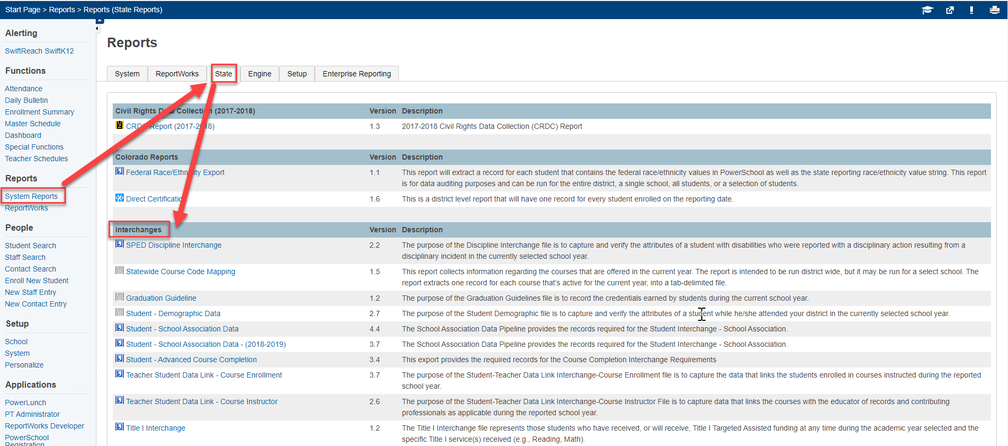
PowerSchool File Extractions
PowerSchool
Login→Start Page→System Reports→Select applicable files depending on Collection
Notes:
The next two slides contain path and screenshots to access the file extraction page for two commonly used student information systems, PowerSchool and Infinite Campus.
The first step in extracting a file from your student information system (or SIS), is to be logged into your school’s SIS. You will then navigate to the Reports section.
Upon login, PowerSchool users should click on System Reports on the left side menu bar. Then click on the State Report tab. This tab contains all the necessary options used to extract state formatted files for your system. In terms of the student interchange, the main files would be Student – Demographic and Student – School Association data. Other files may be necessary and are school dependent.

Slide 4
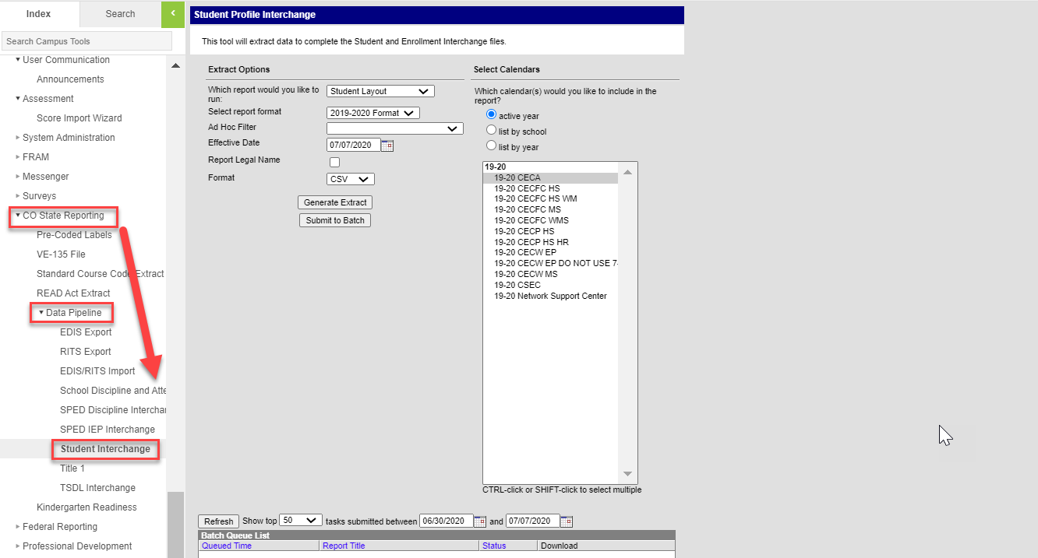
Infinite Campus File Extractions
Infinite Campus
Login→Start Page→CO State Reporting→Data Pipeline→ Select applicable files depending on Collection
Notes:
Infinite Campus users will scroll down to the CO State Reporting section on the left side menu bar upon login. Then click on data pipeline to access all the State reports. For the student interchange, you’ll select either Student Layout or School Association in the first prompt. IC also includes the capability to extract Special Education files along with all the other collections.

Slide 5
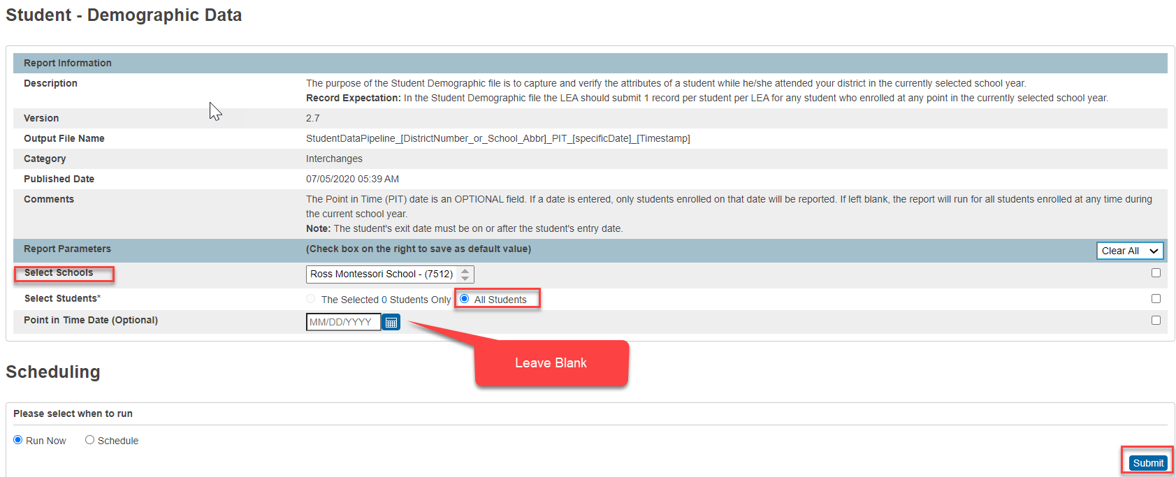
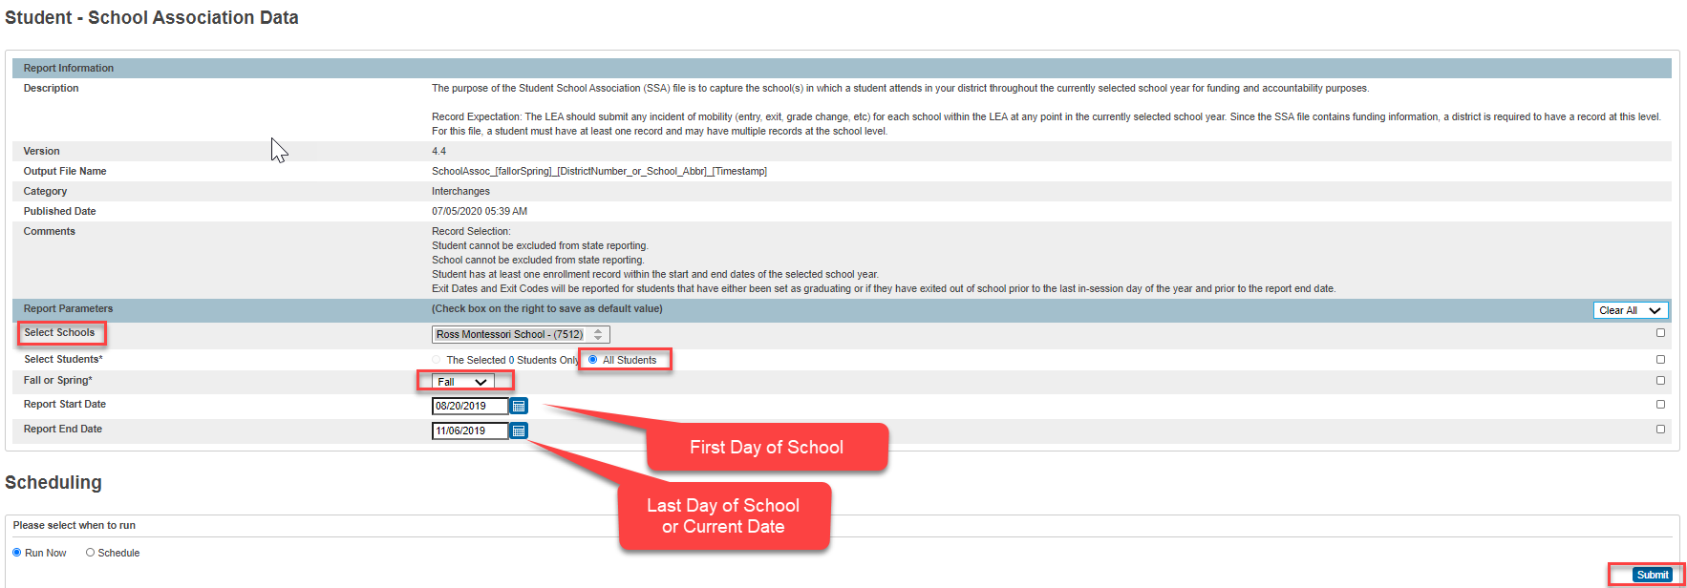
PowerSchool Extraction Prompt Example – Student Interchange
Available Resources: Colorado PowerSchool Student Interchange File Resources
https://docs.powerschool.com/USACO/colorado-reports-in-powerschool/reports/student-demographic-data
https://docs.powerschool.com/USACO/colorado-reports-in-powerschool/reports/student-school-association-data
Notes:
(NEXT) Let’s dive a little further into the actual reports necessary for the Student Interchange and specially how to complete the prompts in PowerSchool. For the Student demographic file, you just want to make sure that the proper school and all students are selected. In terms of the Point in Time, this generally will be left blank as well as it will only pull students active as of the date you specify. As for the School Association data, you’ll want to also ensure that the school and all students are selected. The Fall or Spring will vary if pulling for October Count or End of Year and the dates should be the first day of school and the last day of school or current date.

Slide 6
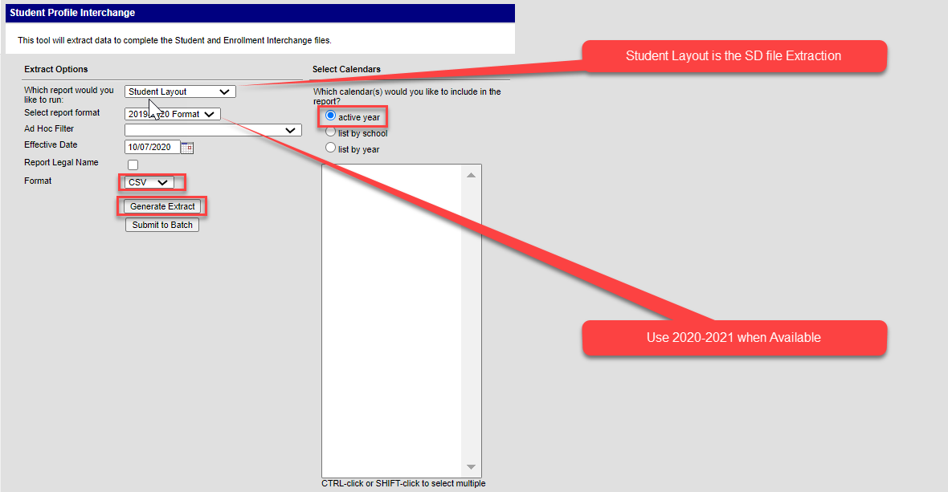
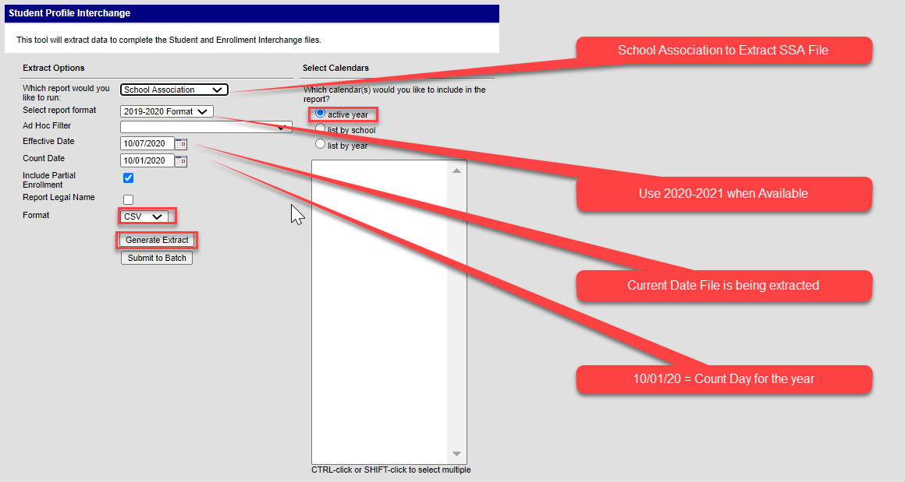
Infinite Campus Extraction Prompt Example – Student Interchange
Available Resources: Campus Community Student Interchange File Resource
https://kb.infinitecampus.com/help/student-interchange-colorado
Notes:
Jumping further into the prompts necessary for IC, you’ll notice that the first question on each of the reports is “Which Report would you like to run”. This is where you would select your Student Layout, School Association, or any other file you intend to extract for every collection. The format should be for the current year with the Ad Hoc left blank. Both files should be extracted as a CSV and then you just click generate extract. These files should go to your downloads folder.

Slide 7
File Naming Structure
Once files are extracted, access your Downloads folder to save your new files
Do not open the files prior to saving, which will result in a loss of leading zeros. Select the Save As option and save files to a pre-created folder
Always name files using the example below. If multiple files submitted in one day, use v2 at the end
File names should not contain spaces
School Code_School Name/Abbreviation_Interchange File Type_Date
October Count File Name Examples:
Student Demographic (SD) interchange file for Golden View Classical Academy
3393_GVCA_SD_09022021
School Student Association (SSA) interchange file for High Point Academy
0655_HPA_SSA_09022021
Notes:
Once you have successfully extracted your files for any collection, you want to go to your downloads folder to access them. You do not want to open the files directly as this results in a loss of leading zeros and many errors related to formatting. If available, you can also use the save as option. Once you have accessed the files from downloads, copy and paste them into a folder you want to keep them on your computer. These files will need to be renamed in accordance with CSI file naming standards. This slide lists examples for several collections on how to accurately name them – starting with the school code, underscore, school abbreviation, underscore, file type, underscore, and the date. If a school wants to submit multiple files in one day, they can add v2 at the end for version 2. It’s also important to mention that the name of the file cannot contain spaces. Files with spaces in the file name cannot be processed in CDE’s data pipeline and will require the file to be renamed.

Slide 8
Use G-Drive for File Transfers
Schools should exchange all sensitive data with CSI, including files with Personally Identifiable Information (PII) through G-Drive.
CSI’s Data Submissions Team will share G-Drive folders to school contacts with active Google (Gmail) accounts who have been officially designated by their school as needing access to specific folders as part of their job responsibilities.
If you do not yet have access, please email Submissions_CSI@csi.state.co.us
Notes:
The Charter School Institute uses Google Drive (G-Drive) for securely exchanging information with its schools.
Schools should exchange all sensitive data with CSI, including files with Personally Identifiable Information (PII) through G-Drive. Student and staff data, including information such as name (for students only; not staff), address, birthdate, SSN and other sensitive demographic data that can be associated with a specific person, should never be sent through email because it is not secure and the data could be compromised.
CSI can only share G-Drive folders to school contacts with active Google (Gmail) accounts who have been officially designated by their school as needing access to specific folders as part of their job responsibilities.
Each school contact will need their own individual Google account. School contacts will not be able to use a group Google email address.
A Google Workspace (formerly G-Suite) account through your school would be preferable to a free personal Google account.
If you do not yet have access to shared folders in G-Drive, please email the CSI Data Submissions Team as soon as possible.

Slide 9
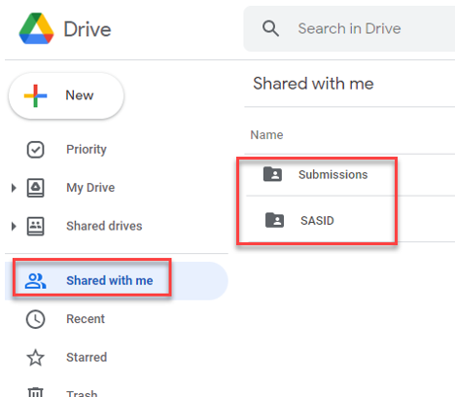
Upload Files to G-Drive
To upload a file, simply drag and drop the file into the appropriate folder.
Data collection files should remain in the native xlsx or csv format and not converted to Google Sheets.
Available Resources:
G-Drive Instructions: https://resources.csi.state.co.us/data-security/
Notes:
Now you are ready to submit the files to CSI through G-Drive.
If you have not been set up with access to the appropriate submissions folders, please email the CSI Data Submissions Team.
When you log in to your Google account, you will see one or more folders in the “Shared with Me” section. There are several separate folders available for each school that can be shared with approved school contacts (i.e., as a school submissions contacts, you may see the following separate folders: Submissions, HR, SASID, READ, etc.).
To upload a file, simply drag and drop the file into the appropriate folder. Data collection files should remain in the native xlsx or csv format and not converted to Google Sheets.

Slide 10
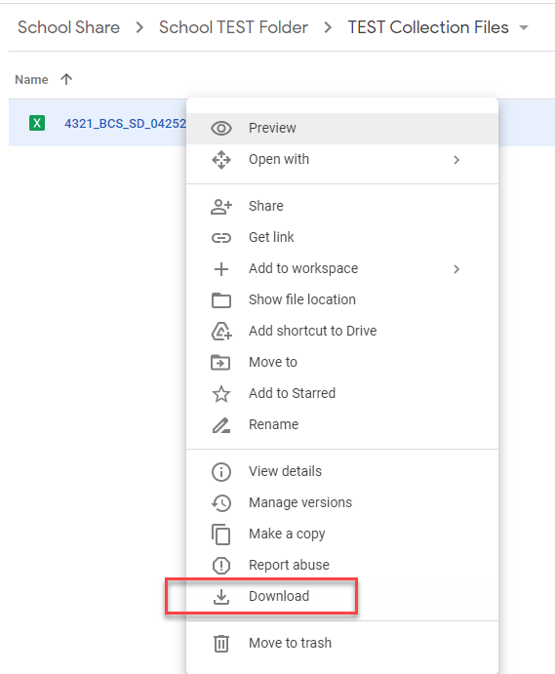
Download Files from G-Drive
To download a file to your computer, simply right click on the file and then pick the Download option
You cannot drag and drop files from shared folders in G-Drive to your computer.
Available Resources:
G-Drive Instructions: https://resources.csi.state.co.us/data-security/
Notes:
To download a file to your computer, simply right click on the file and then pick the Download option
You cannot drag and drop files from shared folders in G-Drive to your computer.

Slide 11
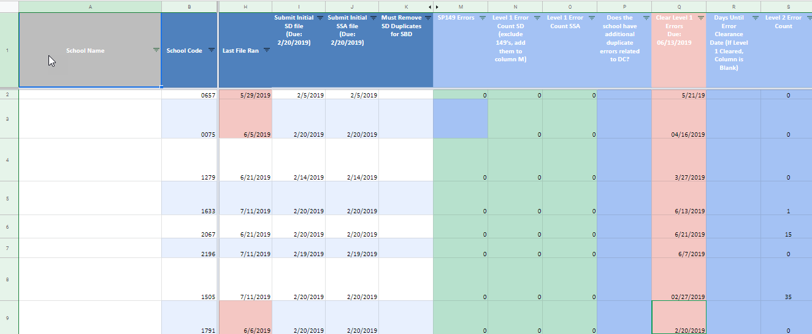
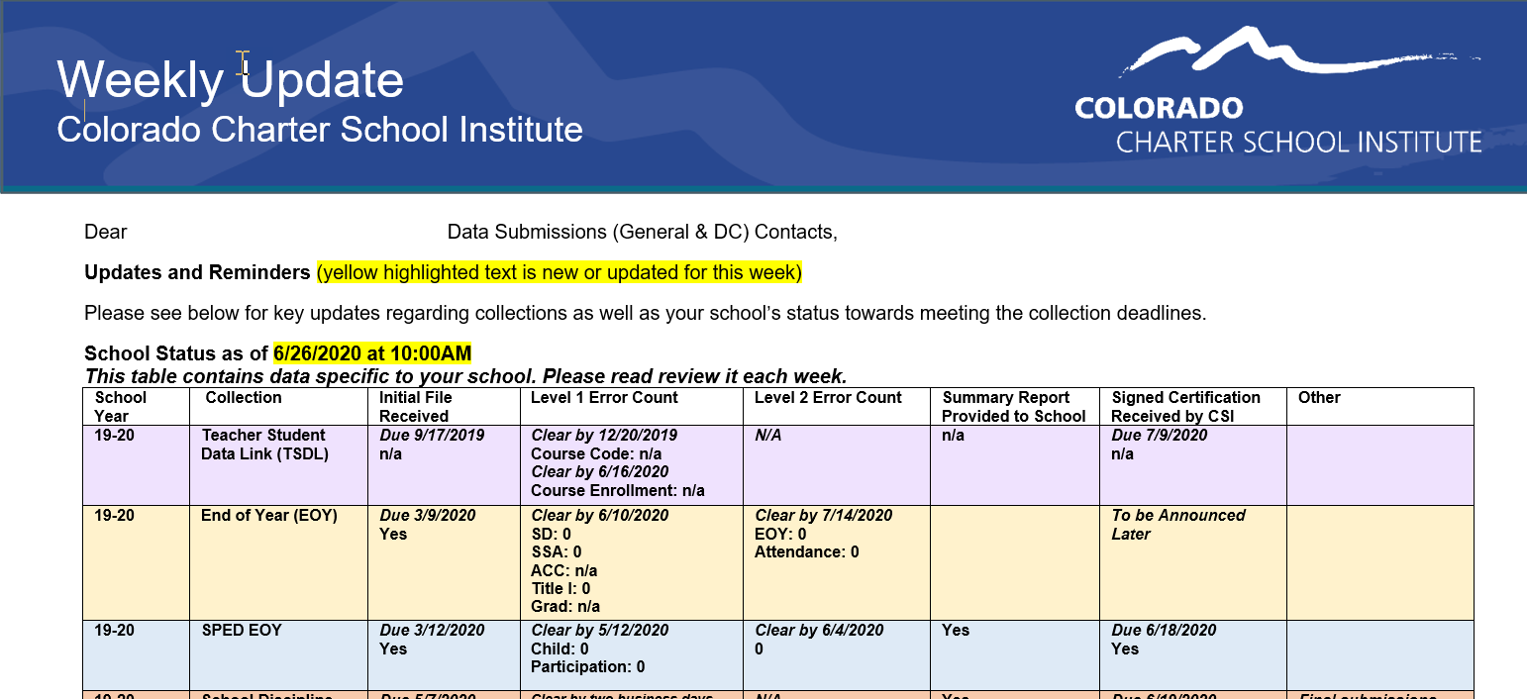
Data Submissions Tracker
Email Submissions_CSI@csi.state.co.us to request the Weekly Update email if you are not receiving them
Notes:
The last step we do on our end once files have been processed is navigate to our Submissions tracker, update the date last file sent, number of errors and comments. I thought this would be helpful to show you our actual submissions tracker as this ties directly into the Weekly email and shows you the number of errors for any given collection. There is a ton of information we update in this tracker, but in terms of day to day collections, we update the date last file submitted and the number of errors.
One note on the weekly email, make sure you look at the school status date and time. This is when the weekly email was created and you may have submitted and had files processed since then with a new number of errors. If you have a difference, be sure to check this date and when you last had files processed.

Slide 12
Step 3 Resources & Supports
For additional support, consider reviewing the following resources and optional exercises.
Resources to Review:
Colorado PowerSchool Student Interchange File Resources (SD and SSA)
Campus Community Student Interchange File Resource
Securely Sharing Data with CSI Webinar
G-Drive Instructions
Similar files for other collections (SPED, Discipline etc.) can be reviewed as well, but will be covered in CSI’s Resources Boot Camp module
Exercises to Complete:
Complete a test file extraction for both the SD and SSA files. Name the files correctly and place them in G-Drive in the correct folder. Please include the word “Test” at the end of your file. Reach out to CSI to notify that the test files are available in G-Drive and CSI staff can confirm whether it was successful.
Notes:
That concludes our module on Step 3 of the Data Submissions Process. For additional support and practice regarding the topics addressed in this module, please take a moment to review the resources listed here and consider completing the optional exercises.

Slide 13
Thank you!
For questions contact the CSI Submissions Inbox at: submissions_csi@csi.state.co.us
Notes:
Thank you for reviewing Module 3. For questions, contact the CSI Data Submissions Team inbox.

