Slide 1
The Data Submissions Process Step 2 (Data Collection, Entry,& Update)
Data Submissions
Recorded July 2023
Notes:
In this module, we will discuss Step 2 of the Data Submissions Process, which focuses on the collection, entry, and update of data in a school’s student information system.

Slide 2
The Data Submissions Process
Notes:
Schools are required to collect a variety of student, staff, and school data for state and federal data collections. The data requirements can be found in the File Layout and Definition document that is associated with each file schools are required to submit to CSI and can be found on each data collection webpage.
Once data has been collected, it needs to be entered into the school’s data management system(s). Data management systems commonly include: • A Student Information System (SIS) like PowerSchool or Infinite Campus • A Student Plan Management System like Enrich, or Infinite Campus Resources on how to enter data into each data management system are available through CSI or directly through the data management system vendor. Diligent, careful, and consistent data entry practices will significantly reduce errors in your data and shorten the time you spend on a given data collection.

Slide 3
Data Integrity
Consistent
Accurate
Valid
Verifiable
Complete
Data entry plan that identifies Who, How often, Process & procedures
Data is true to life
Follow up on unknowns
Data Validation Tools
File Layouts
Data system has master data
Comprehensive data for all students/staff and related elements
Notes:
First, it’s important to know that data entry, update, and overall success and ease in a collection all rely on data integrity. So what is data integrity? Data integrity is the combination of several features of best practices applied to data.
Data entry practice should be consistent – this is why a data entry plan can be helpful in defining data entry procedures. Data needs to be accurate, as in true to the real world situation, and data needs to be valid within the context of the collection. This is why File Layouts are such a key tool in data collections. Data must be verifiable meaning that anything you submit to CDE through us must be backed up in your SIS or with ample documentation. This is particularly useful in the case of collection audits. Last, data must be complete meaning that all required fields and preferably all applicable fields, even if they’re not required, should be filled in accurately.
These five elements make up data integrity and as the data submission coordinator it is important that you can vouch for the integrity of your data.

Slide 4
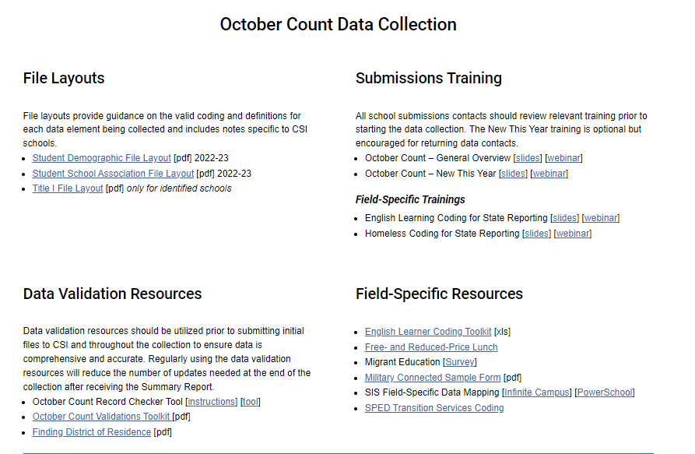
Collection-Specific Data Validation Resources
CSI Data Submissions Resources Page: https://resources.csi.state.co.us/data-submissions-library/
Notes:
So let’s talk a little more about tools provided for each collection to help you with data integrity. This is a screen shot of the Validation tools we have available for the October Count collection that is still wrapping up. Each collection’s webpage will have a Data Validation Resources section with applicable resources you can use to ensure your data is complete and accurate.
The Record Checker Tool should be used prior to submitting an initial file to CSI and can be used throughout the data collection to review summary data for accuracy.
The Validations Toolkit consists of strategies for validating data in your files.
Each CSI school is strongly encouraged to the Record Checker Tool AND the validations toolkit as part of its internal process for ensuring the completeness and accuracy

Slide 5
Step 2 Resources & Supports
For additional support, consider reviewing the following resources and optional exercises.
Resources to Review:
The following resources can be found in the Data Validations section of the October Count webpage:
October Count Validations Toolkit
The Record Checker: Instructions
The Record Checker: Tutorial
Exercises to Complete:
Review the Validations Toolkit for the validation tasks that should be completed during the October Count data collection.
Review either the recorded training or the written directions on how to use The Record Checker.
Notes:
That concludes our module on Step 2 of the Data Submissions Process. For additional support and practice regarding the topics addressed in this module, please take a moment to review the resources listed here and consider completing the optional exercises.

Slide 6
Thank you!
For questions contact the CSI Submissions Inbox at: submissions_csi@csi.state.co.us
Notes:
Thank you for reviewing Module 2. For questions, contact the CSI Data Submissions Team inbox.

