Slide 1
The Data Submissions Process Step 1 (Collection Prep)
Data Submissions
Recorded July 2021
Notes:
Welcome to the CSI Data Submissions Team Beginning of the Year Training series. In this module, we will discuss Step 1 of the Data Submissions Process which focuses on data collection prep.

Slide 2
The Data Submissions Process
Notes:
The Data Submissions Process is made up of five steps, as seen here.
The first step is to prepare for the data collection by reviewing all relevant resources.
The next step (Step 2) is to collect, enter, and update data in the school’s student information system (or SIS). For most CSI schools, this will be either PowerSchool or Infinite Campus.
In Step 3, school contacts will then submit files to CSI.
Step 4, school contacts will review and correct any errors that arise.
Finally, in Step 5, the collection cycle is completed with the final review and certification of data.
You’ll notice that steps 2-4 will be repeated until the data is error-free, which can take multiple iterations depending on the data collection. These steps are all discussed in detail in the Data Submission Handbook.

Slide 3
Step 1: Collection Prep
Notes:
In this module, we will focus on Step 1: Collection Prep.
Sufficiently preparing for a collection sets a strong foundation for your success and will lead to fewer errors and a reduced amount of time you spend on each collection.

Slide 4
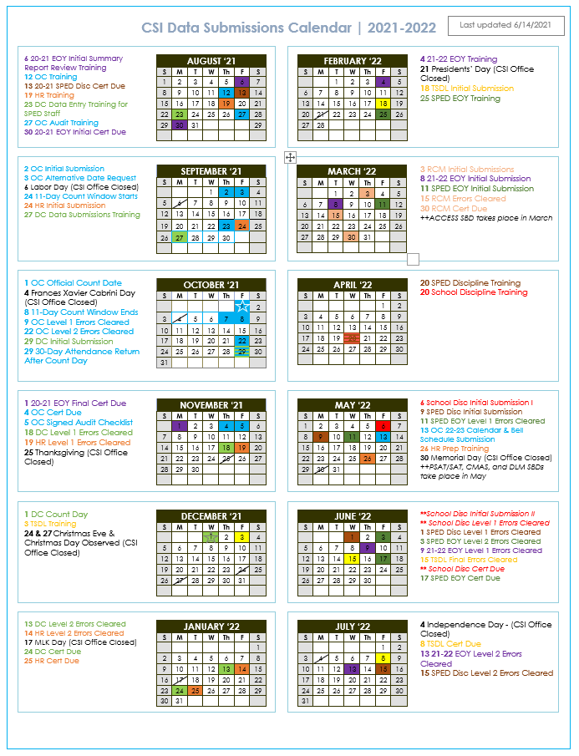
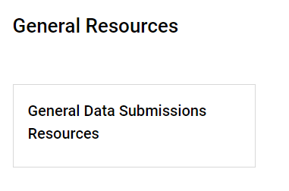
Review Collection Timeline
Training release date
Initial Submission
Level 1 Error Clearance
Level 2 Error Clearance
Summary Report deadline
OC & DC count days and count windows
Notes:
The first resource you’ll want to review is the data submission calendar. This calendar can be accessed in the General Resources section at the top of the Data Submission Library page and is also found at the top of every collection page.
This calendar identifies all the important dates associated with the collection timeline. Dates you’ll want to pay particular attention to are:
When the collection-specific trainings will be released,
the initial submission deadline, which is when the first file submission is due to CSI,
the Level 1 error clearance deadlines,
The Level 2 error clearance deadline, and
When schools must submit a signed summary and certification report, confirming the accuracy of the submitted data.
For more information about the calendar, and tips for staying on top of deadlines, please review the CSI Data Submissions Calendar training module.

Slide 5
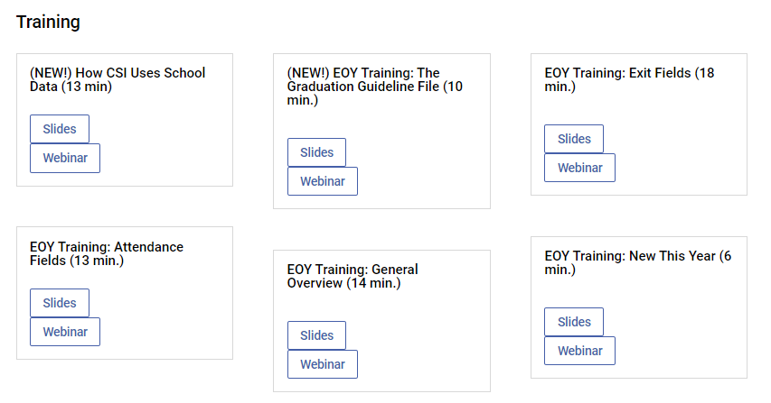
Review Relevant Trainings
CSI Data Submissions Resources Page: https://resources.csi.state.co.us/data-submissions-library/
Notes:
The next set of resources to review would be the posted trainings for the particular data collection. In the screenshot, you’ll see there are several, short modules posted to support school data submissions contacts in completing the End of Year (or EOY) data collection. It is critical to review these trainings before attempting to complete a data collection.

Slide 6
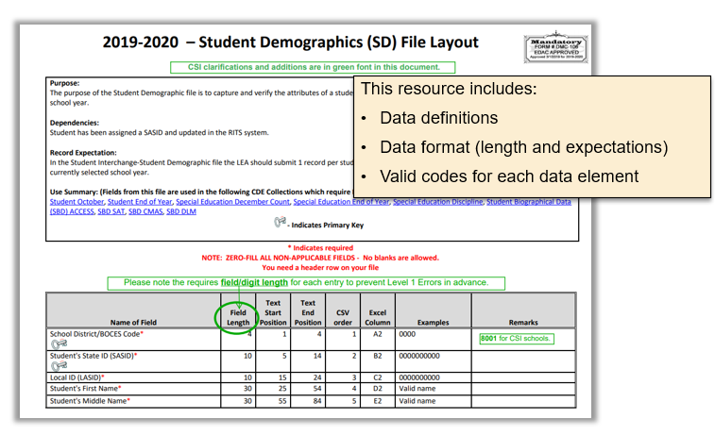
Review the File Layout
Notes:
The next resource to review as part of collection preparation is the File Layout. Each data collection has one or more files that will need to be submitted to CSI. For each file, there is a separate File Layout that should be reviewed. File Layouts are kind of like dictionaries. The File Layout will describe what kind of data should be in each field as well as any specific coding that is required.
In addition to File Layout review being an essential part of preparing for a collection, the File Layout is also essential in troubleshooting errors. For this reason, we recommend printing out the File Layout, or at least bookmarking the page, for the purpose of having it on hand to reference when needed.

Slide 7
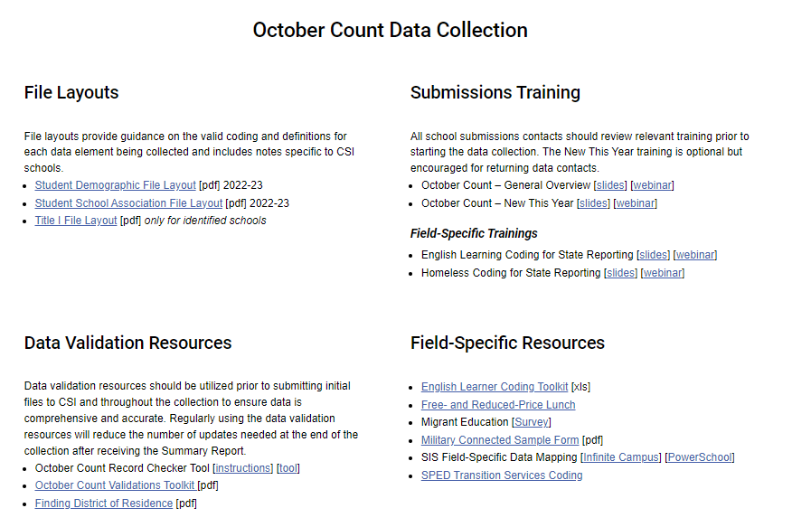
Review Initial Data Validations
Notes:
The next part of the Collection Prep step is to read through the Validation Strategies document and get an idea for what validation processes are needed and at what Submissions Process step. Please note, as seen above, that the Validation Document goes by different names, but is always located in the Data Validation section of the collection resource page.
Many of the Validation steps will be applicable within your SIS before the first data extract and initial submission, so be sure to review the Validation document as part of collection preparation.

Slide 8
Record Checker Tool
Notes:
Released during last years collection cycle, the Record Checker Tool is now a required validation tool to be used prior to your initial file submission at the beginning of a collection.
The Record Checker Tool is found under the Data Validations section of a collection web page and is usually accompanied by instructions or a training module. You will want to review the Record Check Training and as part of the collection prep step.
Again, use of the Record Checker Tool is currently required for most of the collections for which the Record Checker Tool is currently available. This is due to the significate reduction in initial errors we see from schools using the Record Checker Tool.
To learn more about the Record Checker Tool be sure to view Part II of the Excel Training Module.

Slide 9
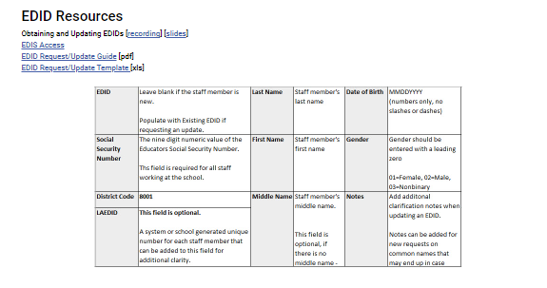
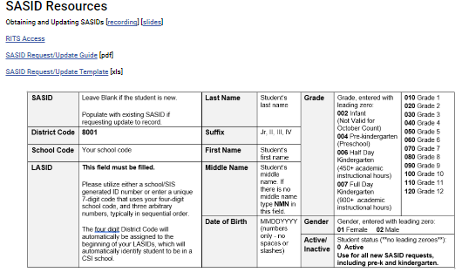
Obtain/Update SASID/EDIDs
See trainings on SASID and EDID Requests for more information.
CSI SASID and EDID Page: https://resources.csi.state.co.us/sasid-edid-requests/
Notes:
A regular part of a data submission contact’s role is to request new student and staff IDs (known as SASIDs and EDIDs, respectively) and update existing student and staff IDs as necessary since they are primary data fields in most data collections.
As part of Step 1: Collection Prep, data submission contacts should make sure all students are assigned SASIDs in your Infinite Campus or PowerSchool and to request SASIDs if the student does not have one.
Errors arising from 0-filled SASIDs will need to be addressed immediately and can be time consuming when CDE is busy. This is why it is very important that you stay on top of SASID request as part of collection preparation.

Slide 10
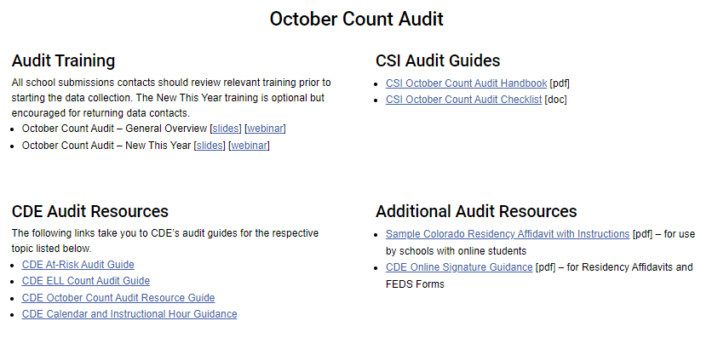
Review Additional Resources
CSI Data Submissions Resources Page: https://resources.csi.state.co.us/data-submissions-library/
Notes:
Next, some collections will have additional resources. As part of the Collection Prep process. Data submissions contacts should take a moment to click through the collection specific resources just to get a feel for what is available should you need it.

Slide 11
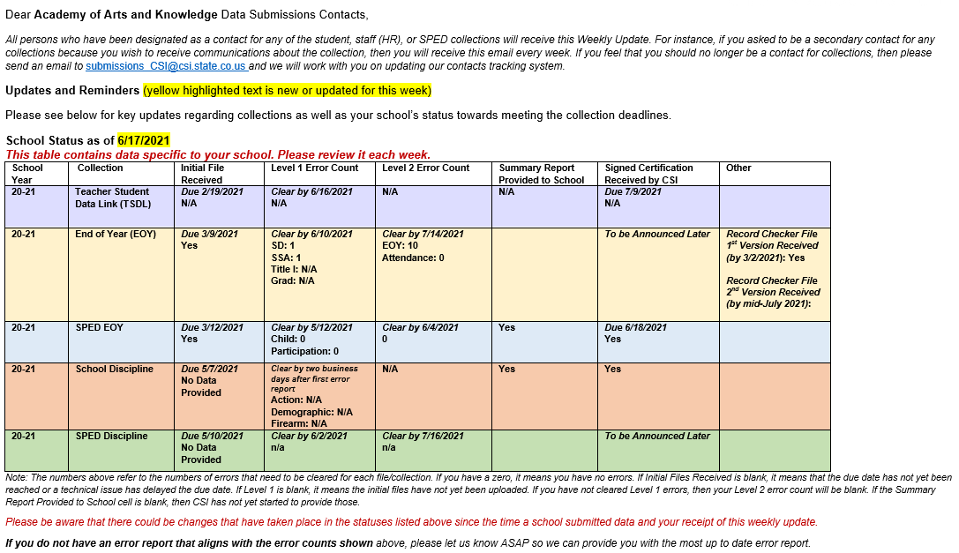
Review the Weekly Update
Notes:
Finally, be sure to review the Weekly Update. The Weekly Update is a weekly email that is sent out by the CSI Data Submissions Team to all school data submissions contacts. This email has general information and updates regarding various data collections as well as school-specific table identifying the school’s status for each open collection. This is an extremely important tool that allows schools to monitor their progress on a regular basis.

Slide 12
Step 1 Resources & Supports
For additional support, consider reviewing the following resources and optional exercises.
Resources to Review:
The following resources can be found on the October Count webpage:
Data Submission Calendar
Collection specific trainings
SD and SSA File Layouts
October Count Validations
Exercises to Complete:
Select a collection or two and review what resources are available and map out in your mind how you would approach preparing for the collection. Which resources would you review and why? What are other resources available for this collection?
Review the October Count Validations Toolkit.
Notes:
That concludes our module on Step 1 of the Data Submissions Process. For additional support and practice regarding the topics addressed in this module, please take a moment to review the resources listed here and consider completing the optional exercises.

Slide 13
Thank you!
For questions contact the CSI Submissions Inbox at: submissions_csi@csi.state.co.us

