Slide 1
Obtaining & Updating SASIDs
Data Submissions
Recorded July 2023
Notes:
Welcome to the CSI Data Submissions Team Beginning of the Year Training series. In this module, we will discuss the process for obtaining and updating SASID.

Slide 2
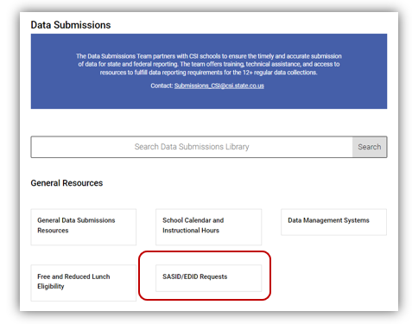
SASID Resources
CSI SASID and EDID Page: https://resources.csi.state.co.us/sasid-edid-requests/
Notes:
CSI has developed resources on SASIDS, found on the main Data Submissions Library page under the top-most heading of General Resources.
The resources include written instructions on everything covered here; the template you will need to download in order to request new SASIDs or update existing SASIDs; and a link to the RITs website, which you will be using to search for existing SASIDs.
When a student enrolls in your school for the first time, the first thing you need to do is look up the student in RITs to see if they already have an existing SASID. (If a student was enrolled in a Colorado public school before enrolling in your school, they should have a SASID in the system already. If a student is new to the Colorado public education system, it is likely they will not have a SASID.)

Slide 3
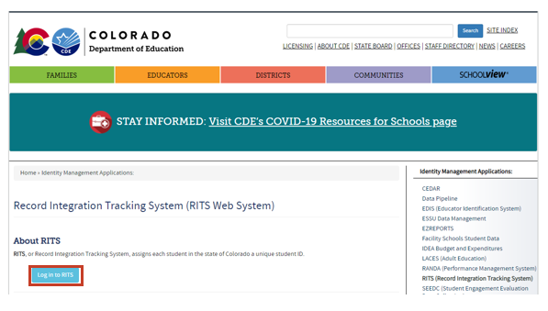
RITS Access
Due to the sensitive nature of student Personally Identifiable Information (PII), school leaders must email submissions_csi@csi.state.co.us to request a staff member gain access to the RITS system.
Link to RITS login page: https://www.cde.state.co.us/idm/rits
Notes:
To access RITs, you can click and book mark the link on this slide.
Most data submissions contacts should have access to RITs. If you do not already have access to RITS you will need to have your school leader contact the CSI Data Submission’s Team to request an account be set up for you.
This is due to the sensitive nature of the Personally Identifying Information, or PII, found on RITs.

Slide 4
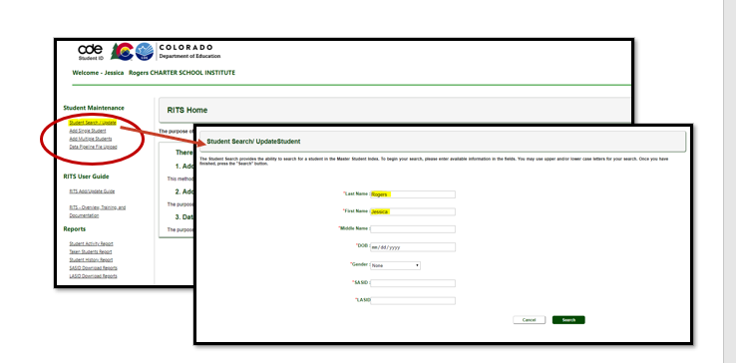
Looking Up a Student in RITS
Notes:
Once you have logged on to the RITS system, you’ll see a page like this.
To see if a new student already has an existing SASID, you’ll select the topmost option “Student Search/Update”. [click] Please note that your access permissions are restricted from making edits and updates, but you will be able to search students.

Slide 5
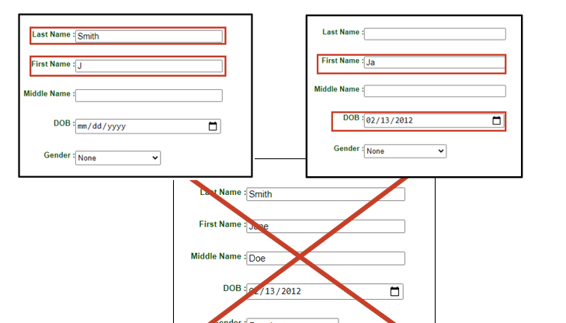
RITS Best Practices
Notes:
When searching for a student in RITs, it is best to not [click] enter data into every field of the search form.
Instead [click] try searching by Last name and First Initial OR the first few letters of the first [click] OR last name (not both) and the date of birth. Using these search techniques allows you to filter the RITs database for your student but also keeps the search broad enough that you can find the student even if their name is misspelled or other elements of their RITs record are incorrect.
Everything from misspelled names, to wrong date of birth and incorrect gender can prevent you from finding an existing record in RITs, so be sure to keep your search broad.
So you’ve searched RITs and you can’t find an existing SASID for a student. You’ll need to request a SASID be created.

Slide 6
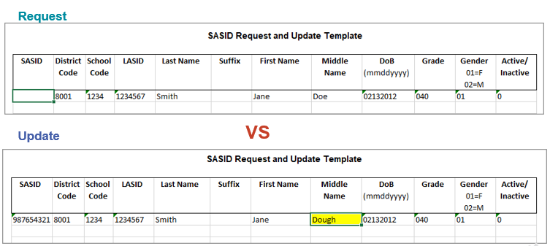
Difference between SASID Request and Update
***Requests and Updates should always be completed in separate files***
Notes:
However, before discussing how to request a new SASID for a student, let’s take a quick look at the difference between a SASID Request and a SASID Update.
The form you use to Request a SASID is the same form you use to request an Update to an existing SASID – The SASID Request and Update Template.
When requesting a SASID be created for a student, you will fill out all fields in the Request form except the SASID field and the suffix field if the student does not have one.
If you are requesting a student’s information be updated in RITs you will need to fill out all of the fields in the form, including the SASID and highlight the cell that contains the data that needs to be updated.
Please note that Requests and Updates should always be submitted to CSI in separate files.

Slide 7
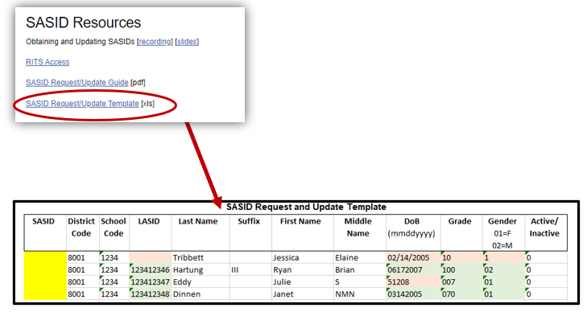
Requesting a New SASID
Save blank template to your desktop or hard drive!
Notes:
To request a new SASID, first download [click] the ‘SASID Request Template’ to your desktop or hard-drive.
[click] When requesting a new SASID all fields must be filled in correctly.

Slide 8
New SASID Request Template
Save blank template to your desktop or hard drive!
Notes:
Let’s take a look at how you correctly fill out in the template. Cells highlighted in [click] red demonstrate the incorrect way to use the field, while cells highlighted in green [click] are examples of the correct data entry for that field.
Correctly submitting a SASID Request form means…
[click] Filling in your school code –not leaving it blank.
[click] Filling in the LASID or populating the field with random numbers if a LASID has not yet been created or is not used by your school.
[click] Accurately and correctly filling in the name files. While the suffix column can be left blank, the Middle name filed cannot. Use the letters NMN – which stand for ‘no middle name’ as a place holder for an absent middle name. You should be filling out this information while referring to legal documentation such as a birth certificate or legal name change document.
[click] The date of birth field must be correctly formatted. No slashes or dashes are allowed and two digits must be used for month and day and four digits need to be used for the year.
[click] Grade and gender coding also need to be correctly formatted, being sure to use the correct number of digits
[click] And the district and active code should always be the same. 8001 for the district and 0 for active.
The SASID field is of course left blank since you are requesting a SASID.

Slide 9
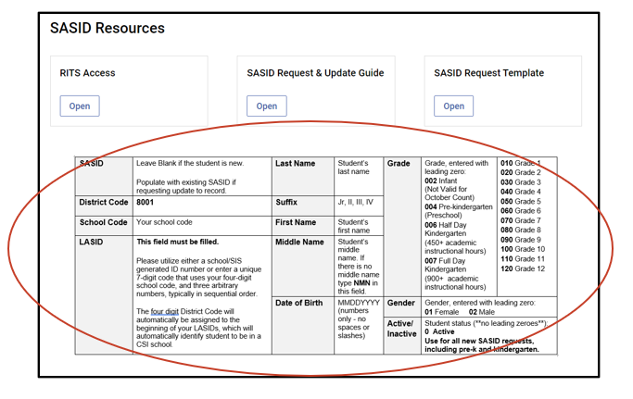
SASID Fill-In Resource
CSI SASID and EDID Page: https://resources.csi.state.co.us/sasid-edid-requests/
Notes:
If you find yourself forgetting how the SASID request form is supposed to be filled out, you don’t need to review the trainings.
We’ve created a quick-view table of all the required fields and possible coding, found directly on the SASID EDID Resource page.

Slide 10
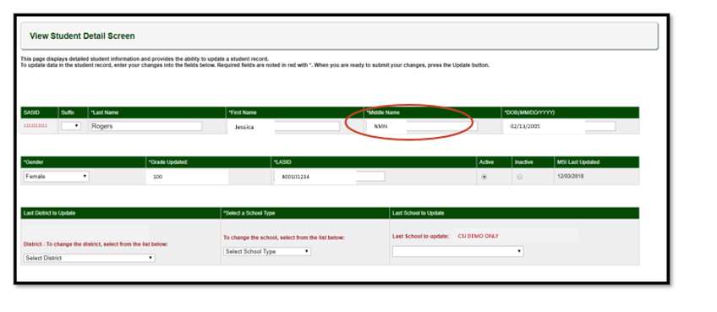
Updating Student Info in RITS
CSI SASID and EDID Page: https://resources.csi.state.co.us/sasid-edid-requests/
Notes:
Now let’s go back to the initial RITs search - Say you did find the student you were looking for but notice that the middle name is missing.
However, you know the students middle name and want to update the record.
As previously mentioned, your RITs access is view-only, meaning you will not be able to directly edit a record in RITs.

Slide 11
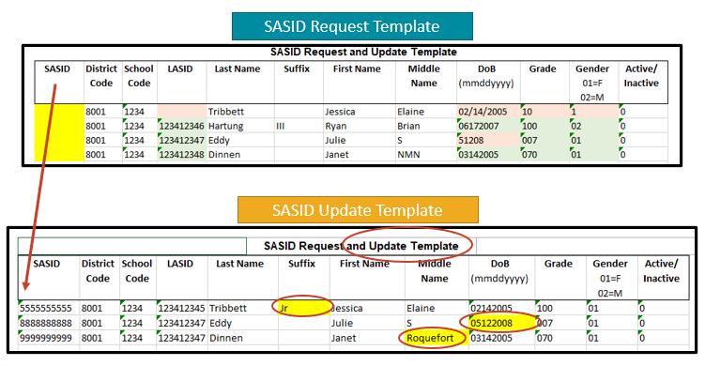
Updating SASID Request Form
CSI SASID and EDID Page: https://resources.csi.state.co.us/sasid-edid-requests/
Notes:
To request an update to a RITs Record you use [click] the same template as you did when requesting a new SASID as this is the SASID Request [click] and Update Template. Be sure to fill in the information completely including the SASID, [click] since that helps us locate the student.
To indicate the fields you want updated, simply highlight [click] those fields, leaving all other field cells clear.
Please note that if you have both new Requests and Updates, you will need to submit two separate files. The upload process for each file is different and Updates and new Requests cannot be combined into one file.

Slide 12
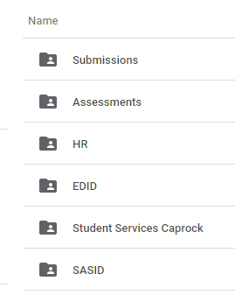
SASID Request File Transfer
SASID request templates should be named similar to how files are to ensure the most recent request is being processed. See below for an example:
5453_MMS_SASIDRequest_09012022
3326_CILA_SASIDUpdate_09012022
All files should be uploaded to the SASID folder. Please email the submissions inbox when available at submissions_csi@csi.state.co.us
Notes:
After you have completed the necessary fields in the template, it is time to save it. You want to be sure you are saving using the example structure in this slide. Generally it is the school code followed by the school abbreviation, the words SASIDRequest and ending with the date. This helps CSI staff more quickly identify which request needs to be processed. After the file is renamed, it should be placed in the G-Drive in the SASID folder. Be sure to never email these as they contain PII or personally identifiable information. The last step in the process would be to email the submissions inbox to notify us that there is a new SASID request to process.
Occasionally, a SASID is not given to a new student because there is another student with similar record entries already in the system. This SASID request then goes into what is called Case Review and the request is reviewed by a CDE employee. We may request that you review or even upload to GDrive the students birth certificate, or other enrollment documents, in order for the SASID request to be processed.

Slide 13
SASID Resources & Support
For additional support, consider reviewing the following resources and optional exercises.
Resources to Review:
SASID/EDID Requests Resource page
The Quick Reference Table at the bottom of the SASID Resource page
Exercises to Complete:
Download the SASID Request and Update Template if you do not already have it.
Practice the ‘Best Practices’ search techniques in RITs to get a feel how to successfully search in RITs.
Notes:
For additional support, consider reviewing of the following resources and optional exercises.

Slide 14
Thank you! submissions_csi@csi.state.co.us
Notes:
Thank you for reviewing the SASID Module. For questions, please contact the CSI Data Submissions Team.

