Slide 1
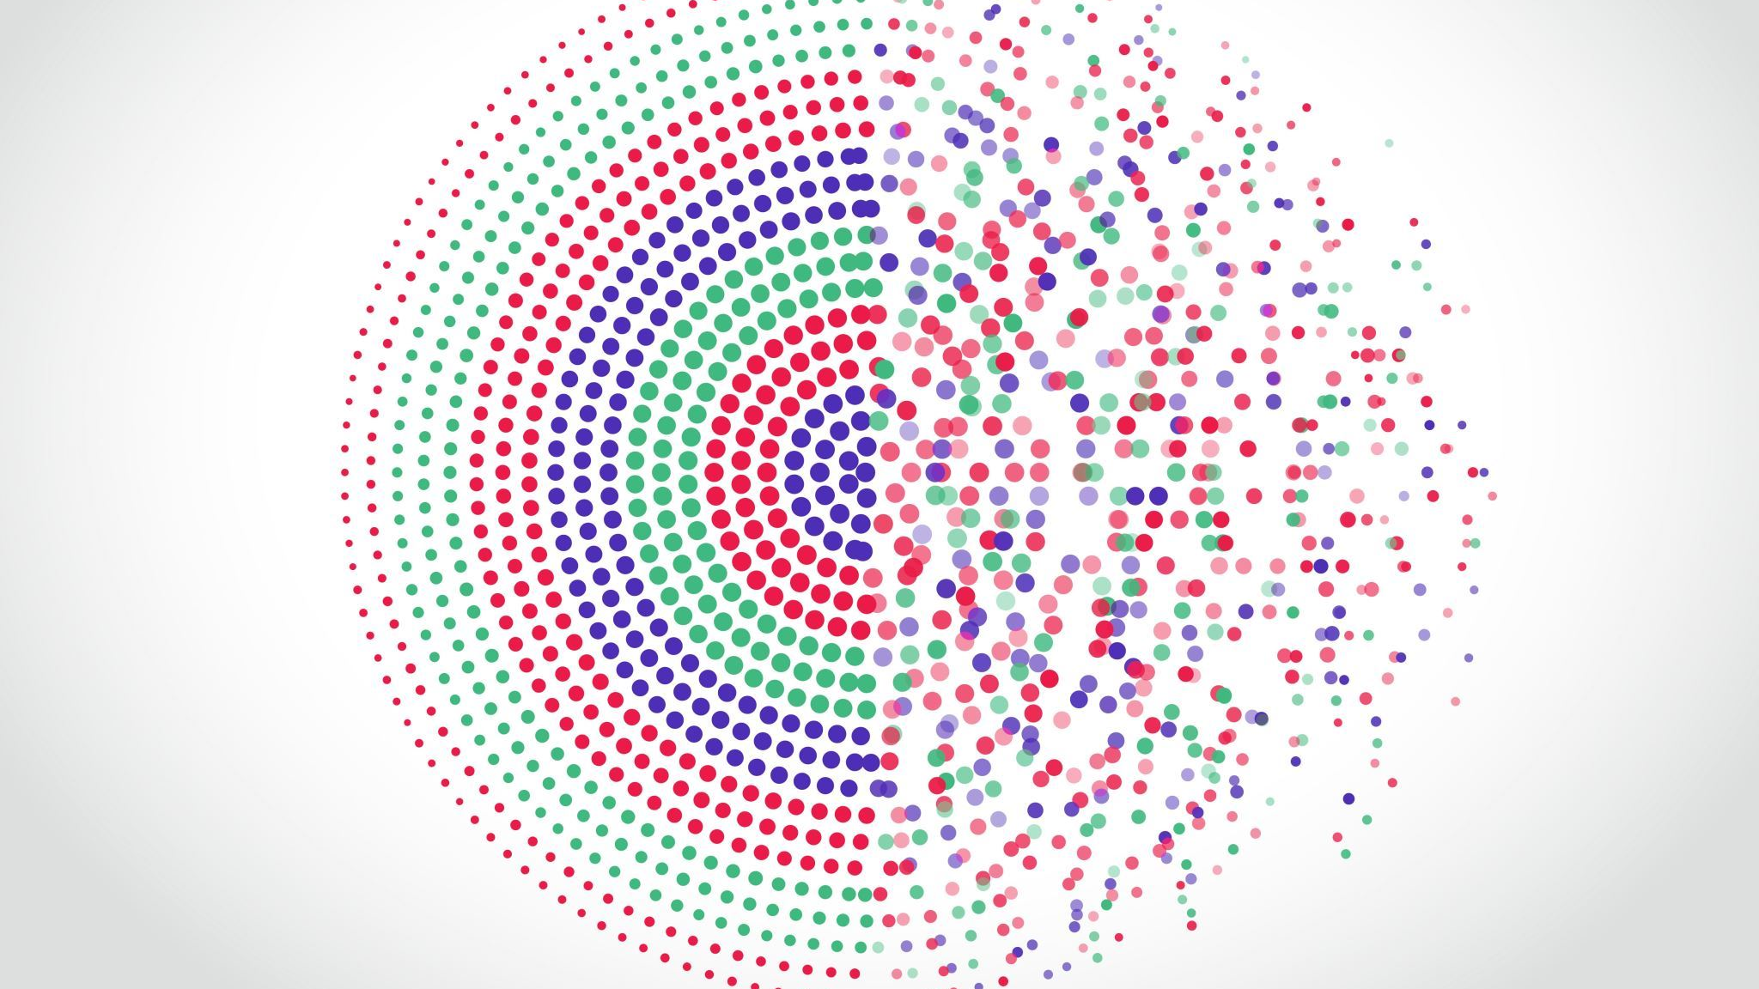
Mental Health Program Plan
Social Emotional Learning

Slide 2
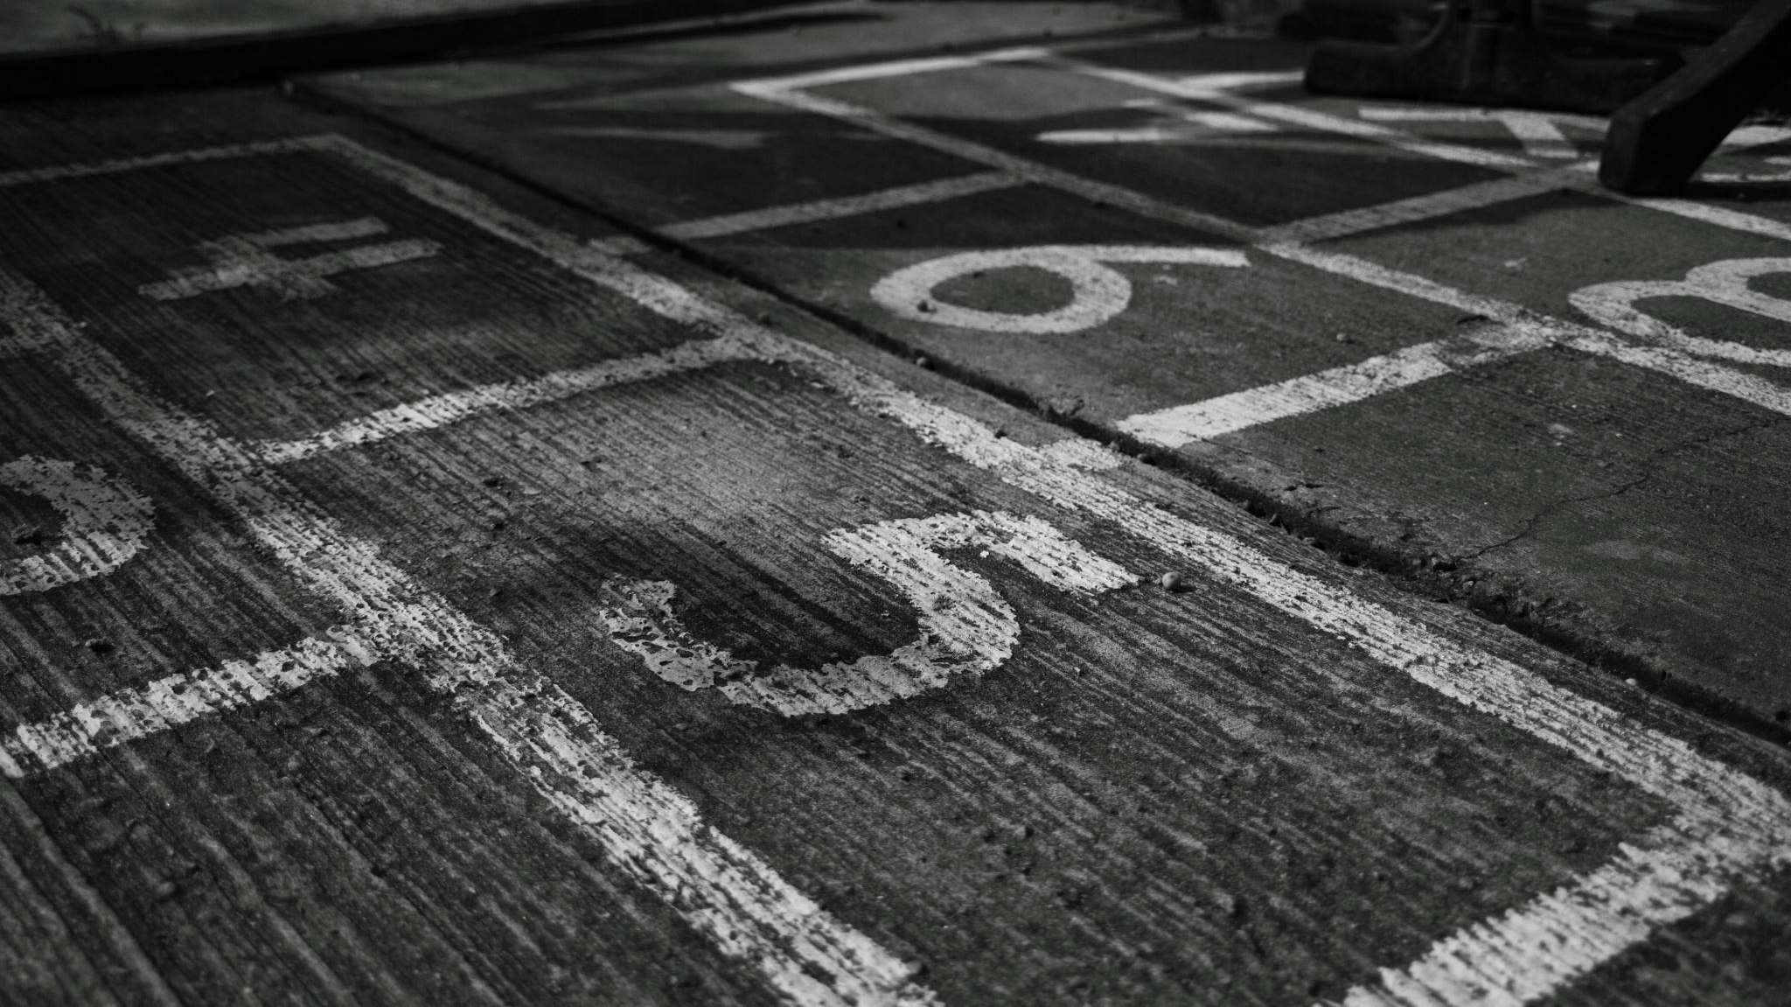
Not Required.....
Is change coming?
Notes:
It is entirely possible that as state and nation suicide rates continue to rise unabated, states, and especially Colorado, will start requiring more intensive interventions for mental health. I would strongly encourage you to proactively consider what would you do, what would you choose if this became a requirement rather than being reactive to a mandate. There is a HUGE push to make sure all students have access to MH services in schools regardless of parental consent & this may not be an area we have autonomy in.
For example, there are other bills in the house that would change SE services in schools right now, and we are unsure of the outcome. SB23-004

Slide 3
SEL & PBIS
Different Things
May be related
Notes:
SEL Curriculum and PBIS are two different things-Social Emotional Learning and Positive Behavior Intervention System. SEL is about learning the "soft" skills that make us better humans inter & intrapersonally & PBIS is the system around us that helps us make better behavior choices rather than punitive reaction when behavioral expectations are not met. They both rely on the idea that prep work ahead of time can help us avoid more painful & punitive decisions in the future, but they might work together (I.e., learning about how to communicate with others help decrease bullying).

Slide 4
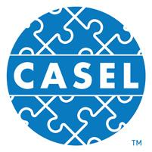
The Case for SEL
Notes:
We don't have any research that notes negative aspects of SEL programming when it's culturally appropriate. SEL programming increases academic achievement, attendance, and saves money. We often hear the most common detraction of SEL is money and academic impact, but research tells us that investing in SEL actually helps students be more successful, is better for staff, and saves money.
Benefits of SEL
•We know from a large body of research on SEL that high-quality SEL programming leads to improved academic performance, decreases in anxiety and behavior issues, among other benefits.
•We also know from research beyond the traditional SEL field that there are additional insights to be gained that are relevant to SEL.
Meta-analysis source (first 3) Durlak, J.A., Weissberg, R.P., Dymnicki, A.B., Taylor, R.D., & Schellinger, K. (2011). The impact of enhancing students’ social and emotional learning: A meta-analysis of school-based universal interventions. Child Development: 82 (1), 405-432.
Financial investment (bottom): Belfield, C., Bowden, B., Klapp, A., Levin, H., Shand, R., & Zander, S. (2015). The Economic Value of Social and Emotional Learning. New York: Center for Benefit-Cost Studies in Education.

Slide 5
SEL & PBIS
Consent​
Active
Passive
Notes:
Whatever program you decide to implement, parental consent will be a part of the process, and informing students of the process-what you're doing and why it's important-will also be important. There are two kinds of consent-active vs. passive, both of which are viable solutions for delivery and assessment UNLESS you are dealing with a specific set of highly charged topics like substance use or sexual activity. Then the consent process MUST be active.

Slide 6
SEL
Are you using curriculum?
1
What do you want to accomplish with your curriculum?
2
How does it fit with all of your populations?
3
(who won't your curriculum work for, and how do you know)
4
Notes:
Reflection questions in choosing an SEL curriculum
How does this fit with your mission & values?
How does this fit for what your staff needs?

Slide 7
SEL #2
SEL
Who is delivering the curriculum?
How often?
How do you know it's working?
Notes:
How does this work with your staffing formulas & overall systemic wellness?
How does this language fit or not for your population and what they hear?

Slide 8
PBIs
Procedures
Professional Development
Fidelity & Efficacy
Applicable Populations
Special Population
Inequities → Action
Notes:
This may be related to the work you are doing in restorative practices and discipline. What kind of data are you collecting and what does it say about the impact you are having on your students-especially your special population students?

Slide 9
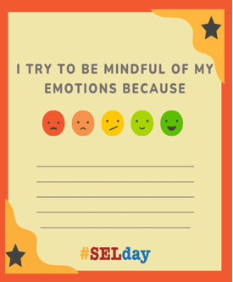
SEL Resources
-SEL Resources
-SELDay
-SEL4CO
-SEL4US
-Rand Assessment Catalogue
Notes:
So many resources for how this might work for you in different ways
March 10th SEL Day
SEL Summit
-last year’s SEL curriculum showcase (ASSET Upstream licenses)
-don’t know yet how this will be funded for next year

Slide 10
Reflections
Is our SEL programming designed for our whole school population and are all students benefiting from our sel?

Slide 11
Reflections #2
Reflections
Is our PBIS System designed for our whole school population and are all students benefiting from our approach?

