Slide 1
Mental Health Program Plan
Screening & School Climate

Slide 2
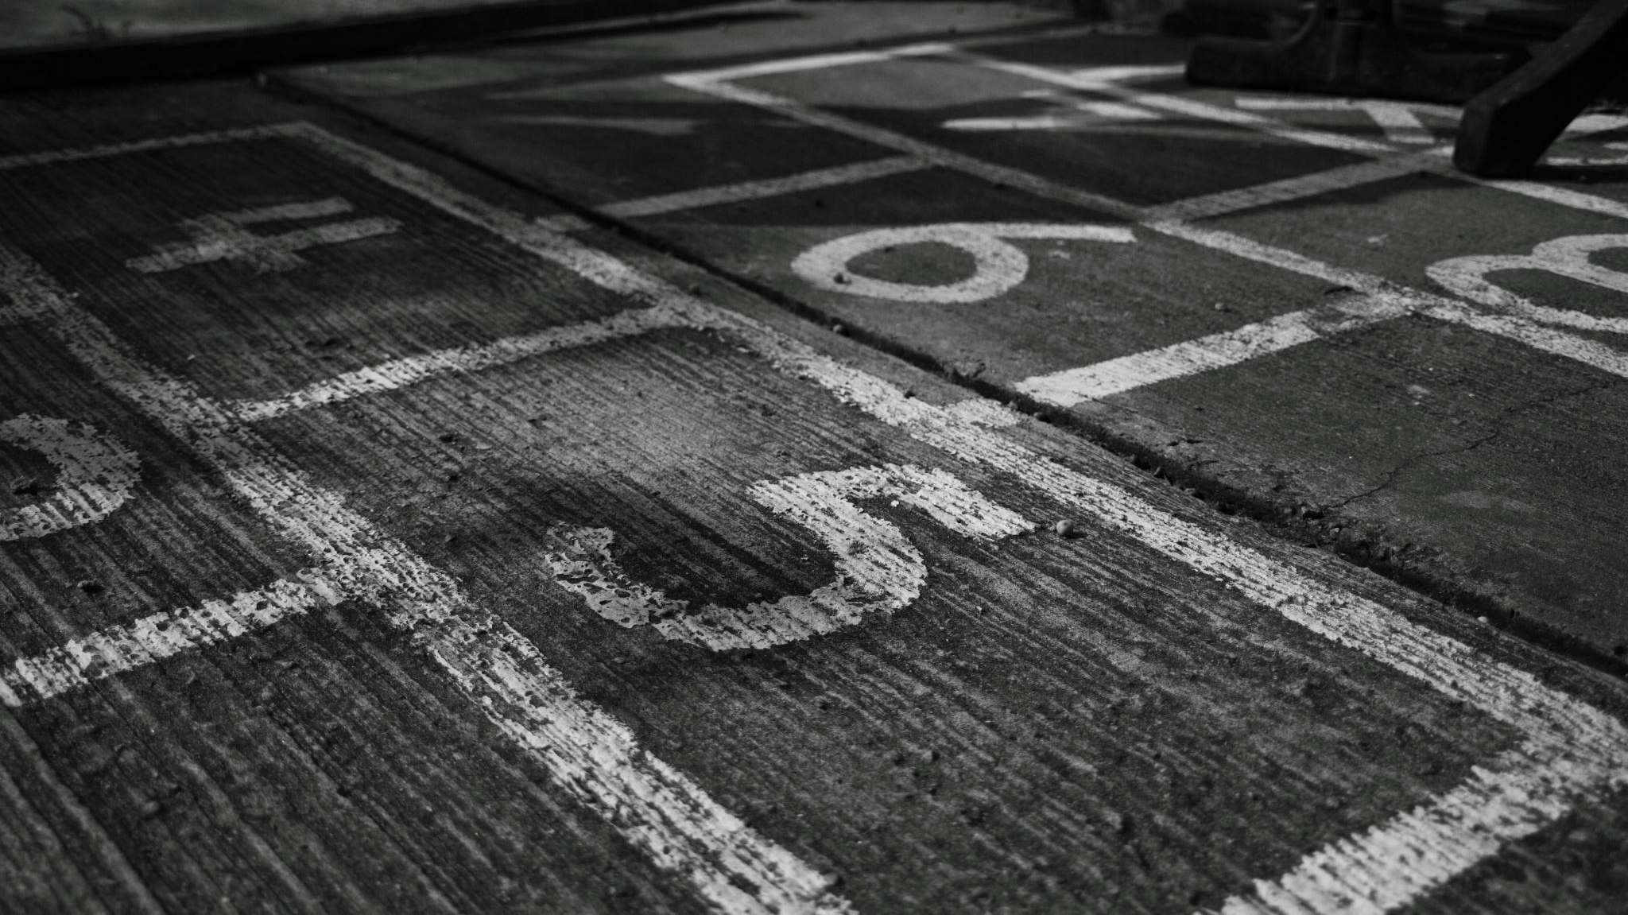
Not Required

Slide 3
Capacity
The age-old question.....
This Photo by Unknown author is licensed under CC BY-NC.
Notes:
Do we have the personnel, resources & time to respond to the data that we collect? Many schools use the "better the devil we know than the devil we don't" approach to data collection. I would encourage you to think of data collection in a different way.

Slide 4
Screenings
Rand Screening Search Tool
The Case for SEL (CASEL)
Notes:
Here are two great resources for trying to figure out what screening tool to use. You can be as narrow or broad as you would like!

Slide 5
Screenings #2
Screenings
Procedures
Consent
Privacy
Collection
Analysis
Actionable Steps→ Communication
Notes:
Here are some things to consider when considering your approach to screening. If you have the capacity in personnel, resources and time, do you have them for each area of the screening process? When schools stumble, it is usually in the analysis phase, followed by the communication phase. Be aware that the kind of data that you collect may be different depending on who is being surveyed, and at what time of year they are being surveyed. Students tend to be more optimistic at the beginning of the year, and staff tend to be more optimistic at the end of the year.

Slide 6
School Climate & Wellness
Procedures
Consent
Privacy
Collection
Analysis
Actionable Steps→Communication
Notes:
Here are some things to consider when considering your approach to assessing for school climate & wellness. If you have the capacity in personnel, resources and time, do you have them for each area of the assessment process? When schools stumble, it is usually in the analysis phase, followed by the communication phase. Be aware that the kind of data that you collect may be different depending on who is being surveyed, and at what time of year they are being surveyed. Students tend to be more optimistic at the beginning of the year, and staff tend to be more optimistic at the end of the year.

Slide 7
Wellness Team
Notes:
Do you have a wellness team? Do you want a wellness team? What tasks they do they carry out? Is it an actual team? What needs are they meeting in your school? How is your wellness team related to the rest of your initiatives?

Slide 8
Reflections
Is our Data Collection designed for our whole school population and what does our data tell us about the way we are serving all students?

