Slide 1
File Layout Resource Overview
Data Submissions
Recorded July 2021
Notes:
This training module recorded by the CSI data submissions team will walk through the file layout resource, where to find each one for the multiple state collections, and how they can be used to help you to complete each collection accurately.

Slide 2
File Layout Resource Basics
Documents created by CDE - one for each file within every state collection by school year
Intent: Provide correct formatting for file submissions
Common Components:
Purpose of the file
Data dependencies
Data attribute details
Indicators of additions/deletions/modifications
Notes:
The file layout resource are documents originally created by the Colorado Department of Education (CDE) for each file that is submitted through the web based “Data Pipeline” portal to complete state collections. Each state collection can have one or more separate files that must be submitted and there will be a file layout for each one of those.
The overall intent of the file layout resource by CDE is to provide correct formatting for each file that must be submitted for state collections. CSI then takes this to another level by adding additional tips and comments specifically to help CSI schools.
Common components of each file layout include the following:
The purpose of the file and any data dependencies that must be in place will be listed on the first page.
An example of a data dependency might be that every student record must already have an assigned SASID to be included in the file. If not, then records without a valid SASID will result in an error once CSI uploads the file to CDE.
The data attribute details make up the bulk of the file layout and are presented first in a table format, listing each data element and position within the file. Following the table format are additional details on the description of each data element along with acceptable values.
Lastly, the indicators of additions, deletions, and modifications for the current year will be in the form of red strikethroughs for deletions, and yellow highlight for additions and modifications. Most file layouts also have a table near the end that summarizes dates and changes that took place across collection years.

Slide 3
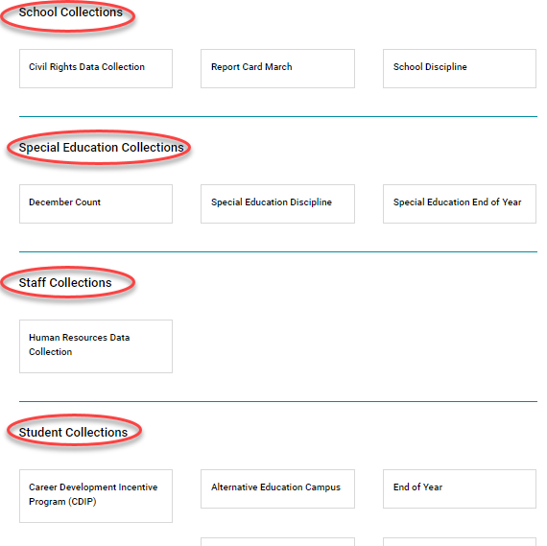
Website Layout
https://resources.csi.state.co.us/data-submissions-library/
Notes:
The Data Submissions Library webpage on the CSI website is divided into sections containing links to each main data collection. The sections include School Collections, SPED Collections, Staff Collections and Student Collections. Each collection has specific data files that schools will submit to CSI and every data file has an associated file layout resource.

Slide 4
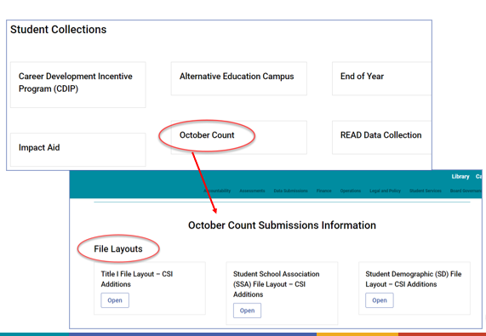
Data Collection Webpage Layout
Notes:
Interchange files refers to the files that are extracted directly from your SIS data system and are used for the main data collections. Some examples of interchange files include the Student Demographic file, Student School Association file, Staff Profile file, and Child file.
In this training module, we’ll focus on the examples of the file layouts for the October Count collection. The two primary interchange files for the October Count collection are the Student Demographic or SD file and the Student School Association or SSA file.

Slide 5
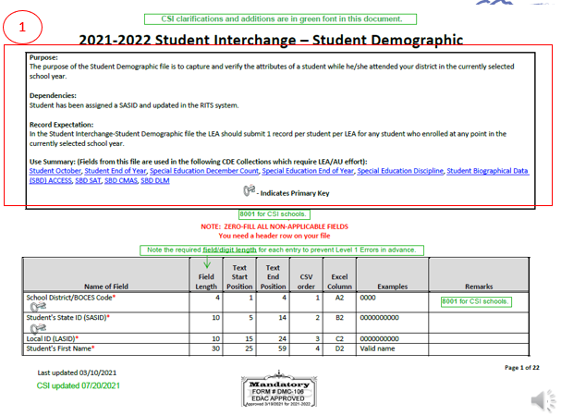
File Layout – Part 1
Notes:
This slide shows the first page of the file layout for the SD interchange file. This file happens to consist of the primary demographic data for each student enrolled at your school for the October Count collection. It can have only one record per student.
The first section of the document provides:
The purpose of the Student Demographic file is to capture and verify characteristics of students while they attended the district in the currently selected school year.
The Student Demographic file depends on each student having a unique identifier, known as a SASID, associated with them. If a student does not have a SASID, then they will pull an error when the file is uploaded to the Data Pipeline.
The record expectation is that each LEA (or Local Education Agency, which in this case is CSI) should include 1 record (or row of data) per student for any student that enrolled in a CSI-school during the selected school year. Therefore, the Student Demographic file includes a row of data for each student in the district. (Keep in mind that for schools on their own student information system, when you extract a Student Demographic file, your SIS is including a row of data for each student in your school. CSI uploads each school’s SD file to Data Pipeline. Once all schools are uploaded, CSI essentially has a ‘district-wide’ file.)

Slide 6
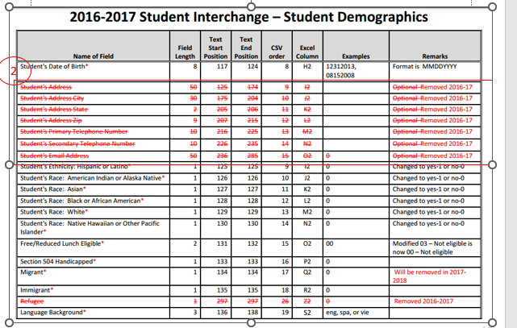
File Layout – Part 2
Notes:
The second page of the File Layout lists all of the data elements and expectations for data including field length, examples, and notes. Here is an old screenshot within the File Layout and Definition document to share for our learning purposes.
As you can see, the document shows updates that have been made to the File Layout from a prior year. Highlighted fields represent new data elements to the interchange file while data elements that are red with a strikethrough represent data elements that are no longer collected.
In this example from 2016-2017, the student address fields have been removed, noted by the red strikethrough font.

Slide 7
File Layout – Part 3
Notes:
The third section of the document provides the definition of each data element and its allowable values. The definitions make up the remaining sections of the File Layout and Definition document.
In this example, you can see three data elements– Student’s Race: American or Alaska Native, Student’s Race: Asian, and Student’s Race: Black of African American. If we were to peek back at the file layout section of this document, you would see that each of these data elements is a separate column in the spreadsheet, which Student’s Race American Indian or Alaska Native in Column J, Student’s Race: Asian in Column K, and Student’s Race: Black or African American in Column L.
In addition to listing the data element, the document provides a definition of the data element as well as the allowable codes. For example, the data element “Student’s Race: American Indian or Alaska Native” is defined and includes particular American Indian and Alaska native groups to help the user understand what the data element is referring to. It also identifies the two allowable values that can be reported for this data element: 0 for No, and 1 for Year. If you were to visualize the spreadsheet, in the Student’s Race: American Indian or Alaska Native column, one would expect to see either a 0 or a 1, depending on whether the particular student is identified with a race of American Indian or Alaska Native or not.

Slide 8
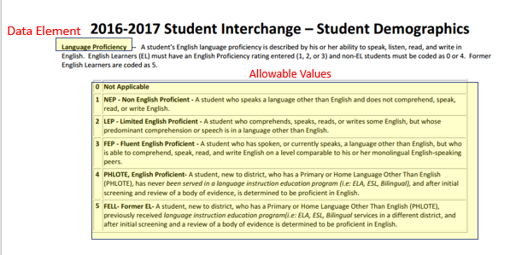
Example – Using the File Layout
Notes:
While our previous example is fairly simplistic in that it was defining a race and the allowable values of a 0 for No and a 1 for Yes, other data elements are more complex. For example, the Language Proficiency data element provides a definition of what language proficiency refers to and then provides 6 allowable codes that could be used. Each code refers to a different level of English language proficiency, from 0 being Not Applicable (in that the student is no an English learner and is proficient in English) to 5 FELL or Former English Learner (for students who were previously not proficient in English but are currently proficient in English).

Slide 9
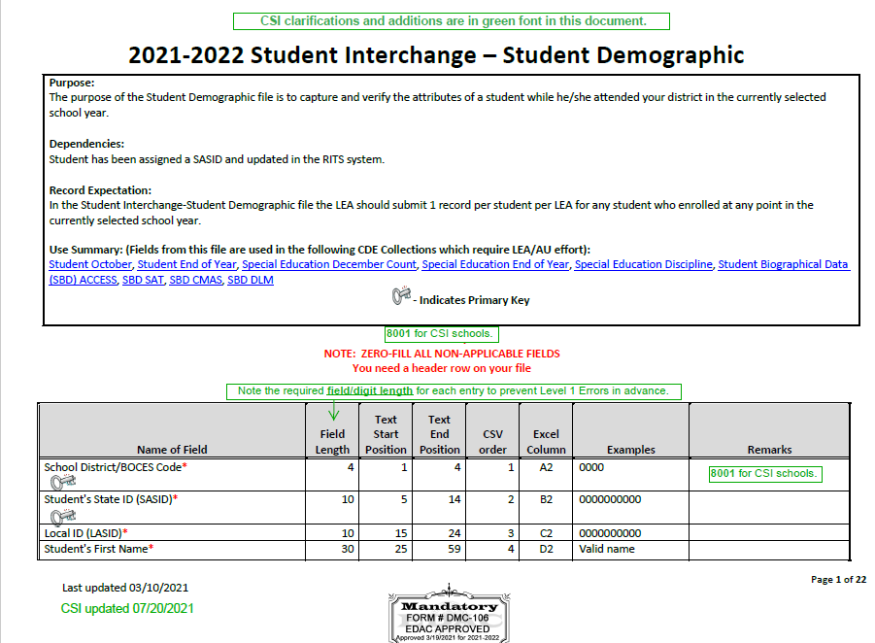
File Layout – CSI Additions
Notes:
The final note to share is that CSI annotates the CDE File Layout document for key data collections. Notes fro CSI schools are in Green. In this first page of the Student Demographic File layout, you’ll see in the second row of the table a green note in the Remarks column. The green note is an addition from CSI noting that all CSI schools should use 8001 as the School District Code. CSI includes notes throughout the file layouts to help schools navigate any CSI-specific information or helpful tips when determining appropriating coding.

Slide 10
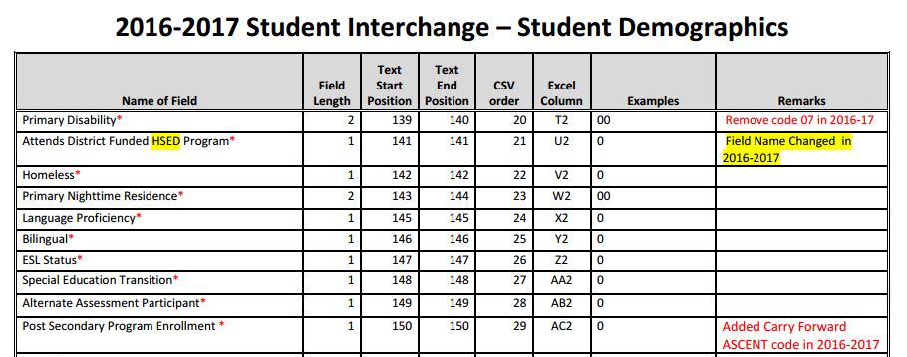
Ways to Use this Resource (1)
1. Ensure all necessary data is being collected
Data Element | Collected Through | Input into Data System by
Primary Disability | IEP | SPED staff
Homeless | Homeless identification form | Registrar
Language Proficiency | Home Language Survey, English language proficiency screener | EL staff
Notes:
Now that you are familiar with the various sections of the Data Layout and Definition document, let’s discuss some of the many ways to make use of this resource.
First, you can use this document as a checklist to ensure that all necessary data is being collected and entered into your data system. Many of the data elements included in the Student Demographic file would typically be collected through student enrollment paperwork. For example, you are collecting name, birthday, gender, race, and ethnicity through enrollment paperwork. Other data elements in the Student Demographic file may be collected through school level identification processes. For example, Language Proficiency is collected by EL staff based on the Home Language Survey and English language proficiency screener assessment.
Second, you can use this document to ensure that relevant school staff are aware of CDE’s definitions of each data element to ensure that data entry into your data system is accurate.
Third, you can use this document to help resolve errors in your data submission. For example, if you receive an error on your data submission because the data you provided for Gender is invalid, you can come back to this resource to identify what the allowable codes should be used to resolve the error.

Slide 11
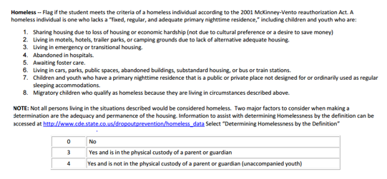
Ways to Use this Document (2)
2. Ensure relevant school staff are aware of CDE’s definitions for each data element
Notes:
Second, you can use this document to ensure that relevant school staff are aware of CDE’s definitions of each data element to ensure that data entry into your data system is accurate.
For example, while staff may have their own definition of what may constitute homelessness, for state reporting, the federal definition provided in this file is what should be used to make the determination of whether a student is identified as homeless.

Slide 12
Ways to Use this Document (3)
3. Resolve errors in your data submission
Notes:
Now that you are familiar with the various sections of the Data Layout and Definition document, let’s discuss some of the many ways to make use of this resource.
First, you can use this document as a checklist to ensure that all necessary data is being collected. Many of the data elements included in the Student Demographic file would typically be collected through student enrollment paperwork. For example, you are collecting name, birthday, gender, race, and ethnicity through enrollment paperwork. Other data elements in the Student Demographic file may be collected through school level identification processes. For example, Language Proficiency is collected by EL staff based on the Home Language Survey and English language proficiency screener assessment.
Second, you can use this document to ensure that relevant school staff are aware of CDE’s definitions of each data element to ensure that data entry into your data system is accurate.
Third, you can use this document to help resolve errors in your data submission. For example, if you receive an error on your data submission because the data you provided for Gender is invalid, you can come back to this resource to identify what the allowable codes should be used to resolve the error.

Slide 13
Thank you!
submissions_csi@csi.state.co.us
Notes:
Thank you for watching this short training module on how to use the very important file layout resource for each data collection. Please reach out to the CSI data submissions team if you have any questions.

