Slide 1
Data Security
Data Submissions
Updated July 2022
Notes:
This training module recorded by the CSI data submissions team will cover important data security information that all schools should be aware of when sharing sensitive student and staff data with CSI.

Slide 2
What is Personally Identifiable Information (PII)?
Information that, alone or in combination, is linked or linkable to a specific student that would allow a reasonable person in the school community, who does not have personal knowledge of the relevant circumstances, to identify the student with reasonable certainty.
PII Examples:
Student name
Names of student's parents or other family members
Student or family address
Other Sensitive Information:
Special population categories
Social security numbers
Date of birth
Salary information
Notes:
Let’s first define personally identifiable information, or PII, for short.
This is “information that, alone or in combination, is linked or linkable to a specific student that would allow a reasonable person in the school community, who does not have personal knowledge of the relevant circumstances, to identify the student with reasonable certainty”.
Examples of PII include a student’s name, the name of the parent or other family members, or the student or family address.
Legally and ethically, we must keep both student and staff information confidential for state reporting. To do so, any data files that include specific PII or information that can be linked to an individual will need to be shared using secure methods. The data should only be accessible by both CSI and school staff having approved permissions to do so as part of their job duties.

Slide 3
What NOT to do with PII
Do not send PII over e-mail or fax
Use SASID/EDID over student/staff name whenever possible
Usually, first 5 digits is enough
Use LASID if available
Do not share PII with unauthorized individuals
School SIS administrator should check user permissions to ensure staff only have access to what they need and no more (information security)
Do not share passwords
Notes:
There are several ways you can ensure PII and other confidential data remain secure in your role as a submissions contact for your school. First, let’s start with what NOT to do with PII.
While it may seem that email and fax capabilities are secure enough to share personally identifiable information, the security permissions do not always meet security standards. Therefore, you should never share PII over email or fax. In situations where you need to reference a student in a communication with CSI, instead of using the student’s name, you need to use another method.
For Students: CSI does allow the exchange of SASIDS (the state K-12 student identifier) in communications. There are also other ways that you can refer to a student. For instance, If you use the SASID, you can simply include the first 5 digits and that is typically all that’s needed for CSI to find the student you are referring to. Another option is to use the LASID or local school identifier if available. Finally, general descriptors about a student record can sometimes be used; it just depends on the situation and collection you are working with.
For Staff: CSI does allow the use of the EDID or state educator ID in communications. However, you can also reference the first few digits of the EDID or use general descriptors for the situation.
You should not share PII with unauthorized individuals. Only those with legitimate needs to access sensitive student or staff information should have the ability to do so. One way to ensure your school is limiting access is by ensuring user permissions are implemented within your SIS and network folders.
Finally, do not share passwords. If another user has a need to access information, then go through the normal channels to establish an appropriate account for the user to access the necessary information if it’s required as part of their job.

Slide 4
How to Share PII
Schools should exchange all sensitive data with CSI, including files with Personally Identifiable Information (PII) through G-Drive.
CSI’s Data Submissions Team will share G-Drive folders to school contacts with active Google (Gmail) accounts who have been officially designated by their school as needing access to specific folders as part of their job responsibilities.
If you do not yet have access, please email Submissions_CSI@csi.state.co.us
Notes:
The Charter School Institute uses Google Drive (G-Drive) for securely exchanging information with its schools.
Schools should exchange all sensitive data with CSI, including files with Personally Identifiable Information (PII) through G-Drive. Student and staff data, including information such as name (for students only; not staff), address, birthdate, SSN and other sensitive demographic data that can be associated with a specific person, should never be sent through email because it is not secure and the data could be compromised.
CSI can only share G-Drive folders to school contacts with active Google (Gmail) accounts who have been officially designated by their school as needing access to specific folders as part of their job responsibilities.
Each school contact will need their own individual Google account. School contacts will not be able to use a group Google email address.
A Google Workspace (formerly G-Suite) account through your school would be preferable to a free personal Google account.
If you do not yet have access to shared folders in G-Drive, please email the CSI Data Submissions Team as soon as possible.

Slide 5
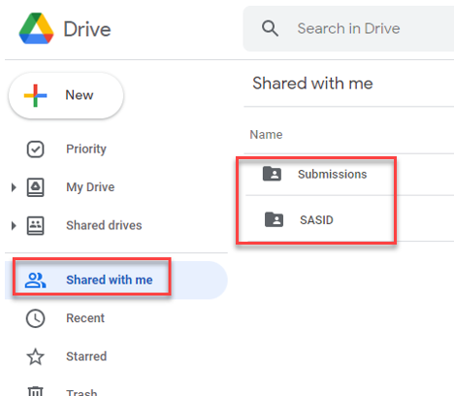
Upload Files to G-Drive
To upload a file, simply drag and drop the file into the appropriate folder.
Data collection files should remain in the native xlsx or csv format and not converted to Google Sheets.
Available Resources:
G-Drive Instructions: https://resources.csi.state.co.us/data-security/
Notes:
Now you are ready to submit the files to CSI through G-Drive.
If you have not been set up with access to the appropriate submissions folders, please email the CSI Data Submissions Team.
When you log in to your Google account, you will see one or more folders in the “Shared with Me” section. There are several separate folders available for each school that can be shared with approved school contacts (i.e., as a school submissions contacts, you may see the following separate folders: Submissions, HR, SASID, READ, etc.).
To upload a file, simply drag and drop the file into the appropriate folder. Data collection files should remain in the native xlsx or csv format and not converted to Google Sheets.

Slide 6
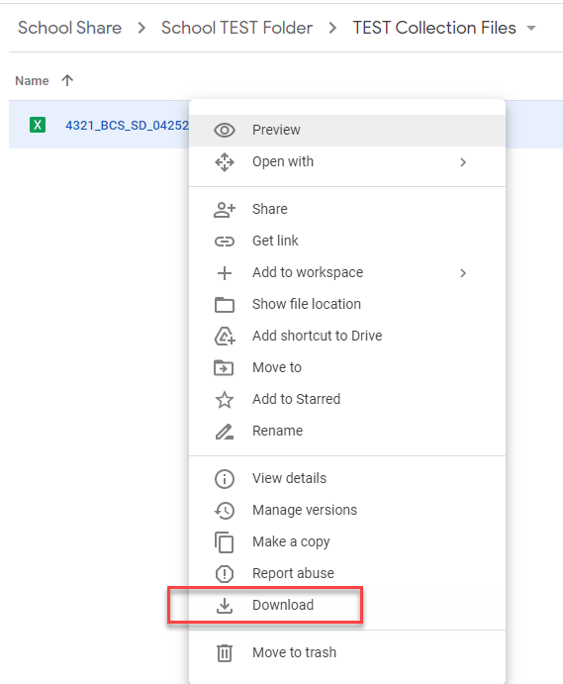
Download Files from G-Drive
To download a file to your computer, simply right click on the file and then pick the Download option
You cannot drag and drop files from shared folders in G-Drive to your computer.
Available Resources:
G-Drive Instructions: https://resources.csi.state.co.us/data-security/
Notes:
To download a file to your computer, simply right click on the file and then pick the Download option
You cannot drag and drop files from shared folders in G-Drive to your computer.
Please note that the bottom of this slide has a link to more detailed, written instructions on how to use G-Drive to exchange files with CSI.

Slide 7
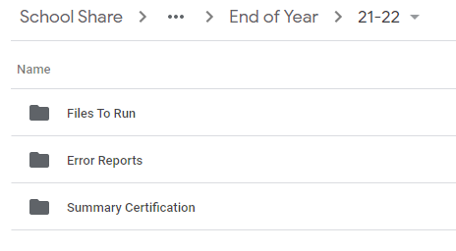
G-Drive Folder/File Structure
Select the folder of the appropriate data collection within the Submissions folder (ex: End of Year).
Select the folder of the appropriate school year (ex: 21-22)
You’ll see multiple subfolders (Files to Run, Error Reports, and possibly others).
Upload your student data files to “Files to Run”
Download your error reports from “Error Reports”
Notes:
Since every CSI school has multiple submissions throughout the year, we have structured G-Drive so that each school has its own school folder. Within that school folder, there are multiple subfolders associated with different data collections. The primary folder used for most data collections is the “Submissions” folder though other collections may exist as stand-alone folders outside of that.
Within the collection-specific subfolders, you’ll typically see school year subfolders, and under those will be a “Files to Run” subfolder and an “Error Reports” subfolder. Those are the most common ones, but you may also see other folders present for the exchange of other types of documents.
When uploading data files to CSI, you will upload them into the “Files to Run” subfolder of the particular data collection you are working on. When receiving error reports from CSI, you will download them from the “Error Reports” subfolder of the particular data collection you are working on.

Slide 8
Naming Data Files
CSI Standard Convention:
School Code_School Name/Abbreviation_Interchange File Type_Date
October Count File Name Examples:
Student Demographic (SD) interchange file for Golden View Classical Academy
3393_GVCA_SD_09022021
School Student Association (SSA) interchange file for High Point Academy
0655_HPA_SSA_09022021
Notes:
The last topic we’ll cover on sharing data with CSI has to do with naming files that you’ll exchange with CSI.
Because of the large number of files being submitted regularly to CSI for differing collections and from differing schools, it is extremely important that schools take the time to use the appropriate naming convention for naming data files.
All file names begin with your 4-digit school code. If you are not sure of your school code, please contact CSI’s Submissions Team and we can let you know.
After the school code, there is an underscore then a shortened version or nickname for your school. Golden View Classical Academy is shortened to GVCA and High Point Academy is shortened to HPA in the slide examples.
The school abbreviation is followed by an underscore and then the file type. SD stands for Student Demographic file. SSA stands for Student school Association file.
Finally, after noting the file type, add another underscore, and note the date you created or revised this particular version of your file. We go through multiple versions of these files for each school, and the date helps us know which file is the most recent or updated version.
Each of the annual submissions (October Count or March Report Card) will include a training that provides a reminder of the appropriate naming convention for that particular collection.

Slide 9
Thank you!
submissions_csi@csi.state.co.us
Notes:
Thank you for watching this short training module on data security when working with state data collections. Please reach out to the CSI data submissions team at the email address provided here if you have any questions.

