Slide 1
CSI School Governing Board Training
June 2023

Slide 2
Introductions
In the Chat Box…
Name
School
Location / Model

Slide 3
Agenda
CSI UPDATES
LEGISLATIVE UPDATES
SUMMER PLANNING
RESOURCES

Slide 4
We believe that behind every successful charter school is a high-performing governing board.
THANK YOU for committing your time, energy, and expertise to a CSI charter school!

Slide 5
CSI Board Updates
Awaiting approval for July 2023 vacancy

Slide 6
CSI Staff Updates
School Programs and Professional Learning Team
Finance and Ops Team
Senior Grant and Procurement Analyst: TBD
School Finance Manager: Art Ford
Authorizing and Accountability Team
Authorization and Accountability Manager: Michael McManus
Special Education Coordinator: Cait Ball
Governance & Legal Support
Senior Director of Governance and Legal Supports: TBD

Slide 7
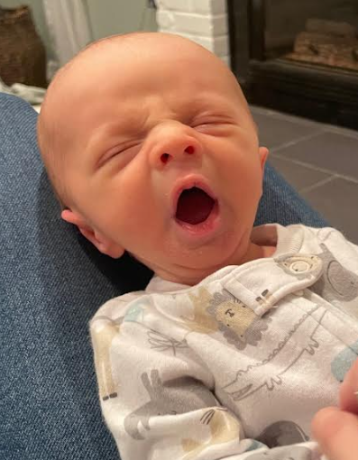
CSI Staff Updates
Welcome, baby Liam!

Slide 8
Portfolio Updates
New CSI Schools Next Year:
Ascent Grand Junction
Transferring Out:
Wildflower Montessori Grand Junction
Ascent 27J
New School Applicants:
James Irwin Charter Academy
University Prep
Be the Change Community School
Wildflower - Aurora

Slide 9
Our Mission
Our mission is to foster high-quality public school options for all students.

Slide 10
Legislative Session Updates

Slide 11
Advocacy led to CSI/CSI School Representation In:
SB 004
Concerning Employment of Certain School Mental Health Professionals
HB 1207
Concerning National Certification Compensation Stipends for National Board-Certified Educators
SB 094
Concerning the Creation of a Task Force to Report on Measures to Improve School Transportation
HB 1198
Concerning National Certification Compensation Stipends for National Board-Certified Educators
HB 1212
Concerning the Creation of a Navigator Program to Promote Apprenticeships to High School Students
SB 258
Consolidate Colorado Educator Programs in Colorado Department of Education

Slide 12
Accountability
Task Force to Study the K-12 Ed Accountability System (HB 23-1241)
26-member taskforce with appointments by the Speaker of the House (5), President of the Senate (5), Minority Leader of the House (4), Senate Minority Leader (4*), Governor (7*), and CDE (1).
Local Innovation For Education Assessments (HB 23-1239)
Postponed indefinitely
Eliminate State Assessment In Social Studies (SB 23-061)
Lost
*charter appointments

Slide 13
Mill Levy Override Equalization (MLOE) Fund
The MLOE Fund was created in 2017 (HB 17-1375) to allow CSI students to access their share of Mill Levy Override dollars.
Full funding equity between district- and institute-authorized schools in Colorado would be ~$41M.
During the 2022 legislative session, we secured $10M, bringing the MLOE fund total to $17 M.
During the 2023 legislative session, we secured a total of $10M, bringing the total to $27M.
$7.5M appropriated through the state budget process (the “Long Bill”).
$2.5M appropriated through the School Finance Act.

Slide 14
As if that weren’t exciting enough…
We secured a provision in the School Finance Act (SFA) to fully buy down the MLOE Fund by the 2024-25 budget year, alongside a full buy-down of the Budget Stabilization Factor (BSF).
The SFA also includes ~$6M in additional declining enrollment dollars.
CSI schools in rural districts to receive rural dollars in 23-24.

Slide 15
Capital Construction
Charter schools can access an additional $10M in capital construction
BEST Charter Match factors were updated to more accurately reflect charter school access to capital for the match contribution.
District authorized charter BEST match starting point was reduced.
23-24 BEST Awards were announced last week.
Congrats to Mountain Song Community School!

Slide 16
Initial insights and strategy for 2024
We will need to go through the JBC budget process once again to ask for MLOE funding equity in 2024-25, however, now we will have the 2023 School Finance Act to support us!
Going forward after next year, the MLOE fund will be fully funded
Notes:
CSI won’t need to submit a budget request to OSPB this year, but the $15M for MLOE equalization is not in the base budget so we’ll still need the legislature to appropriate those funds through the JBC process.

Slide 17
Thank you!
We know that many of your schools, including you as board members, reached out and hosted legislators at your schools, events and meetings. This makes such a difference during session.

Slide 18
Summer Planning

Slide 19
Action Required: Oath of Office
Senate Bill 23-287 designates charter school board members as “public officials” and therefore requires all charter school board members to take an Oath of Office.
All current CSI school governing body members must take, sign, and file an oath by August 3, 2023.
Future board members will have 80 days from joining the board to complete this requirement.
In order to accomplish this, you will want to designate someone to administer the oath to each board member following the requirements below. Once completed, the signed oaths will need to be filed with the county clerk where the school is located.
This can be completed in any of the following manners:
“courts, judges, magistrates, referees, clerks, and deputy clerks” of district or county courts;
“court reporters” who have “registered professional certification or higher”;
a “person designated by the governing body, or any officer thereof”; and “notaries public.”
The oath that must be read aloud includes:
I [name], do [select swear, affirm, or swear by the everliving God] that I will support the constitution of the United States, the constitution of the state of Colorado, and the laws of the state of Colorado, and will faithfully perform the duties of the office of [name of office or position] upon which I am about to enter to the best of my ability.
- C.R.S. § 24-12-101

Slide 20
Board Policy Review
Policies and items that require Board approval and adoption:
Budget
Must be approved annually by June 30th
Student Fees policies
Enrollment Policy
Student Conduct and Discipline Policies
Grievance Policy
Online Programming Policy
If applicable
Calendar and Bell Schedule
Assessment and Parent Refusal Policy
Assessment Calendar
Each school shall adopt and implement procedures by which the school shall annually distribute to the parents of students enrolled by the school an assessment calendar
Conflict of Interest Policy
Crisis Management Policy
This should be reviewed and approved annually

Slide 21
Board Policy Review (con’t)
Policies and items that require Board approval and adoption:
Employee Policies
See also, Assurance of Compliance for more information
Financial Policies
Information Sharing Policies
Applies to CORA and FERPA
Internet Safety and Cyber Security Policy
Records Retention Policy
The Colorado State Archives Records Management Manual
Mission and Vision
Not a policy but the school’s Mission and Vision must be approved by the Board.
Safe School Plan
This can include: Written Code of Conduct, Policies on Student Conduct, Safe School Reporting, and Internet Safety
This plan must include the school’s Bullying policy
Safety and Security Policy
Seclusion and Restraint Policy
Safety, Readiness and Incident Management Plan
Some schools refer to this as their EOP and it should align with the requirements identified in C.R.S. 22-32-109.1(4), CSI’s Safe Schools Policy, and CSI’s Safety Policy Supplement.

Slide 22
Board Annual Calendar

Slide 23
Why Use an Annual Calendar?
Streamlines monthly agenda planning
Ensures legal requirements (actions, trainings) are addressed
Ensures time is allotted for policy review, planning, and evaluation
Helps board members know when specific items will be addressed
Supports new members in understanding the board’s cycle

Slide 24
What to Include
Required board actions
Approve budget (June)
School leader evaluation
Desired board discussion
Reports on goal progress, interim assessment results
Policy reviews
School-related updates
School activities
Advisory/committee meeting updates
Consider:
Are board actions placed in the month when action is required to take place?
Are there actions specified in Board Policy that need to be included?
Are there other activities/events where board participation is expected that should be included in the calendar?
In the chat…
What other items do you include in your board calendar?

Slide 25
Example
Download: Sample School Board Calendar & Focus Questions

Slide 26
Board Focus Questions

Slide 27
Why Have Focus Questions?
Ensures key priorities have adequate discussion
Support tool for newer board members or those less familiar with certain topics
Includes questions that align to questions asked by CSI staff and board
Offers options based on board’s oversight role

Slide 28
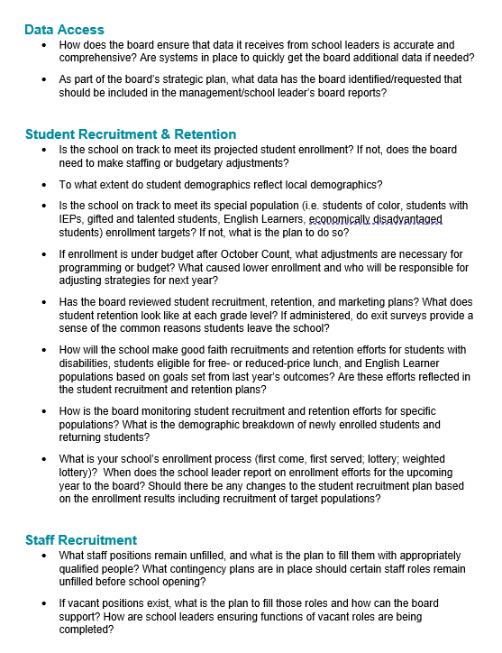
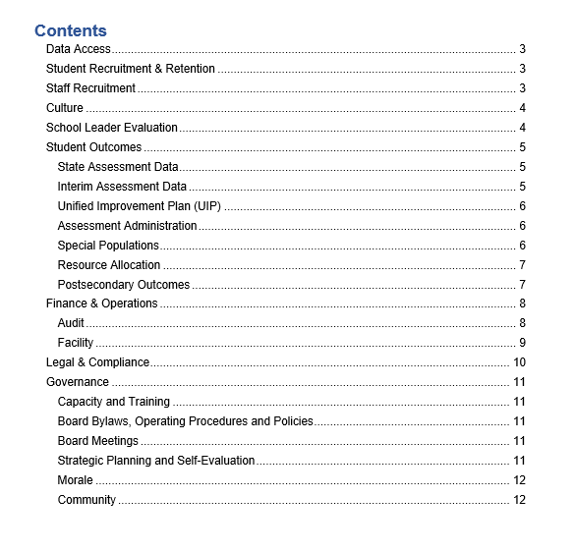
Sample
Download: Sample School Board Calendar & Focus Questions

Slide 29
CSI Governing Board Supports
Resources & Training

Slide 30
Standard Supports
Colorado Department of Education (CDE) Schools of Choice Unit – for all schools
Board Training Modules
Board Fundamentals Training
Topic Based Webinars
Colorado League of Charter Schools (CLCS) – for member schools
Crisis Support
Technical Assistance
Resource Library
Board Recruitment Bank
Live Board Training ($)
Strategic Planning Development/Facilitation ($)
Leader Hiring/Transition Support ($)
Access CDE Charter School Board Resources
Access CLCS Charter School Board Resources
Notes:
Both the Colorado Department of Education and the Colorado League of Charter Schools provide specific supports to school boards that we have included here with links for later reference. Some quick highlights include Board Training Modules for new board members through CDE and a Board Recruitment Bank through the League.

Slide 31
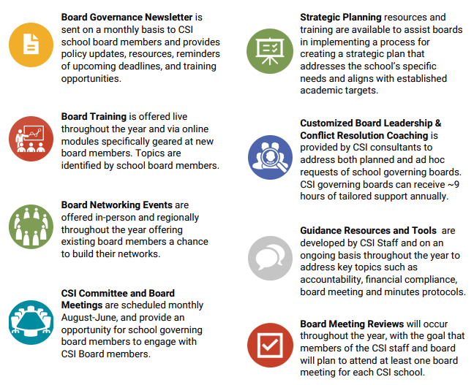
CSI Supports

Slide 32
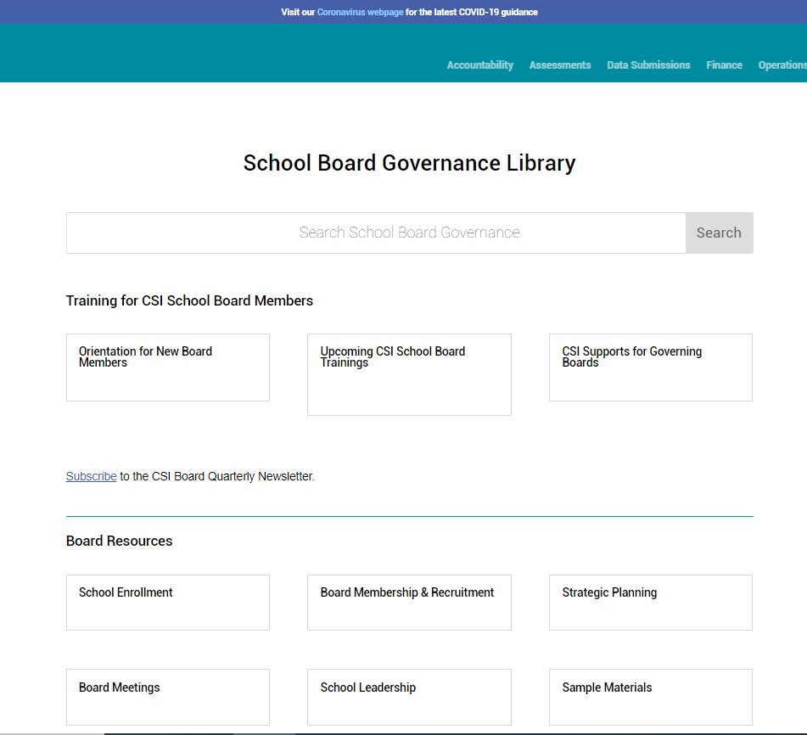
CSI Governance Resource Library
Topics:
CSI Authorization
Board Membership & Recruitment
Strategic Planning
Board Meetings
School Leadership
Charter Contract

Slide 33
Types of Resources
Guidance
School Leader Evaluation
Open Meetings
Tools
Board Meeting Compliance Checklist
Governance Needs Assessment
Samples
Board Meeting Calendar, Agenda, Minute Templates
Sample Policy Language
Trainings
Orientation for New Board Members

Slide 34
Orientation for New CSI School Board Members
CSI School Accountability
Understanding the CSI-School Charter Contract
CSI Compliance Monitoring
CSI Financial Oversight
CSI Special Populations Oversight

Slide 35
Annual Nondiscrimination Training
State Rule requires that charter schools conduct annual training on nondiscrimination laws to employees and board members
25-minute webinar developed by Education Board Partners for CDE Schools of Choice Unit
Accessible for free on CSI, CDE, and League websites
To receive credit/confirmation, access through the League: www.coloradoleague.org/alltrainings
https://resources.csi.state.co.us/cde-annual-non-discrimination-training/
Notes:
1 CCR 301-88-2.02
Charter Schools are subject to all federal and state laws regarding nondiscrimination.

Slide 36
Thank You!

