Slide 1
Unified Improvement Plans (UIP)
Overview for School Accountability Committees

Slide 2
Brief History
Unified Improvement Planning was introduced as part of the Education Accountability Act in 2009 to streamline improvement planning components of state and federal accountability requirements.
Schools are required to submit plans annually (or biennially) via an online template.

Slide 3
Strategic Plan (~5 year)
UIP (1-2 year)
60-90 day plan
Notes:
Plug the Continuous Improvement Collaborative
UIP-Elevator speech or full plan- as long as it presents a coherent picture and meets minimum requirements

Slide 4
UIP Requirements: Overview
-First draft due in August, final draft in October.
-Additional uses
-Contract (authorization) renewal
-Support and resources
-Federal Title I, II, and III funding
Notes:
Timeline- CSI and CDE review and draft
CS/TS/PI/T Identification requirements
Begin drafting in spring

Slide 5
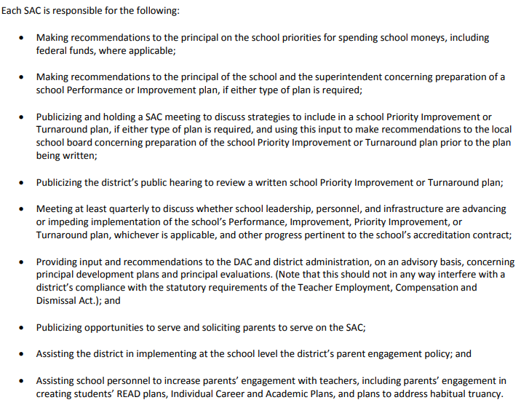
School Accountability Committees (SACs) are required by statute to have a stake in the annual UIP process.
SACs work with the principal to create the UIP
SACs monitor the implementation of the UIP

Slide 6
Identify and prioritize area of improvement
Dig deeper- What’s the underlying cause?
How will we address these challenges?
Create a plan, execute, evaluate
1.
4.
2.
3.

Slide 7
Accessing your school’s UIP
Screen share: www.cde.state.co.us

Slide 8
Defining terms
Data: This can mean academic data (tests, grades), but also can mean evidence related to implementation or how the system is doing.
Disaggregation: ways to break down data/evidence by category. Oftentimes school- or grade-level data doesn’t tell the whole story of whether the school is serving all students well. Common categories for disaggregation including students with an IEP, multilingual students, students who qualify for free lunch, and students who identify as non-white.

Slide 9
Identify and prioritize area of improvement
UIP Sections
Prior Year Targets
Did the school meet last year’s goals?
Current Performance
How is this school doing this year?
Trends
Which data are trends vs. blips?
Priority Performance Challenges
What does our data/evidence tell us we should prioritize?
Academic data: School and state assessments
Grades
Graduation rates
Dropout rates
Non-Academic data:
Attendance
Behavior
Surveys
Observations
Teacher evaluations
Enrollment
Retention

Slide 10
Dig deeper- What’s the underlying cause?
UIP Section
Root Cause Analysis
What are the factors (under school control) that are contributing to the Priority Performance Challenges?
A simple protocol: “5 Whys”.
When thinking about the cause, ask “Why is this happening, and how do we know?” each time you arrive at a possible Root Cause

Slide 11
How will we address these challenges?
UIP Section
Major Improvement Strategies
The school-wide strategies, programs, or practices that will be implemented for the next 1-4 years to address the identified root Causes
This is the “What” in “So what are we going to do about it?”
There must be evidence or research to support the selected strategy, program, or practice. Essentially, how do you know it will work?

Slide 12
Create a plan, execute, evaluate
UIP Section
Action Plan
Action Steps
Implementation Benchmarks
Target Setting
What needs to happen to get each Major Improvement Strategy going?
Once it’s started, how will you know it’s being done correctly?
Once each Major Improvement Strategy is implemented, what impact will it have on student test scores (or other outcome measure)?

Slide 13
SAC Involvement
Typically, school staff will complete the bulk of the analysis and planning for the UIP.
One of the unique strengths of the SAC is family and community voice.
So consider- how can your SAC contribute to this process through the lens of family experience and/or the priorities your committee has set for the year?

Slide 14
Examples of SAC contributions to UIP
Determined need for literacy-specific survey for K-5 families; used survey results to design family-facing programming
Family communication Major Improvement Strategy
SAC hosted “understanding state and school assessment results” hybrid event for families

Slide 15
Additional resources
https://resources.csi.state.co.us/school-accountability-committee-sac/
Ad hoc training available- email or call
jessicawelch@csi.state.co.us
720-827-7616

